Slide 1
The Body Systems
Jesse Crosby

Slide 2
The Digestive System

Slide 3
The Digestive System – Function
The primary functions of the digestive system are to break down large food molecules into smaller molecules that can be used by the body for sustenance and to efficiently dispose of the waste products.

Slide 4
The Digestive System – Individual Organ Functions
Each organ and portion of the digestive system performs a particular function that is essential to the as a whole.
Accessory organs will be noted; parts of the digestive system not labeled as accessory should be assumed to be alimentary.
The mouth is the beginning of the digestive system. Food is initially placed here. The teeth then chew the food, physically breaking it down into more digestible pieces.
Salivary glands are located around the mouth. They deposit the saliva into the oral cavity to lubricate the food. Saliva also contains important enzymes that begin to chemically break down the food. Salivary glands are accessory organs.

Slide 5
The Digestive System – Individual Organ Functions
The pharynx is the section of the throat immediately behind the mouth and above the esophagus. Muscular contractions occur, triggering the swallowing reflex. This results in food being pushed into the esophagus. The swallowing reflex and the epiglottis prevent food from entering the trachea.
The esophagus is the muscular organ that connects the pharynx and the stomach. Peristalsis of the smooth muscles of the esophagus push food into the stomach, while the mucus glands lining the organ keep the food lubricated.

Slide 6
The Digestive System – Individual Organ Functions
The stomach is the hollow, muscular organ between the esophagus and the small intestine. As food enters the stomach, the stomach releases proteases like pepsin to chemically break down proteins in the food and hydrochloric acid to allow the enzymes to function optimally. The wall of the stomach then contracts, mashing the food into a partially digested substance called chyme.
The pyloric sphincter is the region of the stomach connected to the duodenum of the small instestine. The chyme passes through the pyloric sphincter into the small intestine.

Slide 7
The Digestive System – Individual Organ Functions
The small intestine is the section of the gastrointestinal tract after the stomach and before the large intestine. The small intestine is split into three parts:
  The duodenum is the first and shortest part of the small intestine. It is where most of the chemical digestion takes place. Here, carbohydrates are broken down into simple sugars by enzymes like amylase from the pancreas and liver, and lipids are broken down into fatty acids by lipases from the pancreas.
  The jejunum is the second section of the small intestine. It is where most of the carbohydrates, proteins, and lipids are absorbed. Since they’ve been broken down into their constituent particles, they’re small enough to be absorbed by the villi and into the blood stream.
  The ileum is the final section of the small intestine. Nutrients still left over in the partially digested food are absorbed here.

Slide 8
The Digestive System – Individual Organ Functions
The large intestine is the organ between the small intestine and the rectum. It’s primary function is to absorb water from the indigestible mass of food and to push the waste into the rectum for expulsion. It has five main parts involved in digestion:
  The cecum is a pouch that connects the large intestine with the small intestine. The ileocecal sphincter is located between the cecum and the ileum to prevent food matter from being sent back into the ileum.
  The ascending colon is the section of the large intestine above the cecum.
  The transverse colon is the longest and most mobile section of the large intestine. It’s located between the ascending and descending colons.
  The descending colon is the section of the large intestine between the transverse colon and the sigmoid colon.
  The sigmoid colon is the section of the large intestine that leads to the rectum.

Slide 9
The Digestive System – Individual Organ Functions
The rectum is the final portion of the large intestine. Feces are stored here.
The anus is the opening of the digestive tract opposite of the mouth. After fecal matter builds up in the rectum, it is expelled through the anus. The internal anal sphincter and the external anal sphincter control the expulsion.

Slide 10
The Digestive System – Individual Organ Functions
The liver is an accessory organ significant to the proper functioning of the digestive system. Located below the diaphragm, the liver produces bile. Bile is a digestive juice that dissolves fats in the small intestine, allowing enzymes to more efficiently digest them.
The gallbladder is the accessory organ situated just beneath the liver. It stores and concentrates bile for later use.
The pancreas is an accessory organ located behind the stomach. It produces pancreatic juices that contain enzymes. These juices are released into the small intestine and break down carbohydrates, proteins, and lipids in the chyme.

Slide 11
Why do large food particles need to be broken down?
Large food particles need to be broken down for two main reasons:
  First, smaller particles are more easily absorbed into the blood stream. Molecules too large to be absorbed are useless, since they cannot be used for anything.
  Secondly, cells can work more efficiently with monomers than with polymers. Monomers are more versatile than polymers; depending on the types of molecules they’re working with, cells can use monomers to construct necessary polymers or deconstruct monomers to release energy.

Slide 12
Why are enzymes important in digestion?
Enzymes are important in digestion because mechanical digestion cannot adequately break down food particles. Proteases, for instance, are necessary for the complete digestion of proteins.

Slide 13
Physical Digestion v. Chemical Digestion
PHYSICAL DIGESTION | CHEMICAL DIGESTION
Food is broken down via chewing and muscle contractions | Food is broken down via enzymes
Physically alters the food | Chemically alters the food
Occurs mostly in the mouth; less so in the esophagus, stomach, and duodenum | Occurs mostly in the stomach and duodenum; less so in the mouth

Slide 14
Disorders of the Digestive System – Crohn’s Disease
Crohn’s disease is an inflammatory bowel disease that typically (in about 50 percent of cases) affects the ileum and large intestine of the afflicted person, but can manifest anywhere in the gastrointestinal tract.
Some signs and symptoms include: porridge-like diarrhea, frequent intense abdominal pain, itchiness around the anus, fever, and weight loss.
In the United States and Europe, the incidence of Crohn’s disease is about 6 to 7.1:100,000. It is thought to be less prevalent in Asia and Africa. Ashkenazi Jews and smokers tend to develop Crohn’s disease more often.
Though there is no cure for Crohn’s disease, it can be effectively managed with diets low in fiber and dairy and with anti-inflammatory medications.

Slide 15
Disorders of the Digestive System – Irritable Bowel Syndrome
Irritable bowel syndrome is a functional bowel disorder that primarily affects the intestines.
Some signs and symptoms include: abdominal pain, frequent diarrhea or constipation, bloating, and a feeling of incomplete evacuation. Sixty percent of people suffering from IBS also tend to have psychiatric disorders, such as anxiety and depression.
Rates of incidence for IBS vary by country, from as low as 6 percent in Canada to 46 percent in Mexico.
IBS can be effectively managed through diets low in lactose and fructose and high in soluble fiber, laxatives or antidiarrheals, and exercise.

Slide 16
The Digestive System – Sources
http://en.wikipedia.org
http://digestive.niddk.nih.gov/ddiseases/pubs/yrdd/
http://www.ccfa.org/info/about/crohns

Slide 17
The Circulatory System

Slide 18
The Cardiovascular System – Function
The prime function of the cardiovascular system is to distribute nutrients, gases, hormones, blood cells, and other things vital to cellular function to the body’s cells.

Slide 19
What’s the relationship between the structure and the function of arteries, capillaries, and veins?
Arteries are blood vessels that transport blood away from the heart. Since they have to carry blood from the heart, they undergo the highest pressures of all blood vessels. Their muscular, thick, elastic layers help them withstand high pressures.
Veins are blood vessels that transport blood to the heart. They have the greatest diameters of the blood vessels and have lower pressures than arteries. To prevent blood from flowing back into tissue, veins have valves that direct the flow of blood towards the heart.
Capillaries are the smallest blood vessels at one cell thick. They connect arterioles and venules and facilitate the exchange of nutrients and waste chemicals between blood and tissue. Their thinness allows these molecules to easily diffuse them.

Slide 20
How does blood pass through the heart?
Deoxygenated blood first enters the right atrium through the superior and inferior vena cava. It’s then pumped through the tricuspid valve into the right ventricle. Then it’s pumped through the pulmonary valve and pulmonary artery and into the lungs. The now oxygenated blood flows through the pulmonary veins into the left atrium. It’s then pushed through the mitral valve into the left ventricle. Next the blood flows through the aortic valve into the aorta, where it is then split through smaller arteries before eventually reaching the tissue.

Slide 21
What is blood composed of?
Blood is comprised of four main components: plasma, erythrocytes (red blood cells), leukocytes (white blood cells), and platelets.
  Plasma is a solution of water (92 percent by volume) and dissolved proteins, carbohydrates, lipids, clotting factors, minerals, hormones, and carbon dioxide. The other components of blood are suspended in the plasma, which makes up about 55 percent of blood by volume.
  Erythrocytes are the most common blood cell. They deliver oxygen throughout the body via hemoglobin.
  Leukocytes are the blood cells that defend the body from infectious diseases and other deleterious foreign matter. They come in many varieties, including neutrophil, eosinophil, and lymphocytes.
  Platelets are clear cells that help blood clot.

Slide 22
How do erythrocytes demonstrate the relationship between structure and function?
Erythrocytes are shaped like biconcave discs; on both the front and the back, they’re thinner in the middle and thicker near the edges. This special shape confers two main advantages to the red blood cell:
  First, the increased surface area allows more oxygen to diffuse through the cell while it’s traveling through the lungs.
  Secondly, this shape allows the cell to squeeze through tight capillaries more easily, enabling it to flow smoother and more efficiently.

Slide 23
Open v. Closed Circulatory System
Open Circulatory System | Closed Circulatory System
Blood leaves the cardiovascular network and enters directly into body cavities | Blood stays in the cardiovascular network
Because pressure is low, blood flows slowly | Because pressure is high, blood flows quickly
Primarily found in arthropods and most mollusks (excluding cephalopods) | Primarily found in vertebrates, but also in some invertebrates, like cephalopods

Slide 24
How is the cardiovascular system different among fish, amphibians, reptiles, and mammals/birds?
Fish have a two-chambered heart with one atrium and one ventricle. Blood flows through the heart, directly into the capillary-dense and low pressure gills, and then into the capillary-dense body. Since the pressure is so low, the rate of blood flow is also low, limiting a fish’s activity level.
Amphibians have a three-chambered heart with two atria and one ventricle. Blood from the lungs enters into the left atrium, while blood from the body enters into the right atrium. The blood from both atria then flows into the ventricle before being sent back through the body. This system is high pressure, which means the rate of blood flow and the amphibians’ activity level is high.
Reptiles have a three-chambered heart, but some functionally have a four-chambered heart due to the highly partitioned ventricle in some species. Reptilian hearts function a lot like amphibian hearts, except for the fact that reptilian hearts can reverse the direction of the blood flow to regulate internal temperatures and increase diving time.
The mammalian and avian heart functions as explained in slide 20. The high pressure, and therefore high rate of blood flow, allows mammals and birds to maintain high activity levels.

Slide 25
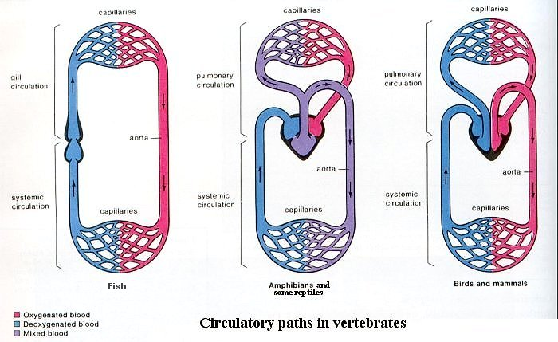
Visual Representation of the Different Circulatory Systems
http://universe-review.ca/I10-82-circulatory.jpg

Slide 26
Disorders of the Cardiovascular System – Anemia
Anemia is a decrease in red blood cell count, an abnormally low level of hemoglobin in the blood, and/or a decreased oxygen-binding capability of the hemoglobin.
Some signs and symptoms include: fatigue, poor concentration, pallor, shortness of breath, heart palpitations, and, in severe cases, ventricular hypertrophy.
The prevalence of iron-deficiency anemia in America ranges from two percent in adult men to 20 percent in black and Mexican-American women. In some areas of Africa, up to 65 percent of the people are anemic.
Vitamin and iron supplements can treat many cases of anemia, but more severe instances can require blood transfusions.

Slide 27
Disorders of the Cardiovascular System – Cardiomyopathy
Cardiomyopathy is the deterioration of the function of the cardiac muscle.
Some signs and symptoms include: chest pains, left ventricular hypertrophy, and abnormal beating motions.
Approximately .02 percent of Americans suffer from cardiomyopathy.
Treatment includes medication; ablation of part of the heart; implantation of pacemakers, defibrillators, or ventricular assist devices; and heart transplants.

Slide 28
The Cardiovascular System – Sources
http://en.wikipedia.org
http://jamespendleton.suite101.com/erythrocyte-life-cycle-functions-and-pathology-a84625\
http://www.rightdiagnosis.com/c/cardiomyopathy/prevalence.htm

Slide 29
The Respiratory System

Slide 30
The Respiratory System – Function
The respiratory system’s primary function is to oxygenate blood so that the blood can distribute oxygen all across the body.

Slide 31
What features of the alveoli adapt them to gas exchange?
Alveoli have a large surface area (about 70 square meters in a typical pair of human lungs) in relation to volume, providing a greater area in which oxygen can diffuse.
Alveolar tissue is thin and elastic, allowing them to expand—and therefore increase their surface area—during the process of breathing.
Capillaries cover the alveoli, allowing oxygen to quickly and easily diffuse directly into the blood.

Slide 32
How are oxygen and carbon dioxide transported in the blood?
Hemoglobin is an iron-containing protein in red blood cells. When blood enters the lungs, the hemoglobin picks up oxygen molecules (up to a maximum of four oxygen molecules for every one hemoglobin molecule). Blood then circulates throughout the cardiovascular system, depositing the oxygen into cells that need it. After releasing the oxygen molecules, the hemoglobin then picks up the waste carbon dioxide molecules and returns to the lungs, where the carbon dioxide is disposed of through exhalation.

Slide 33
How does oxygen get from the air to the hemoglobin?
In nasal breathing, oxygen is inhaled and diffused through the nasal cavity and into the trachea. The oxygen then travels through a bronchiole connected to the trachea and then into the alveolar sacs. The oxygen is then diffused from the sacs into the surrounding capillaries, where it binds to hemoglobin in the blood.

Slide 34
How do inhalation and exhalation occur?
Inhalation is started by the diaphragm. The diaphragm contracts, expanding the ribcage and increasing the volume of the thorax. This increase in volume decreases the pressure in the chest cavity relative to atmospheric pressure, causing air to surge into the lungs, where the oxygen is then filtered from it.
Since lungs are elastic, their stretching during inhalation causes them to later recoil, pushing air back out into the atmosphere until the thoracic and atmospheric pressures are equalized. This process is called exhalation.

Slide 35
Diseases of the Respiratory System – The Common Cold
The common cold is a viral infection of the upper respiratory system that primarily affects the nose.
Some signs and symptoms include: a runny or stuffy nose, an itchy or sore throat, a cough, congestion, bodily aches and headaches, sneezing, a low fever, and mild fatigue.
The common cold is the most common disease in humans. It occurs all across the globe. The average adult is typically infected two to five times a year, while the average child is typically infected six to ten times annually.
There are no known cures for the common cold. Rest, painkillers, and antipyretics can assuage the symptoms, however.

Slide 36
Diseases of the Respiratory System – Lung Cancer
Lung cancer is the unregulated cell growth in tissues of the lung.
Some signs and symptoms include: shortness of breath, coughing up blood, weight loss, and chest pain.
Lung cancer is the most common—and most fatal—cancer in the world; 1.1 million new cases occur each year. In 2004, between 40 to 45 of every 100,000 people died from lung cancer.
Lung cancer can be treated with surgery, radiotherapy, and chemotherapy.

Slide 37
The Respiratory System – Sources
http://en.wikipedia.org
http://www.curoservice.com/parents_visitors/lungs_circulation/structure_alveoli.asp
http://www.fi.edu/learn/heart/systems/respiration.html

Slide 38
The Excretory System

Slide 39
The Excretory System – Function
The primary functions of the excretory system are to dispose of waste, eliminate useless byproducts produced by cells, get rid of dangerous chemical build-ups, and maintain homeostasis.

Slide 40
What are the three categories of nitrogenous waste?
There are three categories of nitrogenous waste.
  Ammonia (chemical formula NH₃) is a highly soluble compound that is toxic in high concentrations. Aquatic organisms typically excrete ammonia, since lots of water is needed to keep ammonia in the body at low concentrations. In many invertebrates, ammonia is released across the entire body; in fish, most is released through the gills.
  Urea (chemical formula CO(NH₂)₂) is a solid, colorless, odorless, highly soluble compound excreted in the urine of mammals, amphibians, and some birds to dispose of waste nitrogen.
  Uric acid (chemical formula C₅H₄N₄O₃) is the primary nitrogenous waste produced by land snails, insects, birds, and some reptiles. It is substantially less soluble than urea or ammonia. These animals typically dispose of uric acid with their feces.

Slide 41
Processes of the Nephron
The nephron fulfills four major functions.
  The glomerulus filters water and useful solutes (such as ions, carbohydrates, and amino acids) from blood into the space made by the Bowman’s capsule.
  This filtrate is diffused through the Bowman’s capsule and passes through the entire nephron to form urine. As the filtrate passes through the nephron, the water and nutrients are then reabsorbed (both by active and passive transport) by the connective tissue surrounding the nephrons and passed into the bloodstream.
  Secretion is when material moves (typically by active transport) from the capillaries surrounding the nephron into the collecting duct and the distal convoluted tubule for filtration.
  Excretion is the sum of these processes that ultimately results in the urine being expelled by the nephrons out of the kidney and into the ureter.

Slide 42
Diseases of the Excretory System – Nephritis
Nephritis is the inflammation of the nephrons. Inflammation primarily occurs in the glomeruli or in the spaces between renal tubules.
Some signs and symptoms include: reduced urine output, retention of waste products, and the release of blood and necessary proteins with the urine.
Nephritis is the eighth highest medical cause of human death. In America, about four in every 100,000 people develop it each year.
Nephritis can be treated with a low-calorie, low-protein diet (in mild cases); medicine; and kidney dialysis (in more severe cases).

Slide 43
Diseases of the Excretory System – Polycystic Kidney Disease
Polycystic kidney disease is a cystic genetic disorder of the kidneys.
PKD is easily identifiable by the large, fluid-filled cysts that develop on one or both kidneys.
There are two types of PKD: autosomal dominant PKD and autosomal recessive PKD. Autosomal dominant PKD has an incidence of about 1 to 2 of every 1,000 live births; ARPKD has an incidence of about 1 in 20,000 live births.
Vasopressin is a molecule that contributes to the enlargement of kidney cysts in PKD sufferers. Due to clinical trials using rodents, some doctors theorize that the consumption of excessive quantities of water suppresses vasopressin in humans. Drinking a lot of water, then, could assist in treating early-stage PKD. Medicine capable of suppressing vasopressin levels is currently being tested.

Slide 44
The Excretory System – Sources
http://en.wikipedia.org
http://www.eoearth.org/article/Excretion_of_toxicants
http://www.freemd.com/acute-interstitial-nephritis/overview.htm
The AP Biology textbook, p. 926-937

Slide 45
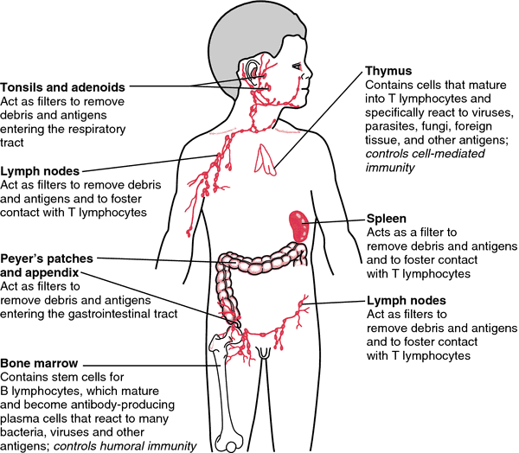
The Immune System

Slide 46
The Immune System – Function
The immune system’s primary function is to protect an organism from disease.

Slide 47
The Immune System – Individual Organs
While bone marrow isn’t an organ, it’s an essential part of the immune system. The bone marrow is the site of hematopoiesis.
The thymus is the site of the maturation of T lymphocytes into cells specifically adapted to fighting particular antigens.
The spleen filters blood, trapping antigens. The presence of antigens activates the B cells, spurring antibody production. Old red blood cells are also destroyed here.
Lymph nodes filter antigens from the lymph.
Adenoids contain antibodies and prevent deleterious organisms from spreading to the rest of the body.
Tonsils contain lymphocytes and antibodies that allow them to trap and destroy bacteria.

Slide 48
How does the body recognize pathogens?
While the human fetus is in utero, immune cells basically inventory the body’s molecules, creating an image of the self. Antibodies do not normally respond to cells tagged as “self.” Invasive organisms contain antigens that are recognized by the antibodies created while the human was a fetus. These antigens, then, mark cells that are to be destroyed by antibodies.

Slide 49
Innate Immunity v. Acquired Immunity
Innate Immunity | Acquired Immunity
Evolved early (vertebrates) | Evolved relatively recently (mammals)
General response | Targeted response that is specific to a particular antigen
Early line of defense; unchanging | Develops slowly, as the body encounters new invaders; changes with time; has a memory
Examples: NK cells, interferon, inflammation | Examples: Antibodies, cell-mediated attack

Slide 50
Active Immunity v. Passive Immunity
Active Immunity | Passive Immunity
The body is exposed to an antigen (naturally or via a vaccine), produces antibodies to combat it, and uses the remaining B cells as memory cells to preempt future infection | Antibodies are transferred from one individual to another
Example: injection of disabled Clostridium tetani to prevent a person from getting tetanus | Example: maternal antibodies are transferred to the fetus via the placenta

Slide 51
Humoral Immunity v. Cell-Mediated Immunity
Humoral Immunity | Cell-Mediated Immunity
B cells transform into plasma cells which secrete antibodies that destroy specific antigens | T cells, NK cells, and macrophages destroy pathogens; does not involve antibodies
Most effective on bacteria, viruses before they’ve entered the cell | Most effective against viruses, though also protects against fungi, bacteria, etc.

Slide 52
B Lymphocytes v. T Lymphocytes
B Lymphocytes | T Lymphocytes
Activated by helper T cells through immunological synapse | Activated through the engagement of the T cell by the major histocompatibility complex
Produce antibodies that attack antigens | Directly attack the entire invading cell

Slide 53
Why are antibodies effective against antibiotics but not viruses?
Bacteria, as independent organisms, are capable of reproducing on their own. Viruses have to take over host cells and repurpose them for viral propagation. Antibiotics disrupt bacterial reproduction. Since viral replication is tied to the functions of an organism’s own cells, eliminating viruses is entirely different from eliminating bacteria.

Slide 54
Diseases of the Immune System – HIV/AIDS
Acquired immune deficiency syndrome (AIDS) is a disease of the human immune system caused by the human immunodeficiency virus (HIV). Since AIDS disrupts the immune system, it makes it much easier for a person to get infections, and these infections are typically much more severe.
Some signs and symptoms include (depending on stage of progression): recurrent upper respiratory tract infections, unexplained chronic diarrhea, severe bacterial infections, toxoplasmosis of the brain, candidiasis of the respiratory organs, and Kaposi’s sarcoma
33.4 millions people worldwide have HIV/AIDS, with 2.7 million new HIV infections occurring annually.
There is no known cure, however antiretroviral drugs can be used to prevent death and infection in HIV/AIDS sufferers.

Slide 55
Diseases of the Immune System – Systemic Lupus Erythematosus
Lupus is a systemic autoimmune disease that can affect any part of the body. It involves the body’s immune system attacking the body’s cells and tissues, resulting in inflammation and tissue damage.
Some signs and symptoms include: malar rash, discoid rash, inflammation of the membranes around the heart and/or lungs, oral ulcers, arthritis, photosensitivity, anemia, renal disorder, seizures, and psychosis
About 53 out of every 100,000 Americans has lupus.
There is no cure for lupus, but it’s treatable by suppressing the immune system.

Slide 56
The Immune System – Sources
http://en.wikipedia.org

Slide 57
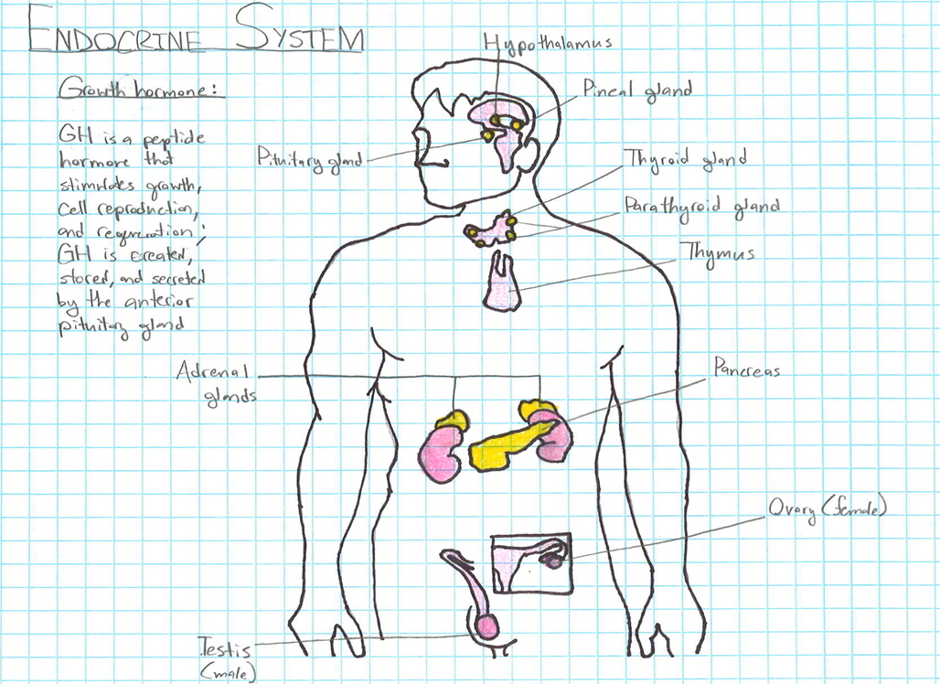
The Endocrine System

Slide 58
The Endocrine System – Function
The endocrine system is the system of glands that synthesize and distribute hormones that regulate the body’s functions.

Slide 59
The Endocrine System – Homeostasis
Homeostasis is the tendency of the body to maintain internal stability.
Hormones produced by the endocrine system cause other body systems to take measures to ensure homeostasis. For example, when a human’s blood sugar levels get too high, the pancreas produces insulin, which gets transported to the liver via the bloodstream. Upon receiving the insulin, the liver begins converting glucose in the blood to glycogen.

Slide 60
The Endocrine System – Negative Feedback
Negative feedback is when the output of a system signals a decrease in the system’s input.
Homeostasis is based on negative feedback mechanisms. For example, in the process of baroreflex, baroreceptors in the heart and adjacent blood vessels sense that the body’s blood pressure is too high. They respond by decreasing the heart rate, consequently decreasing blood pressure.

Slide 61
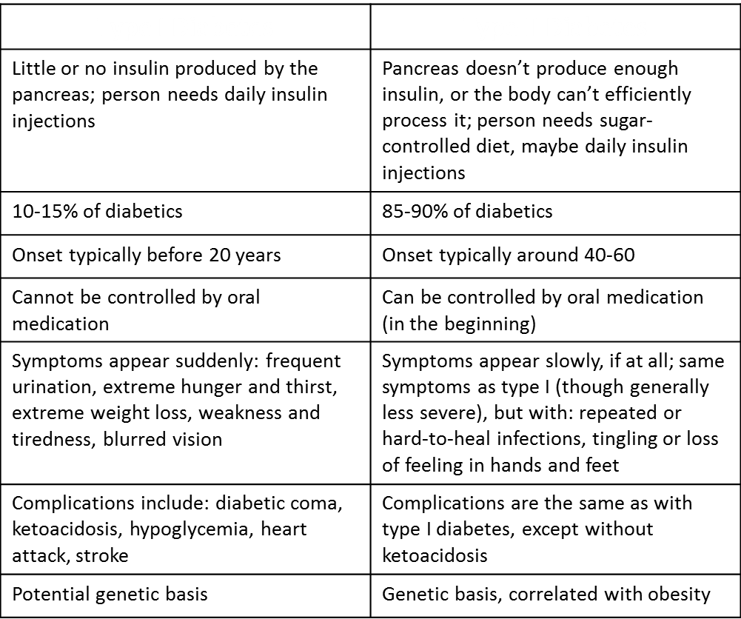
The Endocrine System – Type I Diabetes v. Type II Diabetes

Slide 62
Disorders of the Endocrine System -- Acromegaly
Acromegaly is a syndrome in which the anterior pituitary gland produces too much growth hormone during puberty.
Some signs and symptoms include: swelling of the hands, feet, nose, lips, and ears; swelling of the internal organs, especially the heart, kidneys, and vocal cords; expansion of the skull; pronounced brow and lower jaw protrusion; and acrochordons.
Approximately 1 in 25,000 Americans have acromegaly.

Slide 63
The Endocrine System – Sources
http://en.wikipedia.org/
http://www.rightdiagnosis.com/a/acromegaly/

Slide 64
The Reproductive System & Development

Slide 65
The Reproductive System & Development – Function
The function of the reproductive system is to produce offspring.

Slide 66
The Reproductive System & Development – Sexual v. Asexual Reproduction
Sexual Reproduction | Asexual Reproduction
Male and female gametes fuse to produce a zygote, which then develops into an embryo. The offspring is genetically distinct from the two parents. | Through binary fission, budding, the production of spores, parthenogenesis, or another form of asexual reproduction, a single organism creates genetically identical offspring. Examples include the sponge’s release of the gemmule; the water flea’s use of parthenogenesis; and the baker’s yeast’s use of budding.

Slide 67
The Reproductive System & Development – Spermatogenesis
Spermatogenesis is the process in which sperm is produced.
The diagram on the following slide explains spermatogenesis step-by-step.

Slide 68
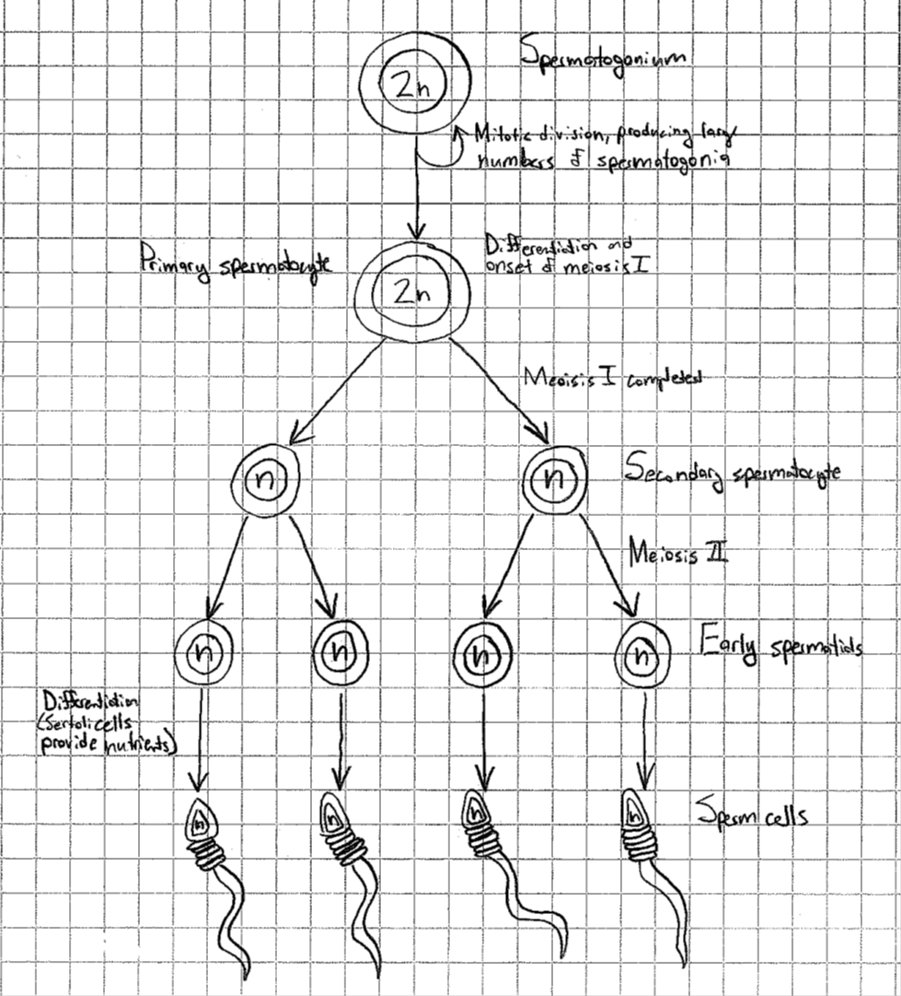

Slide 69
The Reproductive System & Development – Oogenesis
Oogenesis is the process in which ova are produced.
The diagram on the following slide explains oogenesis step-by-step. Note the two polar bodies (for the sake of simplicity, only two were depicted; the first polar body also undergoes meiosis) and the concentration of the cytoplasm in one cell. This occurs so that the eventual zygote will have as many nutrients as possible to ensure healthy growth.

Slide 71
The Reproductive System & Development – Menstrual v. Estrous Cycle
Menstrual Cycle | Estrous Cycle
Occurs in primates (including humans) | Female vertebrates, except for primates
Occurs every 28 days | Time period varies depending on species (rats, for instance, have an estrous cycle that occurs every 4-5 days)
Ovulation occurs | Ovulation occurs
Menstruation results in the shedding of the uterine epithelial layer | Endometrium is reabsorbed if conception does not occur
 | Reproduction can only occur at a time that coincides with the estrous cycle (when the female is “in heat”)
 | Stages: proestrus, estrus, metestrus, diestrus, anestrus

Slide 72
The Reproductive System & Development – The Menstrual Cycle
The ovarian cycle involves the maturation and division of oocytes until fertilization occurs. It lasts 28 days, beginning on the first day of menstruation.
The uterine cycle occurs if fertilization doesn’t happen. The uterine lining is shed, resulting in menstruation.
Hormone control plays a significant role in the menstrual cycle. Luteinizing hormone (LH) and follicle-stimulating hormone (FSH) cause oocytes to develop and ovaries to produce estrogen and progesterone.
A feedback mechanism regulates the levels of all these compounds. The presence of estrogen and progesterone inhibit the production of LH and FSH.

Slide 73
The Reproductive System & Development – Embryonic Development
Following fertilization, the zygote rapidly divides, forming the morula. This mass of cells then undergoes cleavage, producing the blastula. The cells then organize into germ layers during gastrulation, forming the gastrula. Cells in the gastrula then differentiate into primitive organ tissue in the process of organogenesis.

Slide 74
The Reproductive System & Development – Germ Layers
Germ layers are the distinct layers of cells developed during embryogenesis. In triploblastic organisms, there are three primary germ layers:
  The ectoderm contains the nervous tissue.
  The mesoderm contains the muscles and connective tissue.
  The endoderm contains the digestive tube, lungs, liver, and urinary bladder.

Slide 75
Disorders of the Reproductive System – Endometriosis
Endometriosis is a condition in which the endometrial tissue bleeds into the abdominal cavity.
Some signs and symptoms include: pelvic pain, severe menstrual cramps, painful sex, and infertility.
Between 3 and 10% of women of reproductive age have endometriosis.
Endometriosis can be treated with anti-inflammatory drugs and laparoscopic surgery.

Slide 76
Disorders of the Reproductive System – Infertility
Infertility is the inability to conceive children.
The characteristic sign of infertility is the inability to become pregnant.
The prevalence of infertility depends on the definition of the disorder and the age of the population surveyed. In the United Kingdoms, eight out of every 100 couples are unable to get pregnant within two years.
Infertility can have a wide range of causes, from physical issues (such as endometriosis) to psychological ones. Depending on the specific cause of a woman’s infertility, treatments ranging from counseling to medications that stimulate the release of eggs may be appropriate.

Slide 77
The Reproductive System & Development – Sources
http://en.wikipedia.org

Slide 78
The Nervous System

Slide 79
The Nervous System – Function
The nervous system coordinates actions and transmits signals throughout the body.

Slide 80
The Nervous System – the Central and Peripheral Nervous Systems
The central nervous system integrates the information that it receives from the rest of the body. It also coordinates actions within the body. The central nervous system is composed of the brain and the spinal cord.
The peripheral nervous system connects the central nervous system to the body’s limbs and organs. It’s composed of the nerves and ganglia outside of the brain and spinal cord.

Slide 81
The Nervous System – the Neuron

Slide 82
The Nervous System – a Simple Reflex Arc

Slide 83
The Nervous System – the Brain

Slide 84
The Nervous System – the Path of the Nerve Impulse
The nerve impulse (also called the action potential) travels through the following pathway:
  Resting state – activation gates on the Na+ and K+ channels are closed; membrane’s resting potential is maintained
  Depolarization – a stimulus opens the gates on some Na+ channels, triggering an influx of Na+ and depolarizing the membrane; if the depolarization reaches the threshold, an action potential is created
  Rising phase of the action potential – depolarization opens most Na+ activation gates, while K+ gates stay closed; Na+ influx makes the inside of the membrane positive relative to the outside
  Falling phase of the action potential – in activation gates on Na+ channels close, blocking further influx of Na+; activation gates on K+ channels open, triggering an efflux of K+ and making the inside of the membrane negative relative to the outside
  Undershoot – both Na+ gates close; as the K+ activation gates close, inactivation gates of Na+ channels open, returning the membrane to its resting state

Slide 85
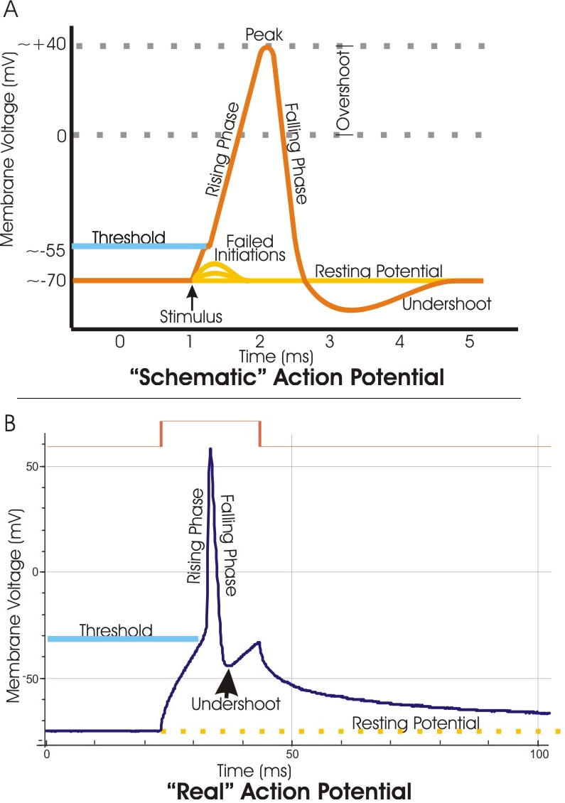
The Nervous System – the Path of the Nerve Impulse

Slide 86
The Nervous System – Neurotransmitters
Neurotransmitters are chemicals that transmit a signal from a neuron to a target cell across a synapse.
When a neurotransmitter binds to a channel through which both Na+ and K+ can diffuse, the channel opens and the membrane depolarizes, bringing the membrane potential toward the threshold. This depolarization is called a excitatory postsynaptic potential.
When a different neurotransmitter binds to a channel selective exclusively for K+, the channel opens and the membrane hyperpolarizes, moving the membrane potential farther from the threshold. This hyperpolarization is called inhibitory postsynaptic potential.

Slide 87
Disorders of the Nervous System – Alzheimer’s Disease
Alzheimer’s disease is the most common form of dementia. It results in a major loss of cognitive ability and eventually death.
Some signs and symptoms include: memory loss, confusion, irritability, aggression, mood swings, and trouble with language
In 2006, 0.40% of humans had Alzheimer’s disease; by 2050, that figure is expected to triple. The disease is most common in people 65 years of age and older.
There is no cure for Alzheimer’s disease. Pharmaceutical and psychosocial treatment, along with dedicated caregiving, can assuage the symptoms, however.

Slide 88
Disorders of the Nervous System – Parkinson’s Disease
Parkinson’s disease is a degenerative disease of the central nervous system that results in the death of dopamine-generating cells in the brain.
Some signs and symptoms include: tremor, rigidity, slowness or inability to move, postural instability, slowed cognitive speech, depression, and insomnia.
In industrialized countries, 0.3% of the population has Parkinson’s disease; 4.0% of the population above 80 years of age has it.
There is no cure for Parkinson’s disease. The administration of Levodopa, a compound that gets converted to dopamine in the brain, has been the most commonly used treatment for 30 years. Surgery can also relieve some symptoms.

Slide 89
The Nervous System – Sources
http://en.wikipedia.org
The AP Biology textbook, p. 1019, 1022

Slide 90
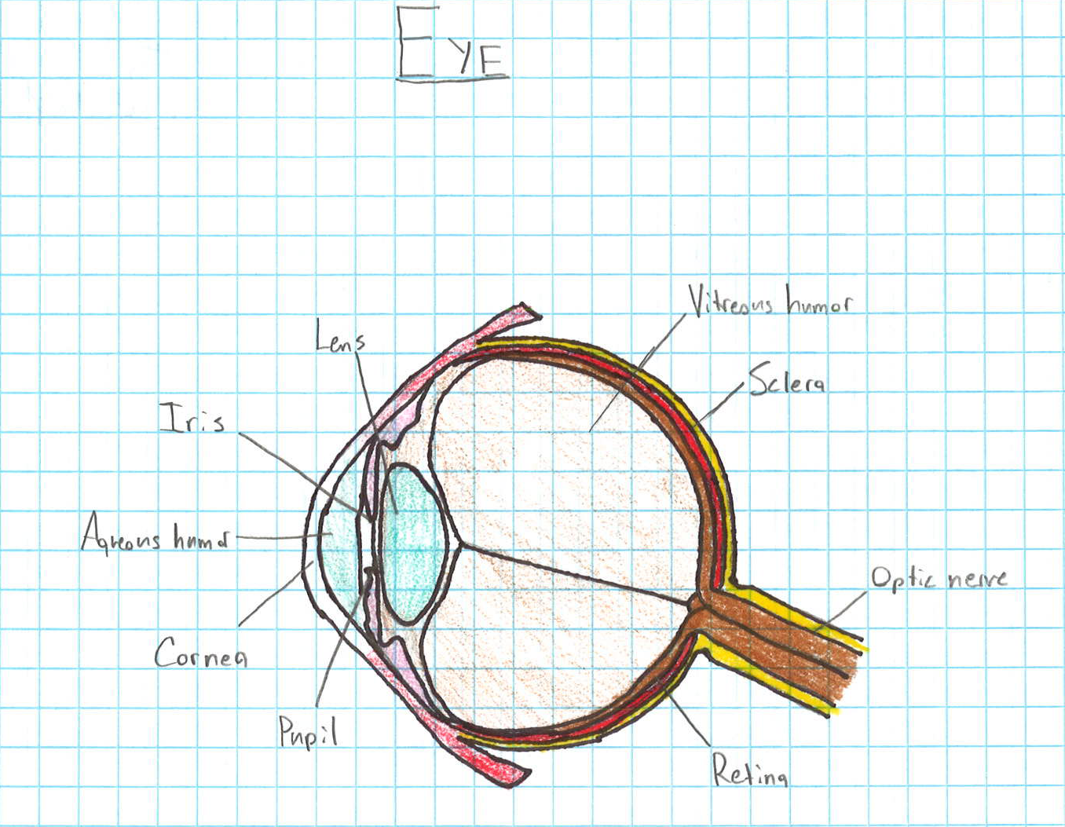
The Senses

Slide 91
The Senses – Function and Location
Mechanoreceptors: sensory receptors that respond to mechanical pressures or distortion; located in the skin
Thermoreceptors: sensory receptors that respond to changes in temperature; located in the skin, corneas, and bladder
Chemoreceptors: sensory receptors that detect chemical stimuli in the environment; located in the nose, tongue, and blood vessels
Photoreceptors: sensory receptors that convert light into electrical signals that the brain can visually interpret; located in the retina
Pain receptors: sensory receptors that detect mechanical, chemical, and thermal changes above a certain threshold; located in the skin and on internal surfaces

Slide 92
The Senses – Rhodopsin
Rhodopsin is a pigment located in the rod cells of the retina and is responsible for the perception of light.
Rhodopsin is involved in cell signaling in that it is a part of the system that converts energy from photons into electrical signals capable of being processed by the brain.

Slide 93
The Senses – Sources
http://en.wikipedia.org/

Slide 94
The Muscular System

Slide 95
The Muscular System – Function
The muscular system permits movement, maintains posture, and facilitates the circulation of blood throughout the body.

Slide 96
The Muscular System – the Sarcomere

Slide 97
The Muscular System – the Sliding Filament Model
According to the sliding filament model of muscle contraction, neither the thick filaments nor the thin filaments change in length when the sarcomere shortens. Instead, the filaments slide past each other longitudinally, shrinking only the I band and the H zone.
The sliding filament model occurs as such:
  Myosin head of the thick filament is bound to ATP and is in its low-energy configuration → myosin head hydrolyzes ATP to ADP and inorganic phosphate and is converted to its high-energy configuration → myosin head binds to the actin of the thin filament, forming a cross-bridge → myosin releases the ADP and phosphate, returning to its low-energy state and sliding the thin filament → ATP binds to the myosin head, releasing it from the actin and allowing a new cycle to begin

Slide 98
Disorders of the Muscular System – Duchenne Muscular Dystrophy
Duchenne muscular dystrophy is an X-linked genetic disorder caused by a mutation in the dystrophin gene. It results in muscular degeneration, difficulty walking, and death.
Some signs and symptoms include: weakness of and loss of muscle mass in the legs and pelvis (and, as the disease progresses, the arms, neck, and other parts of the body), enlargement of calf and deltoid muscles, low endurance, and difficulty standing or ascending staircases
Approximately 1 in 3600 boys has the disease. Since the disease is X-linked, females very rarely are affected and are more likely to be carriers.
There is no cure for DMD, though physical therapy and aids such as braces and splints can assist in managing the disorder.

Slide 99
Disorders of the Muscular System – Fibromyalgia
Fibromyalgia is a syndrome characterized by chronic widespread pain and allodynia.
Some signs and symptoms include: debilitating fatigue, sleep disturbance, joint stiffness, difficulty swallowing, numbness and tingling, and cognitive dysfunction.
About 2-4% of the general population is afflicted with fibromyalgia, and women are affected more frequently than men by a ratio of 9:1.
Fibromyalgia is medically unexplained; as such, there is no universally agreed-upon treatment. Symptom management is the go-to response. Treatments ranging from cognitive behavioral therapy to antidepressants to exercise may be administered.

Slide 100
The Muscular System – Sources
http://en.wikipedia.org/
The AP Biology textbook, p. 1068

Slide 101
The Skeletal System

Slide 102
The Skeletal System – Function
The skeletal system provides a number of important functions, including: support, protection of the internal organs, movement, blood cell production, and mineral storage.

Slide 103
The Skeletal System – Role in Movement
Structure | Role in Movement
Bones | Provide framework for muscles; give the muscles something to connect to and move
Ligaments | Connect bones together
Muscles | Move bones
Tendons | Attach muscles to bones

Slide 104
The Skeletal System – the Different Types of Skeletal Systems
Hydrostatic skeleton | Exoskeleton | Endoskeleton
No hard structures | Hard, protective outer covering | Internal network of bones and cartilage
Muscles surround a fluid-filled body cavity | Muscles are in the hard body surface | Muscles connected to bones within the body
Muscles around the fluid-filled chamber (circular muscles) contract, forcing the muscles that extend across the chamber (longitudinal muscles) to stretch; when the longitudinal muscles contract, the circular muscles stretch; this alternating system of contraction and stretching moves the organism | Movement occurs as a result of the muscles moving the stiff parts of the exoskeleton | Movement occurs as a result of muscle contractions moving bones
Ex: worms, sea anemones, hydras | Ex: lobsters, crabs, insects | Ex: humans, cats, elephants

Slide 105
Disorders of the Skeletal System – Scoliosis
Scoliosis is a medical condition in which a person’s spine is curved from side-to-side, as opposed to being straight.
Some signs and symptoms of scoliosis include: uneven musculature on one side of the spine, a rib or shoulder blade prominence, uneven hip or leg length, and slow nerve action.
Approximately seven million people in the U.S. have scoliosis. A minor curve of 10 degrees or less affects 1.5-3 % of individuals.
Scoliosis can be treated with physical therapy, bracing, and surgery.

Slide 106
Disorders of the Skeletal System – Osteoporosis
Osteoporosis is a medical condition in which bone tissue becomes progressively thinner and less dense.
Some signs and symptoms include: bone pain, frequent fractures, loss of height, lower back pain, neck pain, and stooped posture.
Approximately 55% of Americans age 50 or above have osteoporosis. About one in three women and one in twelve men worldwide are affected.
Medication (such as bisphosphonates) and diets rich in calcium, vitamin D, and vitamin K can help manage osteoporosis.

Slide 107
The Skeletal System – Sources
http://en.wikipedia.org/

