Slide 1
Skeletal System
Alex Wiemann

Slide 2
Function
Support
Protection
Movement
Produce blood cells
Store minerals

Slide 3
Structural Roles in Movement
Structure | Function
Bones | Fit together at joints, which allow movement
Ligaments | Connect bones together
Tendons | Attach muscles to bones
Muscles | Move bones by extending or flexing a joint
Nerves | Control contraction and relaxation of muscles

Slide 4
Animal Skeletal Systems
Hydrostatic skeleton | Exoskeleton | Endoskeleton
Do not contain hard structures | Hard, protective, outer covering | Internal skeleton which is a framework of bones and cartilage
Muscles surround fluid-filled body cavity | Muscles are in the hard body surface | Movements occurs with muscle contractions moving bones
Movement occurs when muscle contracts and squeeze internal fluid causing the organism to stiffen and the body to shorten and widen | Movement occurs with propelling or contracting “wings” | Provides support for body and protection
Examples: worms, sea anemones | Examples: lobsters, crabs, mollusks, clams | Examples: lions, human

Slide 5
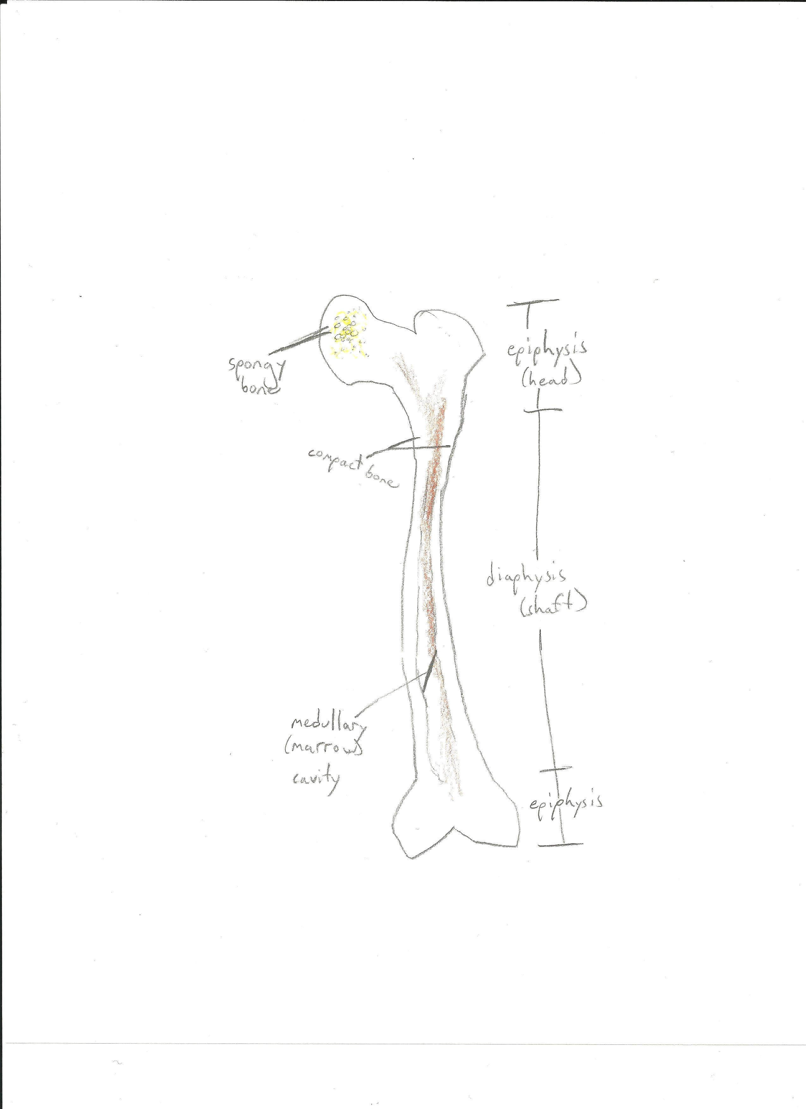
Long Bone

Slide 6
Leukemia
Description: type of blood cancer that begins in bone marrow
Signs and symptoms: fever, night sweats, headaches, bruising, joint pain, fatigue, weak, weight loss
Prevalence: about 47,150 people will die of leukemia in 2012, 23,540 will be diagnosed
Treatment: chemotherapy, radiation, stem cell transplant

Slide 7
Osteoporosis
Description: thinning of bone tissue and loss of density over time
Signs and symptoms: bone pain, fractures, loss of height, low back pain, neck pain, stooped posture
Prevalence: 44 million in U.S. ages > 50
Treatment: calcitonin, hormone replacement therapy, parathyroid hormone, exercise, diet of high calcium foods

Slide 8
Resources
http://www.ivy-rose.co.uk/HumanBody/Skeletal/Skeletal_System.php
http://www.cliffsnotes.com/study_guide/Skeletons-in-Animals.topicArticleId-8741,articleId-8716.html
http://www.ncbi.nlm.nih.gov/pubmedhealth/PMH0002276/
http://www.ncbi.nlm.nih.gov/pubmedhealth/PMH0001400/
http://www.webmd.com/cancer/tc/leukemia-treatment-overview
http://seer.cancer.gov/statfacts/html/leuks.html
http://www.nof.org/advocacy/resources/prevalencereport

