Slide 1
Reproductive System
Alex Wiemann

Slide 2
Function
The function of the reproductive system is to produce offspring.

Slide 3
Sexual vs. Asexual Reproduction
Sexual Reproduction | Asexual Reproduction
Male/female gametes fuse to produce offspring | Unicellular organisms produce single organism to reproduce on its own – genetically identical
 | Examples: Sponges - release a specialized mass of cells, called a gemmule Planarians use fragmentation, breaking off a part of their body into distinct piece Echinoderms use regeneration by detaching a piece of the parent to develop into offspring

Slide 4
Spermatogenesis
Process of producing sperm
Meiosis I: Diploid cell containing 46 chromosomes differentiates into primary spermatocyte, which splits into two
Meiosis II: secondary spermatocytes divides into sperm

Slide 5
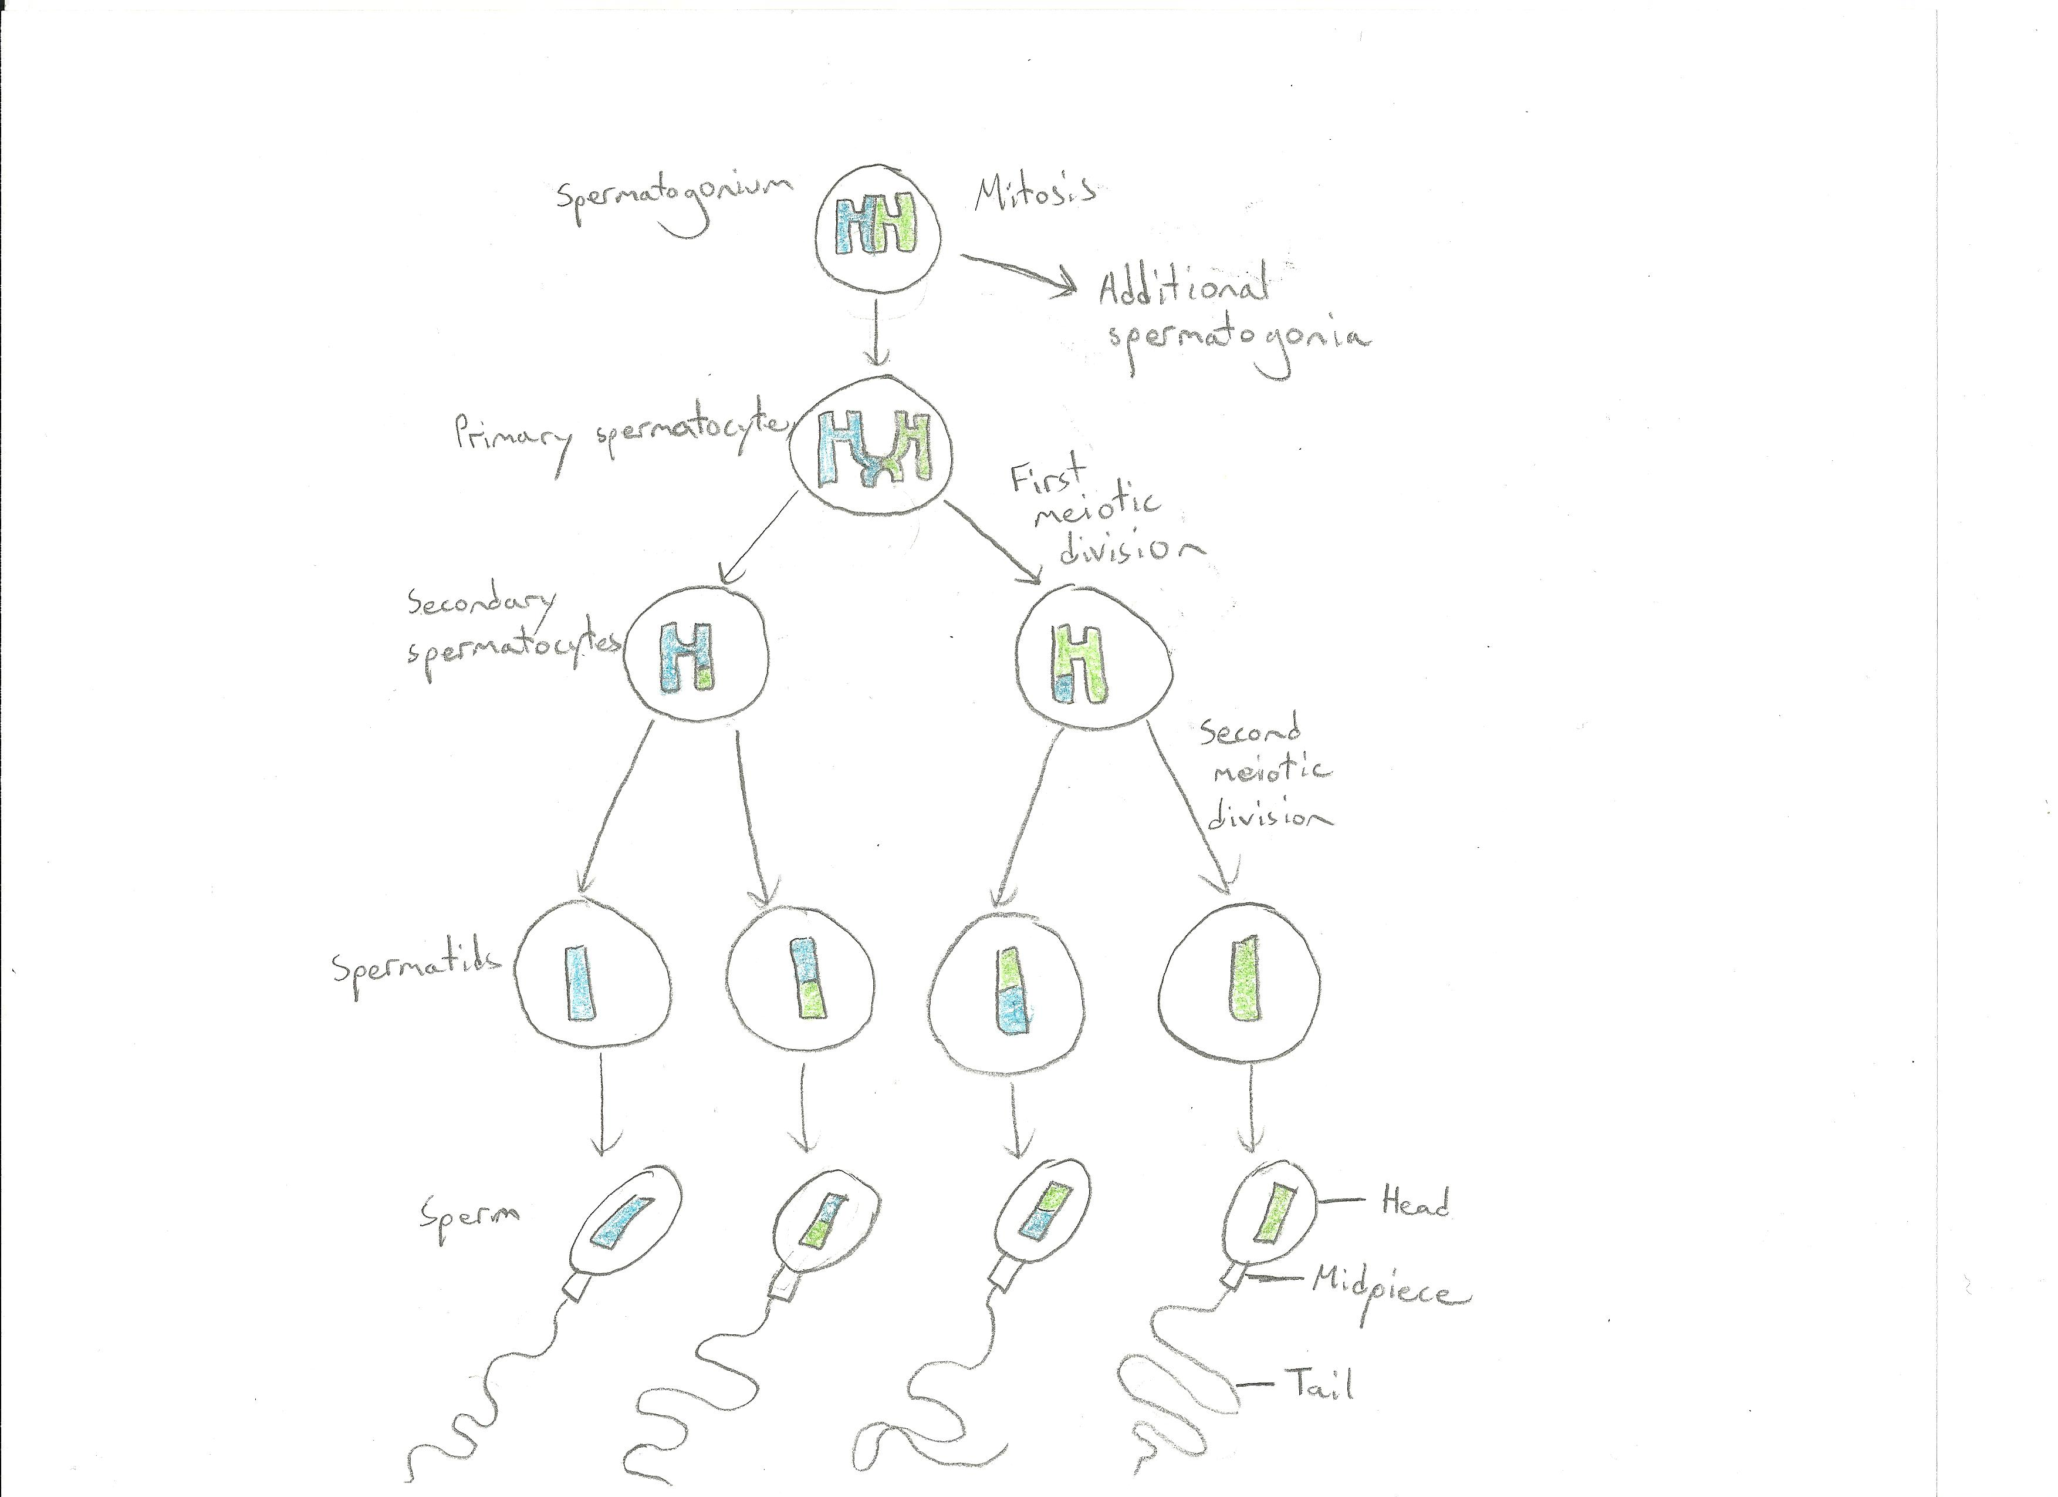
Spermatogenesis

Slide 6
Oogenesis
Development of egg cells
Occurs almost entirely in ovaries

Slide 7
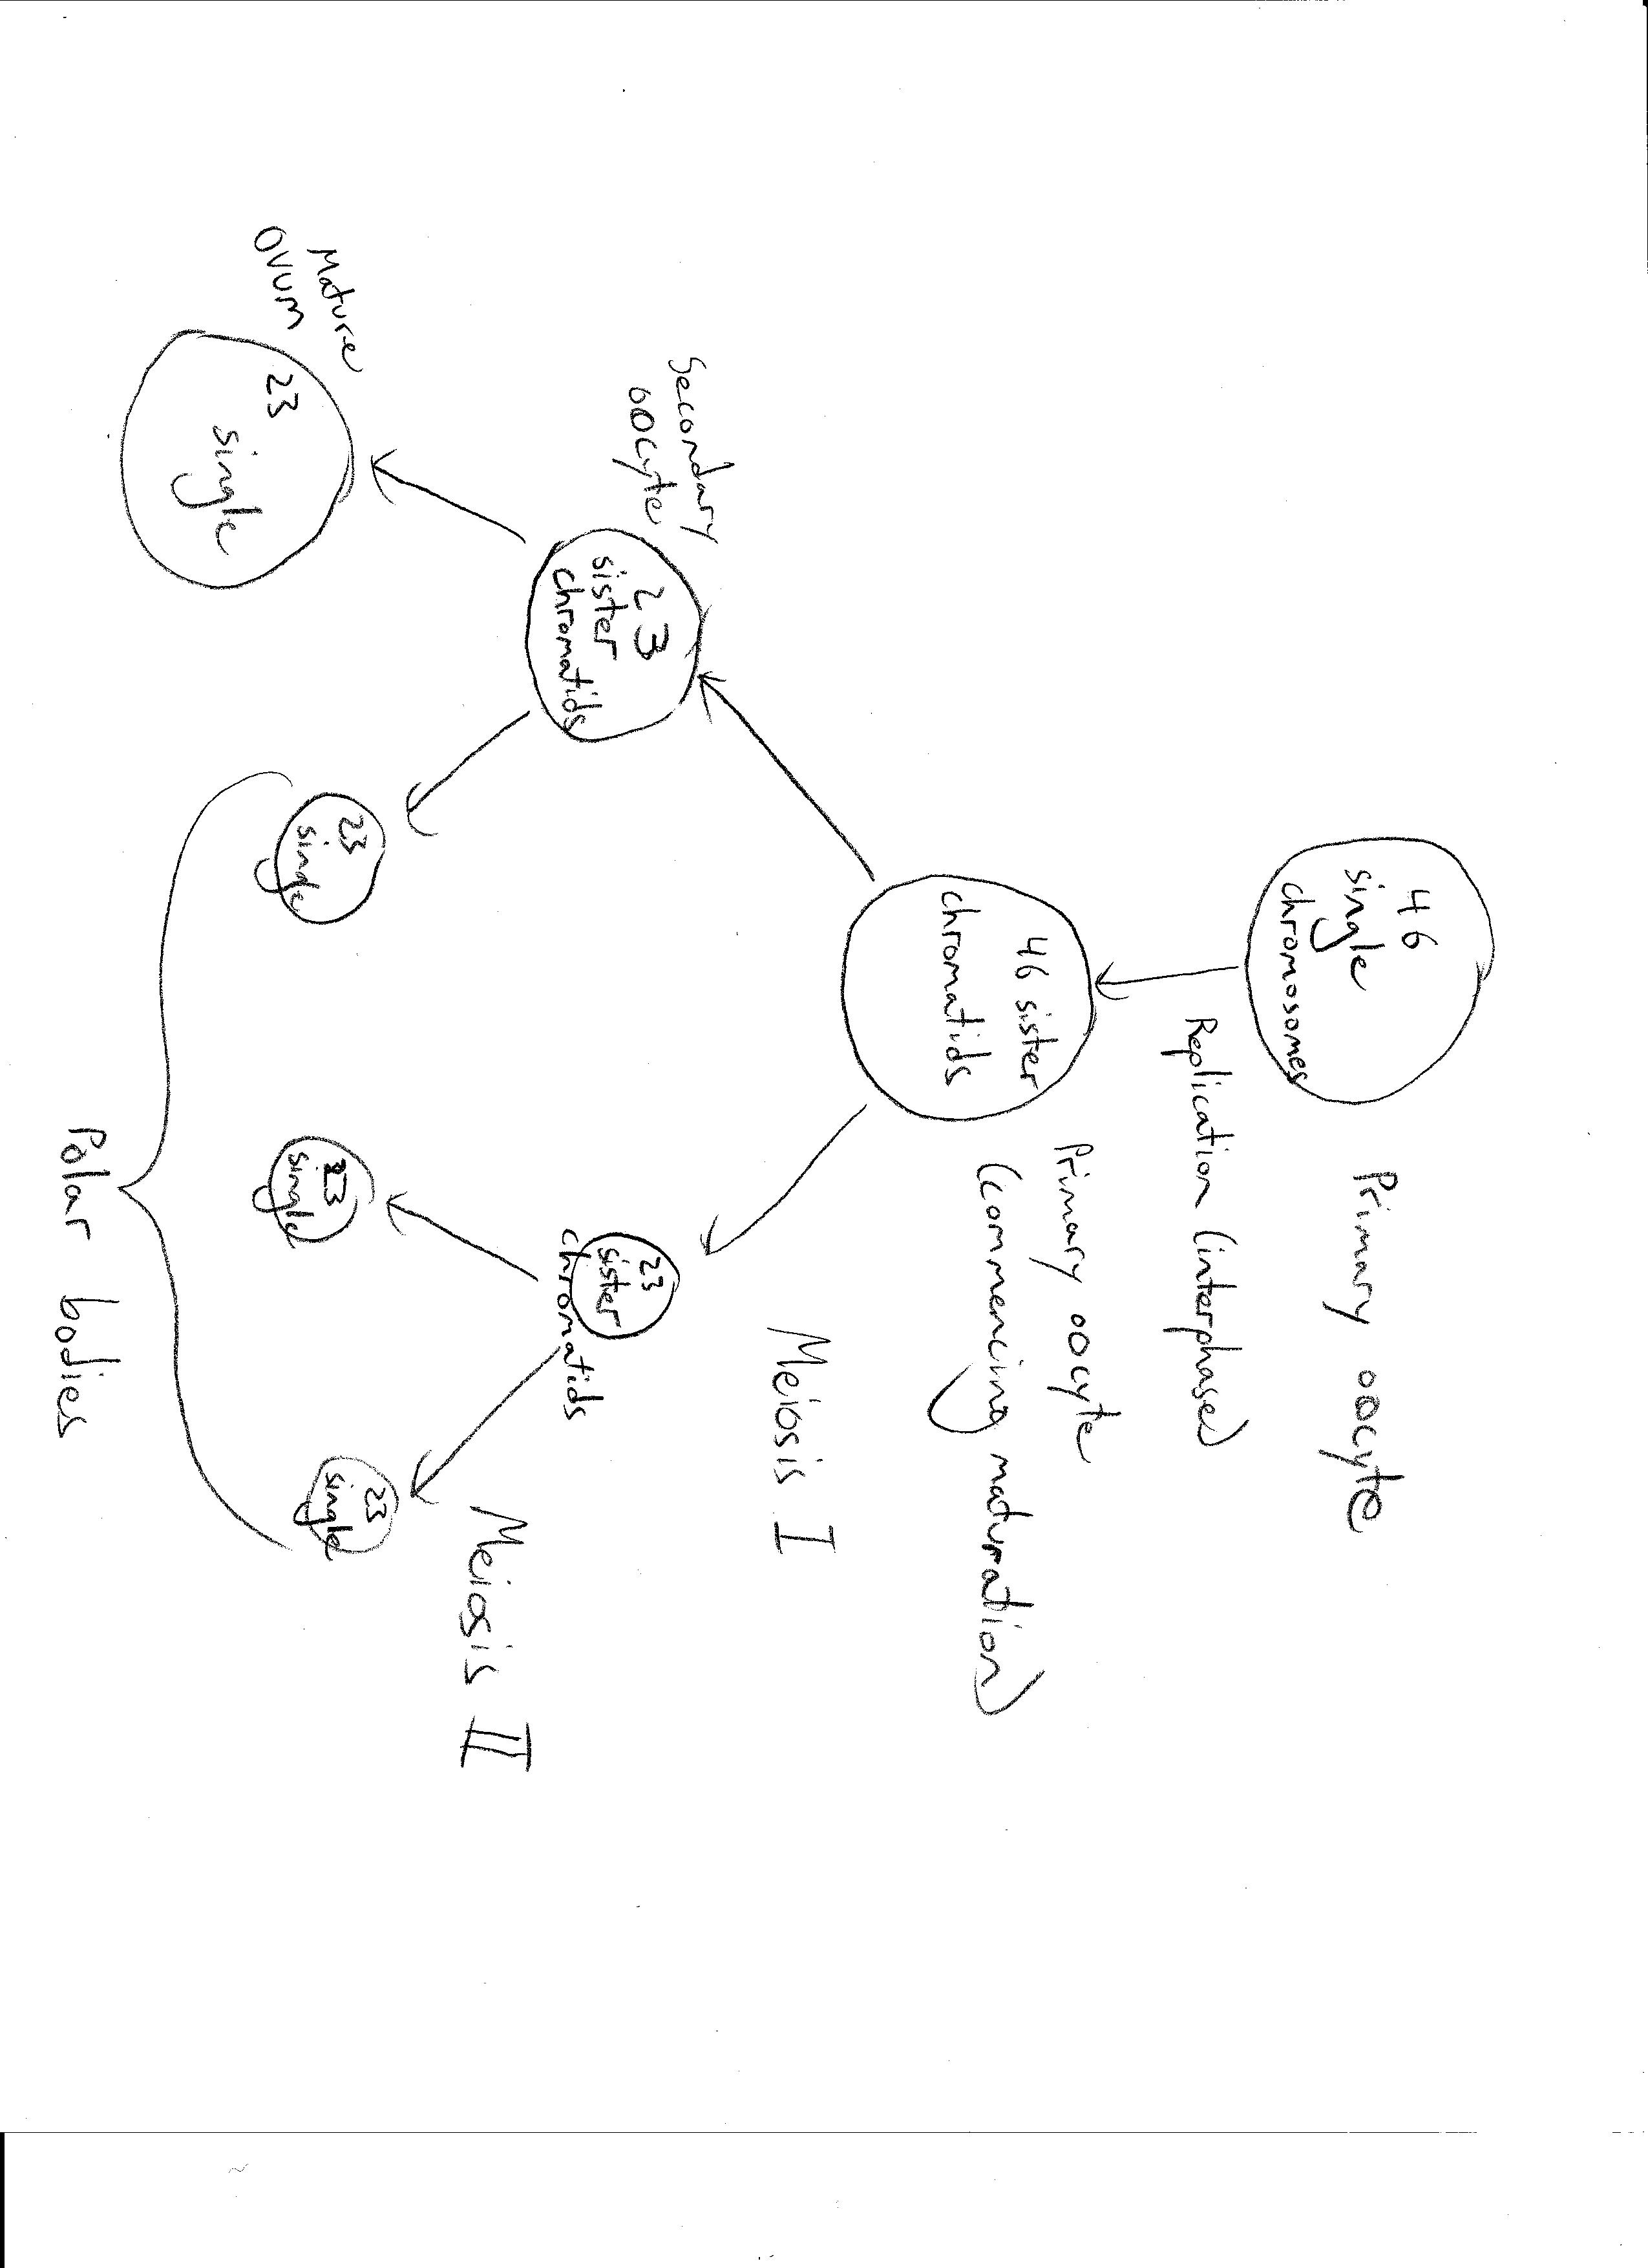
Oogenesis

Slide 8
Menstrual Cycle | Estrous Cycle
Humans/Primates | Non-primate female vertebrates
Occurs every 28 days | Time period differs between animals -rats every 4-5 days
Ovulation occurs | Ovulation occurs
Uterine epithelial layer sheds through menstruation | Reabsorbs the endometrium if conception does not occur during a cycle
 | Reproduction only occurs at a time coinciding with ovulation – estrous phase – “in heat”
 | Stages: proestrus, estrus, metestrus, diestrus

Slide 9
Menstrual Cycle
Ovarian cycle
Lasts 28 days, beginning at 1st day of menstruation
Oocytes mature and divide until fertilization
Uterine cycle
If no fertilization, uterine lining sloughs off – called menses or menstruation

Slide 10
Menstrual Cycle (cont.)
Hormonal control
Luteinizing hormone, follicle-stimulating hormone – stimulate oocytes to develop and ovaries to release estrogen and progesterone
estrogen and progesterone - stimulate development of uterine lining
Feedback mechanisms
Progesterone/estrogen inhibit hypothalamus and anterior pituitary gland from release GnRH which stimulates release of LH and FSH

Slide 11
Embryonic Development
Morula: earliest stage of embryonic development, after fertilization but before implantation
Cleavage: zygote produces identical copies
Blastula: ball of cells – end product of cleavage
Gastrulation: organization of cleaved cells into germ layers
Gastrula: end product of gastrulation
Organogenesis: initial formation of organs starting with less differentiated tissues found in the early embryo

Slide 12
Germ Layers
Ectoderm
Nervous tissue
Mesoderm
Muscle and connective tissue
Endoderm
epithelial tissue: digestive tube, lungs, liver, urinary bladder

Slide 13
Endometriosis
Definition: condition involving endometrial tissue bleeding into abdominal cavity monthly
Signs and symptoms: pelvic pain, severe menstrual cramps
Prevalence: 3-10% of women in reproductive age
Treatment: anti-inflammatory drugs, laparoscopic surgery

Slide 14
Infertility
Definition: inability to conceive children
Signs and symptoms: inability to conceive
Prevalence: varies based on definition, 1 in 5 untreated couples will eventually conceive
Treatment: education and counseling, intrauterine insemination, medicines to treat infections/clotting disorders, medications to release eggs

Slide 15
Resources
www.montgomerycollege.edu/~kmarshal/BI205/ppt/chap27-8.pdf www2.gi.alaska.edu/STEP/lessons_database/lessons/scan/scan_68_LifeScience_SexualAndAsexualReproduction.pdf+site:.edu+sexual+asexual+reproduction&hl=en&gl=us&pid=bl&srcid=ADGEESh9HAJZJx7OI6OFQfJnh73a3YXgpoCJ2sjOOeRwBHzMC5i7FnunvDx1ht7u81Cwl7KdX5ZW1eN4pDeaDMpZEffBjxF_FrFxYRsOx11gtvZmoAFZdzH6Mn_lE_sOwhICn2wOqoov&sig=AHIEtbQk7ftIdDjFbEBBFI1AMqHvjIiHDg http://www.rci.rutgers.edu/~uzwiak/HumanSexuality/HSSpringLect3.html http://biology.about.com/od/genetics/ss/Asexual-Reproduction.htm
http://php.med.unsw.edu.au/embryology/index.php?title=Menstrual_Cycle
http://www.uwyo.edu/wjm/repro/estrous.htm
http://www.sumanasinc.com/webcontent/animations/content/ovarianuterine.html
http://users.rcn.com/jkimball.ma.ultranet/BiologyPages/E/EmbryonicDevelopment.html
http://www.mansfield.ohio-state.edu/~sabedon/biol1130.htm
http://women.webmd.com/endometriosis/endometriosis-treatment-overview
http://www.ncbi.nlm.nih.gov/pubmedhealth/PMH0002173/

