Slide 1
POKER CHIP PEER REVIEW
Idea from Kristen Dotti AP BIO Labs/Stats workshop
Image from: http://www.veryicon.com/icon/png/Game/Poker/Poker%20Chips.png

Slide 2
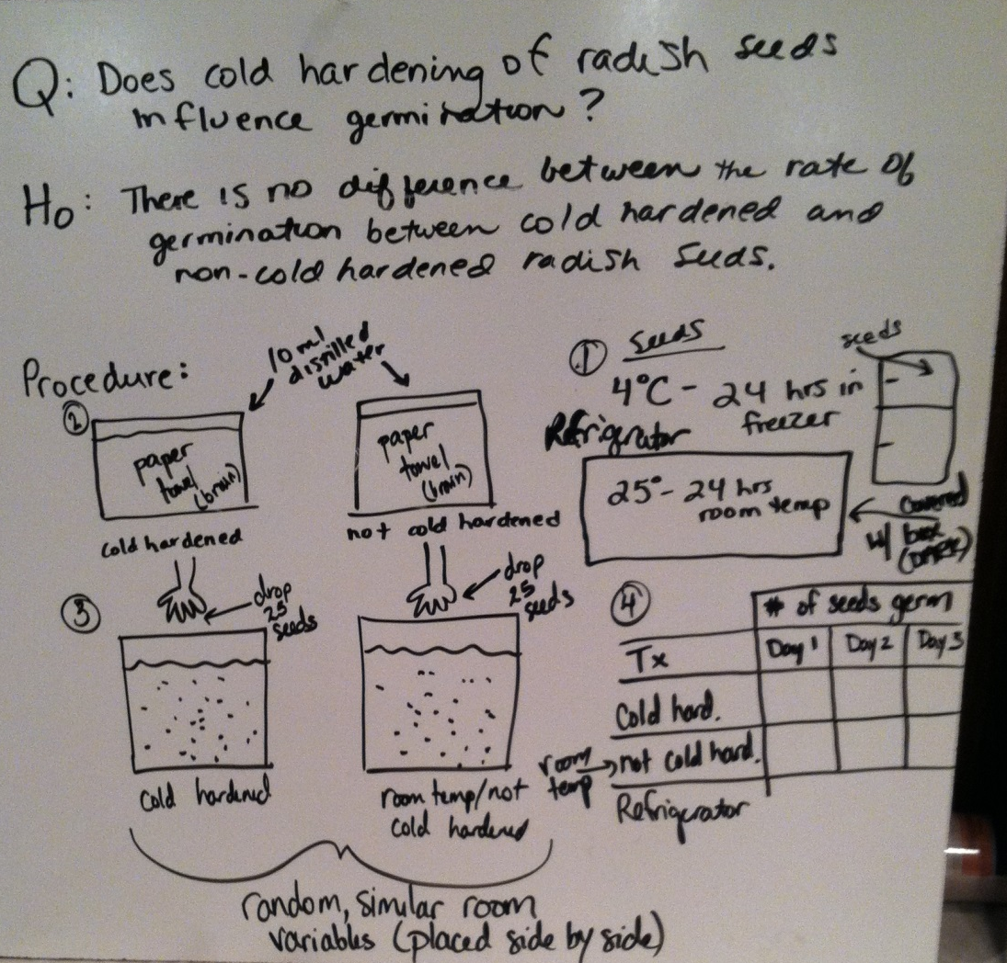

Slide 3
WHITE BOARD EXPERIMENTAL DESIGN
Q: H₀:
H_{A}:
Procedure in pictures: (be specific include control variables)
DATA TABLE:

Slide 4
“CONSTRUCTIVE” CRITICISM
BAD EXAMPLES: ?

Slide 5
“CONSTRUCTIVE” CRITICISM
GOOD EXAMPLES: Have you thought about . . .
How do you think ______ might affect _____? I’m not sure that idea would work because . . . Suggest an way to improve it.
A solution to that problem might be . . .
Praise 1st: I really liked _____ but I think ____ is a problem.

Slide 6
EXPERIMENTAL DESIGN EVALUATION
GROUPS will NOT be evaluated here on their experimental design. (Teacher will do that later when final lab is turned in and graded ☺ )
Your job is to “help the presenting group” design the “BEST experiment possible”.
Points will be given by the group to EVALUATORS for their constructive criticism.

Slide 7
Poker Chip Points
White = 1 Ask a ? ”Did you think about …?
Red =2 Offer a solution “Maybe you could . . .”
Blue = 3 Holy cow/Something Amazing

Slide 8
Anyone in group can give chips to anyone else EXCEPT themselves
Anyone in group can question the points given
Group makes a decision on all “contested” points.

