Slide 1
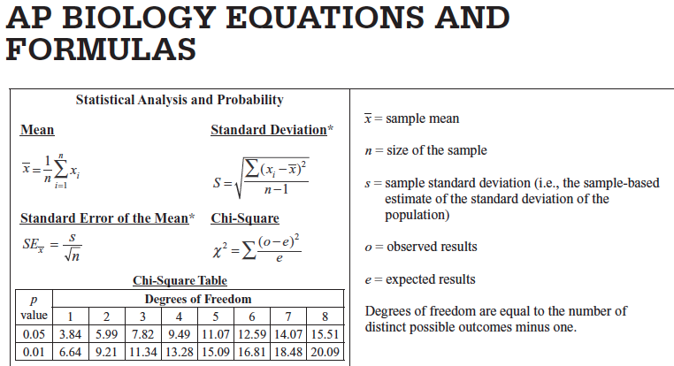
Stats for AP Biology
SLIDE SHOWS MODIFIED FROM:
http://apbiowarde.weebly.com/uploads/3/8/3/0/38303939/stats_pp.pptx
https://www.google.com/url?sa=t&rct=j&q=&esrc=s&source=web&cd=2&cad=rja&uact=8&ved=0ahUKEwiBgJ6ntcTXAhWHTSYKHUT_DWAQFggvMAE&url=http%3A%2F%2Fwww.bville.org%2Ftfiles%2Ffolder427%2Fap_standard_deviation_and_standard_error.pptx&usg=AOvVaw3J7ssjoCq2jMZGlQ3dcAmW

Slide 2
Bozeman Biology videos: AP Science Practice 2: Using Math Appropriately
Statistics for Science
Standard Deviation Standard Error
Modified from: Mathisfun.com
http://www.mathsisfun.com/data/standard-deviation.html

Slide 3
Data analysis allows you to…
Arrive at conclusions about your data
Make claims about your data
Support arguments using your data
Estimate the reliability of your data
Effectively communicate conclusions about your work to a larger scientific community

Slide 4
Appropriate descriptive statistics for a data set typically include:
Mean (average)
Sample size
Standard deviation
Standard error

Slide 5
Mean (average)
Sum of the numbers in the sample divided by the total number in the sample
Summarizes the entire sample
Might provide an estimate of the entire population’s (that was sampled) true mean

Slide 6
Sample size
How many members of the population are included in the study
Important when determining confidence that analysis of sample set is representative of entire population
In formulas, sample size = n

Slide 7
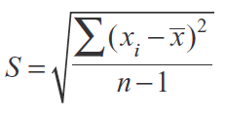
Standard deviation
Tool for measuring the spread (variance) in the sample population
Large standard deviation indicates that the data have a lot of variability
Small standard deviation indicates that the data are clustered close to the sample mean
You do NOT have to
calculate this on the
AP Biology Exam, but
you should understand
how it is derived and used.

Slide 8
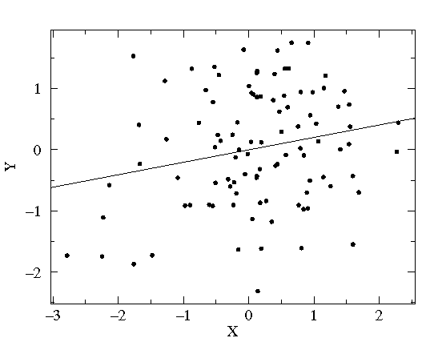
Large standard deviation
(spread out from mean)
Small standard deviation
(clustered close to mean)

Slide 9
In a normal distribution 68.2% within 1 standard deviation from mean 95.4% within 2 standard deviations from mean 99.7% within 3 standard deviations from mean
http://www.strath.ac.uk/media/faculties/hass/appliededucationalresearch/mod4unit3/curve1.jpg

Slide 10
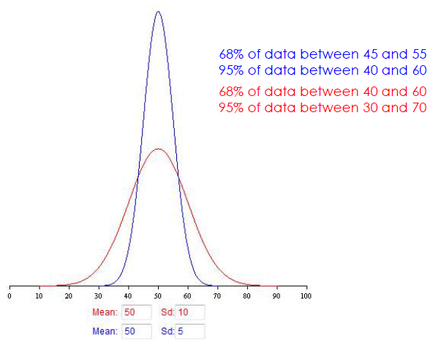
The magnitude of the standard deviation depends on the spread of the data set
Two data sets: same mean; different standard deviation

Slide 11
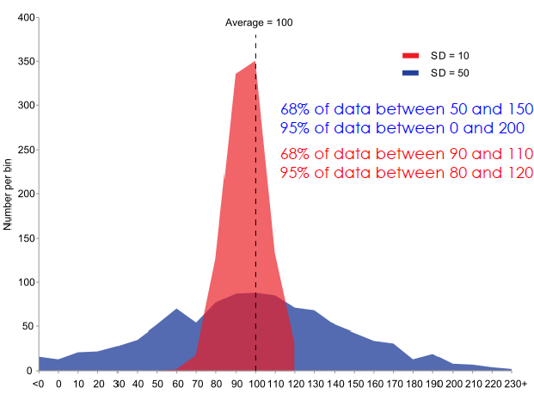
Actual data sets aren’t always so pretty...

Slide 12
Standard Error of the Mean (Standard Error)
Allows you to infer how well the sample mean matches up to the true population mean
Helps you to determine confidence in the data collected in a sample
95% confidence interval = ± 2 SE
(Random sampling of the population should produce a mean
that falls within ± 2 SE 95% of the time.)
You do NOT have to
calculate this on the
AP Biology Exam, but
you should understand
how it is derived and used.

Slide 13
Example Problem
A student noticed that the ivy leaves growing on the shady side of a building were larger than ivy leaves growing on the sunny side of the same building. The student collected and measured the maximum width, in centimeters, of 30 leaves from each habitat. Use statistical analysis to determine if it’s likely that there is a significant difference in leaf size between the shady and sunny ivy plants with 95% confidence (±2 SE).

Slide 14
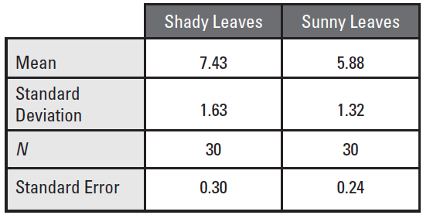
Collected Data

Slide 15
Collected Data
2 SE
95% confidence
0.60
0.48

Slide 16
Collected Data
Graph Mean
2 SE
0.60
0.48

Slide 17
Graph Means
7.43
5.88

Slide 18
Collected Data
2 SE
0.60
0.48
Add ± 2 SE Error Bars

Slide 19
Add ± 2 SE Error Bars
7.43 ± 0.60
5.88 ± 0.48

Slide 20
Conclusions
±2 SE Error bars (95% confidence intervals) do NOT overlap between sunny and shady means (7.43 - 0.60 > 5.88 + 0.48; 6.83 > 6.36)
Strongly suggests that the two populations are indeed statistically significantly different from one another
If the error bars/confidence intervals did overlap between the groups, you could not claim a statistically significant difference.

Slide 21
Lower standard deviation:
Data is closer to the mean
Greater likelihood that the independent variable is causing the changes in the dependent variable
Higher standard deviation:
Data is more spread out from the mean
More likely factors, other than the independent variable, are influencing the dependent variable

Slide 22
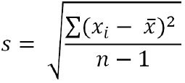
Calculating standard deviation, s
Calculate the mean (X)
Determine the difference between each data point, and the mean
Square the differences
Sum the squares
Divide by sample size (n) minus 1
Take the square root

Slide 23
Standard Error:
Indication of how well the mean of a sample (x) estimates the true mean of a population (μ)
Measure of accuracy, if the true mean is known
Measure of precision, if true mean is not known

Slide 24
STANDARD DEVIATION the standard deviation of the sample is the degree to which individuals within the sample differ from the sample mean.
STANDARD ERROR OF THE MEAN
the standard error of the mean is an estimate of how far the sample mean is likely to be from the population mean
Bozeman Biology Standard Deviation
Bozeman Biology Standard Error

Slide 25
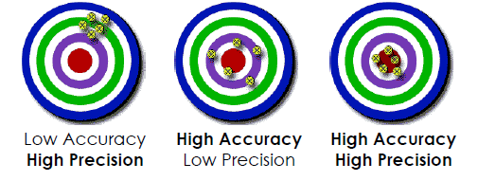
Accuracy – How close a measured value is to the actual (true) value
Precision – How close the measured values are to each other.

Slide 26
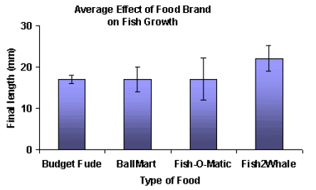
Which is a valid statement?
Fish2Whale food caused the most fish growth
Fish2Whale food caused more fish growth than did Budget Fude
✗
✓

Slide 27
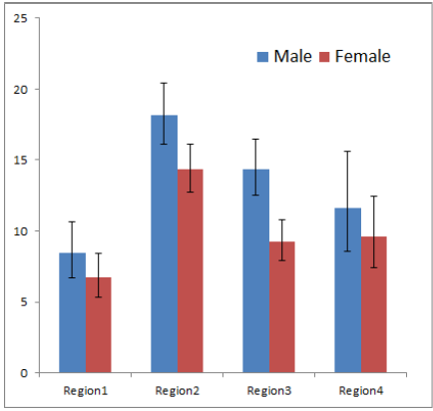
Statements:
In all four regions, more males exhibited the trait measured than did females.
More males in region 3 exhibited the measured trait than did females
✗
✓

Slide 28
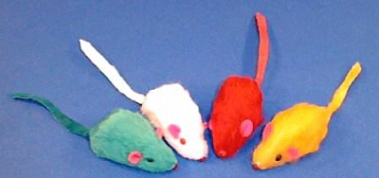
Does the mutagen have an impact on mean tail length ( ) in Mus musculus?
A group of mice was fed a diet with a mutagen added that was thought to affect tail length in mice.
Another group of mice was fed the same diet w/o the mutagen added.
H_{O} ?
Mutagen mice idea from Kristen Dotti Catalyst Learning Curriculum
Image from: http://www.petdiscounters.com/assets/images/product_images/image/d_4491.jpg

Slide 29
MEASURING MICE
Determine the tail lengths of the mice in the sample provided to your group.
Determine RANGE, MEAN, STANDARD DEVIATION, STANDARD ERROR of the MEAN, 95% CONFIDENCE for the mice in your sample.
Post your measurements on class data chart
Image from: http://www.petdiscounters.com/assets/images/product_images/image/d_4491.jpg

Slide 30
What can you conclude about Experiment 1?
What can you conclude about Experiment 2?
When standard error (SE) bars do not overlap, it suggests there might be a difference between the two means, but you cannot be sure. More statistics needs to be done.
When SE bars overlap you can be sure there is NO statistically significant difference between the two means.

