Slide 1
Mean, Median, Mode Variance Standard Deviation
Bozeman Biology videos: Statistics for Science
Standard Deviation Standard Error
Science Practice 2: The student can use mathematics appropriately
Modified from: Mathisfun.com
http://www.mathsisfun.com/data/standard-deviation.html

Slide 2
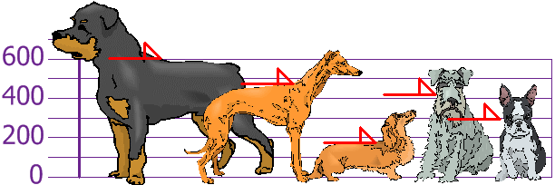
A sample of dogs was measured
The heights (at the shoulders) are:
600mm, 470mm, 170mm, 430mm and 300mm.
Image from: http://www.mathsisfun.com/data/standard-deviation.html

Slide 3
FIND the RANGE
Smallest number - largest number
170 mm – 600 mm
The heights (at the shoulders) are:
600mm, 470mm, 170mm, 430mm and 300mm.
Image from: http://www.mathsisfun.com/data/standard-deviation.html

Slide 4
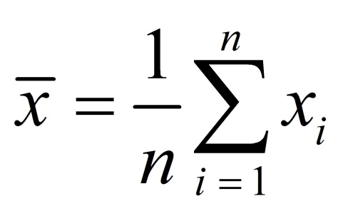
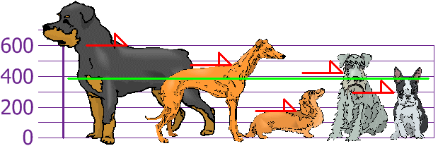
Find the MEAN
MEAN ( ): average of all data points
Mean height is 394 mm
Image from: http://www.mathsisfun.com/data/standard-deviation.html

Slide 5
FIND the MEDIAN
The heights (at the shoulders) are:
600mm, 470mm, 170mm, 430mm and 300mm.
.
Image from: http://www.mathsisfun.com/data/standard-deviation.html

Slide 6
MEDIAN: Data point that is found in the middle when all the measurements are lined up from in order from high to low (or an average of middle two values if there is an even number of data points
170mm 300mm 430mm 470 mm 600mm
.

Slide 7
FIND the MODE
The heights (at the shoulders) are:
600mm, 470mm, 170mm, 430mm and 300mm.
.
Image from: http://www.mathsisfun.com/data/standard-deviation.html

Slide 8
MODE: Most common data point
170mm 300mm 430mm 470 mm 600mm
There is no mode for these data

Slide 9
The heights (at the shoulders) are:
600mm, 470mm, 170mm, 430mm and 300mm.
Determine the VARIANCE. How far is each measurement away from the mean?
Image from: http://www.mathsisfun.com/data/standard-deviation.html

Slide 10
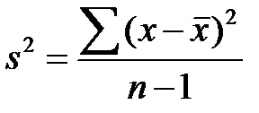
VARIANCE (= s²)
s² = (600 – 394)² + ( 470- 394) ² + ( 170- 394)² + ( 430-394)² +( 470- 394) ² 5-1
s² = 206 ² + 76 ² + (-224)² + 36 ² + (-94) ²
4
s² = $21,704$
http://www.mathsisfun.com/data/standard-deviation.html

Slide 11
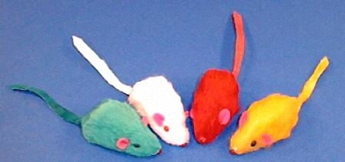
Does the mutagen have an impact on mean tail length ( ) in Mus musculus?
A group of mice was fed a diet with a mutagen that was thought to affect tail length in mice added.
Another group of mice was fed the same diet w/o the mutagen added.
H_{O} ?
Mutagen mice idea from Kristen Dotti Catalyst Learning Curriculum
Image from: http://www.petdiscounters.com/assets/images/product_images/image/d_4491.jpg

Slide 12
MEASURING MICE
Determine the tail lengths of the mice in the sample provided to your group.
Determine RANGE, MEAN, MEDIAN, MODE, & VARIANCE for the mice in your sample.
Post your measurements on class data chart
Image from: http://www.petdiscounters.com/assets/images/product_images/image/d_4491.jpg

Slide 13
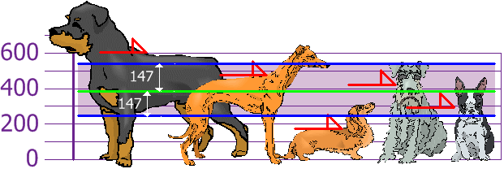
STANDARD DEVIATION (s)
Watch Bozeman Biology video
Standard Deviation= square root of Variance
σ = √21,704 = 147.32... = 147mm
Standard Deviation is useful. Now we can show which heights are within one Standard Deviation (147mm) of the Mean:
Rottweilers are tall dogs and Dachshunds are a bit short
Image from: http://www.mathsisfun.com/data/standard-deviation.html

Slide 14
STANDARD DEVIATION the standard deviation of the sample is the degree to which individuals within the sample differ from the sample mean.
STANDARD ERROR OF THE MEAN
the standard error of the mean is an estimate of how far the sample mean is likely to be from the population mean
Bozeman Biology Standard Error

Slide 15
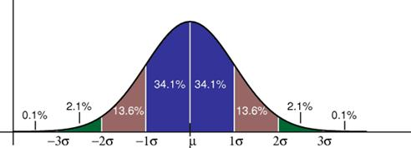
In a normal distribution 68.2% within 1 standard deviation from mean 95.4% within 2 standard deviations from mean 99.7% within 3 standard deviations from mean
http://www.strath.ac.uk/media/faculties/hass/appliededucationalresearch/mod4unit3/curve1.jpg

