Slide 1
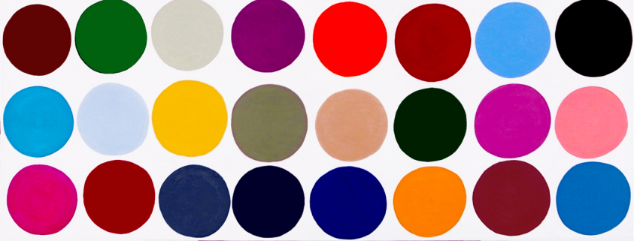
This is a happy island community.
Count organisms and determine phenotype frequencies for the populations.
http://3.bp.blogspot.com/-EwASyC3nFIU/Txh4guyfSKI/AAAAAAAAPig/SUyMmCetJX4/s1600/3.+Jessica+Snow%252CDot..dot..dot..%252848%2529%252C+2011%252C+acrylic+on+panel%252C18x24.png

Slide 2
Position your organisms as they go about their day.
Are they birds that fly around looking for food? Do they stay in a herd or family group? Do they set up a territory? Predators and prey? Migrate seasonally?
http://3.bp.blogspot.com/-EwASyC3nFIU/Txh4guyfSKI/AAAAAAAAPig/SUyMmCetJX4/s1600/3.+Jessica+Snow%252CDot..dot..dot..%252848%2529%252C+2011%252C+acrylic+on+panel%252C18x24.png

Slide 3
20 organisms closest to “south side of island” are washed away in a tidal wave.
http://www2.arnes.si/~dkrape/tidalwave.gif

