Slide 1
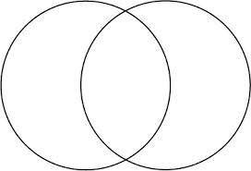
MAKE A MINI VENN
TRANSCRIPTION
TRANSLATION

Slide 2
MAKE A MINI VENN
TRANSCRIPTION
TRANSLATION

