Slide 1
AP BIO DNA EXTRACTION Slide show by Kelly Riedell/Brookings Biology

Slide 2
COLLECT AND BREAK OPEN CELLS Get tube with 3 mL water and label with your initials. Place in test tube rack.
GENTLY rub you teeth/tongue against n the inside of your cheeks for 30 seconds.
DON’T chew so hard you draw BLOOD!
Images from BIO-RAD lab manual
http://damascusroadministries.files.wordpress.com/2009/10/no_blood_med.gif?w=136&h=112

Slide 3
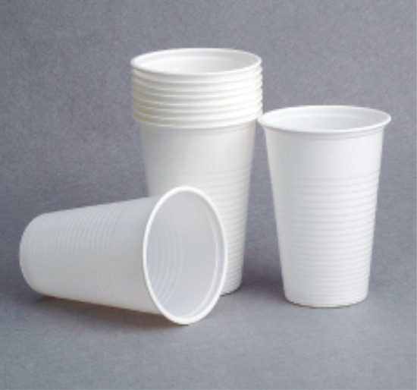
COLLECT AND BREAK OPEN CELLS
Take the 3 mL water from the test tube into your mouth and swish it around vigorously for 30 seconds. Don’t swallow the water!
Spit into cup provided.
Use pipette to transfer liquid to 15 mL test tube.
http://shuangtong.en.made-in-china.com/product/qeZnwBrvwbcI/China-200ml-Plastic-Cup.html
Bio Rad Genes in a Bottle teacher guide

Slide 4
COLLECT AND BREAK OPEN CELLS
Add 2 mL LYSIS BUFFER
Place cap on tube and GENTLY INVERT 5 times.
DO NOT SHAKE!
Bio Rad Genes in a Bottle teacher guide
http://www.drugstore.com/suave-shampoo-aloe-and-water-lily/qxp27077

Slide 5
Remove proteins
Add 5 DROPS of PROTEASE and SALT solution.
What does the name tell you about what proteases do?
Protease digests proteins
Bio Rad Genes in a Bottle teacher guide
http://www.meijer.com/assets/product_images/styles/xlarge/1001029_024600010016_A_400.jpg

Slide 6
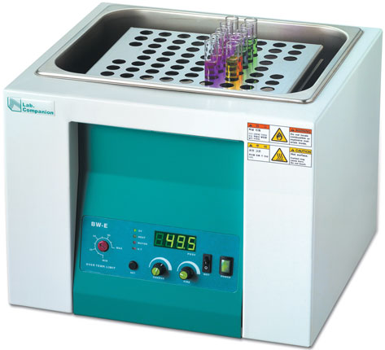
Add cap and GENTLY invert tube a 3 times. DON’T SHAKE!
Write your initials on tube cap.
REMOVE THE PROTEINS Place your tube in a test tube rack in the water bath and incubate at 50° C for 10 minutes to allow proteases to work
Bio Rad Genes in a Bottle teacher guide
http://www.lightlabsusa.com/images/D/d-16539-110.jpg

Slide 7
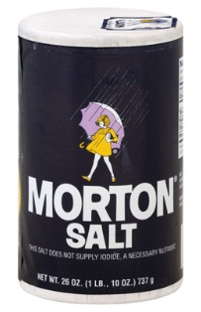
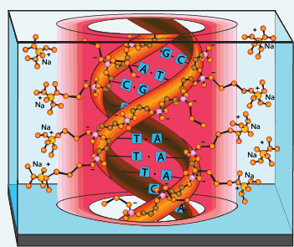
Soap – disrupts phobic phospholipids in cell membranes and releases DNA from cell
Protease- gets rid of proteins associated with DNA and DNases (enzymes that digest DNA)
Salt ions- surround charges on DNA and helps bring DNA together
http://www.drugstore.com/suave-shampoo-aloe-and-water-lily/qxp27077 http://www.meijer.com/assets/product_images/styles/xlarge/1001029_024600010016_A_400.jpg
http://molecularcreation.com/enzymes.htm

Slide 8
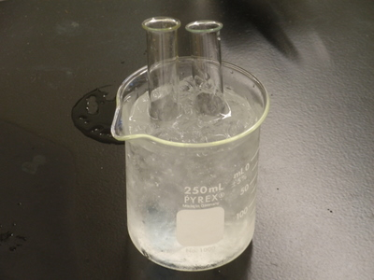
Obtain a tube containing 91% isopropyl alcohol. Keep the alcohol as cold as possible by placing it in the cup of ice.
http://depts.washington.edu/chem/courses/labs/162labs/images/PA030140.JPG

Slide 9
Making the DNA Visible Tilt tube at a 45° angle and slowly add the alcohol, carefully letting it flow GENTLY down the inside of the tube.
Add ~ 8- 10 ml total of cold alcohol. You may need to use several pipets full
You should be able to see two layers (upper and lower) forming.
As you add the alcohol, pay close attention to the place where the alcohol and cell extract layers meet.
Bio Rad Genes in a Bottle teacher guide

Slide 10
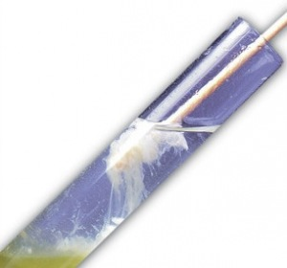
Making the DNA Visible
Screw cap on tube and let it sit upright UNDISTURBED AT ROOM TEMP for 5 minutes to give time for DNA to precipitate.
After 5 minutes look at tube (especially in area where alcohol and cell extract layers meet)
http://geneticmaize.files.wordpress.com/2011/09/window_testtube.jpg?w=300&h=280
http://www.clker.com/clipart-28904.html

Slide 11
Making the DNA Visible
After 5 min, SLOWLY invert the tube 5 times to help DNA which has begun to precipitate to aggregate.
You should see wispy white DNA clumps .
Bio Rad Genes in a Bottle teacher guide

Slide 12
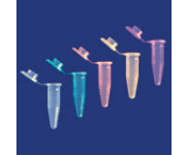
Use pipette to transfer the precipitated DNA to the small microtube provided. Fill remaining space in tube with cold alcohol.
Add string before you close/glue the top. Use Superglue to seal the top of the vial.
http://learn.genetics.utah.edu/content/labs/extraction/howto
http://www.biotek.com.au/assets/Uploads/_resampled/paddedimage194160-Coloured-Microtubes.png

Slide 13
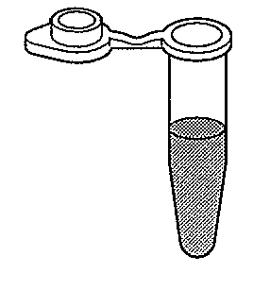
Images from BIO-RAD lab manual
Dry off the opening of the tube.
Add string BEFORE you close lid.
Seal with “Super glue”
http://paint-and-supplies.hardwarestore.com/50-272-super-glue.aspx

