Slide 1
Show What You Know VIDEO assignment
LO 3.4 The student is able to describe representations and models illustrating how genetic information is translated into polypeptides. [See SP 1.2]

Slide 2
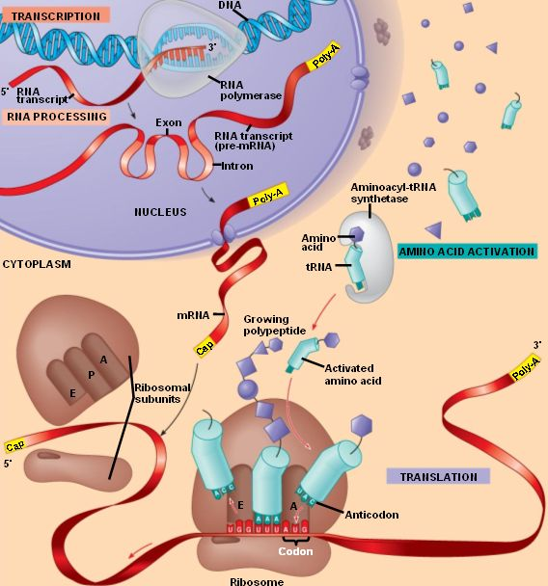

Slide 3
Use the diagram provided and make a video tracing the flow of chemical information from the gene to the protein product.
You must include a description/explanation of everything in the picture.
2 people in your group
Everyone in group must talk in video
Be sure to include important: locations, enzymes, molecules involved

Slide 4
THINGS TO INCLUDE:
Transcription (location, enzymes, steps)
Pre-mRNA editing (introns/exons/5’cap/polyA tail
Exit from nucleus
Translation (location, cell parts, RNA functions, intiation, elongation, termination, codon/anticodon, A, P, E sites)
tRNA charging
What happens next? (3D structure, modifications)
Post transcriptional regulation
Post translational regulation

