Slide 1
Talking to Animals
A Presentation by yuru zhang

Slide 2
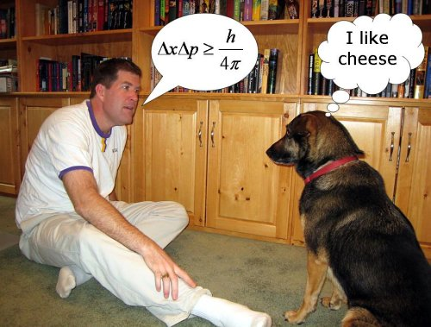
Have you ever had the feeling?
http://4.bp.blogspot.com/-TWOvm0BT7qw/Tx0wcdaY__I/AAAAAAAAEQg/kboZ5C_-phk/s1600/science-talking-dog.jpg

Slide 3
Myth or Fact?
Can we really talk to animals?
Dr. Doolittle
Communication through gestures
Telepathy???
Terri O’Hara
She’s an “animal communicator”
Happiness, sadness, joy and grief
Physical sensations
What animal communication really is…
Recognition of animal emotions through observation of behavior (eating patterns, social vs. antisocial, depression, etc.)
Stance, voice tone, body language
BowLingual

Slide 4
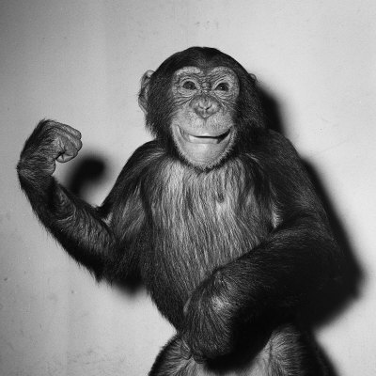
Talking To Animals

