Slide 1
Necrotizing Fasciitis
By Praneeth Babu Marella

Slide 2
Necrotizing Fasciitis
Necrotizing Fasciitis is commonly knows as the Flesh Eating Bacteria.
Necrotizing fasciitis refers to a rapidly spreading infection, usually located in fascial planes of connective tissue that results in tissue death
Most likely to occur in a person with a compromised immune system.
You are also likely to get it if you have Diabetes, Chronic Systemic Diseases and Alcohol/Drug Abuse.
Different types of bacterial infection can cause necrotizing fasciitis.

Slide 3
Necrotizing Fasciitis
The symptoms of necrotizing fasciitis include redness, swelling, and pain in the affected area. Blisters may be seen in the involved area of skin. Fever, nausea, vomiting, and other flulike symptoms are common.
Necrotizing fasciitis is treated with antibiotics, and early treatment is critical. Surgery to remove infected fluids and tissue may be necessary.

Slide 4
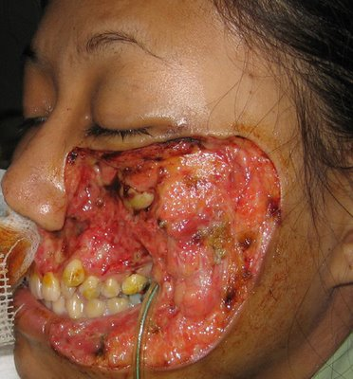
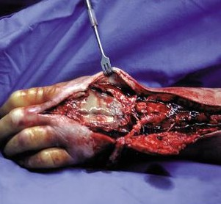
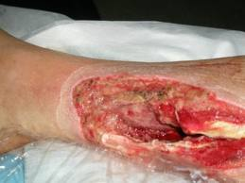
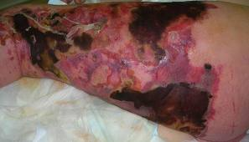
Pictures
Viewer discretion is advised some pictures maybe disturbing to the viewers

Slide 5
Sources:
http://www.dailyworldpost.com/flesh-eating-bacteria-pictures-symptoms.html
http://newzeelend.wordpress.com/2009/09/18/nz-sees-surge-in-flesh-eating-disease-cases/
http://microbiology2009.wikispaces.com/Necrotizing+fasciitis

