Slide 1
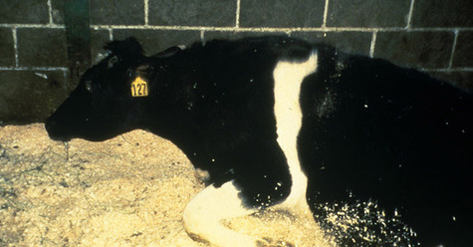
Bovine Spongiform Encephalopathy, a.k.a. “Mad cow disease”
http://media.tecca.com/2012/04/26/mm-630-mad-cow-disease-wiki-usdaaphis-475x248.jpg

Slide 2
What the butt is mad cow disease?
Mad cow disease is a fatal neurodegenerative disease in cows that results in the degeneration of tissue in the brain and spinal cord.
The disease is caused by prions—infectious, misfolded proteins. When healthy animals come into contact with prions, their normal proteins are deformed into the infectious prions. A build-up of prions creates masses of plaque fibers in the brain, causing holes to form.
Mad cow disease is typically transmitted via ingestion. Livestock consume feed with animal byproduct additives. These additives—ranging from cow blood to restaurant scraps to chicken feces—contain the infectious prions.
Due to more relaxed feed regulations, over 183,000 of the nearly 189,000 verified cases of mad cow disease have occurred in the U.K. One hundred seventy-six of the 280 cases of variant Creutzfeldt-Jakob disease—the human analogue of mad cow disease—also occurred in the UK.

Slide 3
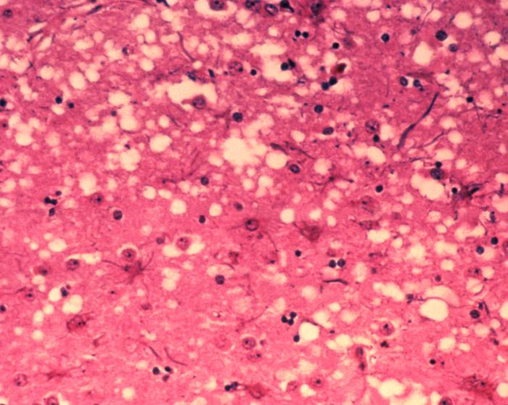
Say what?
http://en.wikipedia.org/wiki/File:Aphis.usda.gov_BSE_5.jpg

