Slide 1
The Love Canal
By Albert Wu

Slide 2
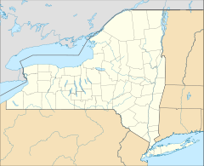
Origins of the Love Canal
Located in Niagara Falls, New York
Meant to be a hydroelectric canal designed by William Love in 1890s
Never finished
Location of Love Canal
http://en.wikipedia.org/wiki/File:USA_New_York_location_map.svg

Slide 3
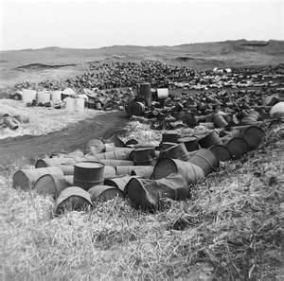
Chemical Waste Dumping
Later became a chemical dumpsite
Bought by Hooker Chemical Company
In 1953, it was sold to the city for one dollar
Love Canal dumping site
http://kimberlygerson.com/wp-content/uploads/2011/06/LoveCanal001.jpg

Slide 4
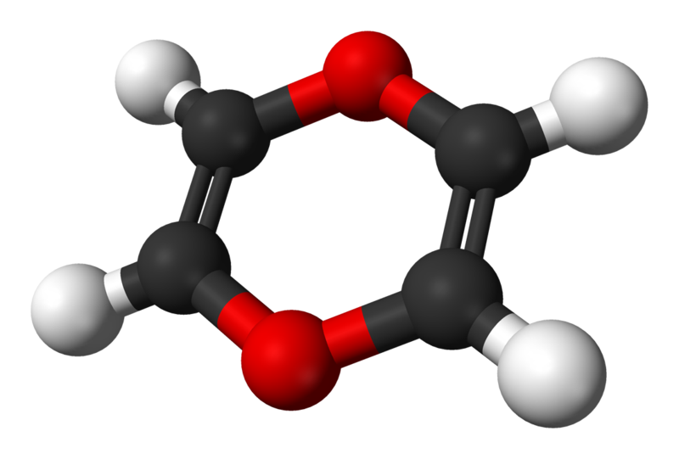
The Love Canal Tragedy
About 100 homes and a school were built.
Soon, abnormal numbers of birth defects and miscarriages began to occur.
An emergency was declared in 1978, evacuation began.
1979 tests on survivors showed chromosome damage.
Dioxin, a carcinogen found in the Love Canal.
http://en.wikipedia.org/wiki/1,4-dioxin

Slide 5
Sources
http://en.wikipedia.org/wiki/Love_Canal
http://www.epa.gov/aboutepa/history/topics/lovecanal/01.html
http://arts.envirolink.org/arts_and_activism/LoisGibbs.html

