Slide 1
Chernobyl
What happened at Chernobyl?

Slide 2
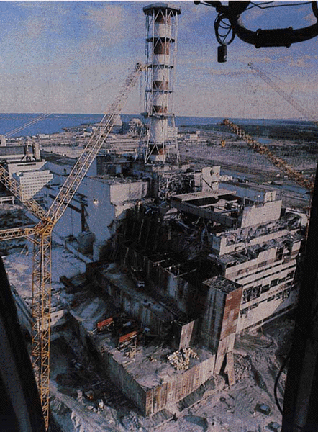
Chernobyl Meltdown
This was a power plant and one of the nuclear reactors.
This happened in the Ukraine and the explosion was massive, yet the press and the plant said that this was not a big deal.
This released radiation and is responsible for a lot of mutations

Slide 3
What happened!
An engineer took over and performed an experiment and he backed down all of the safety mechanisms to perform this.
They were trying to see if they could sustain the nuclear reactor with less mechanisms, in other words just water.
When they did back everything down, the plant got a call and said that they had to power the grid for a while.
They did and then the reactor’s power was dropping down so they removed the water and then the reactor started to rise and go out of control.
They then stuck in the 2 graphite moderator rods and the water.
Doing this the reactor exploded with a gigantic heat wave and resulting in the nuclear blast.

Slide 4
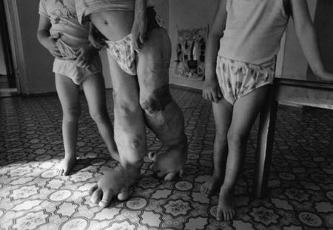
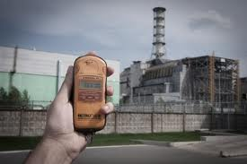
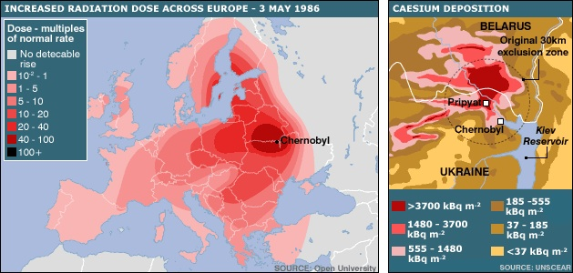
The After Effects

Slide 5
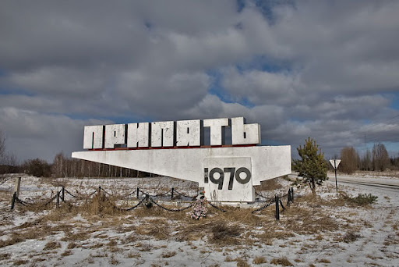
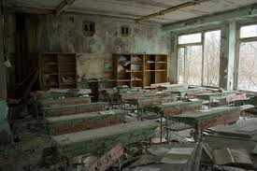
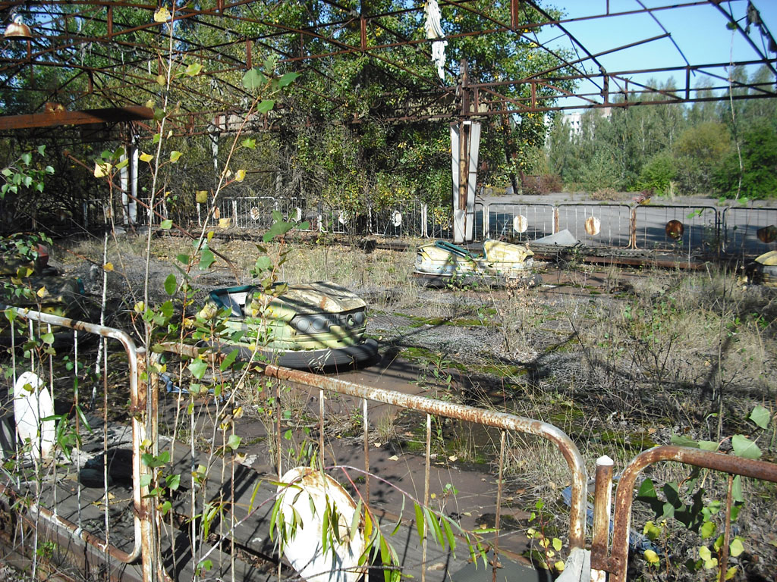
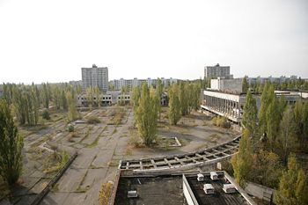
Today

