Slide 1
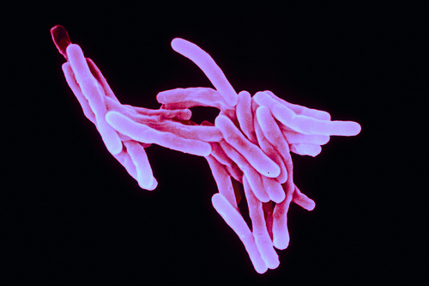
Antibiotic Resistant Bacteria
http://wellcometrust.files.wordpress.com/2011/03/tb-bacilli.jpg
Laurelle Anderson

Slide 2
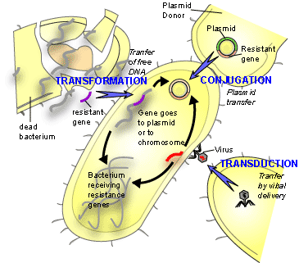
How It Happened
Antibiotic resistant genes are passed from cell to cell using transfomation, conjugation, and transduction (non-reproductive ways of passing genes
Evolutionary pressure from antibiotics causes gene to be preferred
Antibiotic resistant TB formation
http://textbookofbacteriology.net/themicrobialworld/bactresanti.html

Slide 3
Examples
Methicillin-Resistant Staphylococcus Aureus (golden staph)
Vancomycin-Resistant Enterococcus (VRE)
Multi-Drug-Resistant Mycobacterium Tuberculosis (MDR-TB)

Slide 4
Effect on People
Creates super bugs/super bacterium

Slide 5
Bibliogarphy
http://www.betterhealth.vic.gov.au/bhcv2/bhcarticles.nsf/pages/Antibiotic_resistant_bacteria?open
http://en.wikipedia.org/wiki/Antibiotic_resistance
http://www.pnas.org/content/91/7/2428.full.pdf

