Slide 1
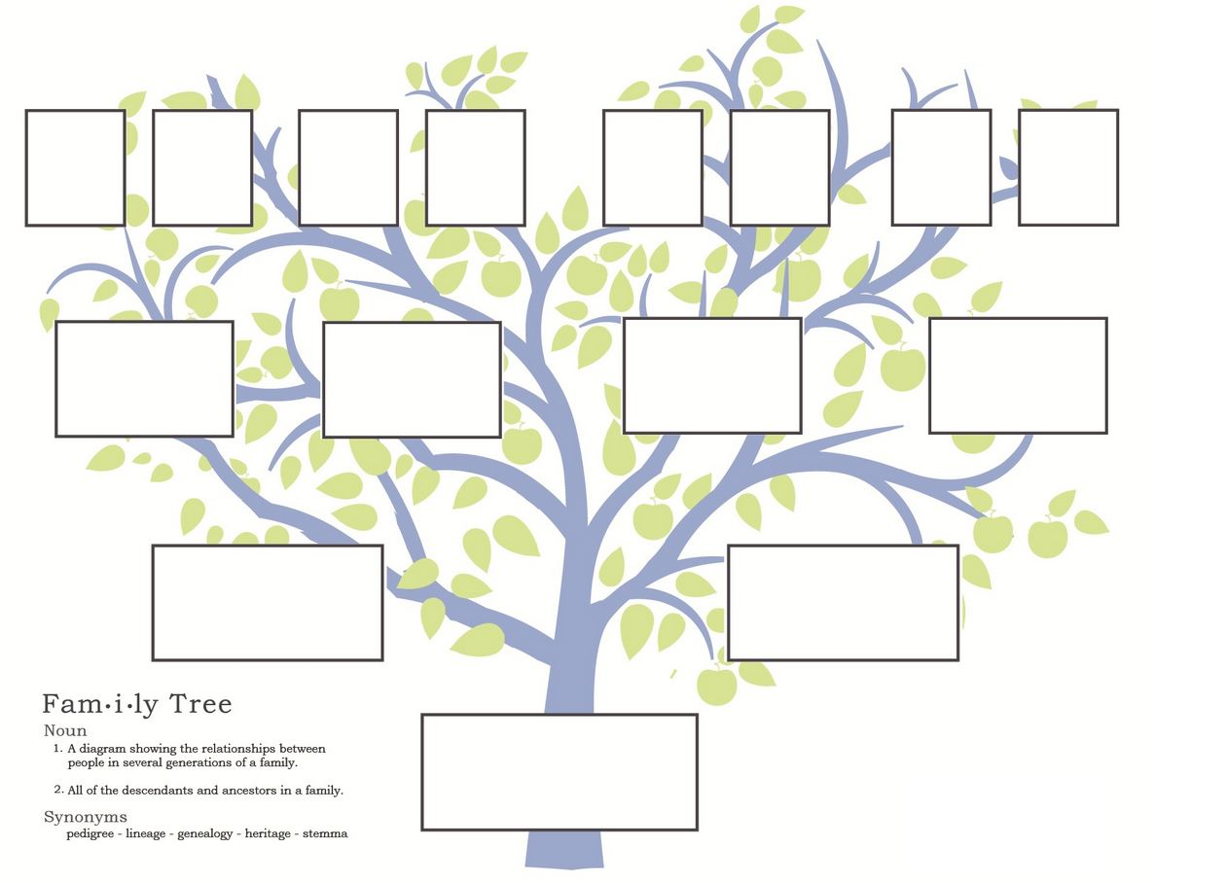
Riedell/Davis Family Tree
This slide show has links to many documents/pictures. Click on the links next to the numbers on each slide in sequence to follow the family tree and see the links.

Slide 2
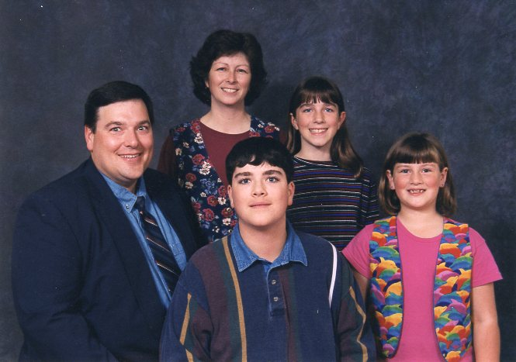
5
Walter Edwin Riedell, Jr
b. 4/20/1955 Berwyn, IL
1
Michael Davis Riedell
b. 10/29/1983 Carbondale, IL
4
Married: 7/19/1980 Rockford, IL
2
Rebecca Linn Riedell b. 1/5/1986 Peoria, IL
3
Sarah Anne Riedell
b. 8/4/1989 Sioux Falls, SD
6
Kelly Jo Davis
b. 2/2/1956 Rockford, IL

Slide 3
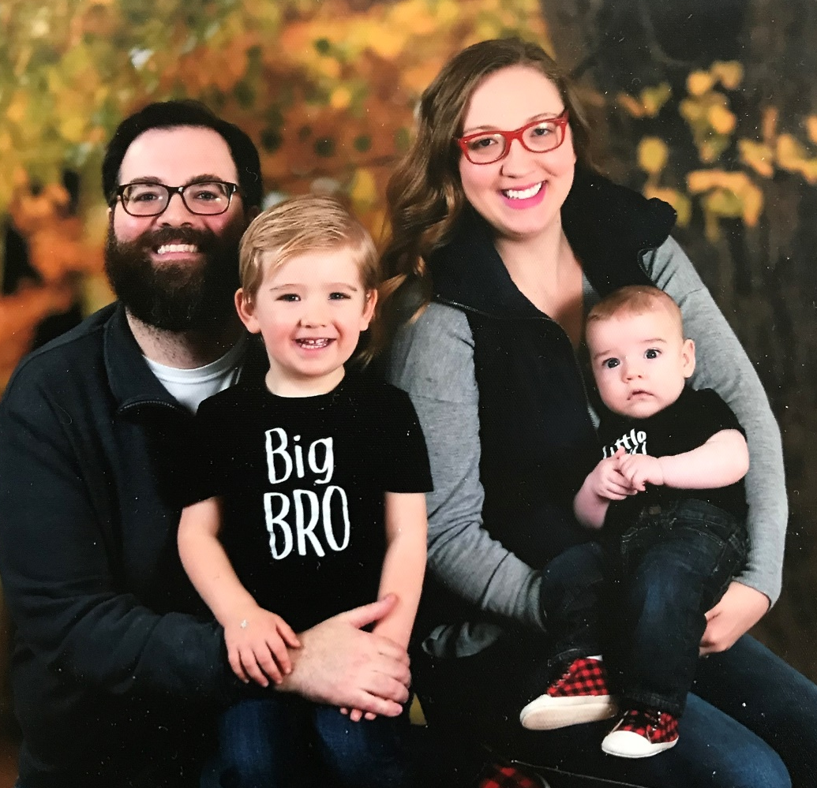
Michael Davis Riedell
b. 10/29/1983 Carbondale, IL
1
Abraham Davis Riedell
b: 1/16/2016 Arlington, VA
Married: 5/1/2014 Arlington, VA
2
Archer Louis Riedell
b. 7/12/2018 Frankfort am Main Germany
Sarah Louise Manthey b. 2/20/1987
BACK TO
RIEDELL/DAVIS FAMILY TREE

Slide 4
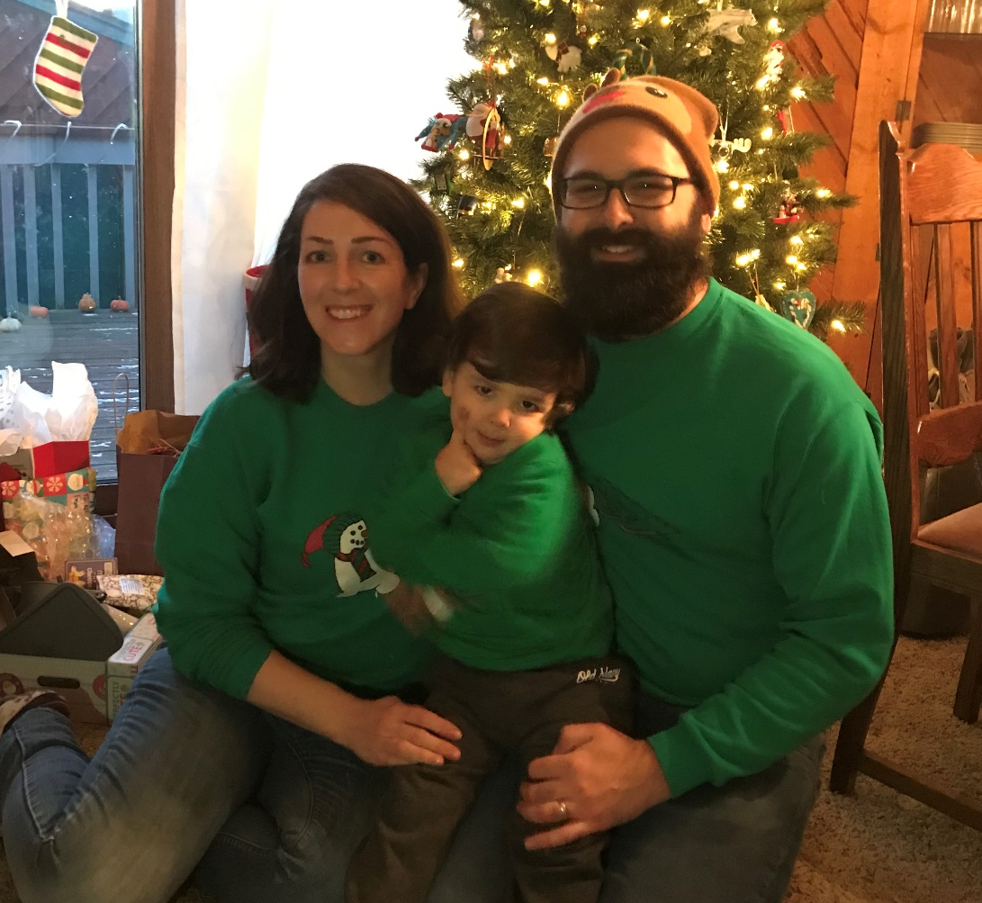
3
Royce Trevlin Faircloth III b. 2/8/1983 Madison, SD
Married: 6/9/2012 Minneapolis, MN
2
Leighton Wakefield Faircloth
b. 2/24/2016 Minneapolis, MN
Rebecca Linn Riedell b. 1/5/1986 Peoria, IL
1
1
BACK TO
RIEDELL/DAVIS FAMILY TREE

Slide 5
Royce Trevlin Faircloth Sr b.
Royce Trevlin Faircloth Jr b.
Royce Trevlin (Trey) Faircloth III b. 2/8/1983 Madison, SD ?
Gretchen Hills b. 9/11/ ?
BACK TO RIEDELL/FAIRCLOTH FAMILY TREE

Slide 6
3
Walter Edwin Riedell, Sr
b: 6/28/1921 d: 2/12/2012
Chicago, IL LaGrange, IL
Susanne Gail Riedell b: 1/1/1947 Chicago, IL
Janet Lynn Riedell b. 11/27/1950 Berwyn, IL
Married: 1/29/1944
2
Carolyn Beth Riedell
b. 12/29/1952 Berwyn, IL
Walter Edwin Riedell, Jr
b. 4/20/1955 Berwyn, IL
4
1
LaVerne Lillian Suva
b: 9/30/1923 d:8/27/1997 Hinsdale, IL

Slide 7
Gustave Riedel
b: 1865 d:1941
2nd “L” added to Riedell
by Clara Groess Riedell
2
Otto Walter Riedel b: 4/27/1899 d: 1945
Chicago, IL
Anna Dornquast
b: 1866 d: 1905
1
Walter Edwin Riedell S b: 6/28/1921
Chicago, IL
d: 2/12/2012 LaGrange, IL
Married: 6/2/1920
3
Clara Madeline Groess b: 7/25/1895 d: 12/4/1984 Cicero, IL

Slide 8
Frederich Groess
b: near Hapsburg
Clara Madeline Groess
b: 7/25/1895 d: 12/4/1984
Henry Peters
Ida Peters
Carolyn Last ?
BACK TO RIEDELL/SUVA FAMILY TREE

Slide 9
2
Louis Thomas Suva b. 7/22/1895 d: 11/14/1978
LaVerne Lillian Suva
b: 9/30/1923 d: 8/27/1997 Berwyn, IL
1
Married: 9/10/1921
3
Lillian Barbara Hurt b: 7/13/1898 d: 8/5/1996 Chicago, IL

Slide 10
Joseph Suva
Frank Suva
b: 1867 d: 1911?
?
Louis Thomas Suva b. 7/22/1895
d: 11/14/1978
Thomas Hasek
Josephine Hasek
b
Mary ?
BACK TO SUVA/RIEDELL FAMILY TREE

Slide 11
1
Frank Hurt
b. 3/21/1869 d: 6/24/1957
John Divis
Lillian Barbara Hurt b: 7/13/1898
d: 8/5/1996 Chicago, IL
Vaclac (James) Divis b: 1826
Katherine Kuchvalek
1
Barbara Divis
b: 12/3/1872 Trebon Czechoslovakia
d: 7/2/1940
Antonin Prokes
Josephine Prokes (2nd wife)
Theresa Hanus
2
BACK TO DAVIS/RIEDELL FAMILY TREE

Slide 12
Frank Suva
b: 1867 d: 1911?
Louis Thomas Suva b. 7/22/1895 d: 11/14/1978
Josephine Hasek
b: 1873? d: 1948
LaVerne Lillian Suva
b: 9/30/1923
d:8/27/1997
Married:
Frank Hurt b: 3/21/1869 d: 6/24/1957 Czechoslovakia
Lillian Barbara Hurt b: 7/13/1898 d: 8/5/1996 Chicago, IL
Barbara Divis b: 12/3/1872 d: 7/2/1940 Trebon Czechoslovakia
BACK TO TREE

Slide 13
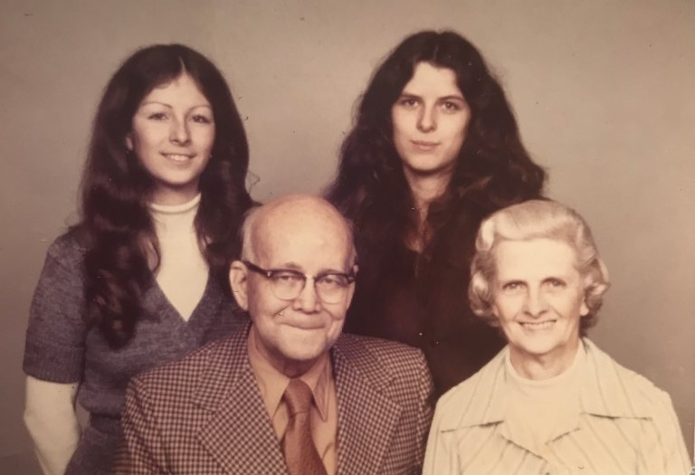
5
Robert Gibson Davis
b. 4/6/1898 d: 2/1/1978 Grafton, WV Rockford, IL
2
3
Kelly Jo Davis
b. 2/2/1956 Rockford, IL
1
4
Married: 8/10/1954
Barbara Louise Davis
b. 2/7/1957 Rockford, IL
8
Josephine Louise O’Donnell (2nd wife) b. 12/15/1914 d: 2/15/1994 Rockford, IL Brookings SD
6
7
9
Pictures and Documents

Slide 14
3
Nathan Davis b:10/21/1833 Virginia d: 1/16/1919
1
Gibson Linn Davis b: 10/19/1867 Taylor County WV d: 12/6/1907 Monongah Mine disaster
Married: 8/4/1852
Robert Gibson Davis
Sarah Henderson b. 12/20 /1834 Marion County WV
d: 12/29/1911
Married: 4/16/1825
Elijah Gough
2
Mary Alice (Molly) Gough b: 2/10/1872 Taylor County WV
d:

Slide 15
Traveled from Ireland to Mexico in 1771 Came to US Westmorland, PA in 1777 Fought in Revolutionary War
William Linn I b. Jan 30, 1734 Near Belfast, Ireland d. Dec 23, 1808 Monongalia County WV
Sarah Linn b. 1787 Monongalia County WV d. Nov 11, 1873 Marion County WV
Nathan Davis 10/21/1833 Virginia
Isabella Gibson (2nd wife) b. Oct 1761 in Ireland came to USA 1784/85 d. Feb 24, 1834 Monongalia County WV
Married: 4/16/1825
William Henderson b. 1804 Monongalia County WV
d. Dec 9, 1864 Marion County WV m. Apr 16, 1825 Morgantown
BACK TO O’DONNELL/DAVIS FAMILY TREE

Slide 16
James O’Donnell b: Oct 1882 Donmore Galway Ireland d:
John Charles O’Donnell b. 7/1853 Donmore Galway Ireland
d: 1/7/1907 Fall River MA
Bridget Walsh b: Donmore Galway Ireland d: April 1891 Fall River MA
William Joseph O’Donnell b. 4/5/1885 Fall River MA
d: 8/24/1947 Rockford IL
John Porter b: England
Emily Porter
b: 8/27/1858 d: 4/28/1932 Oldham England
Margaret Conlon b: Clare Ireland d: Sept 1907
BACK TO TREE

Slide 17
William Joseph O’Donnell
b. 4/5/ 1885 d: 8/24/1947 Fall River MA Rockford, IL
Josephine Louise O’Donnell
b. 12/15/1914 d: 2/15/1994 Rockford, IL Brookings, SD
Married: 10/8/1913 Sandusky MI
Robert Porter O’Donnell b: 11/22/1916 d: 1/6/194 Rockford, IL San Diego, CA
Lottie May Kelly b. 11/19/1887 d: 12/14/1977 Tyre, MI Rockford, IL

Slide 18
Adam Kelly
Freeman Edgar Kelly b. 8/28/1861
d: 3/21/1944
Augusta Trainor
Lottie Mae Kelly b. 11/19/1887
d: 12/15/1977 Rockford, IL
Joseph Grow
Josephine Grow
b: 5/31/1868
d: 8/8/1914
Mary Ann Morningstar
BACK TO O’Donnell/Kelly TREE

Slide 19
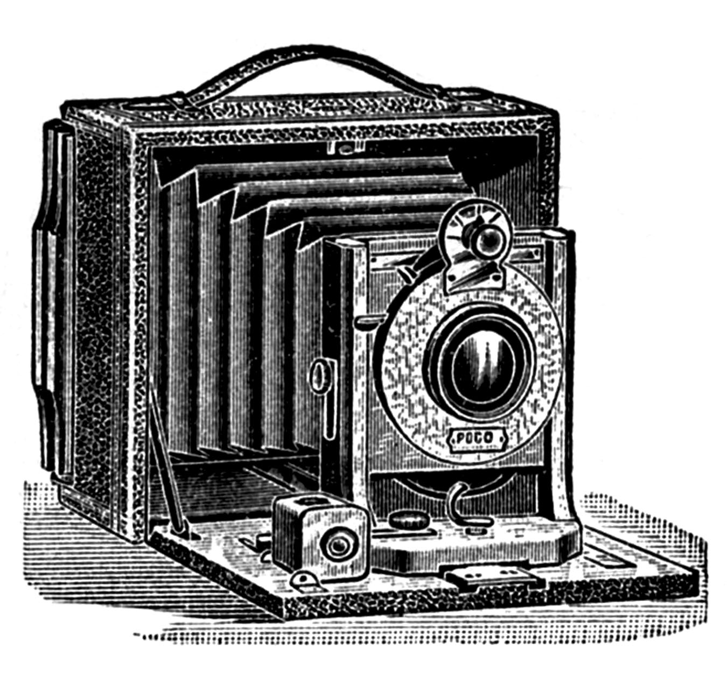
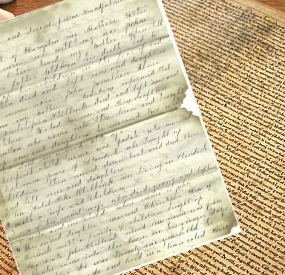
PICTURES & DOCUMENTS

Slide 20
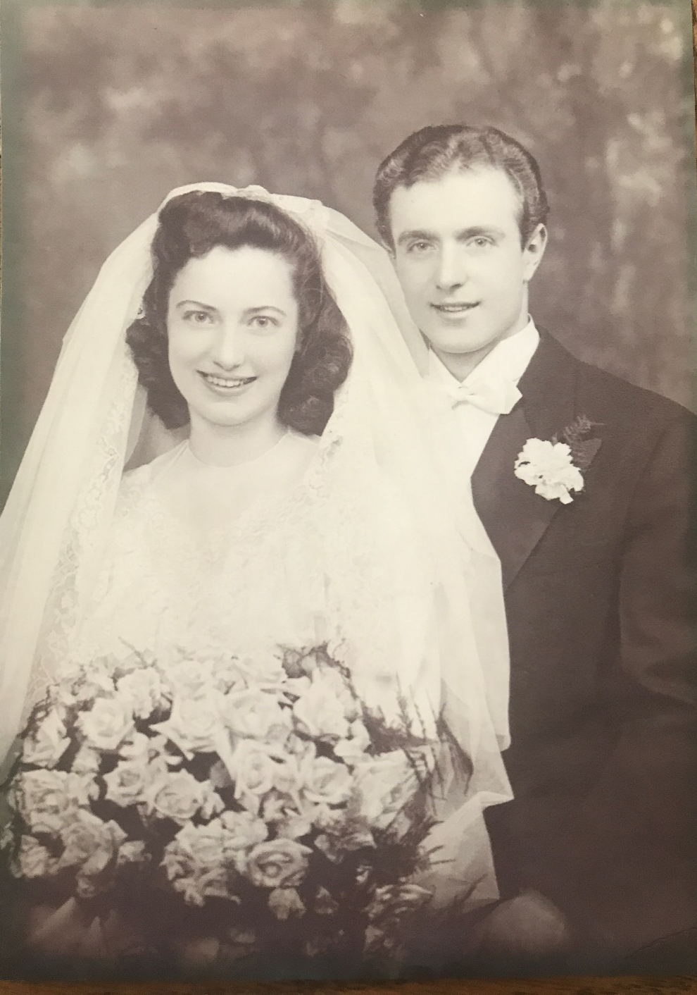
LaVerne Lillian Suva and Walter Edwin Riedell, Sr
Married: Jan 29, 1944
BACK TO RIEDELL/SUVA FAMILY TREE

Slide 21
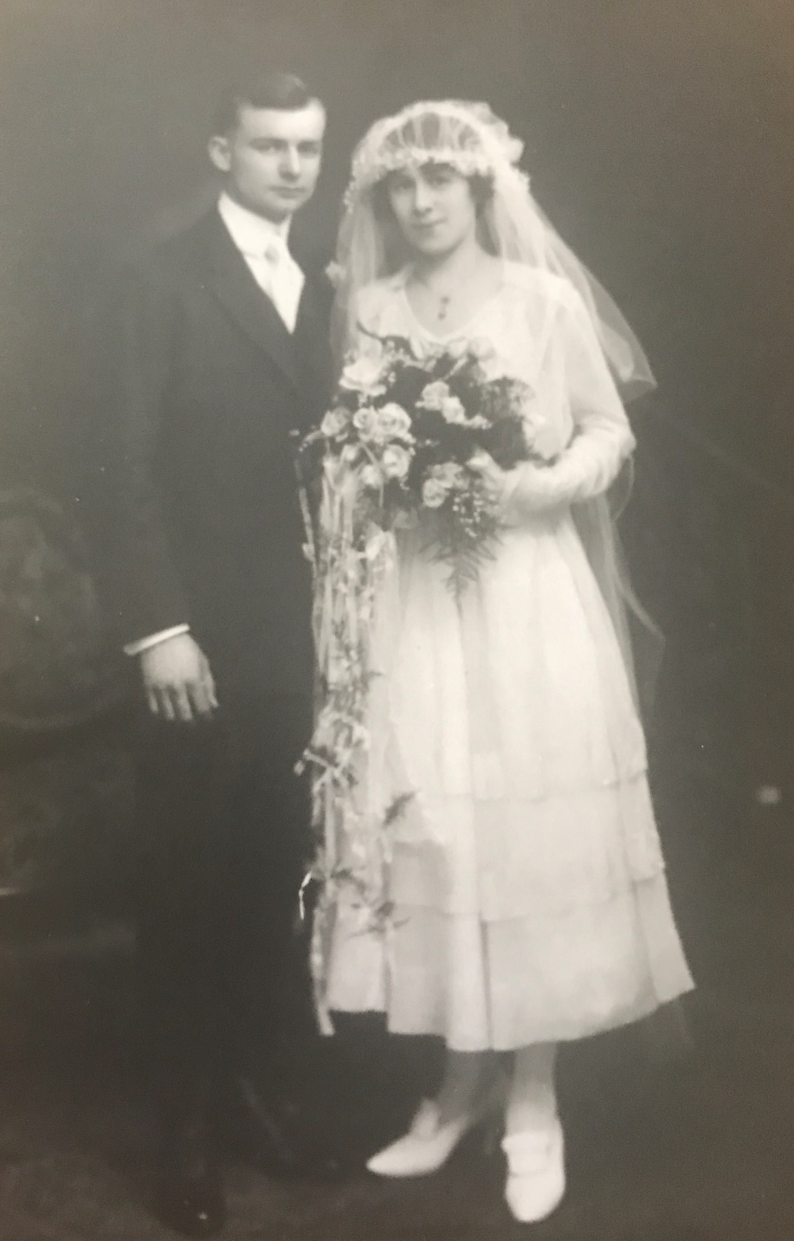
Clare Madeline Groess and Otto Riedell
Married: June 2, 1920 Chicago, IL
BACK TO GROESS/RIEDELL FAMILY TREE

Slide 22
Otto Riedell-Draft Registrations
WW I
WW II
BACK TO GROESS/RIEDELL
FAMILY TREE

Slide 23
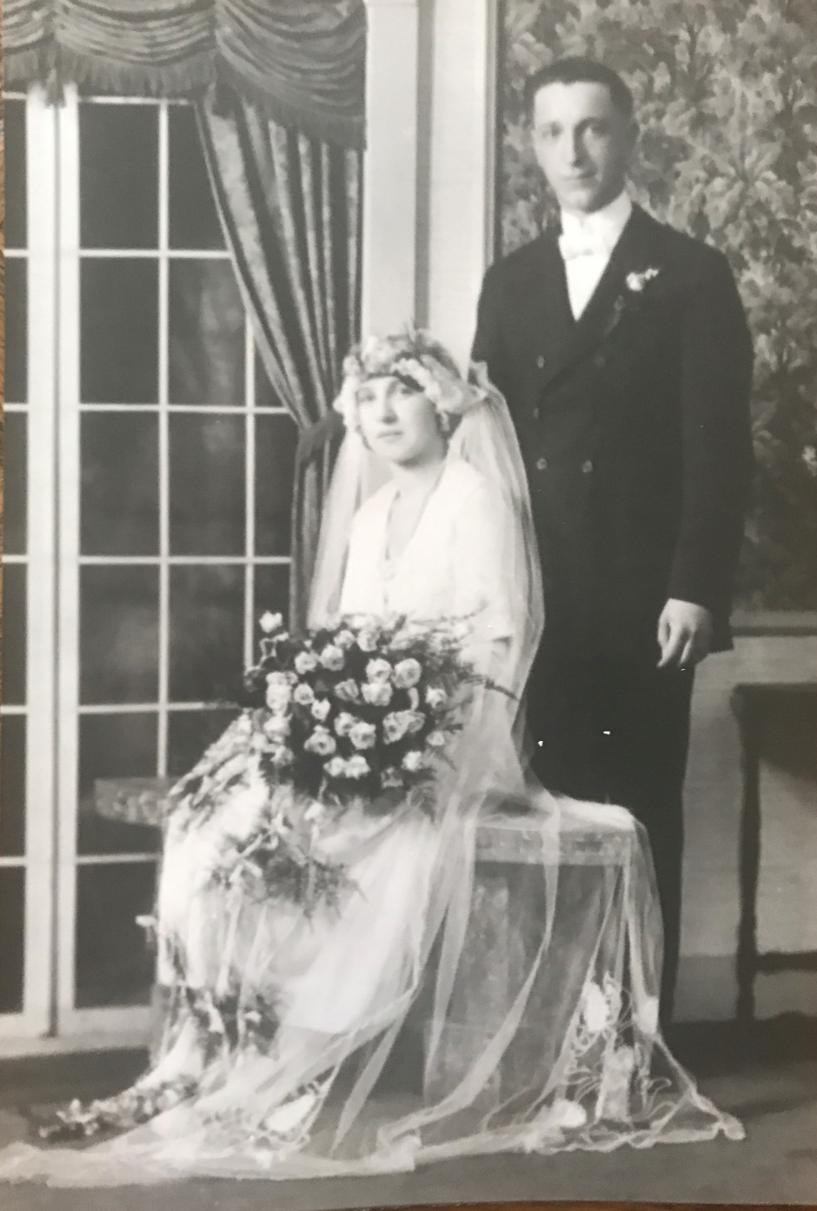
Lillian Barbara Hurt and Louis Thomas Suva
Married: 9/10/1921
BACK TO HURT/SUVA FAMILY TREE

Slide 24
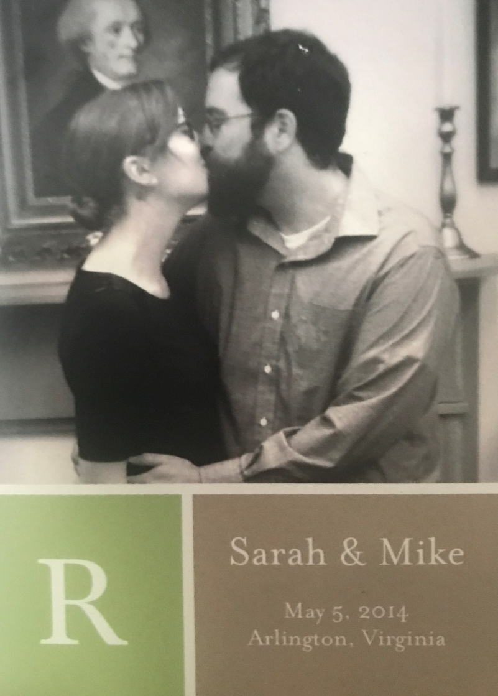
Michael Davis Riedell & Sarah Louise Manthey
Married: 5/1/2014 Arlington, VA
BACK TO RIEDELL/MANTHEY FAMILY TREE

Slide 25
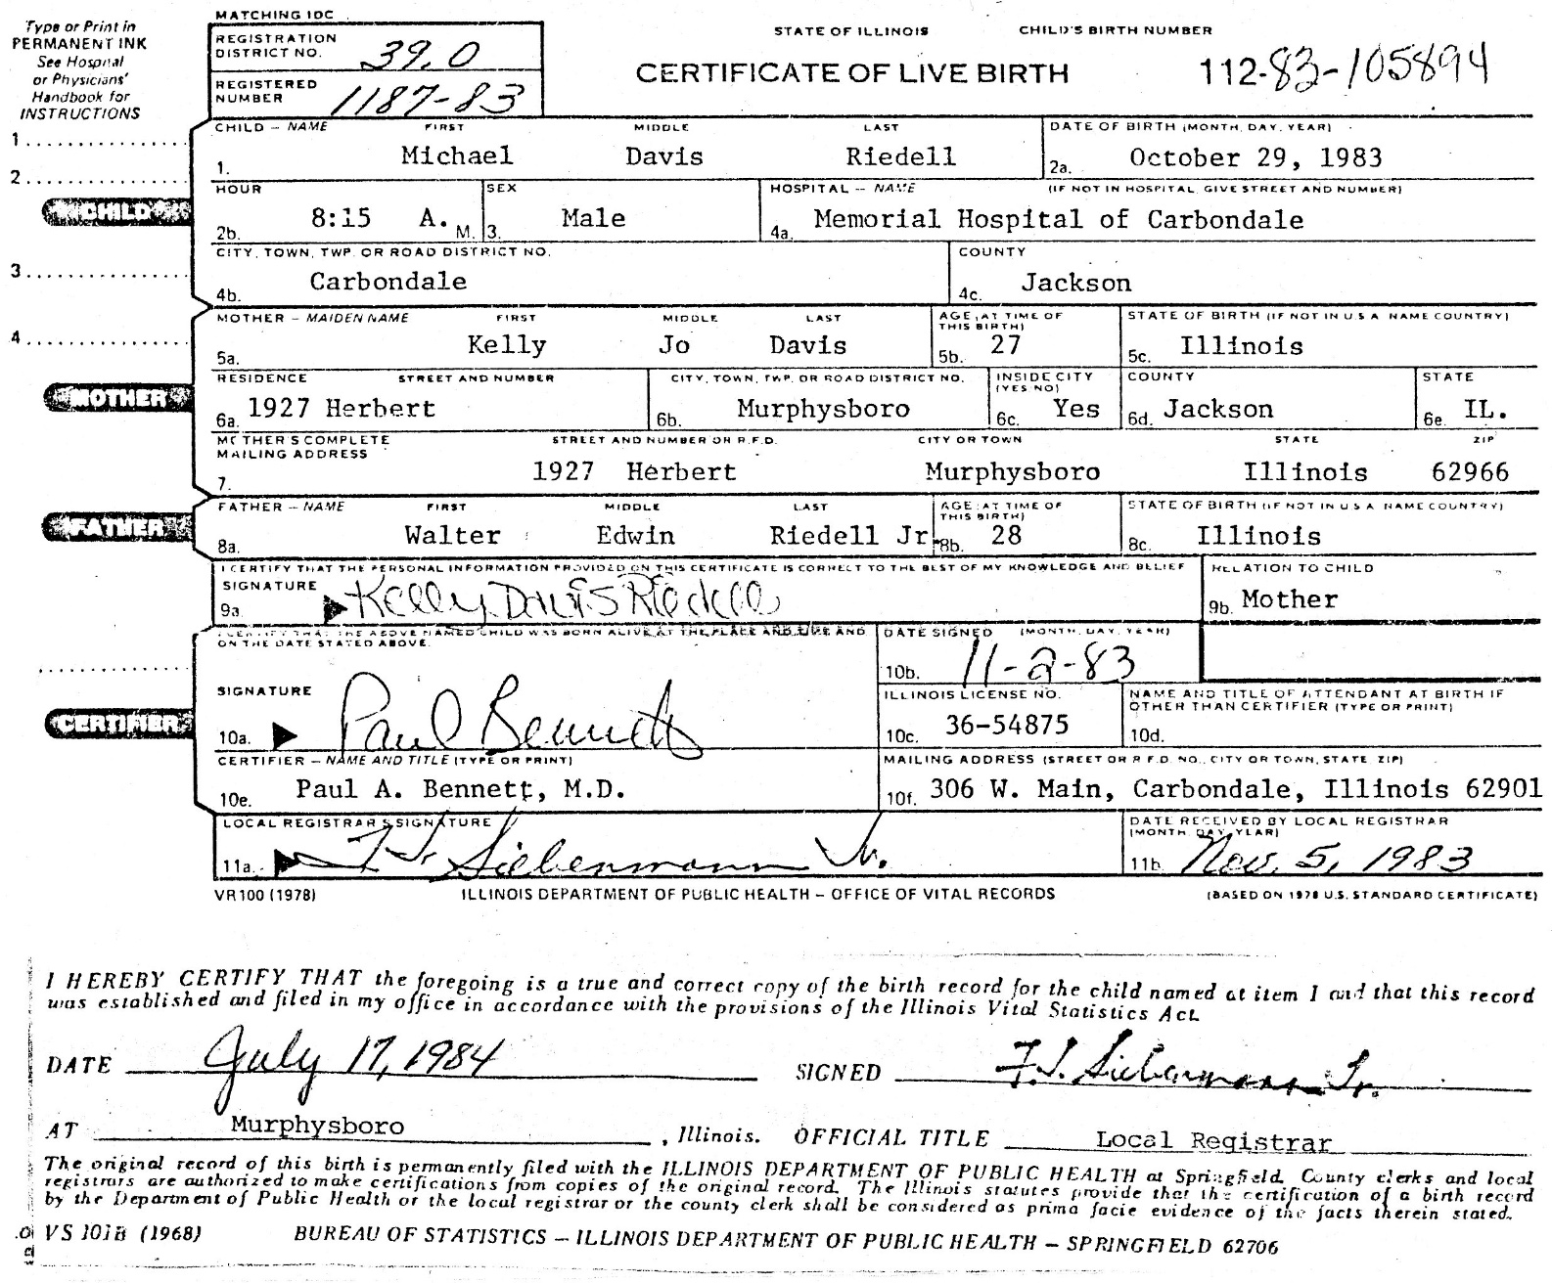
MICHAEL RIEDELL-Birth Certificate
Hospital Birth Certificate

Slide 26
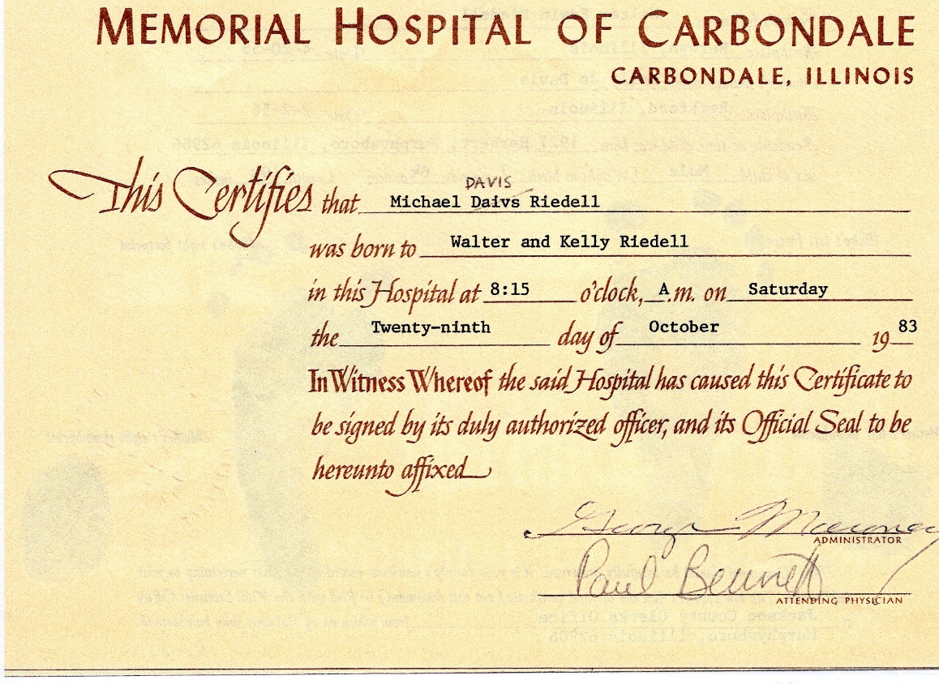
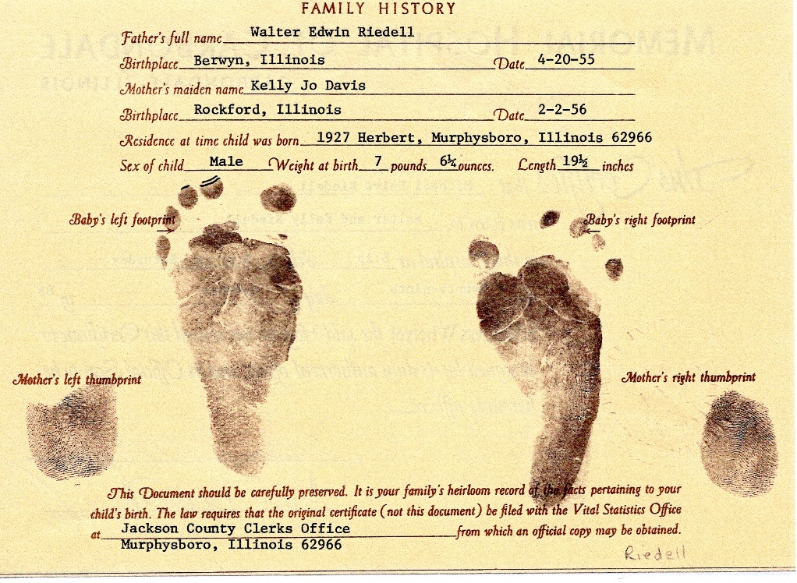
MICHAEL DAVIS RIEDELL
Birth certificate
Baptism certificate

Slide 27
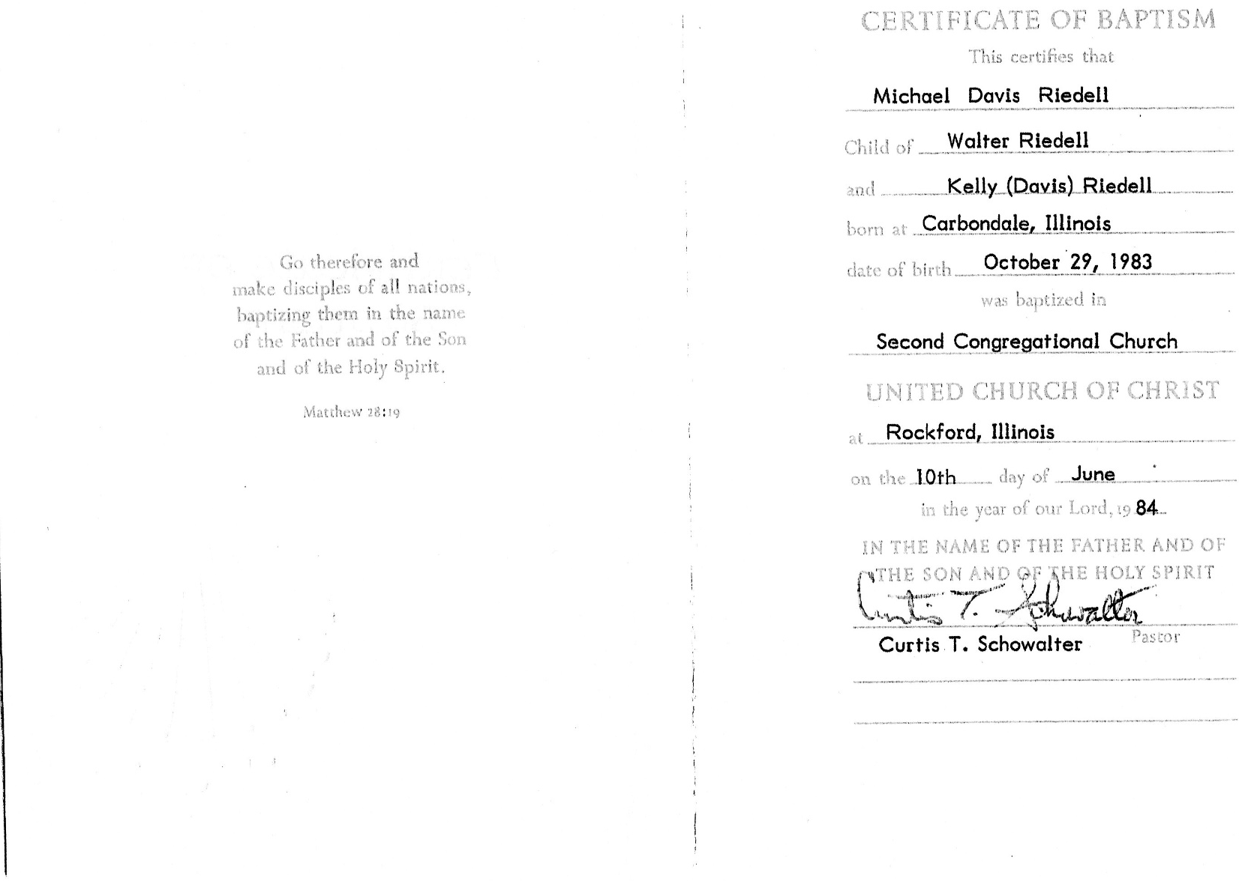
MICHAEL DAVIS RIEDELL
Baptism certificate
BACK TO DAVIS/RIEDELL FAMILY TREE

Slide 28
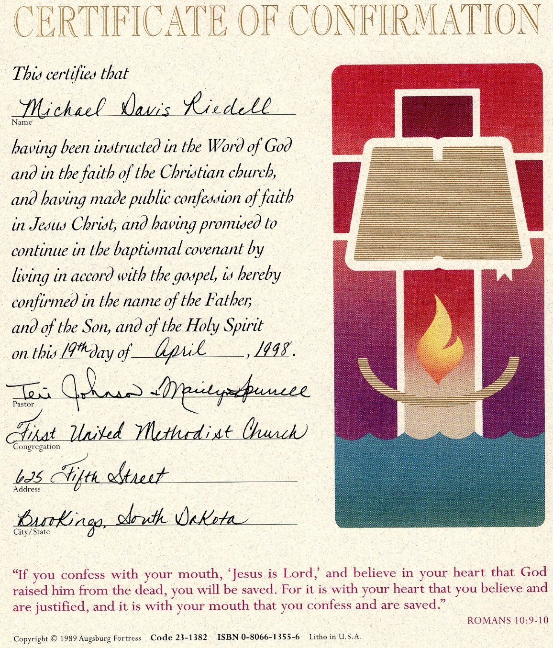
MICHAEL DAVIS RIEDELL
BACK TO DAVIS/RIEDELL FAMILY TREE

Slide 29
Rebecca Linn Riedell & Royce Trevlin (Trey) Faircloth III
Married 6/9/2012
Minneapolis, MN
BACK TO RIEDELL/FAIRCLOTH FAMILY TREE

Slide 30
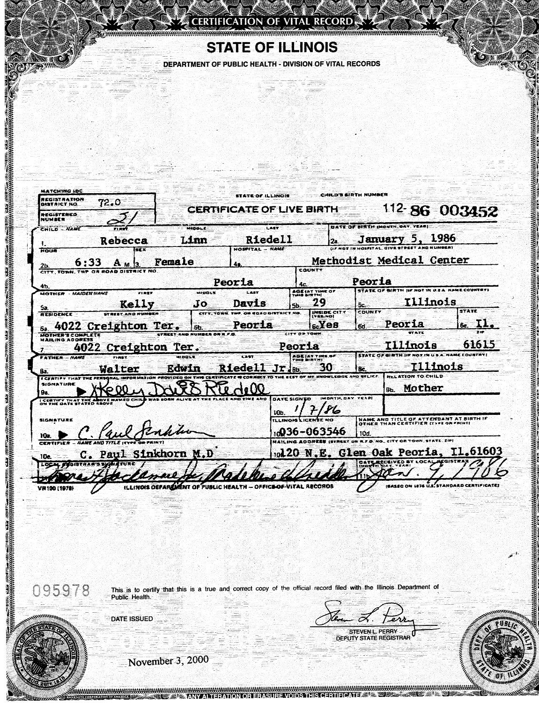
REBECCA LINN RIEDELL
Birth certificate
Hospital Birth Certificate

Slide 31
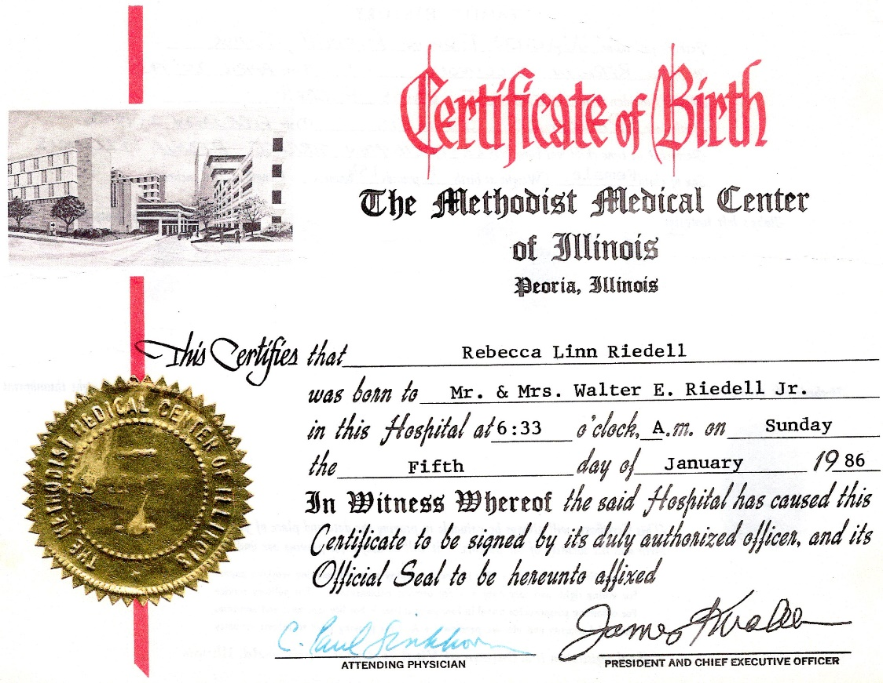
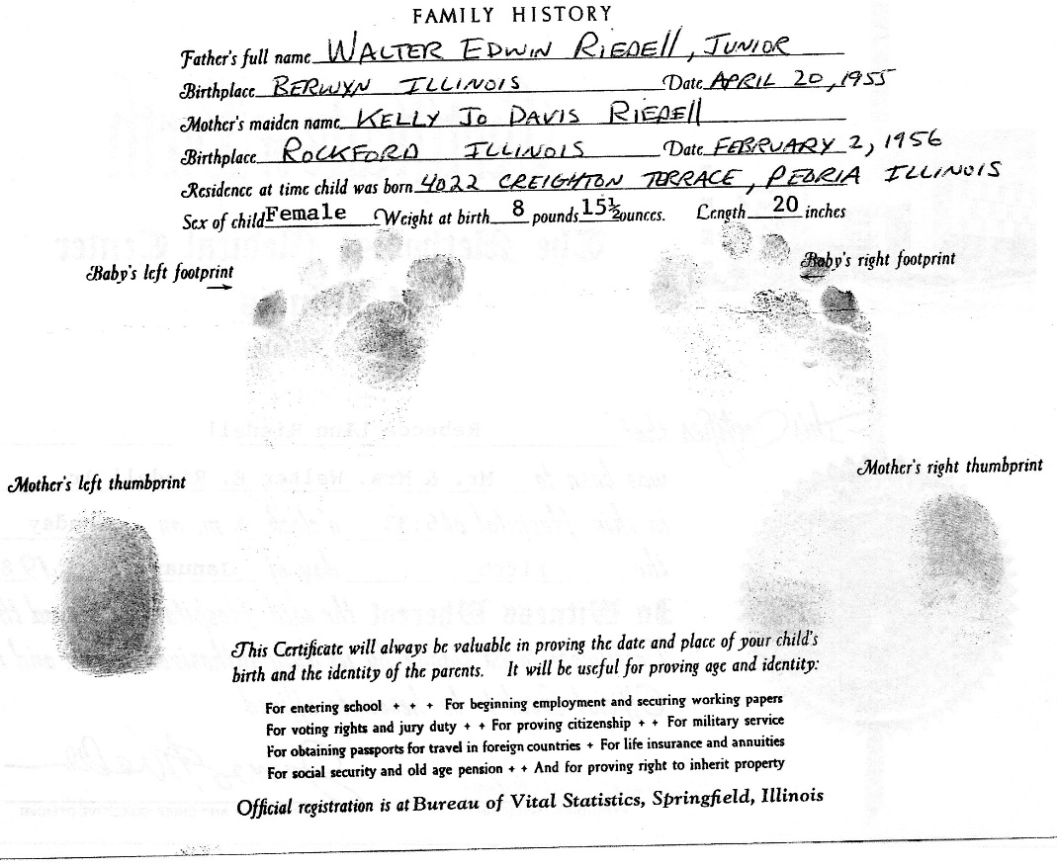
REBECCA LINN RIEDELL
Hospital Birth certificate
Baptism certificate

Slide 32
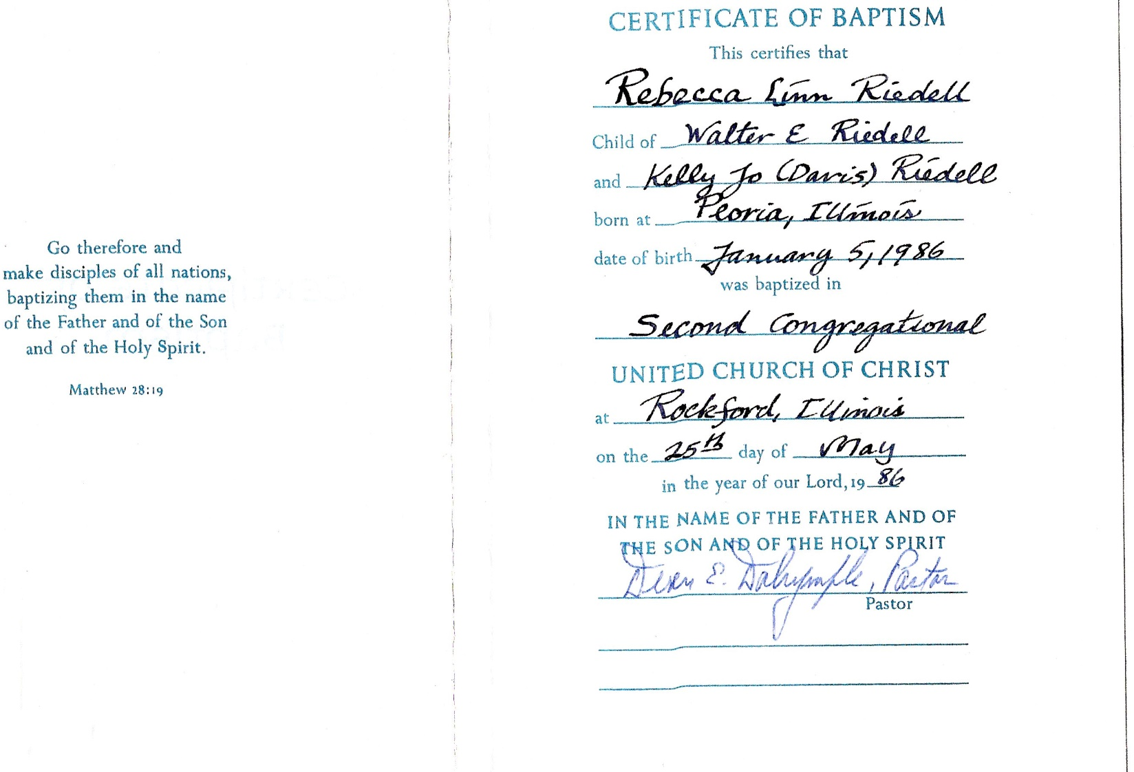
REBECCA LINN RIEDELL
Baptism certificate
Confirmation certificate

Slide 33
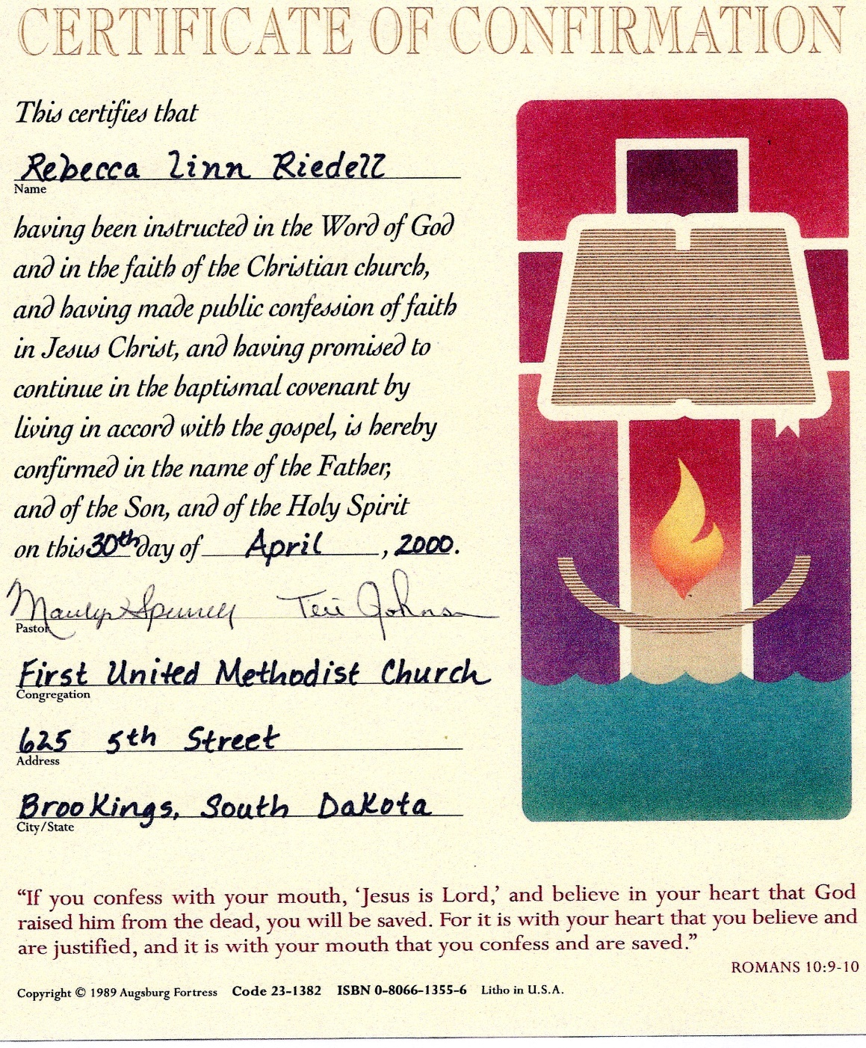
REBECCA LINN RIEDELL
BACK TO FAIRCLOTH/RIEDELL FAMILY TREE

Slide 34
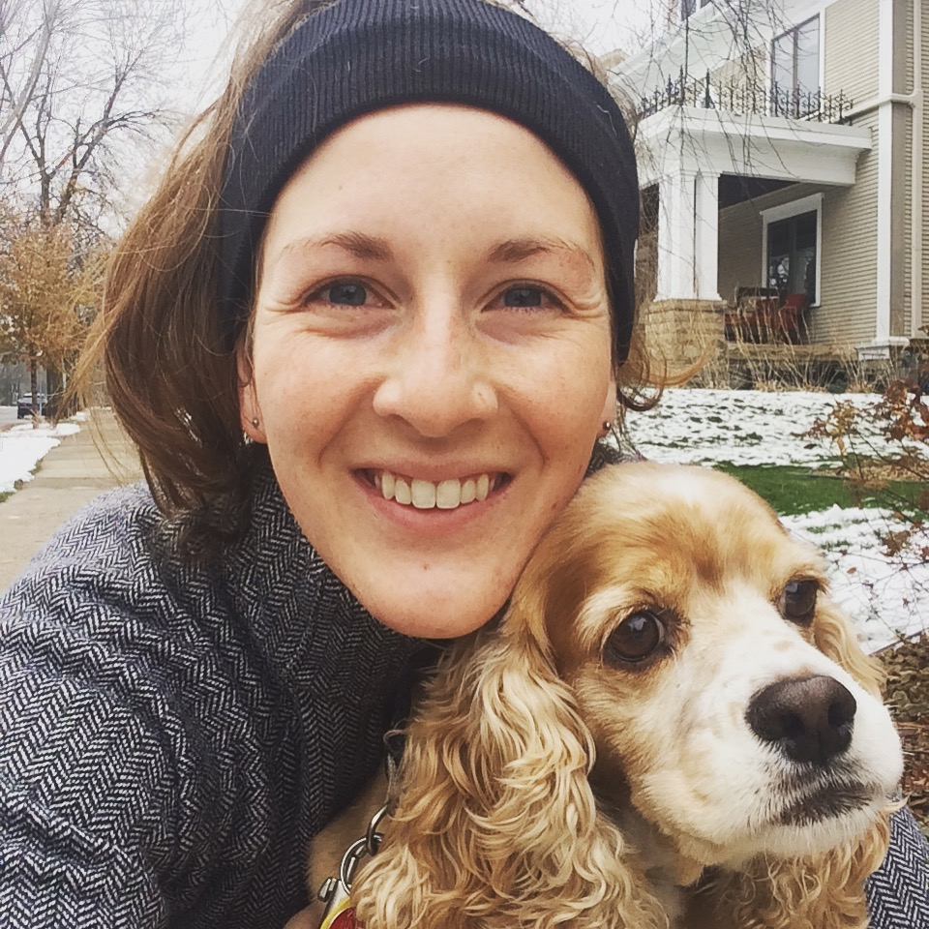
Sarah Anne Riedell & Lola
Birth certificate

Slide 35
SARAH ANNE RIEDELL
Birth certificate
Hospital birth certificate

Slide 36
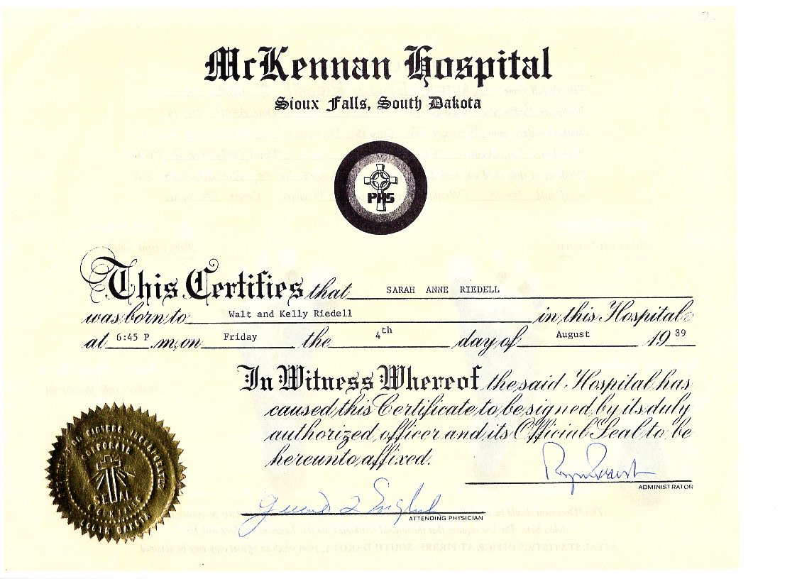
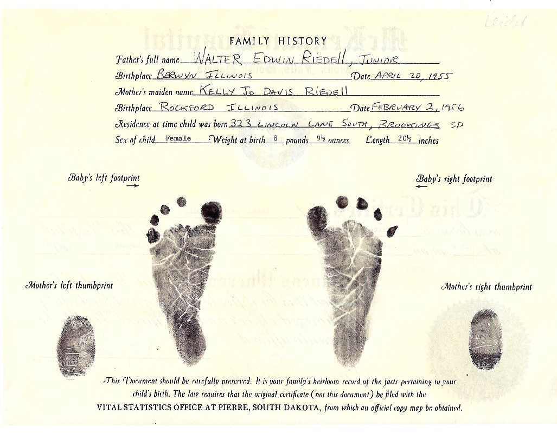
SARAH ANNE RIEDELL
Hospital Birth certificate
Baptism certificate

Slide 37
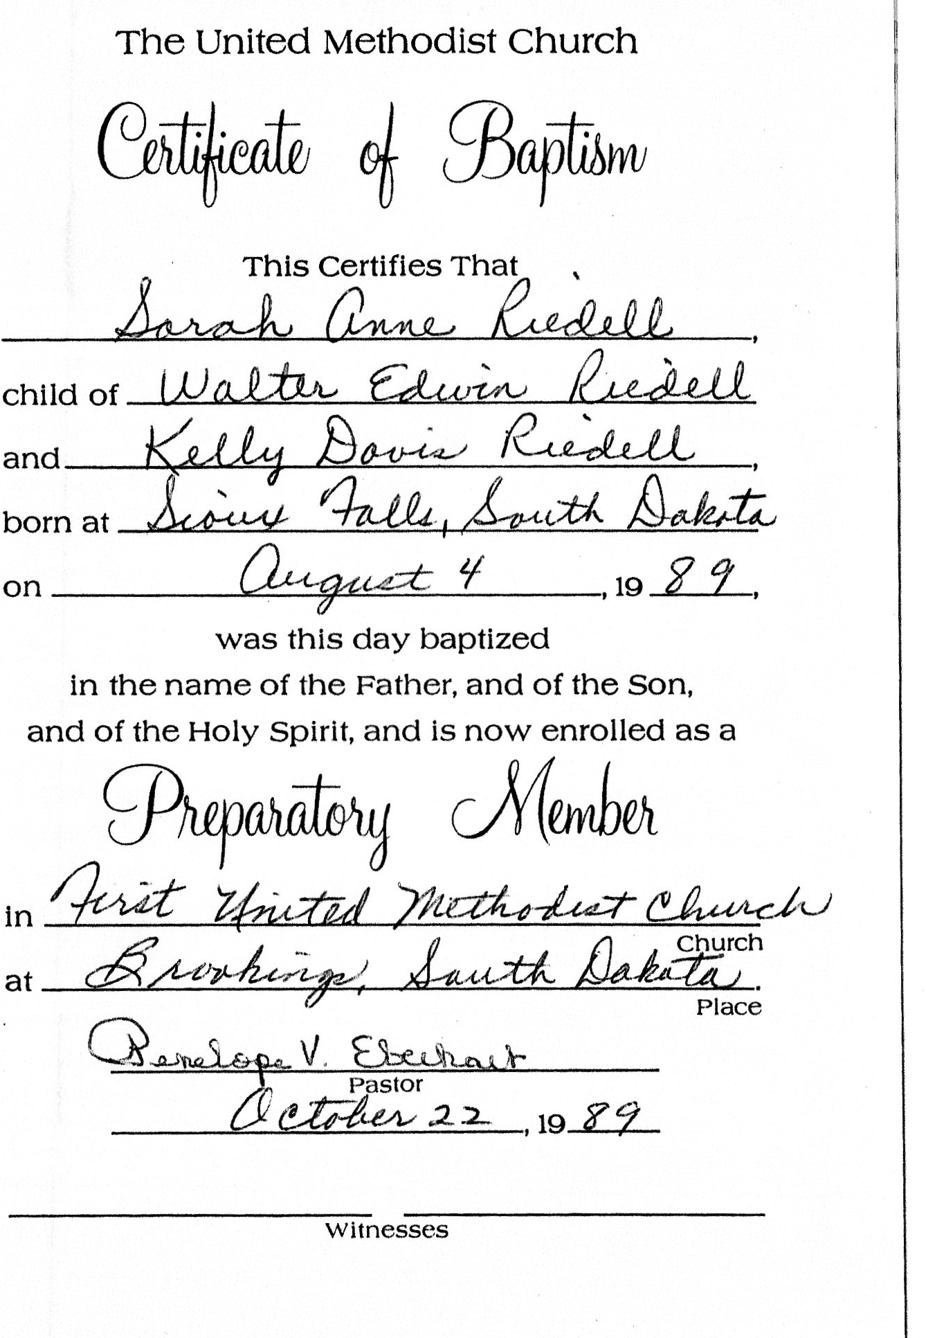
SARAH ANNE RIEDELL
Baptism certificate
Confirmation certificate

Slide 38
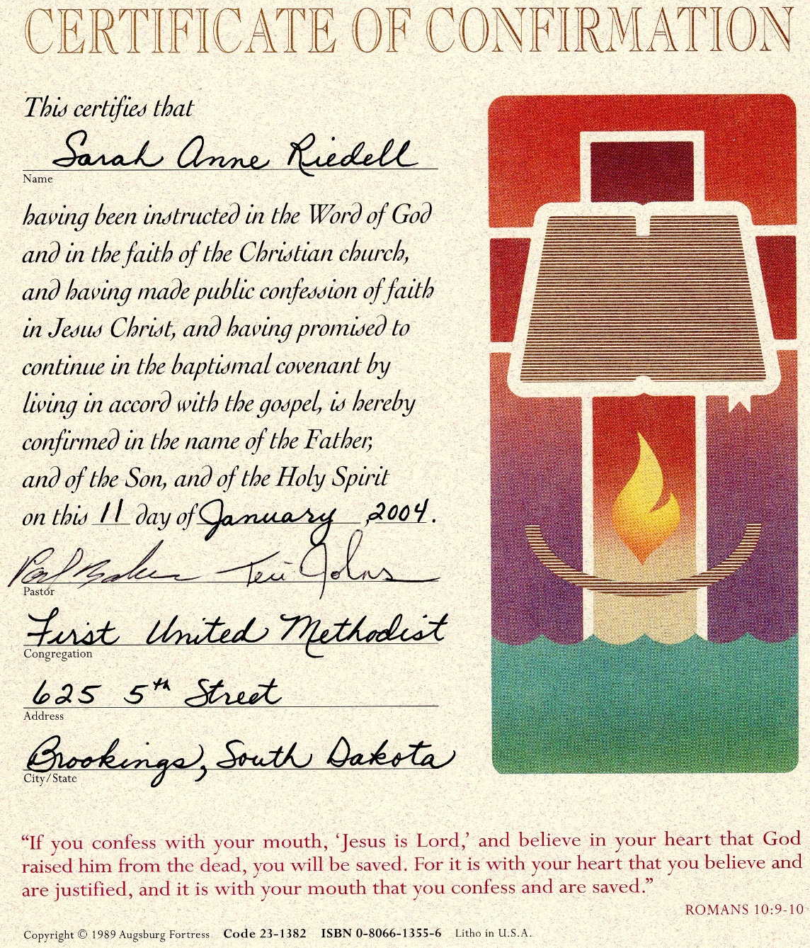
SARAH ANNE RIEDELL
BACK TO DAVIS/RIEDELL FAMILY TREE

Slide 39
MARY ALICE GOUGH DAVIS
Father: Elijah Gough
Husband: Gibson Linn Davis
After husband died in Monongah Mine Explosion (1907)
Left with 8 children
Alanzo “Lonnie”
Bess Hazel Helen Mary Alice Gough Linn “Dave”
Robert Lena “Linda” Lester
NEXT

Slide 40
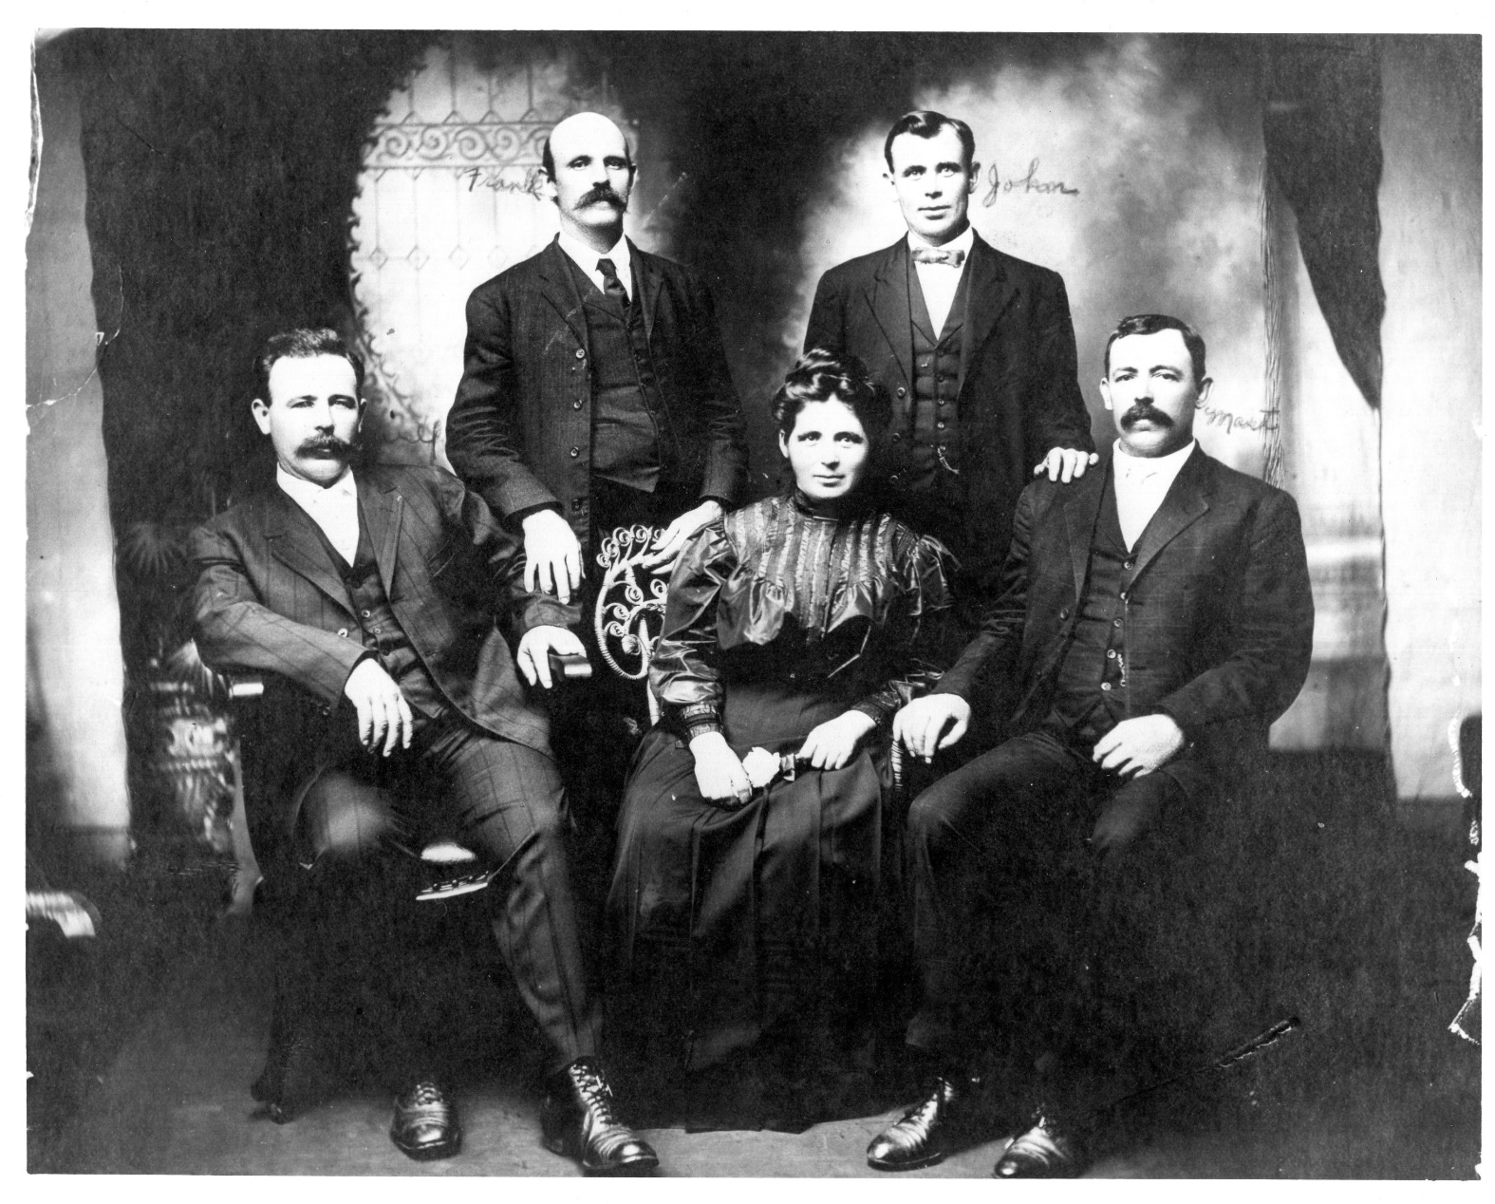
MARY ALICE GOUGH DAVIS-age 36
1908 spring after mine explosion
NEXT

Slide 41
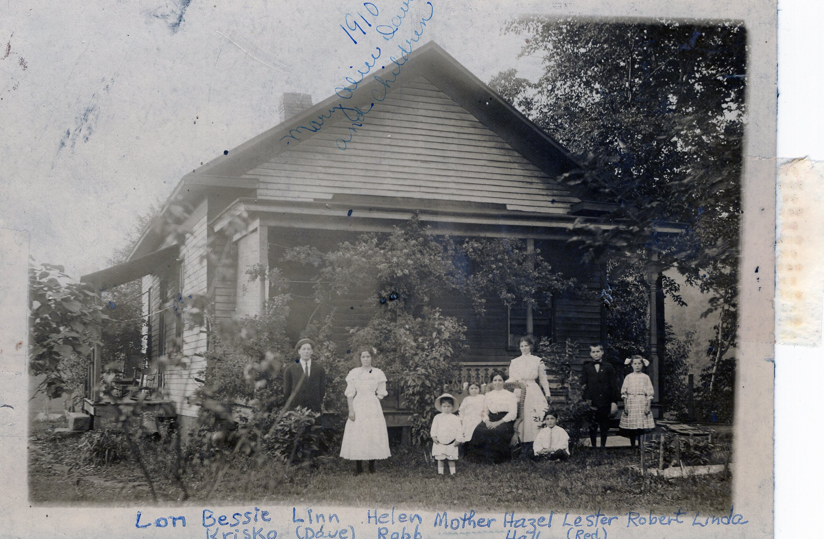
MARY ALICE GOUGH DAVIS with children 1910
BACK TO FAMILY TREE

Slide 42
GIBSON LINN DAVIS Killed in Monongah Mine Disaster
In West Virginia’s Marion County, an explosion in a network of mines owned by the Fairmont Coal Company in Monongah kills 361 coal miners. It was the worst mining disaster in American history.
WIKIPEDIA: Monongah Mine Disaster 1907
Monongah Disaster
List of the dead ... GL Davis is Gibson Linn Davis
BACK TO FAMILY TREE

Slide 43
ROBERT GIBSON DAVIS Birth Certificate
BACK TO DAVIS/O’DONNELL FAMILY TREE

Slide 44
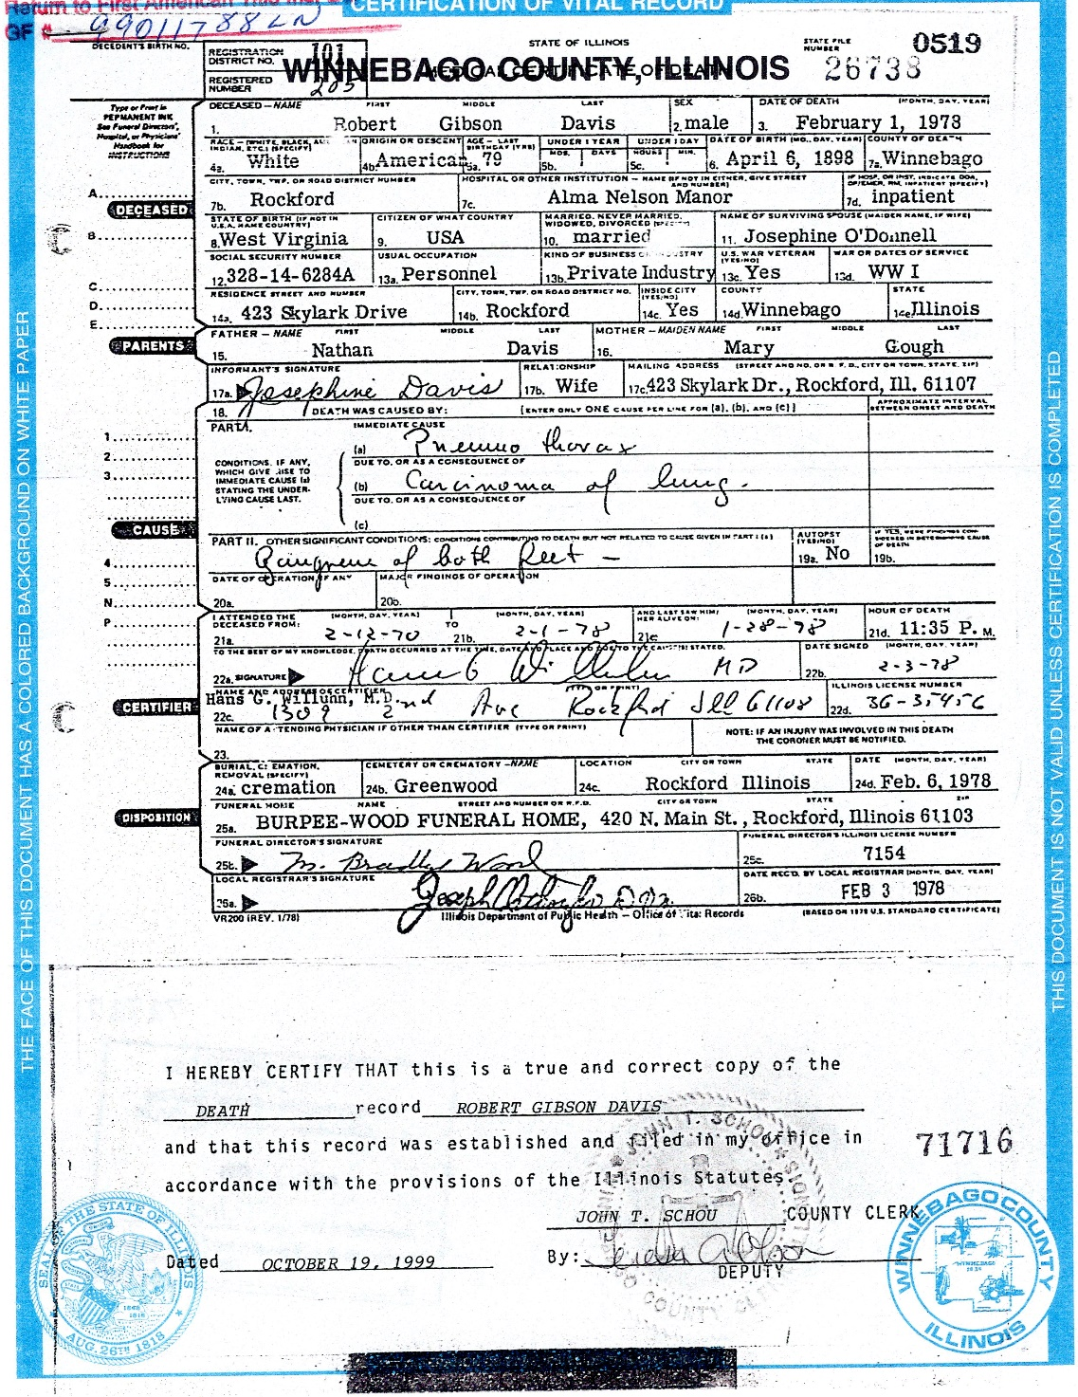
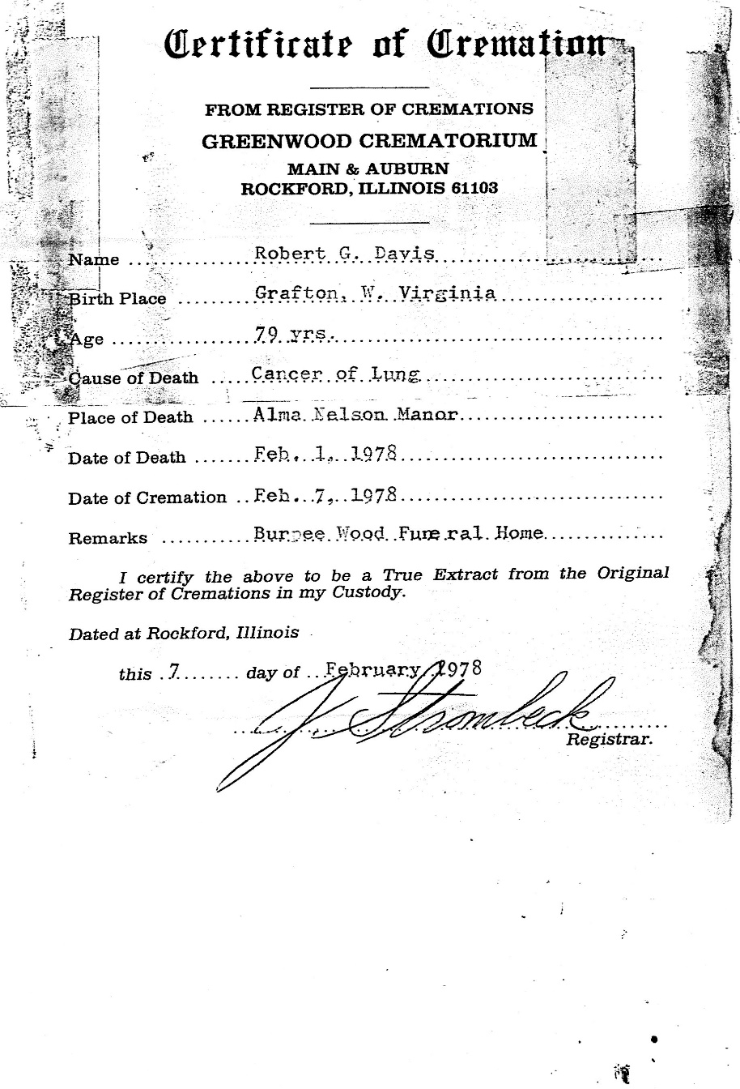
ROBERT GIBSON DAVIS DEATH and Cremation Certificate
Ashes of Robert and Josephine Davis released in Boulder Creek, Colorado
BACK TO DAVIS/O’DONNELL FAMILY TREE

Slide 45
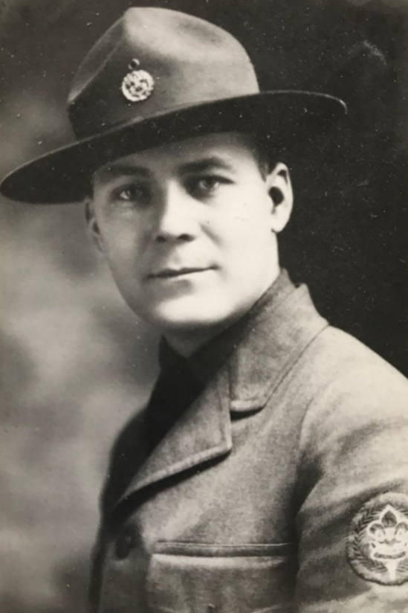
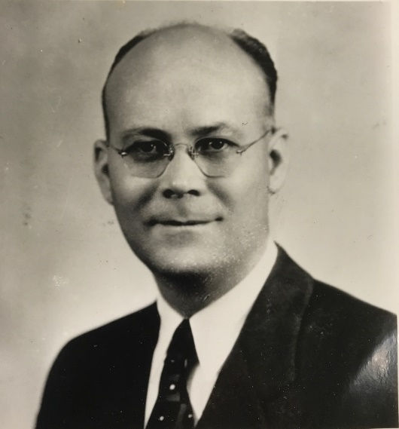
ROBERT GIBSON DAVIS

Slide 46
JOSEPHINE LOUISE O’DONNELL DAVIS
Birth certificate
BACK TO FAMILY TREE

Slide 47
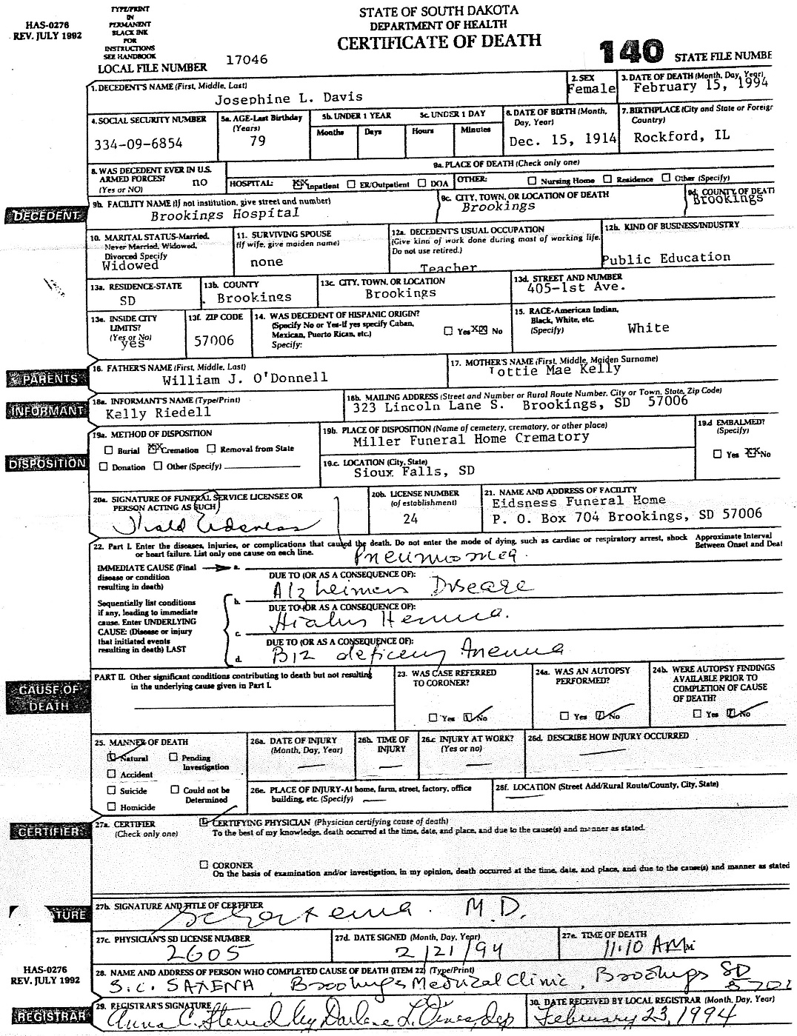
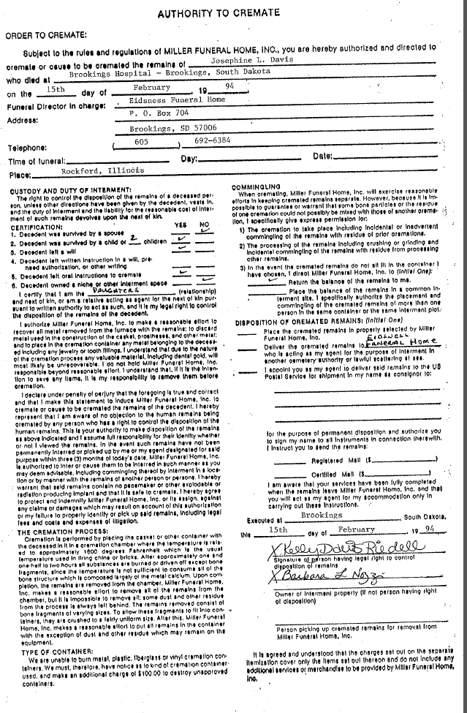
JOSEPHINE LOUISE O’DONNELL DAVIS
BACK TO DAVIS/O’DONNELL FAMILY TREE

Slide 48
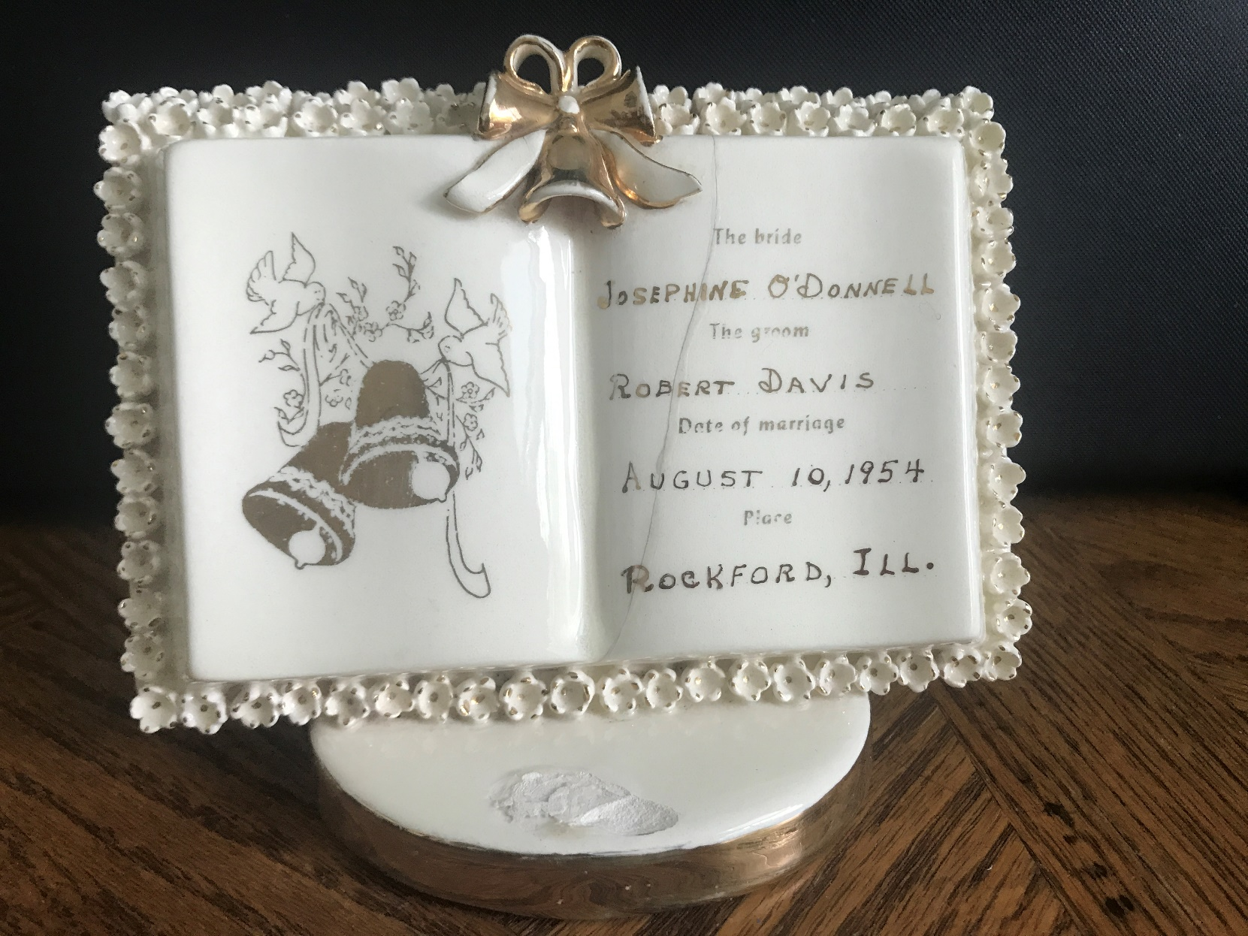
JOSEPHINE O’DONNELL and ROBERT DAVIS wedding
BACK TO O’DONNELL/DAVIS FAMILY TREE

Slide 49
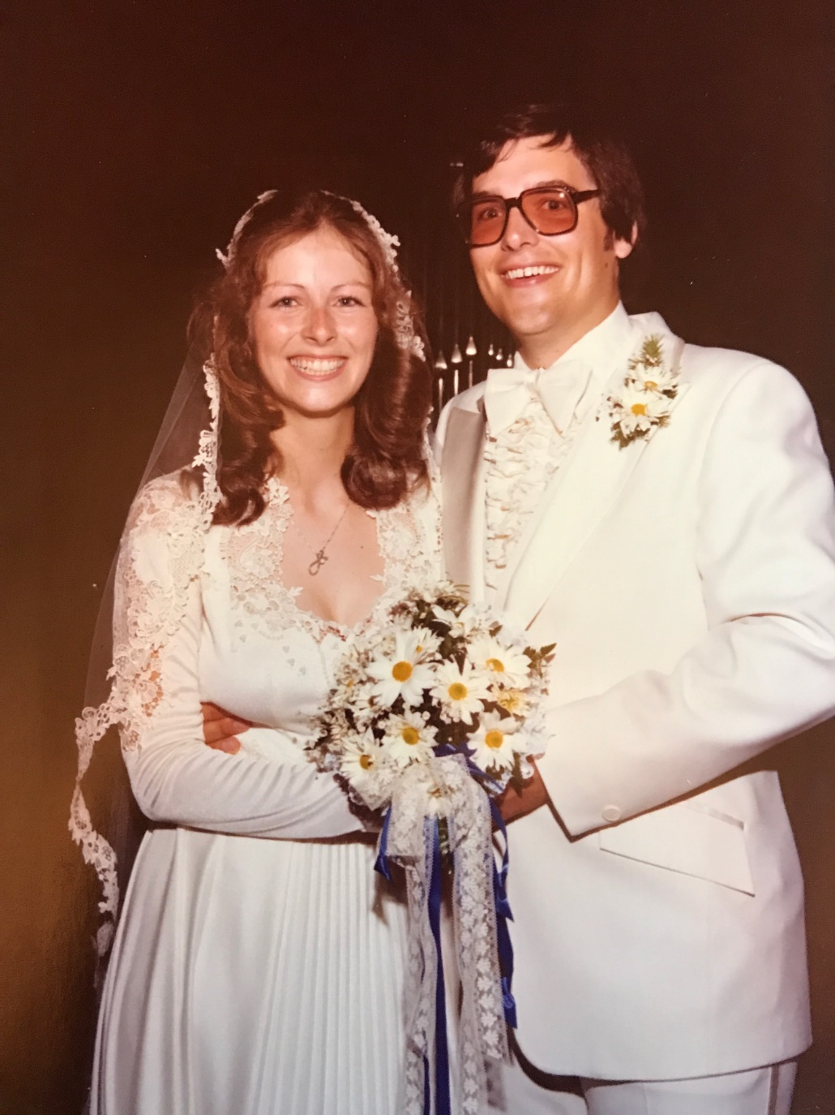
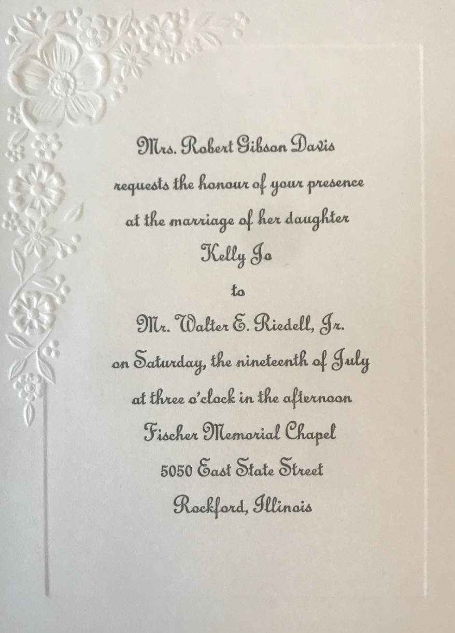
Walter Edwin Riedell, Jr and Kelly Jo Davis
Married: 7/19/1980 Rockford, IL
MARRIAGE CERTIFICATE

Slide 50
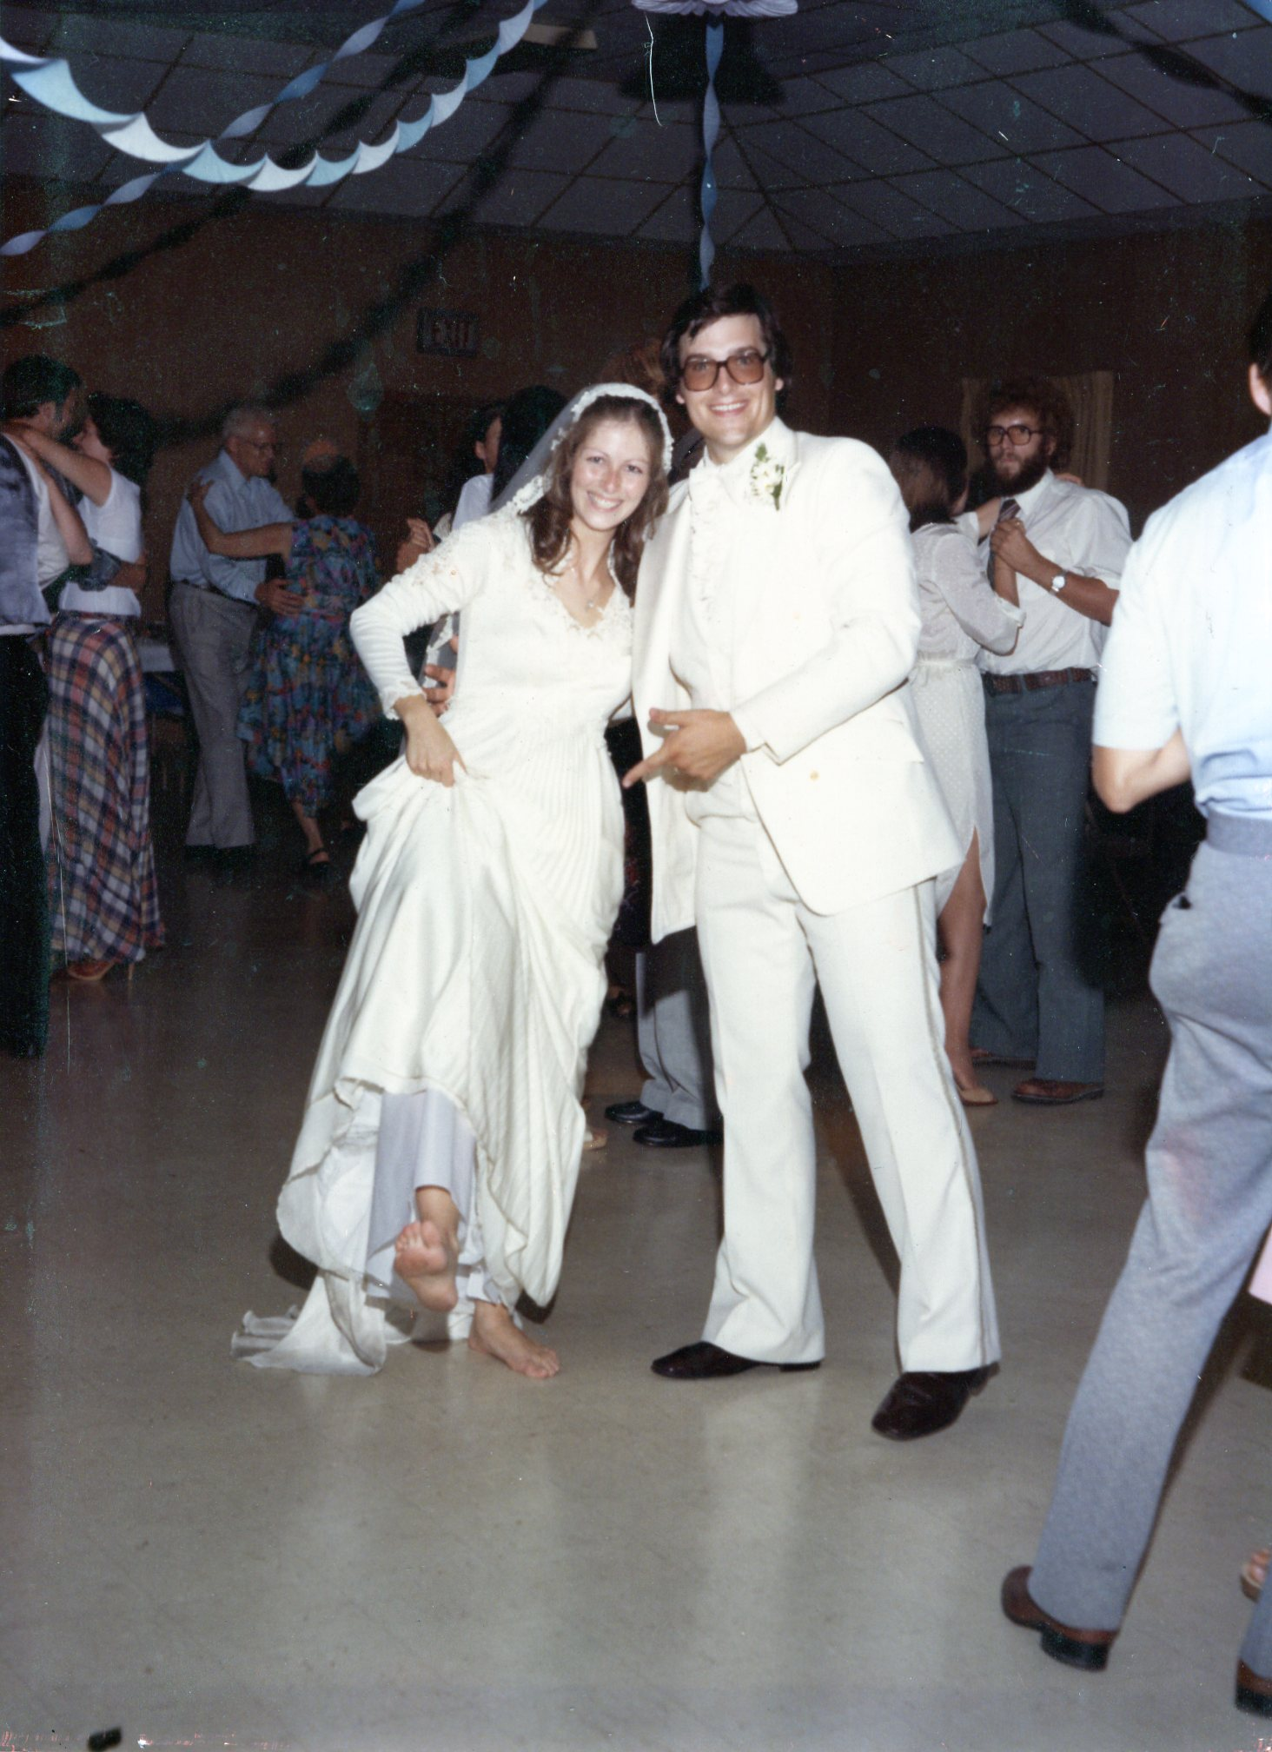
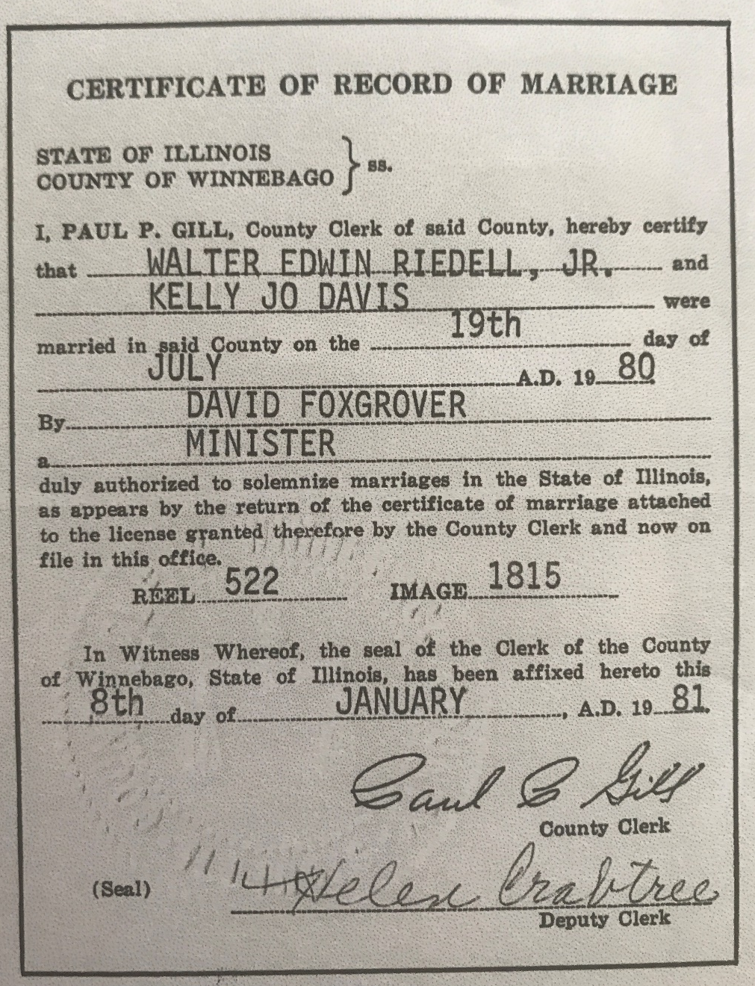
BACK TO RIEDELL/DAVIS FAMILY TREE

Slide 51
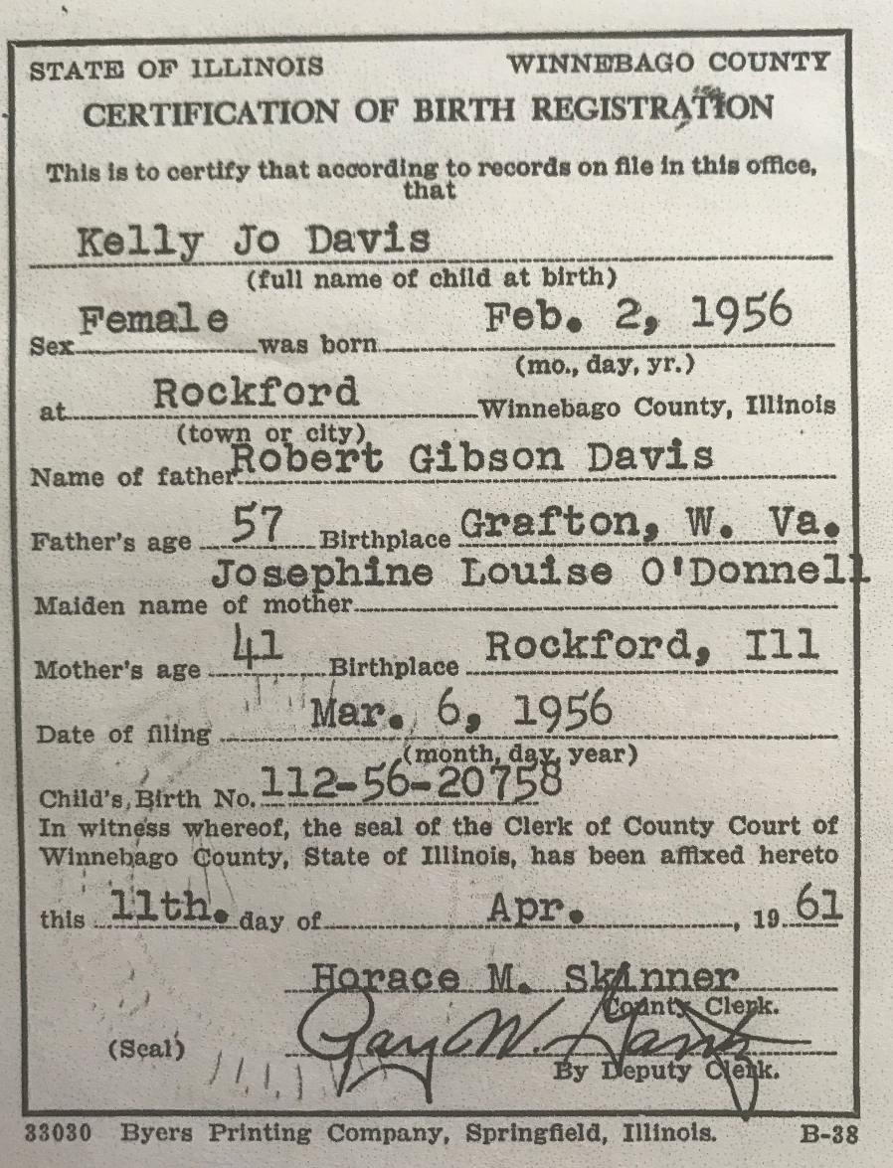
KELLY JO DAVIS – Birth Certificate
BACK TO DAVIS/O’DONNELL FAMILY TREE

Slide 52
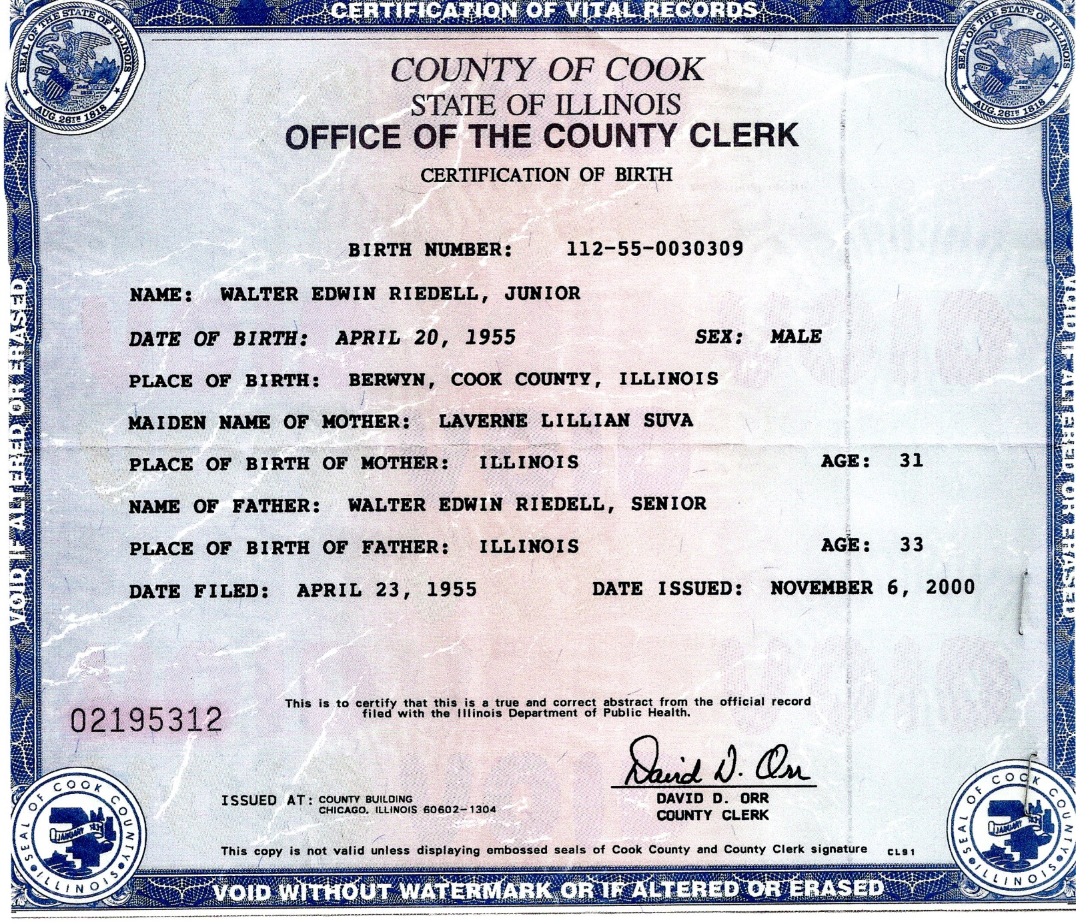
WALTER EDWIN RIEDELL, JR – Birth Certificate
BACK TO RIEDELL/SUVA FAMILY TREE

Slide 53
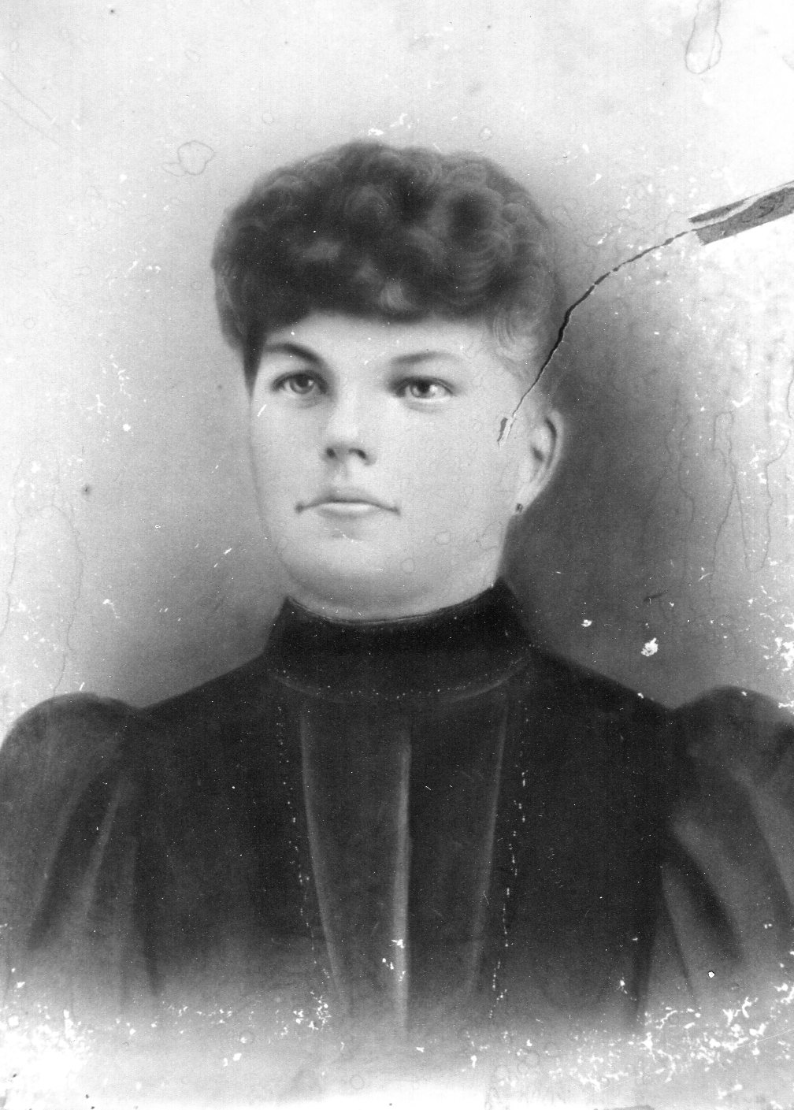
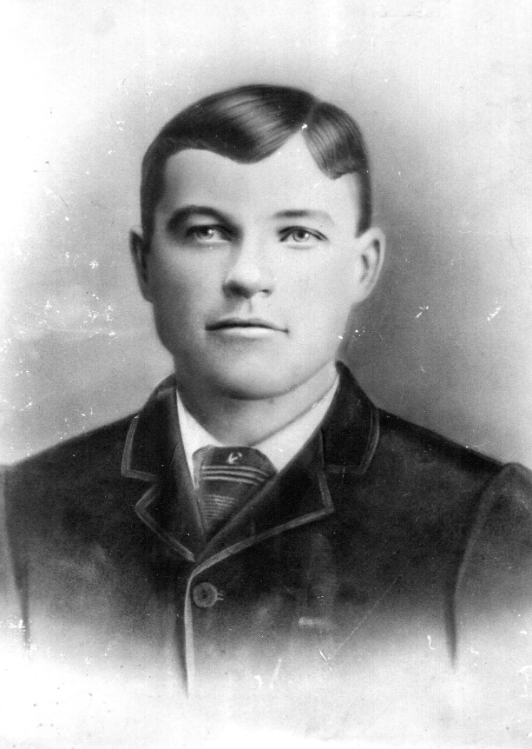
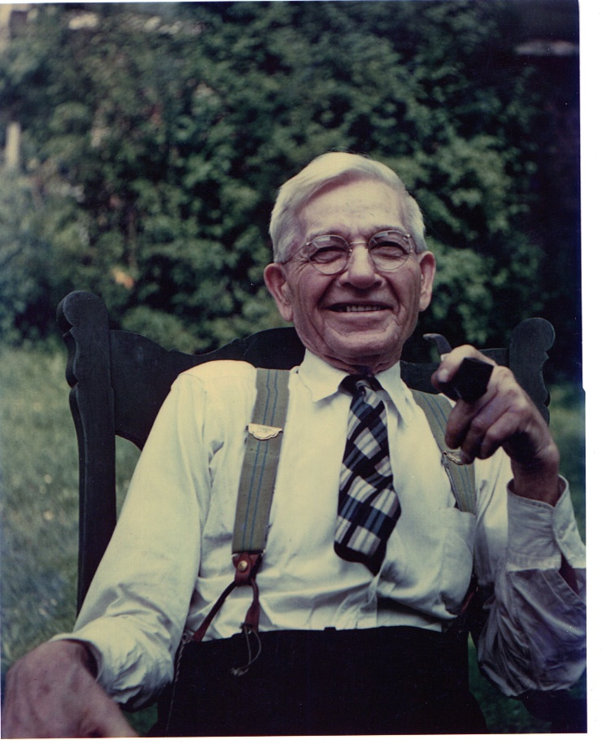
BARBARA DIVIS FRANK HURT
BACK TO FAMILY TREE

Slide 54
Barbara Louise Davis & Anthony (Tony) Martin Nozzi b: 2/7/1957 b: 9/13/1947
Rockford, IL
Married 6/9/2012

Slide 55
TREES WITHOUT LINKS

Slide 56
Henry Peters
Carolyn Last

Slide 57
James O’Donnell b. Dunmore , County Galway Ireland
d. Oct 1882
Bridget Walsh b. Dunmore, County Galway Ireland
d. Apr 1891 Fall River, MA
John Porter b. England
Margaret Conlon b. Clare Ireland d. Sept 1907
Adam Kelly b. 1825 d. 1908
Augusta Trainor
??? Lawrence
Joseph Groh (Grow)
Mary Ann Morningstar

Slide 58
Frank Suva
Louis Thomas Suva
b. July 22, 1895 Chicago, IL d. Nov 14, 1978
m. Sept 10, 1921
Josephine Hasek
Frank Hurt
b. Mar 21,1869 d. June 24, 1957
Lillian Barbara Hurt
b. July 13, 1898 Chicago IL d. Aug 5, 1996
Barbara Divis b. Dec 3 1872 d. July 2, 1940

Slide 59
Gustav Riedel b. 1865 Hapsburg Northern Germany d. 1941
Otto Riedel
b. 1899 d. 1945
Anna Dornquast b. 1866 d. 1905
Frederich Groess
Clara Madeline Groess
b. July 25, 1895 Cicero, IL d. Dec 4, 1984
Ida Peters

Slide 60
John Charles O’Donnell b. July 1853 Dunmore Galway Ireland d. Jan 7, 1907 Fall River, MA
William Joseph O’Donnell
b. Apr 5, 1885 Fall River, MA d. Aug 24, 1947 Rockford, IL
m. Oct 8, 1913
Emily Porter b. Aug 27, 1858 Oldham, England d. Apr 28, 1932
Freeman Edgar Kelly
b. Aug 28, 1861 d. Mar 21, 1944
Lottie May Kelly
b. Nov 19, 1887 Tyre, MI d. Dec 14, 1977 Rockford, IL
Josephine Grow
b. May 31, 1868 d. Aug 8, 1914

