Slide 1
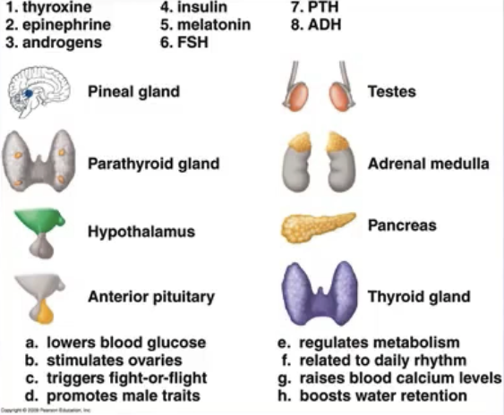

Slide 2
Pineal gland 5. melatonin
b. related to daily rhythm (like sleep patterns)
Parathyroid 7. PTH (parathyroid hormone)
g. raises blood calcium levels (more absorption from intestines and released from bones)
Hypothalamus 8. ADH (anti-diuretic hormone)
h. boosts water retention
Anterior pituitary 6. FSH (follicle stimulating hormone)
b. stimulates ovaries (to mature a oocyte in follicle of ovary)
Testes 3. androgens
d. promotes male traits
Adrenal medulla 2. epinephrine
c. triggers fight-or-flight
Pancreas 4. insulin
a. lowers blood glucose levels
Thyroid gland 1. thyroxine
e. regulates metabolism

Slide 3
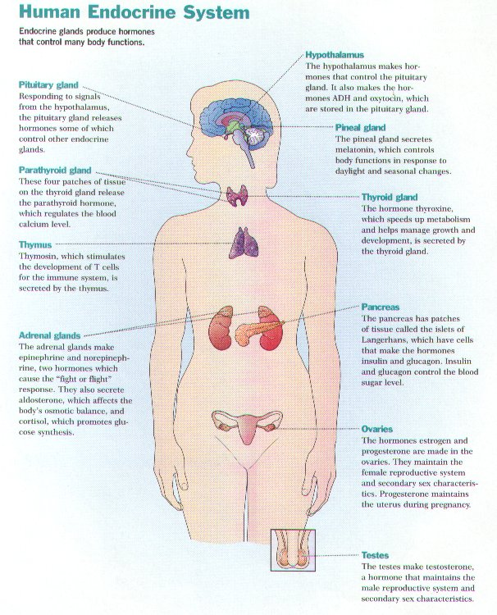
http://www.growtall.com/endocrine2.htm

Slide 4
GLAND | HORMONE | FUNCTION
PINEAL
PARATHYROID
HYPOTHALMUS
ANTERIOR PITUITARY
TESTES
ADRENAL MEDULLA
PANCREAS
THYROID

