Slide 1
Surface Area/Volume ratio Opener BILL-Kelly Riedell
2020 CED ESSENTIAL KNOWLEDGE
ENE-1.B.1 Surface area-to-volume ratios affect the ability of a biological system to obtain necessary resources, eliminate waste products, acquire or dissipate thermal energy, and otherwise exchange chemicals and energy with the environment.
ENE-1.B.2 The surface area of the plasma membrane must be large enough to adequately exchange materials—
a. These limitations can restrict cell size and shape. Smaller cells typically have a higher surface area-to-volume ratio and more efficient exchange of materials with the environment.
b. As cells increase in volume, the relative surface area decreases and the demand for internal resources increases.
c. More complex cellular structures (e.g., membrane folds) are necessary to adequately exchange materials with the environment.
d. As organisms increase in size, their surface area-to-volume ratio decreases, affecting properties like rate of heat exchange with the environment.
SP 2.B Explain relationships between different characteristics of biological concepts, processes, or models represented visually b. In applied contexts

Slide 2
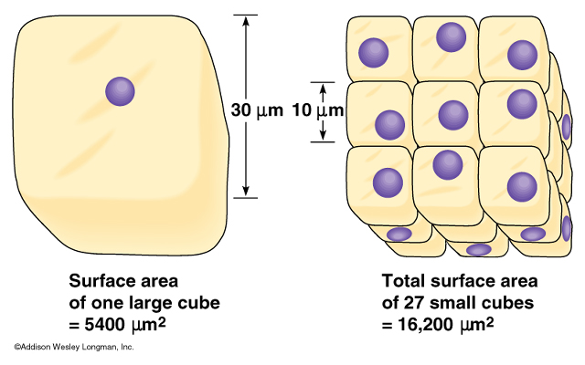
http://bioserv.fiu.edu/~walterm/B/cell_components/4.3%20Effect%20of%20cell%20size%20on%20s.JPG
How does the cell Surface Area/volume ratio differ in these TWO diagrams? Explain the relationship of this concept to transport and cell division.

Slide 3
http://bioserv.fiu.edu/~walterm/B/cell_components/4.3%20Effect%20of%20cell%20size%20on%20s.JPG
How does the cell Surface Area/volume ratio differ in these TWO diagrams? Explain the relationship of this concept to transport and cell division.

Slide 4
http://bioserv.fiu.edu/~walterm/B/cell_components/4.3%20Effect%20of%20cell%20size%20on%20s.JPG
How does the cell Surface Area/volume ratio differ in these TWO diagrams? Explain the relationship of this concept to transport and cell division.

Slide 5
http://bioserv.fiu.edu/~walterm/B/cell_components/4.3%20Effect%20of%20cell%20size%20on%20s.JPG
How does the cell Surface Area/volume ratio differ in these TWO diagrams? Explain the relationship of this concept to transport and cell division.

Slide 6
http://bioserv.fiu.edu/~walterm/B/cell_components/4.3%20Effect%20of%20cell%20size%20on%20s.JPG
How does the cell Surface Area/volume ratio differ in these TWO diagrams? Explain the relationship of this concept to transport and cell division.

Slide 7
http://bioserv.fiu.edu/~walterm/B/cell_components/4.3%20Effect%20of%20cell%20size%20on%20s.JPG
How does the cell Surface Area/volume ratio differ in these TWO diagrams? Explain the relationship of this concept to transport and cell division.

