Slide 1
Explain the role of each of the following in mitosis or cytokinesis - Kinetochores - Microtubules - Motor proteins - Actin filaments
2011B AP FRQ
AP BIO- Kelly Riedell/Brookings Biology

Slide 2
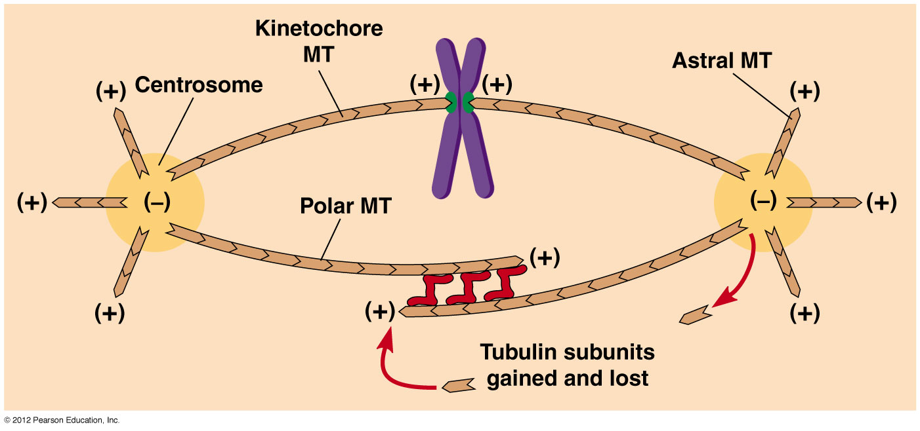
Microtubules- -Make up spindle fibers (cytoskeleton) -responsible for movement of chromosomes AND elongating cell during cell division

Slide 3
Kinetochores- -spot on centromere where spindle fiber attaches -hold motor proteins that depolymerize microtubules as they move
Motor proteins- - “Pacman-like” motor proteins attached to kinetochore that “walk” along microtubules of spindle

Slide 4
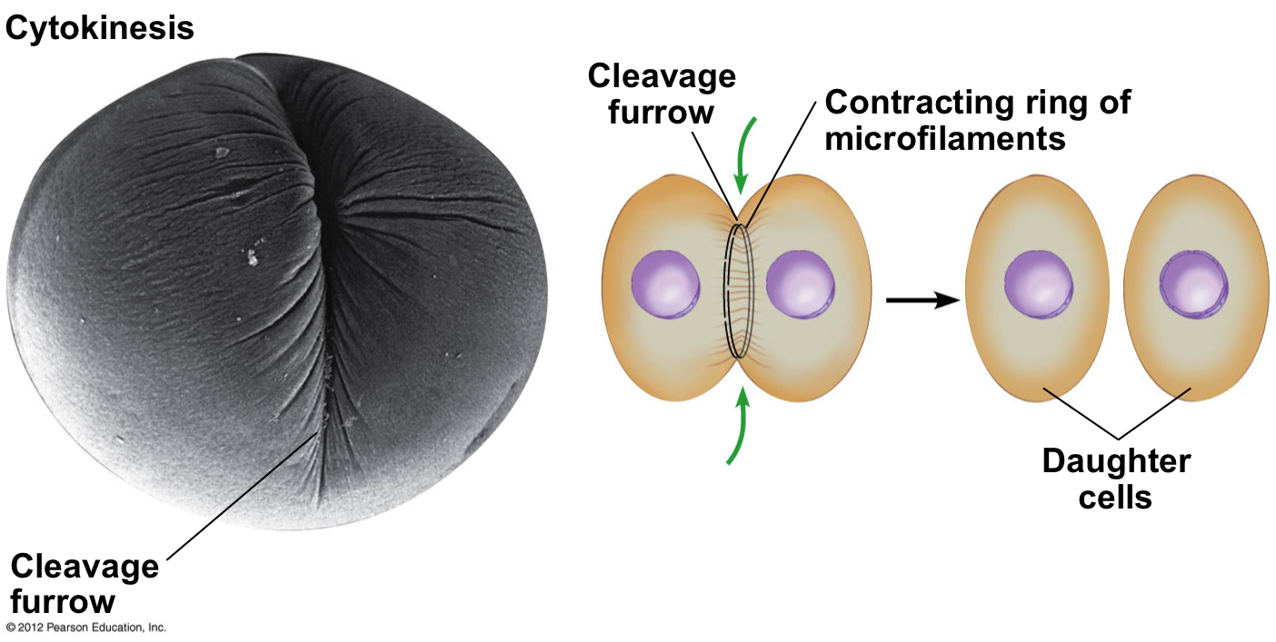
http://classconnection.s3.amazonaws.com/229/flashcards/808229/png/cyto21318482870353.png
Actin microfilaments create a ring
around cell and tighten to pinch cell
during cytokinesis (cleavage furrow)

