Slide 1
Competitive/Non-competitive Inhibitor VENN Slide show by Kelly Riedell/Brookings Biology
2020 CED
LEARNING OBJECTIVE ENE-1.F Explain how changes to the structure of an enzyme may affect its function.
ESSENTIAL KNOWLED ENE-1.F.1 Change to the molecular structure of a component in an enzymatic system may result in a change of the function or efficiency of the system—
ENE-1G.4 Competitive inhibitor molecules can bind reversibly or irreversibly to the active site of the enzyme. Noncompetitive inhibitors can bind allosteric sites, changing the activity of the enzyme.
SP 2.D Represent relationships within biological models, including b. Diagrams

Slide 2
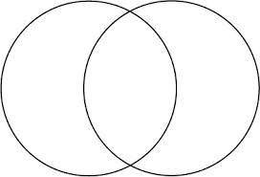
MAKE A MINI VENN
COMPETITIVE INHIBITORS
NON-COMPETITIVE INHIBITORS

Slide 3
MAKE A MINI VENN
COMPETITIVE INHIBITORS
NON-COMPETITIVE INHIBITORS

Slide 4
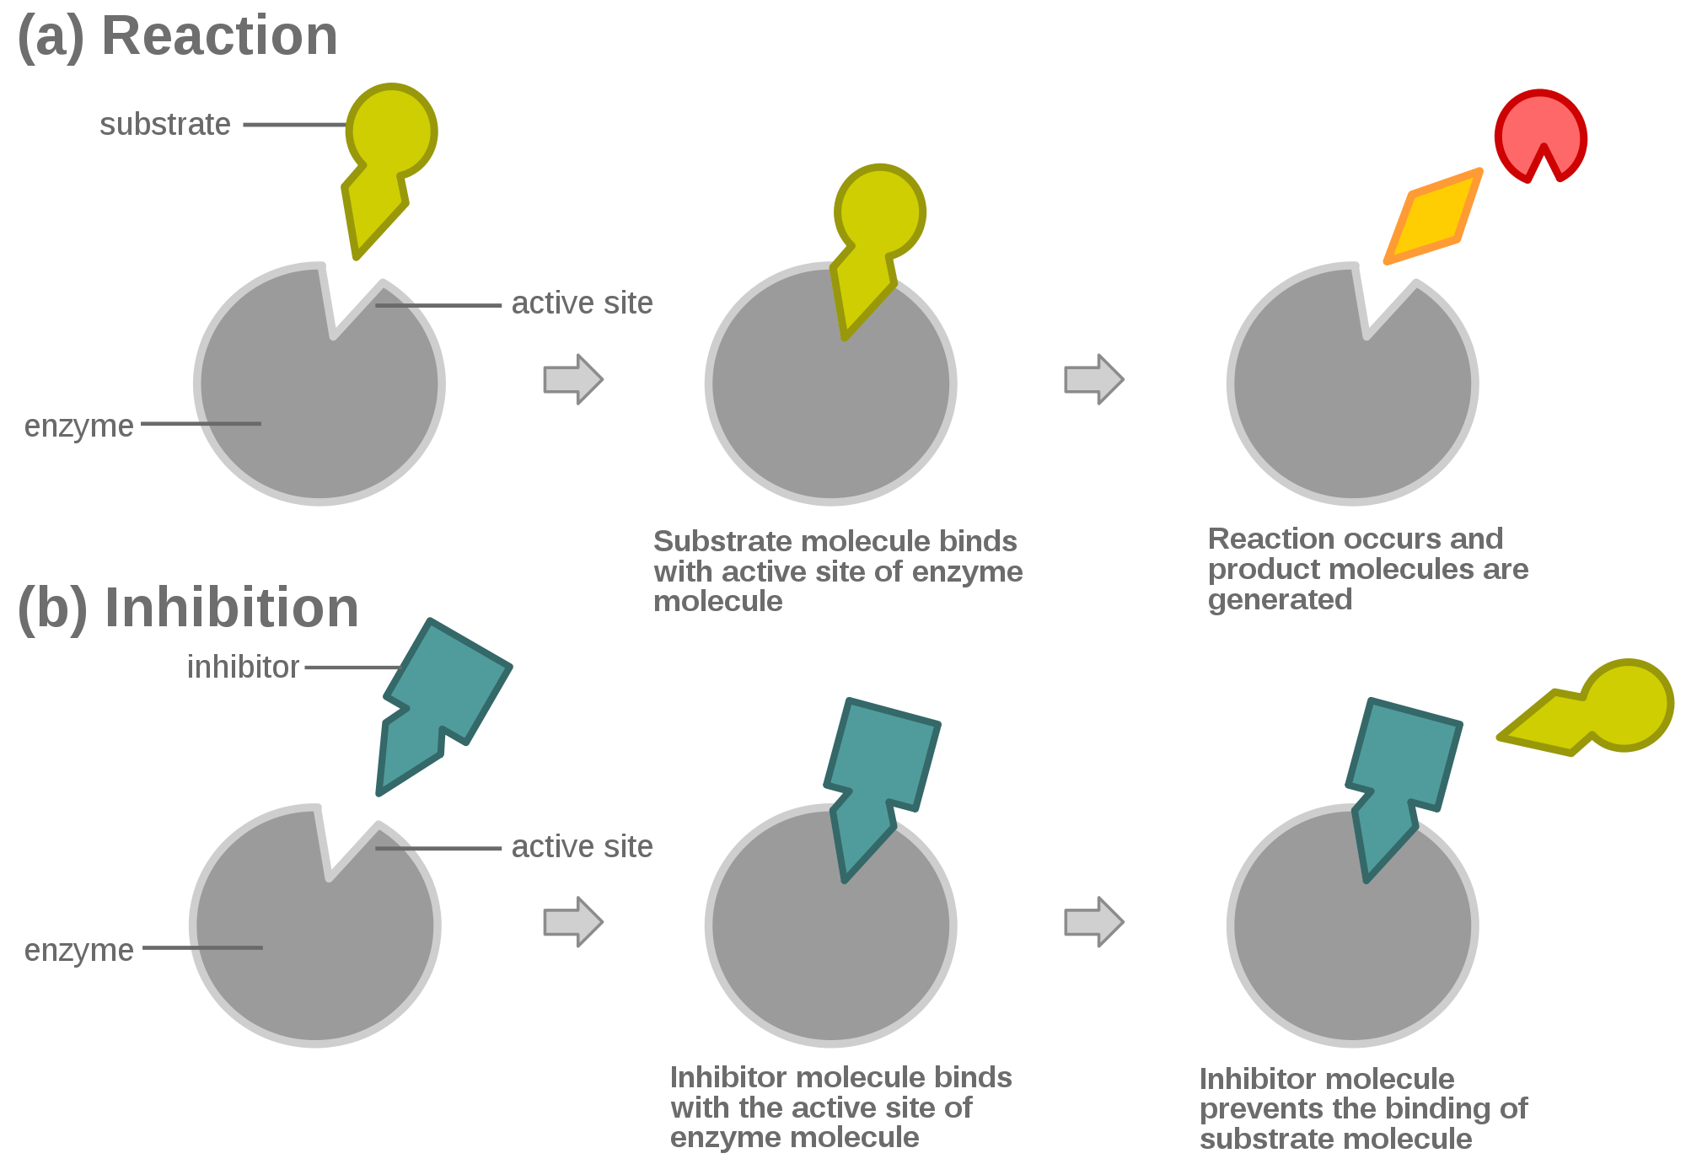
COMPETITVE INHIBITION

Slide 5
NON-COMPETITVE (ALLOSTERIC) INHIBITION

