Slide 1
ENZYME GRAPH OPENER Slide show by Kelly Riedell/Brookings Biology
LEARNING OBJECTIVE ENE-1.E Explain how enzymes affect the rate of biological reactions.
ESSENTIAL KNOWLEDGE
ENE-1.E.1 The structure and function of enzymes contribute to the regulation of biological processes—
a. Enzymes are biological catalysts that facilitate chemical reactions in cells by lowering the activation energy
SP 2.A Describe characteristics of a biological concept, process, or model represented visually.

Slide 2
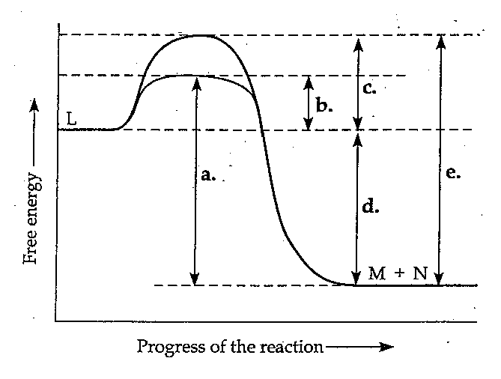
Image from: https://3.bp.blogspot.com/-ofT67cVS3gg/UOaYQS1H__I/AAAAAAAAAY0/8g-JLiA1xrQ/s1600/Test+3+Q+64.jpg
Is this a positive delta G or negative delta G reaction?
The activation energy required by this reaction without enzyme added is labeled _____
The activation energy required by this reaction with enzyme added is _____
How does adding enzyme change the energy of the products?

Slide 3
Image from: https://3.bp.blogspot.com/-ofT67cVS3gg/UOaYQS1H__I/AAAAAAAAAY0/8g-JLiA1xrQ/s1600/Test+3+Q+64.jpg
Is this a positive delta G or negative delta G reaction?
The activation energy required by this reaction without enzyme added is labeled _____
The activation energy required by this reaction with enzyme added is _____
How does adding enzyme change the energy of the products?

Slide 4
Image from: https://3.bp.blogspot.com/-ofT67cVS3gg/UOaYQS1H__I/AAAAAAAAAY0/8g-JLiA1xrQ/s1600/Test+3+Q+64.jpg
Is this a positive delta G or negative delta G reaction?
The activation energy required by this reaction without enzyme added is labeled _____
The activation energy required by this reaction with enzyme added is _____
How does adding enzyme change the energy of the products?

Slide 5
Image from: https://3.bp.blogspot.com/-ofT67cVS3gg/UOaYQS1H__I/AAAAAAAAAY0/8g-JLiA1xrQ/s1600/Test+3+Q+64.jpg
Is this a positive delta G or negative delta G reaction?
The activation energy required by this reaction without enzyme added is labeled _____
The activation energy required by this reaction with enzyme added is _____
How does adding enzyme change the energy of the products?

Slide 6
Image from: https://3.bp.blogspot.com/-ofT67cVS3gg/UOaYQS1H__I/AAAAAAAAAY0/8g-JLiA1xrQ/s1600/Test+3+Q+64.jpg
Is this a positive delta G or negative delta G reaction?
The activation energy required by this reaction without enzyme added is labeled _____
The activation energy required by this reaction with enzyme added is _____
How does adding enzyme change the energy of the products?

Slide 7
Image from: https://3.bp.blogspot.com/-ofT67cVS3gg/UOaYQS1H__I/AAAAAAAAAY0/8g-JLiA1xrQ/s1600/Test+3+Q+64.jpg
Is this a positive delta G or negative delta G reaction?
The activation energy required by this reaction without enzyme added is labeled _____
The activation energy required by this reaction with enzyme added is _____
How does adding enzyme change the energy of the products?

