Slide 1
CANDY CORN OPENER Slide show by Kelly Riedell/Brookings Biology
LEARNING OBJECTIVE ENE-1.E Explain how enzymes affect the rate of biological reactions.
ESSENTIAL KNOWLEDGE
ENE-1.E.1 The structure and function of enzymes contribute to the regulation of biological processes— a. Enzymes are biological catalysts that facilitate chemical reactions in cells by lowering the activation energy
LEARNING OBJECTIVE
ENE-1.F Explain how changes to the structure of an enzyme may affect its function
SP 6.E Predict the causes or effects of a change in, or disruption to, one or more components in a biological system based on a. Biological concepts or processes

Slide 2
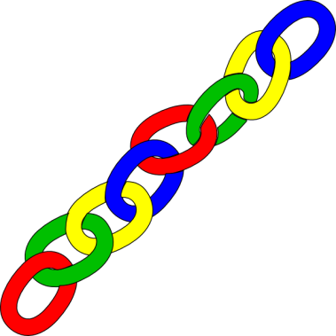
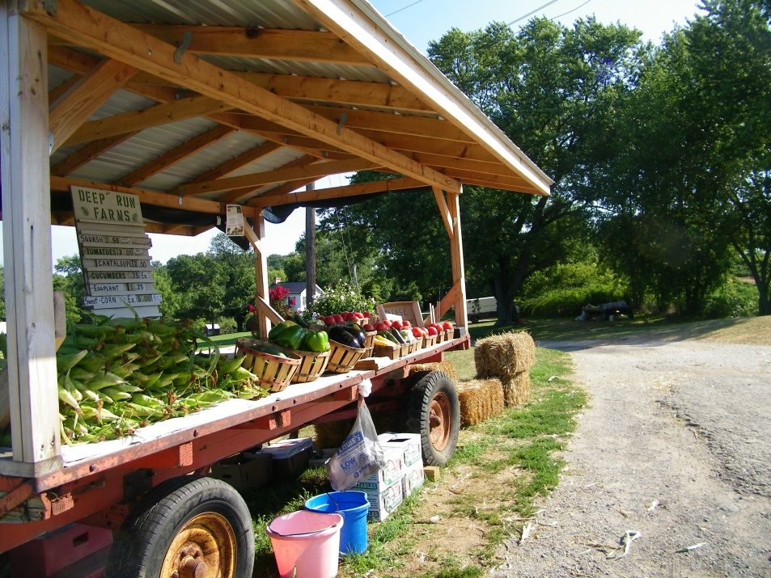
http://www.gurneys.com/product/kandy_korn_se_sweet_corn/vegetables
MAKE A CONNECTION
“Candy Corn” is a variety of sweet corn enjoyed by many people. These corn plants have been modified by geneticists to produce corn that tastes sweeter than other varieties because Candy Corn lacks an enzyme that “field” corn plants have. What do you think is the function of this missing enzyme in other corn plants? EXPLAIN YOUR ANSWER.
http://www.deeprunfarmsmaryland.com/wp-content/uploads/2012/07/101_0368.jpg

