Slide 1
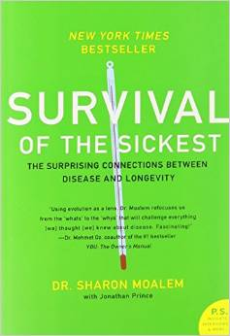
Survival of the Sickest
by Dr. Sharon Moalem
Genome
by Matt Ridley

Slide 2
Connections between genetic mutations and resistance to disease.
Sickle cell- malaria Cystic fibrosis- typhoid Tay-Sachs – tuberculosis
AB blood type-cholera Vitamin D receptor-osteoporosis

