Slide 1
BILL- Dihybrid Crosses Slide show by Kelly Riedell/Brookings Biology
2020 CED ESSENTIAL KNOWLEDGE IST 1.I.2 b. The pattern of inheritance (monohybrid, dihybrid, sex-linked, and genetically linked genes) can often be predicted from data, including pedigree, that give the parent genotype/phenotype and the offspring genotypes/phenotypes..
SP 2.B Explain relationships between different characteristics of biological concepts, processes, or models represented visually b. In applied contexts.

Slide 2
MAKING GAMETES
R r Y y
___________ ____________ _____________ _____________

Slide 3
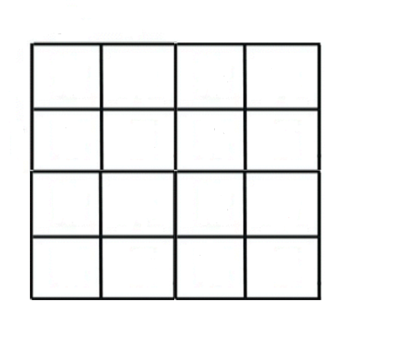
RY
Ry
rY
ry
____ Round & Yellow
____ Round & green
____ Wrinkled & yellow
____ wrinkled & green
RY
Ry
rY
ry

Slide 4
____ ____________ TRAIT 1 ; ____________ TRAIT 2
____ ____________ TRAIT 1; _____________ TRAIT 2
___ ____________ TRAIT 1; _____________ TRAIT 2
____ ____________ TRAIT 1; _____________ TRAIT 2
__________ratio is a clue that it’s a
____________________________cross

