Slide 1
MAKE A CLADOGRAM
Slide show by Kelly Riedell/Brookings Biology
Source: Kim Foglia
LEARNING OBJECTIVE
EVO-3.B Describe the types of evidence that can be used to infer an evolutionary relationship.
ESSENTIAL KNOWLEDGE
EVO-3.B.1 Phylogenetic trees and cladograms show evolutionary relationships among lineages—
Phylogenetic trees and cladograms both show relationships between lineages, but phylogenetic trees show the amount of change over time calibrated by fossils or a molecular clock.
Traits that are either gained or lost during evolution can be used to construct phylogenetic trees and cladograms—
i. Shared characters are present in more than one lineage.
ii. Shared, derived characters indicate common ancestry and are informative for the construction of phylogenetic trees and cladograms.
iii. The out-group represents the lineage that is least closely related to the remainder of the organisms in the phylogenetic tree or cladogram.

Slide 2
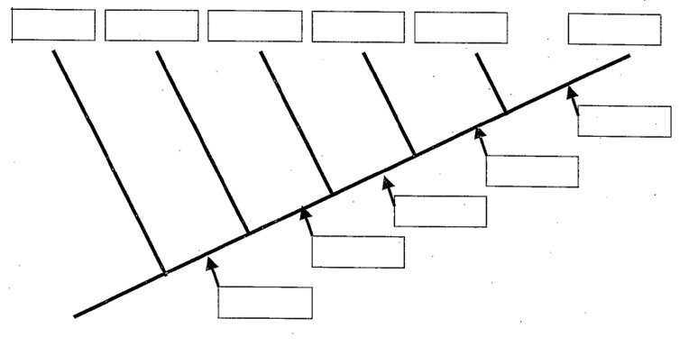
CREATE A CLADOGRAM FROM THIS TABLE

