Slide 1
WHAT’s the DIFFERENCE BETWEEN: Gene Flow and Genetic Drift?
Kelly Riedell/Brookings Biology
2020 CED ESSENTIAL KNOWLEDGE EVO-1.H.1 Evolution is also driven by random occurrences— a. Mutation is a random process that contributes to evolution.
b. Genetic drift is a nonselective process occurring in small populations— i. Bottlenecks. ii. Founder effect. c. Migration/gene flow can drive evolution. SP 1.B Explain biological concepts and/or processes.

Slide 2
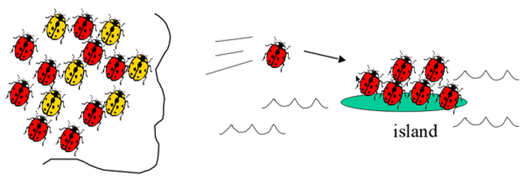
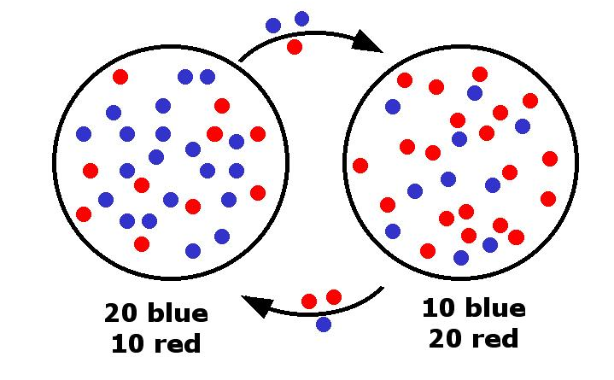
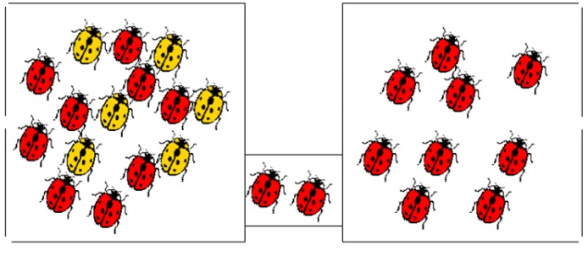
GENETIC DRIFT vs GENE FLOW
Changes in gene pool DUE TO RANDOM CHANCE NOT related to natural selection
Start a new population
Founder effect- individuals move to new place
Bottlenecks – population size is reduced due to catastrophic event; Surviving population has different allele frequency
Migration of alleles or genes from one existing population to another.
http://larryfrolich.com/Evolution/NaturalSelection/founder.jpg
http://biology.gsu.edu/houghton/2107%20'08/Figures/Chapter22/bottleneck.jpg
http://www.umbc.edu/bioclass/biol100/powerpoints/lecture10/img034.jpg

