Slide 1
REPRODUCTIVE BARRIERS
Kelly Riedell/Brookings Biology
FROM http://www.dwm.ks.edu.tw/bio/activelearner/19/ch19summary.html
2020 CED ESSENTIAL KNOWLEDGE EVO-3.D.1 Speciation may occur when two populations become reproductively isolated from each other.
EVO-3.F.1 Speciation results in diversity of life forms.
EVO-3.F.2 Speciation may be sympatric or allopatric.
EVO-3.F.3 Various prezygotic and postzygotic mechanisms can maintain reproductive isolation and prevent gene flow between populations.

Slide 2
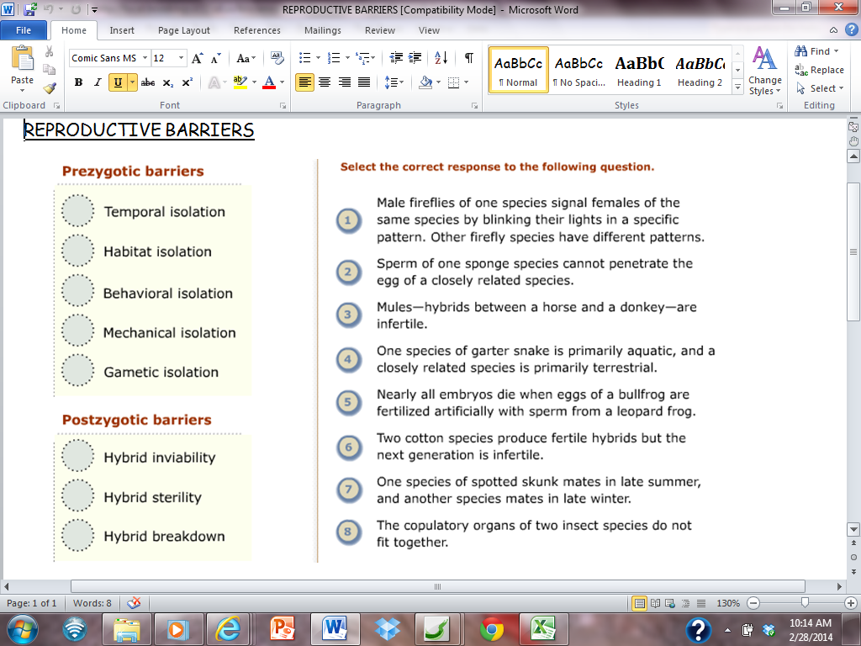
FROM http://www.dwm.ks.edu.tw/bio/activelearner/19/ch19summary.html

Slide 3
FROM http://www.dwm.ks.edu.tw/bio/activelearner/19/ch19summary.html

