Slide 1
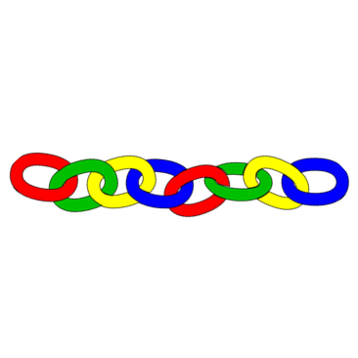
Make a connection Kelly Riedell/Brookings Biology
Image from: https://tse1.mm.bing.net/th?id=OIP.7_EQFnf-Y_Mm5fRhmQTvTAHaHZ&pid=Api&P=0&w=300&h=300
2020 CED -ESSENTIAL KNOWLEDGE
SYI-1.F.1 The folding of the inner membrane increases the surface area, which allows for more ATP to be synthesized. ENE-2.L.1 Internal membranes facilitate cellular processes by minimizing competing interactions and by increasing surface areas where reactions can occur.
ENE-1.K.3 The electron transport chain transfers energy from electrons in a series of coupled reactions that establish an electrochemical gradient across membranes—
c. The transfer of electrons is accompanied by the formation of a proton gradient across the inner mitochondrial membrane or the internal membrane of chloroplasts, with the membrane(s) separating a region of high proton concentration from a region of low proton concentration. In prokaryotes, the passage of electrons is accompanied by the movement of protons across the plasma membrane.
d. The flow of protons back through membrane-bound ATP synthase by chemiosmosis drives the formation of ATP from ADP and inorganic phosphate. This is known as oxidative phosphorylation in cellular respiration, and photophosphorylation in photosynthesis.
SP 1.C Explain biological concepts, processes, and/or models in applied contexts.

Slide 2
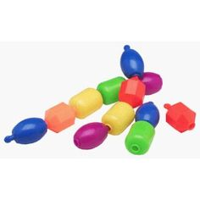
CONNECT TO SOMETHING YOU KNOW
Mitochondria carry out cellular respiration.
To capture energy from glucose and make ATP, H⁺ ions are actively pumped across the cristae membrane into the inner membrane space, creating an electrochemical gradient that powers the production of ATP when these H⁺ ions passively diffuse down their gradient through an ion channel (ATP synthase).
What might the folding of the cristae membranes have to do with the ability to move H⁺ ions across the cristae and make ATP?

