Slide 1
CELL SIGNALING Slide show by Kelly Riedell
Modified from a PREZI by David Knuffke Cell communication POGIL

Slide 2
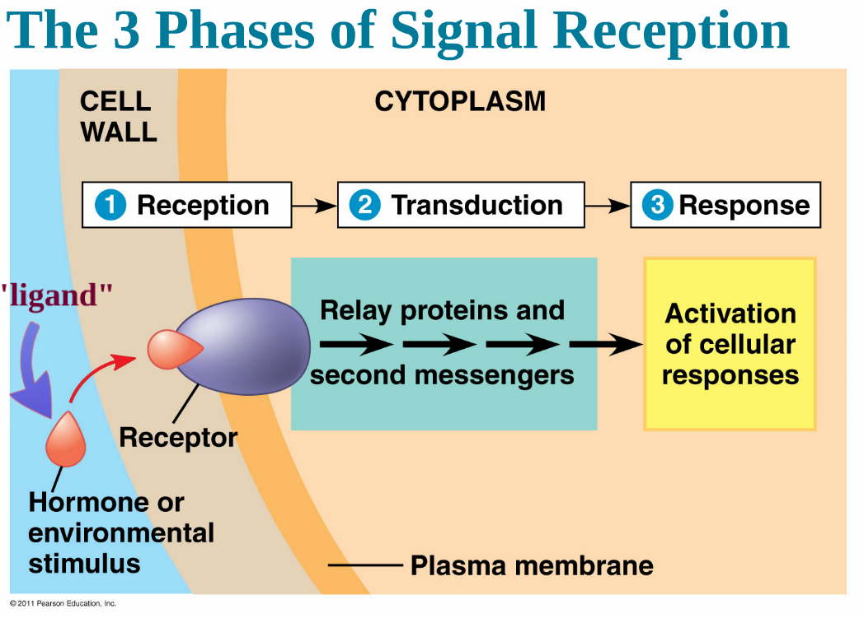

Slide 3
AUTOCRINE Signal “self” EX: Cancer cells make growth factors
JUXTACRINE Signal “touching neighbor” EX: Plant plasmodesmata
PARACRINE Signal cells in close proximity EX: Neurotransmitters Embryo development Bacteria Quorum sensing
ENDOCRINE (hormones) Long distance signaling EX: Sex hormones-puberty Insulin made by pancreas/controls blood sugar Adrenaline-fight or flight

Slide 4
SIGNAL MOLECULE = LIGAND Shape of ligand –matches shape of receptor “LOCK & KEY”
HYDROPHILIC LIGANDS BIND SURFACE RECEPTORS EX: INSULIN
HYDROPHOBIC LIGANDS BIND INTRACELLULAR RECEPTORS EX: TESTOSTERONE

Slide 5
SIGNALING PATHWAYS Highly CONSERVED across ALL DOMAINS
G-PROTEINS: - attached to receptor - are activated by transfer of phosphate from GTP
- activated G-protein can then activate another enzyme

Slide 6
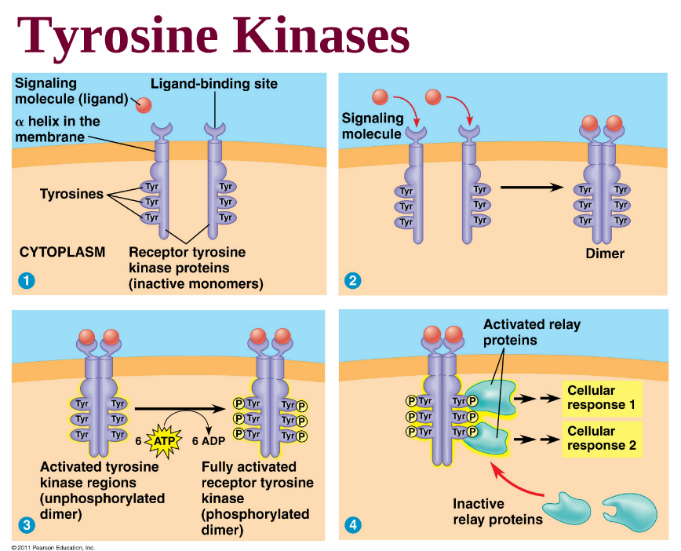
KINASES = Proteins that “phosphorylate” (add a phosphate to) another molecule
ADDING PHOSPHATES TO MOLECULES “TURNS THEM ON”
TYROSINE KINASES: Proteins attached to receptors join to form dimers when ligand binds receptor Activated by transfer of phosphate from GTP Remain ACTIVE as long as LIGAND is attached Activated dimers can then activate another enzyme

Slide 7
Ligand binds to ligand-gated ion channel and opens “gate”
Incoming IONS act as SECOND MESSENGERS to trigger the response Gate stays open as long as ligand is attached

Slide 8
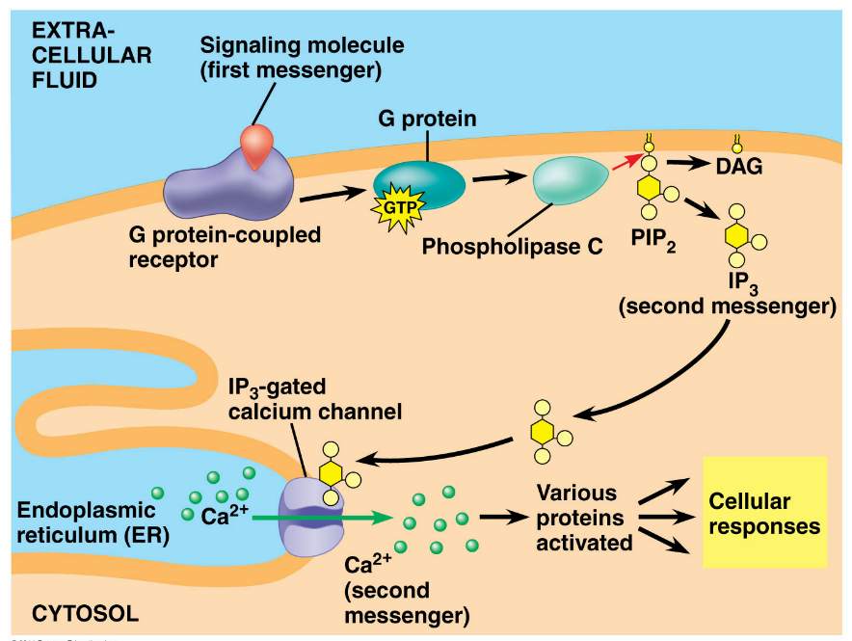
SECOND MESSENGERS = Internal signaling molecules released due to external signal Trigger response pathway in cell Calcium ions= common 2nd messenger
INFLUX of Ca⁺⁺ ions into cell or MOVEMENT of Ca⁺⁺ ions internally can trigger a response

Slide 9
CYCLIC AMP is a typical SECOND MESSENGER that affects metabolism
Production of c-AMP can
activate other molecules

Slide 10
AMPLIFICATION MORE FROM LESS
PHOSPHORYLATION CASCADE allows cells to AMPLIFY the original signal

Slide 11
The L

Slide 12
RESPONSE Gene is turned on Message is made and translated into a protein that will do something

