Slide 1
3’
5’
5’
3’

Slide 4
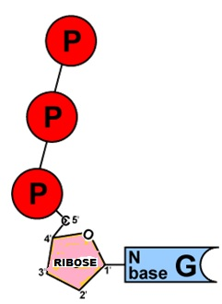

Slide 6
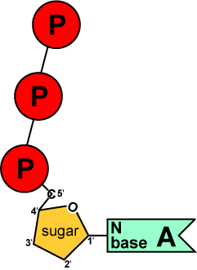

Slide 8
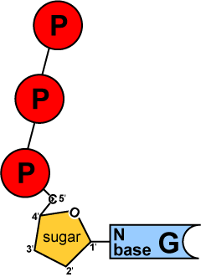

Slide 10
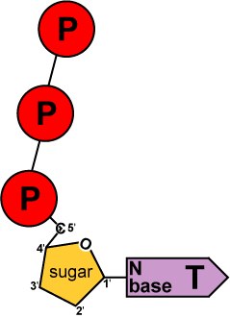

Slide 12
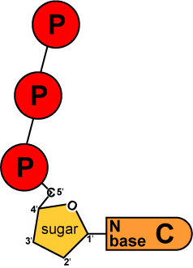

Slide 15
Can’t replace this primer- NO 3’ end

Slide 16
X

Slide 24
Can’t replace this primer- NO 3’ end

Slide 25
Can’t replace this primer- NO 3’ end

Slide 26
LABEL
Write down DNA Polymerase “RULES” Leading strand
Lagging strand
5’ ends
3’ ends
Add arrows to show direction of elongation
Okazaki fragments

