Slide 1
Blackboard Learn Beginner

Slide 2
Key Dates
May 1, 2011
New WebCT courses are no longer available
January 1, 2012
WebCT will be shut down
WebCT courses no longer available

Slide 3
Additional Trainings
Additional sessions planned for early December
Will be advertised over K-12 List Serves

Slide 4
What is Blackboard Learn?
Online course management system
New WebCT
improves upon WebCT features
Includes Web 2.0 technologies
Additional tools have been added
Blogs
Wikis

Slide 6
Why would I use Blackboard Learn?
Increased access to course materials
Available online at anytime and anywhere
Quick feedback
objective-based questions graded and available immediately after submission
survey option allows students to respond immediately and anonymously to multiple choice or true-false questions in class
Improved communication,
Announcements
Class discussions
Virtual classroom
Additional student data
Track student usage of courses and related materials

Slide 7
If you already have a WebCT course…
Log in to the K-12 Members site (https://members.k12.sd.us)

Slide 8
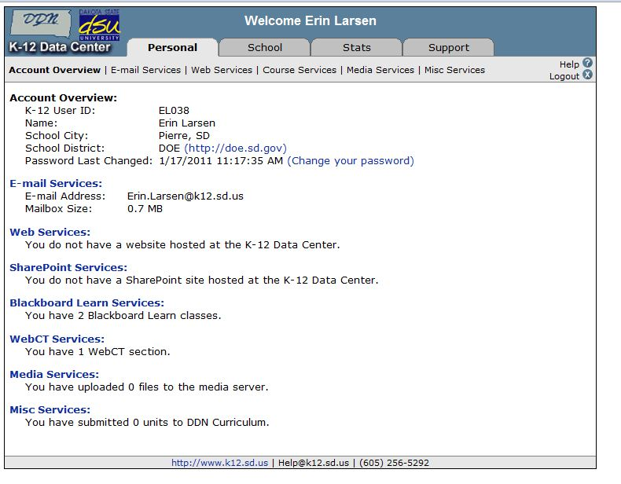
Under the Personal tab, click on the Course Services link.

Slide 9
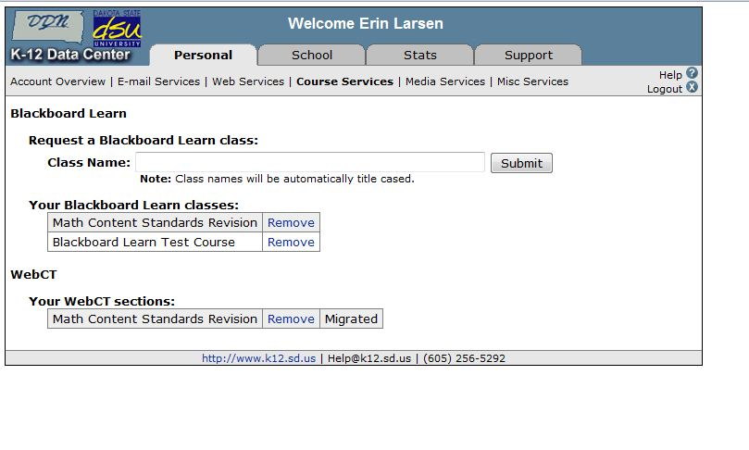
In the Your WebCT sections area, locate the section you wish to migrate to Blackboard Learn.
Click the Migrate link to the right of the section.
Verify that you have chosen the correct WebCT section to migrate, then click the Submit button.

Slide 10
While the migration is in progress, the Migrate link will change to Migrating...
Once the migration process has completed:
The Migrating... link will change to Migrated.
You will receive an email notification with additional information.

Slide 11
Migrated WebCT Courses Reminders
WebCT will be shut down on January 1, 2012.
WebCT sections that have not been migrated by that date will no longer be available.
The migration process does not remove the original WebCT section.
You can continue using the original WebCT section to complete the current semester.
Will need to add your own home page to migrated courses
Student enrollment is not migrated to Blackboard Learn.
This includes grades, submitted assignments, etc.
Only course content is migrated.

Slide 12
Creating a new class…
You can request a new Blackboard Learn class at any time.
Log in to the K-12 Members site (https://members.k12.sd.us).
Under the Personal tab, click on the Course Services link.

Slide 13
Enter the name of the class in the “Request a Blackboard Learn class” field and click the Submit button.
The class name will appear in the your pending Blackboard Learn classes area.
Once the class has been created:
The class name will appear in the Your Blackboard Learn classes area.
You will receive an email notification with additional information.

Slide 14
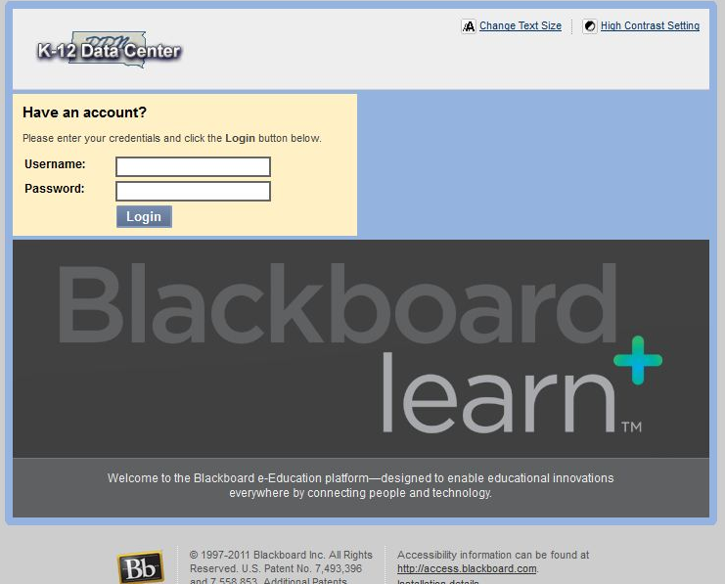
Logging-in to Your Course
Go to https://courses.k12.sd.us.
Type in your State K-12 username and password.
Notes:
This is the same username/password you use to access your State K-12 E-mail.

Slide 15
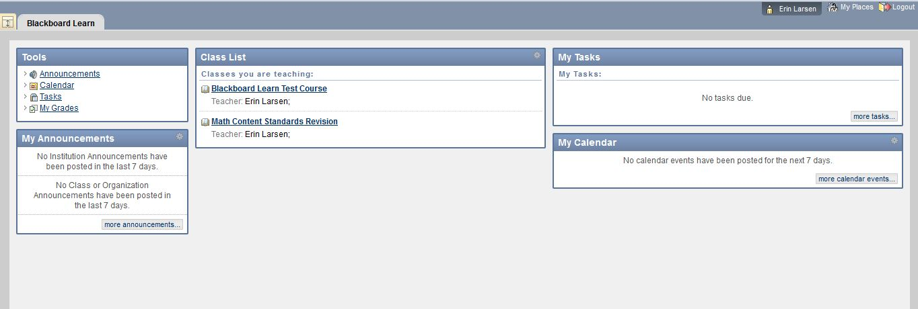
User Dashboard
Made up of components that provide information from various sources in the Blackboard system
The user can always return to the home page by clicking the Blackboard tab regardless of the page he or she is viewing.
The Settings button (gear icon) will allow users to customize settings for information displayed by certain modules

Slide 16
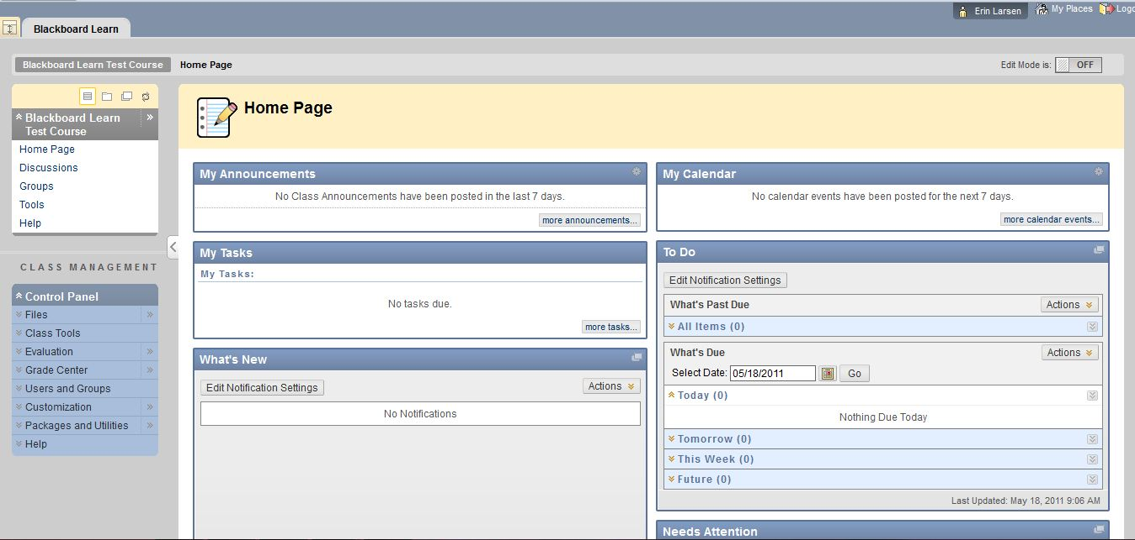
Course Home Page
Toggle Edit Mode ON/OFF
Allows users to change the way they are viewing the content on screen.
Switching the Edit Mode to ON allows users with certain roles in the system to add, remove, and edit content and tools in the course.
Switching the Edit Mode to OFF displays the Course as students would see it.
The Edit Mode toggle will only appear to those users who have permission to use it.

Slide 17
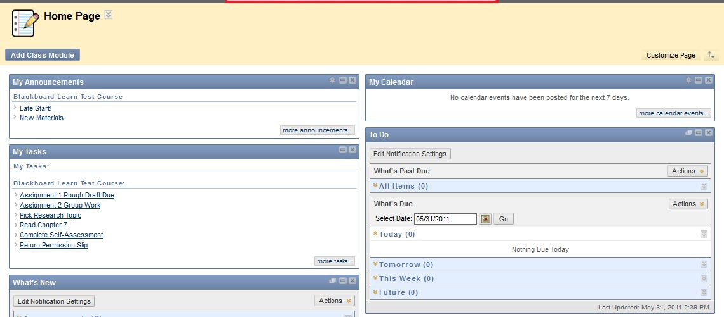
Course Home Page
Provides user with information from various sources in the course
Modify the layout by dragging modules to different locations in the content area or clicking the Add Modules button.
Modules can be minimized or deleted using the control buttons in the upper right‐hand corner of the module pane.
The Settings button (gear icon) will allow the user to customize the settings for information displayed by certain modules.

Slide 18
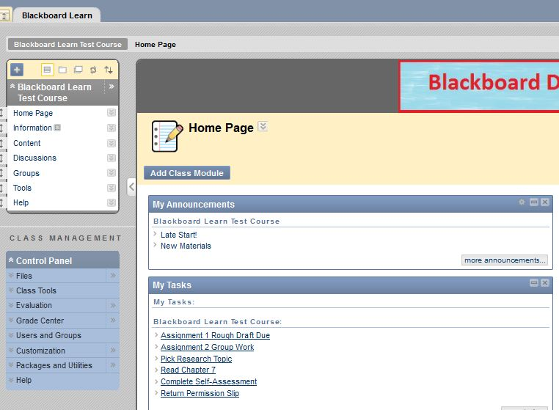
Course Menu
Contains links to the content area as well as other areas of the course.
Includes default links that can be renamed or rearranged

Slide 19
Course Management
Performed through the Control Panel located on the lower left‐hand corner of the Blackboard Learn window.
Only Instructors, Teaching Assistants, Graders, and System Administrators can access the control panel.
Control Panel allows users to
Access file manager.
Create class announcements.
Update the course calendar.
Work in the grade center.

Slide 20
Course Content Tools

Slide 21
Course Content
Course content is the set of materials assembled by the course builder which are used to teach the course.
Folders
Files
Assignments
Tests
Materials may be created outside of Blackboard Learn
Documents
Audio/Video files
Materials may be created within Blackboard Learn
Discussion boards
Wikis
Blogs
Content is added, deleted, edited and organized using the Course Menu and Control Panel.

Slide 22
Building Content

Slide 23
Content Availability
An availability option on the Add and Edit pages allows the user to set the content to available or unavailable.
Availability option allows instructors to create content and save it in a draft format before it is made available within a class.
This availability setting is separate from adaptive release settings.
If an item is not available, users may not access it regardless of the adaptive release rules.

Slide 24
Creating a Content Folder
Variety of ways to organize course
Folders for each week of the course
Folders for each topic
Separate folders for assignments and assessments
Once a folder is created, content and additional subfolders may be added.
The following steps will add a folder to a Content Area:
Toggle Edit Mode ON.
Open a Content Area.
Click Build Content.
Click Content Folder.
Enter folder Information and folder options.
Click Submit.

Slide 25
Adding File Content
Files (documents, PDFs, presentations, etc.) may be uploaded to Blackboard Learn
Can be included as content in a folder.
The following steps will add a file to a folder:
Toggle Edit Mode ON.
Open a folder.
Click Build Content.
Click File.
Browse you local computer, select the file to be uploaded, and complete the remaining options.
Click Submit.

Slide 26
Adding Video Content
Videos may be uploaded as content.
The following steps will add a video to a folder:
Toggle Edit Mode ON
Open a folder.
Click Build Content.
Click Video.
Browse you local computer, select the video file to be uploaded, and complete the remaining options.
Click Submit.

Slide 27
Adding a Web Link
Links to outside web sites and resources may be added to folders.
Always enter the full web address to the link (e.g.: http://www.sample.com).
The following steps will add an external link to a folder:
Toggle Edit Mode ON.
Open a folder.
Click Build Content.
Click URL.
Enter a Name (This will become the link users click on to access the content).
Enter the full URL.
Use the text box to add a description and complete the remaining options.
Click Submit.

Slide 28
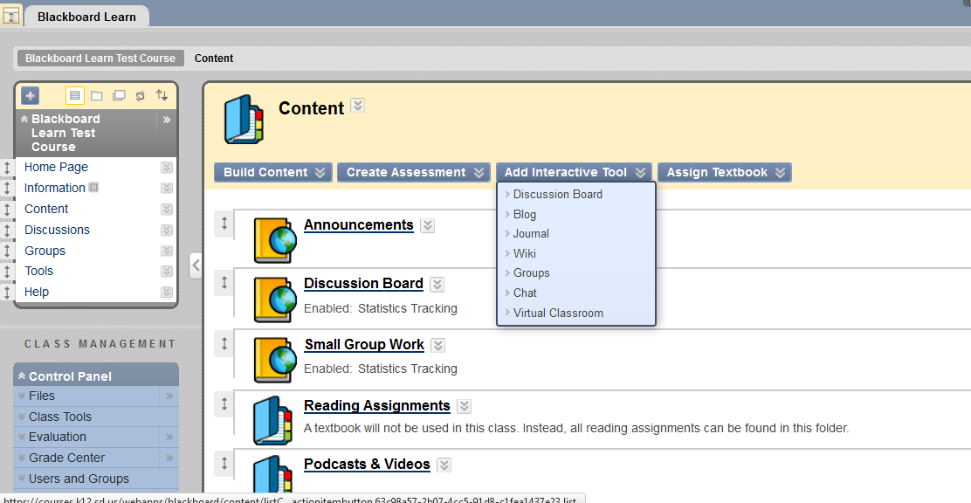
Creating a Discussion Board
Discussion Boards allow instructors to post a topic and students to discuss the topic in a forum‐like environment.
The following steps will add a discussion board to a folder:
Toggle Edit Mode ON.
Select a folder.
Click Add Interactive Tool.
Click Discussion Board.
Link to an existing discussion board or create a new forum.
Click Submit.

Slide 29
Learning Modules
A collection of content items focused on a specific subject that students can navigate at their own pace.
A pathway can be set so that students must view content in sequentially or set to permit students to view the content in any order.
All types of content, such as items, assignment, and assessments may be included in a Learning Module.

Slide 30
Information Tools

Slide 31
Creating Announcements
The announcement tool allows instructors to create and manage announcements distributed to the class.
Instructors can also send announcements as an email to students in the course to ensure students receive the information.
The following steps will create a class announcement:
Toggle Edit Mode ON.
Click Class Tools on the Control Panel.
Click Announcements.
Click Create Announcement.
Enter the announcement information and options.
Click Submit.

Slide 32
Creating Calendar Events
Allows instructors to post course events to the course calendar.
The following steps will create a calendar event:
Toggle Edit Mode ON.
Click Course Tools on the Control Panel.
Click Course Calendar.
Click Create Class Event.
Enter the event information and options.
Click Submit.

Slide 33
Creating Tasks
Instructors can post tasks to users participating in their courses.
Each user can post personal tasks to their page.
Task information is arranged in columns that display the priority, task name, status, and due date.
The following steps will create a task:
Toggle Edit Mode ON.
Click Class Tools on the Control Panel.
Click Tasks.
Click Create Class Task.
Enter the task information and options.
Click Submit.

Slide 34
Assessment Tools

Slide 35
Assignments
Allow instructors to create coursework and manage grades and feedback for each student.
Files may be attached to the assignments.
Students may access the assignment, complete it in a separate file, and send it back to the instructor.
Instructors may respond to each student separately, sending comments about their individual assignment, and attaching files.

Slide 36
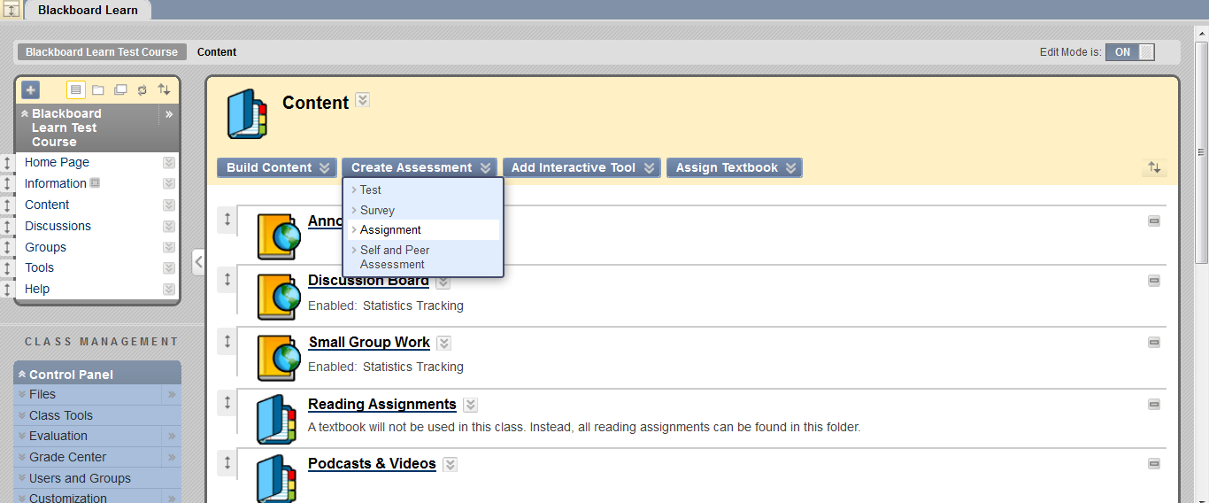
Creating an Assignment
The following steps will add an assignment to a folder:
Toggle Edit Mode ON.
Open a folder.
Click Create Assessment
Click Assignment.
Complete the Assignment Information, Assignment Files, Grading, Availability, Due Dates, and Recipients information.
Click Submit.

Slide 37
Grading Assignments
Assignments can be accessed for grading through the Needs Grading Page or through the Grade Center.
Accessing Assignments for Grading from the Grade Center
In the Control Panel, expand the Grade Center section.
Click Assignments.
Point to the cell to access the Action Link and click it to access the contextual menu,
Select Attempt.
On the Grade Assignment Page
The submission content can be found under Review Current Attempt.
Click the file name to view any attached files.
Type a numerical value in the grade box.
Click Save and Exit to return to the Grade Center.

Slide 38
Assigning a Test
Tests are deployed to students in the course by adding the tests to a folder.
Instructors may view and grade tests submitted by students in the Grade Center.
Tests submitted by students may not be viewed or graded from the folder where they are posted.
The following steps will add a test to a folder:
Toggle Edit Mode ON.
Select a folder.
Click Create Assessment.
Click Test.
There are two options for adding a Test:
Create a New Test (Click Create).
Select an existing Test (Select a Test from the Add Test box).
Click Submit.
After a Test is added to a folder, the Test Options page is displayed.

Slide 39
Test Options
Make the Test Link Available
Select Yes to make a link to the assessment appear to students.
If this option is set to No, it will not appear to students.
Use the Display After and Display Until fields to limit the amount of time the link appears.
Add a New Announcement for this Test/Survey
Select Yes to create an announcement for the Test.
The announcement will include the date and state “an Assessment has been made available in…”
This Announcement will appear in the Course Announcements.
Multiple Attempts
Allows students to take the assessment multiple times.
The status of multiple attempts is displayed to students at the top of the assessment.
Select Number of Attempts and enter a numeral to indicate a specific number of attempts that is allowed.

Slide 40
Test Options
Force Completion
Students must complete the assessment the first time it is launched
Students may not exit the assessment and continue working on it at a later date.
If the Force Completion option is enabled, it is explained to students at the top of the assessment.
If Force Completion is not enabled, students may save their progress and complete the assessment at another time.

Slide 41
Test Options
Set Timer
Select this check box to set a time limit for finishing the assessment.
If this option is selected, the time elapsed is displayed to the Student during the assessment.
Password
Select this check box to require a password for students to access the test.
Passwords cannot be longer than 15 characters and are case sensitive.

Slide 42
Collaboration Tools

Slide 43
Creating Messages
Messages are private communications that occur within a Class and among Class members.
Users must be logged into the class to read and send messages.
The Messages area has two folders, Inbox and Sent that cannot be deleted or renamed.
Students are not notified if they receive a new message, so routine checks must be made for new messages.
The following steps will create a message:
Click Class Tools on the Control Panel.
Click Messages.
Click Create Message.
Enter the message information and options.
Click Submit.

Slide 44
Groups Tool
Allows instructors to organize students into groups of any size.
Instructors can provide communication and collaboration tools that only group members can access.
Discussion boards
Blogs
Messages
Tasks
File Exchange
Groups can be designated as Self-Enroll
Students add themselves to a group
Groups can be designated as Manual Enroll
Instructor assigns students to a group.

Slide 45
Management Tools

Slide 46
Enrolling Users
Click on the class that you would like to enroll students to
User pool is based on K12 Data Center usernames.
The following steps will enroll users in a class:
Click on Control Panel → Users and Groups → Users.
Click on Find Users to Enroll button.
In the Username text field type the user ID that you would like to enroll. (Use the Browse button to search by a different field)
Click the Submit button.
The student should appear on the bottom of the page.

Slide 47
Class Roles
Users are assigned a role for each class they participate.
E.g.: a User with a role of teaching assistant in one class can have a role of student in another class.
Class role is set when a user is enrolled.
Can be edited after enrollment from the control panel.
Roles are based on access to the Control Panel
All new users added to a course are students by default.
In order to change a student’s role, send an email message to help@k12.sd.us

Slide 48
Class Roles
Course Roles include:
Course Builder
The course builder role has access to most areas of the Control Panel.
Does not have access to Student Grades.
Grader
The grader role has limited access to the Control Panel.
Can assist the instructor in the creation, management, delivery, and grading of tests.
Guest
Users with the role of Guest have no access to the Course Control Panel
Instructor
Instructors have access to all areas in the Course Control Panel.
This role is generally given to the person developing, teaching or facilitating the class.
Student
Student is the default user role.
As user with the role of student has no access to any areas on the Course Control Panel.
Teaching Assistant
Teaching assistants have access to nearly everything in the Course Control Panel.

Slide 49
Grade Center
A central repository for
assessment data
student information
instructor notes
A communication and reporting tool which can assist students and instructors to understand student progress
Found in the Control Panel

Slide 50
Course Copy
Course Copy will copy of the content of one course to another in Blackboard Learn.
Perform the following steps to copy a course:
Open Control Panel in the course to be copied and click Packages and Utilities.
Click Class Copy.
Select “Copy Class Materials into an Existing Course” for the copy type.
Enter the Destination Course ID (Must have a blank course set-up).
Place a checkmark by each item under Select Course Materials.
Click Submit.
The instructor will receive an email notification when the copy is complete.

Slide 51
More Resources

Slide 52
Exemplary Courses
Blackboard Learn recommended courses
http://kb.blackboard.com/display/EXEMPLARY/Exemplary+Course+Program
Click on “Course Tour” in the right hand column

Slide 53
Additional Resources
Teacher Help Manual
Link within the Control Panel
Student Help Manual
Link within the Course Menu
Blackboard Learn K12 Teacher Center
http://connections.blackboard.com/groups/690c134764/summary
Blackboard Partnerships
http://www.blackboard.com/Partnerships/Extensions.aspx
Blackboard On-Demand
http://ondemand.blackboard.com/

Slide 54
Still need help?
Try Google-ing your question
Several help videos and discussion boards exist
Search K-12 Data Center FAQs
http://k12.sd.us/
Email K-12 Data Center Help Desk
help@k12.sd.us

