Slide 1
Blackboard Learn Advanced

Slide 2
Where are we headed?
Move WebCT Courses to Blackboard Learn
Create a Course & Add Content
Use Advanced Collaboration Features
Locate Additional Resources

Slide 3
Key Dates
May 1, 2011
New WebCT courses are no longer available
January 1, 2012
WebCT will be shut down
WebCT courses no longer available

Slide 5
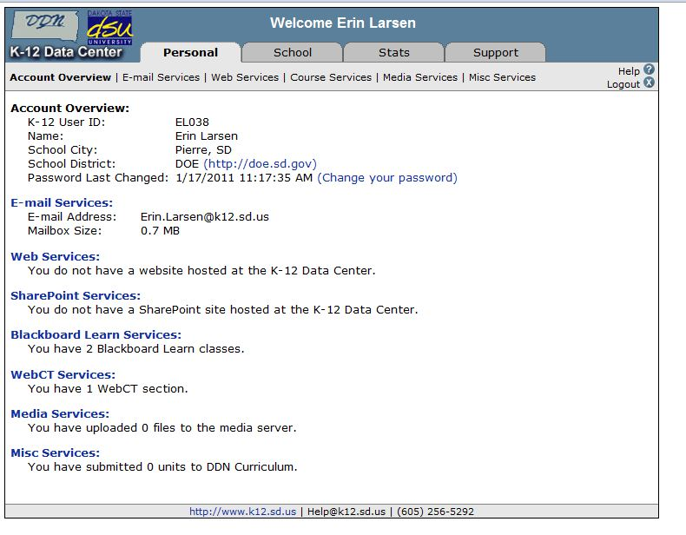
What About my old WebCT Courses?
Log in to the K-12 Data Center Members site (https://k12.sd.us)
Under the Personal tab, click on the Course Services link.
Notes:
Discuss differences with webct

Slide 6
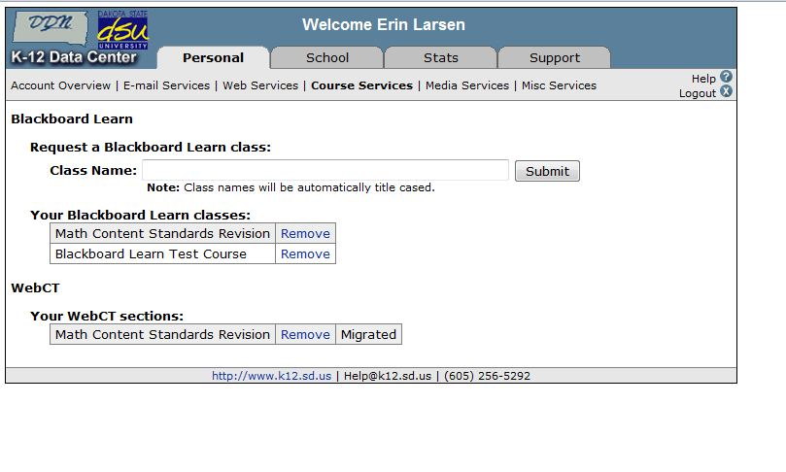
In the Your WebCT sections area, locate the section you wish to migrate to Blackboard Learn.
Click the Migrate link to the right of the section.
Verify that you have chosen the correct WebCT section to migrate, then click the Submit button.

Slide 7
While the migration is in progress, the Migrate link will change to Migrating...
Once the migration process has completed:
The Migrating... link will change to Migrated.
You will receive an email notification with additional information.

Slide 8
Migrated WebCT Course Reminders
WebCT will be shut down on January 1, 2012.
WebCT sections that have not been migrated by that date will no longer be available.
The migration process does not remove the original WebCT section.
You can continue using the original WebCT section to complete the current semester.
Student enrollment is not migrated to Blackboard Learn.
This includes grades, submitted assignments, etc.
Only course content is migrated.

Slide 9
Creating a new class…
You can request a new Blackboard Learn class at any time.
Log in to the K-12 Members site (https://members.k12.sd.us).
Under the Personal tab, click on the Course Services link.

Slide 10
Enter the name of the class in the “Request a Blackboard Learn class” field and click the Submit button.
The class name will appear in the your pending Blackboard Learn classes area.
Once the class has been created:
The class name will appear in the Your Blackboard Learn classes area.
You will receive an email notification with additional information.

Slide 11
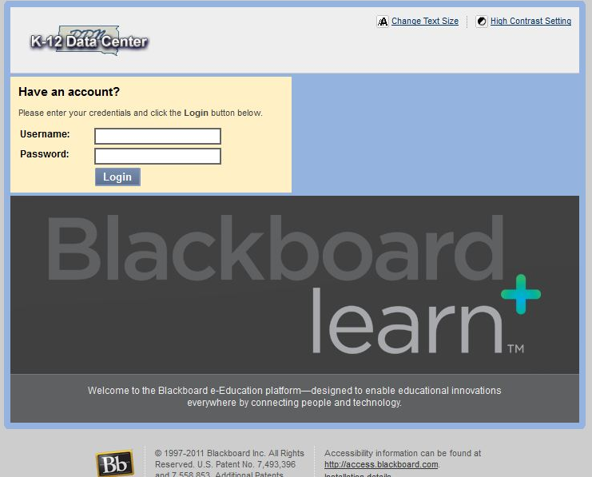
Logging-in to Your Course
Go to https://courses.k12.sd.us.
Type in your State K-12 username and password.

Slide 12
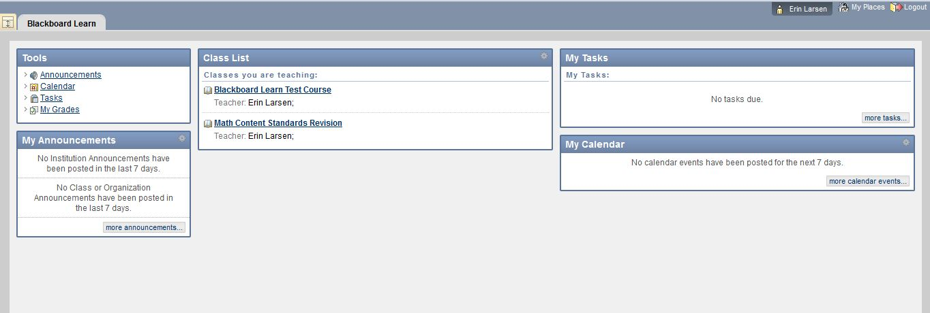
User Dashboard
Made up of components that provide information from various sources in the Blackboard system
The user can always return to the home page by clicking the Blackboard tab regardless of the page he or she is viewing.
The Settings button (gear icon) will allow users to customize settings for information displayed by certain modules

Slide 13
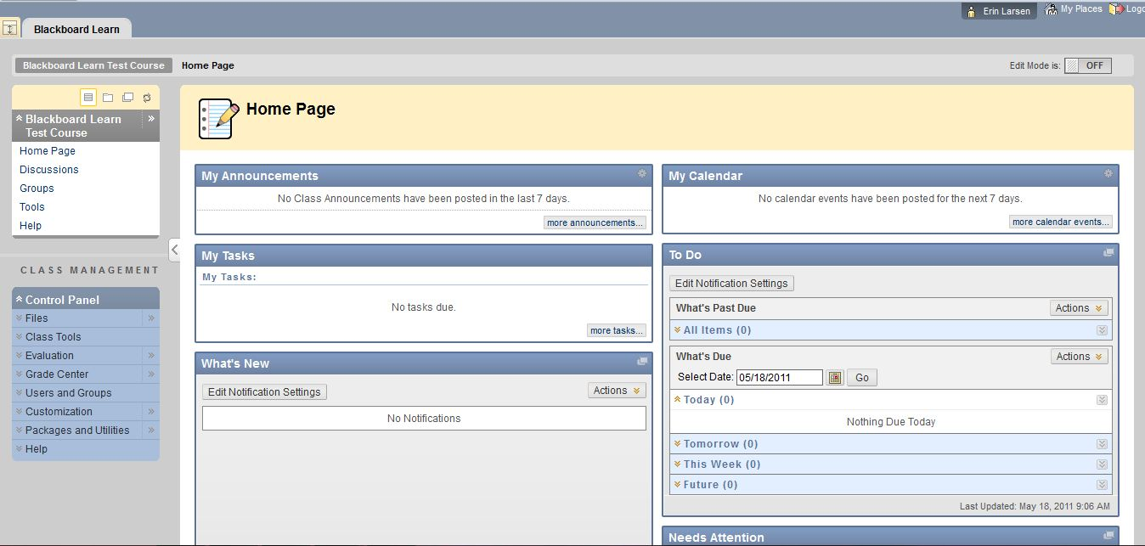
Course Home Page
Toggle Edit Mode ON/OFF
Allows users to change the way they are viewing the content on screen.
Switching the Edit Mode to ON allows users with certain roles in the system to add, remove, and edit content and tools in the course.
Switching the Edit Mode to OFF displays the Course as students would see it.
The Edit Mode toggle will only appear to those users who have permission to use it.

Slide 14
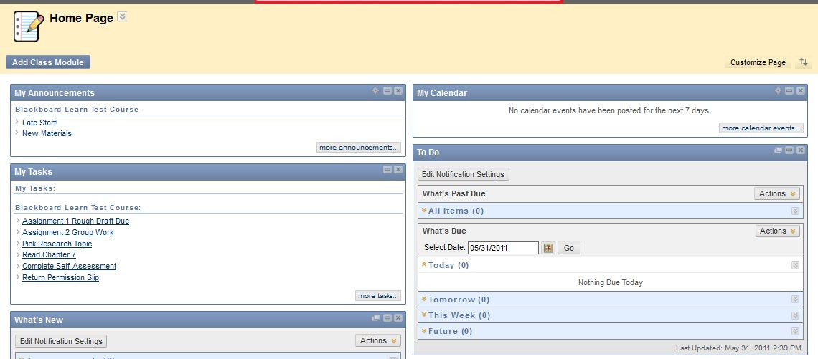
Course Home Page
Provides user with information from various sources in the course
Modify the layout by dragging modules to different locations in the content area or clicking the Add Modules button.
Modules can be minimized or deleted using the control buttons in the upper right‐hand corner of the module pane.
The Settings button (gear icon) will allow the user to customize the settings for information displayed by certain modules.

Slide 15
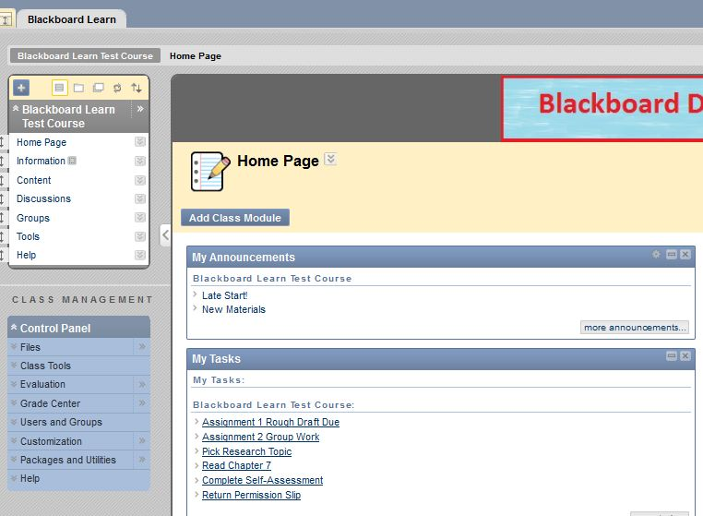
Course Menu
Contains links to the content area as well as other areas of the course.
Includes default links that can be renamed or rearranged
Use the double “v” icon to edit links

Slide 16
Course Management
Performed through the Control Panel located on the lower left‐hand corner of the Blackboard Learn window.
Only Instructors, Teaching Assistants, Graders, and System Administrators can access the control panel.
Control Panel allows users to
Access file manager.
Create class announcements.
Update the course calendar.
Work in the grade center.

Slide 17
Course Content Tools

Slide 18
Course Content
Course content is the set of materials assembled by the course builder which are used to teach the course.
Folders
Files
Assignments
Tests
Materials may be created outside of Blackboard Learn
Documents
Audio/Video files
Materials may be created within Blackboard Learn
Discussion boards
Wikis
Blogs
Content is added, deleted, edited and organized using the Course Menu and Control Panel.

Slide 19
Adding a Content Area
By default, a specific number of Content Areas appear in a class.
Teachers may create additional Content Areas or edit existing Content Areas.
To add a Content Area to the Class Menu:
Toggle Edit Mode On
Point to the plus sign above the Class Menu.
Select Create Content Area.
Complete the remaining options for the particular content.
Click Submit.
The new Content Area appears on the Class Menu
If the Content Area contains no content, an icon of a dotted square appears.
If the Content Area is unavailable to students, an icon of a square with a line through it appears.

Slide 20
Building Content
Files (documents, PDFs, presentations, etc.) may be uploaded to Blackboard Learn
The following steps will add content to your course:
Toggle Edit Mode ON.
Click on a content page within the Course Menu
Click Build Content.
Click the link of the type of content you wish to add.
Complete the remaining options for the particular content.
Click Submit.

Slide 21
Building Content
Notes:
Touch on tools as well—calendar, tasks, announcements

Slide 22
Adding Mashups
Allow instructors to include content from an external website.
Flickr Photo
Link to a site for viewing and sharing photographic images
SlideShare
Link to a site for viewing and sharing PowerPoint presentations, Word documents, or Adobe PDF Portfolios
YouTube
Link to a site for viewing and sharing online videos

Slide 23
Adding Mashups
The following steps will add a mashup to a course:
Toggle Edit Mode ON.
Click on a content page within the Course Menu
Click Build Content.
Click the Mashup link
Search by keyword for the type of content you wish to add.
Click Submit

Slide 24
Folders
Set up a hierarchy to group related material together.
E.g.: based on a theme such as all placing all media clips in one folder.
E.g.: group material together based on a schedule, such as placing all items for "week 1" together.
The following steps will add a folder to your course:
Toggle Edit Mode to ON.
Open a Content Area.
Point to Build and select content folder.
Complete the remaining options for the particular content.
Click Submit.

Slide 25
Lesson Plans
Combines information about the lesson itself with the curriculum resources used to teach it.
Default Lesson Plan includes
instructional level
grade level
objectives
subject area

Slide 26
Creating Lesson Plans
The following steps will add a lesson plan to your course:
Toggle Edit Mode ON
Access the Class area where the Lesson Plan will be added.
Point to Build Content and select Lesson Plan.
Lesson Pans are created in two steps based on the two tabs presented on the Create Lesson Plan page.

Slide 27
Learning Modules
A collection of content items focused on a specific subject.
Teachers can create a structured path for progressing through the items.
The path can be set so that students must view content sequentially, or set to permit users to view the content in any order.
Content within a Learning Module is added and managed just like content in a Content Folder.

Slide 28
Information Tools

Slide 29
Class Outline
Syllabus builder
Allows teachers to use a customizable template to pre-build lessons as needed.
How to Create a Class Outline
Select a Content Area.
Edit Mode is ON.
Point to Build Content.
Select Class Outline.
Type a Class Outline Name.
Choose Create New Class Outline to use the Class Outline Builder tool.
Click Submit.

Slide 30
Creating Announcements
The announcement tool allows instructors to create and manage announcements distributed to the class.
Instructors can also send announcements as an email to students in the course to ensure students receive the information even if they do not login to the course
The following steps will create a class announcement:
Toggle Edit Mode ON.
Click Class Tools on the Control Panel.
Click Announcements.
Click Create Announcement.
Enter the announcement information and options.
Click Submit.

Slide 31
Creating Calendar Events
Allows instructors to post course events to the course calendar.
The following steps will create a calendar event:
Toggle Edit Mode ON.
Click Course Tools on the Control Panel.
Click Course Calendar.
Click Create Class Event.
Enter the event information and options.
Click Submit.

Slide 32
Creating Tasks
Instructors can post tasks to users participating in their courses.
Each user can post personal tasks to their page.
Task information is arranged in columns that display the priority, task name, status, and due date.
The following steps will create a task:
Toggle Edit Mode ON.
Click Class Tools on the Control Panel.
Click Tasks.
Click Create Class Task.
Enter the task information and options.
Click Submit.

Slide 33
Rubrics
Lists evaluation criteria for an assignment.
Made up of rows and columns.
Rows correspond to the various criteria of an assignment.
Columns correspond to the level of achievement expressed for each criterion.
New rubrics default to three rows and three columns.
Rubrics can be duplicated by selecting the copy option from the contextual menu.

Slide 34
Creating Messages
Messages are private communications that occur within a Class and among Class members.
Users must be logged into the class to read and send messages.
The Messages area has two folders, Inbox and Sent that cannot be deleted or renamed.
Students are not notified if they receive a new message, so routine checks must be made for new messages.
The following steps will create a message:
Click Class Tools on the Control Panel.
Click Messages.
Click Create Message.
Enter the message information and options.
Click Submit.
Notes:
Similar to email, but

Slide 35
Assessment Tools

Slide 36
Assignments
Allow instructors to create coursework and manage grades and feedback for each student.
Files may be attached to the assignments.
Students may access the assignment, complete it in a separate file, and send it back to the instructor.
Instructors may respond to each student separately, sending comments about their individual assignment, and attaching files.

Slide 37
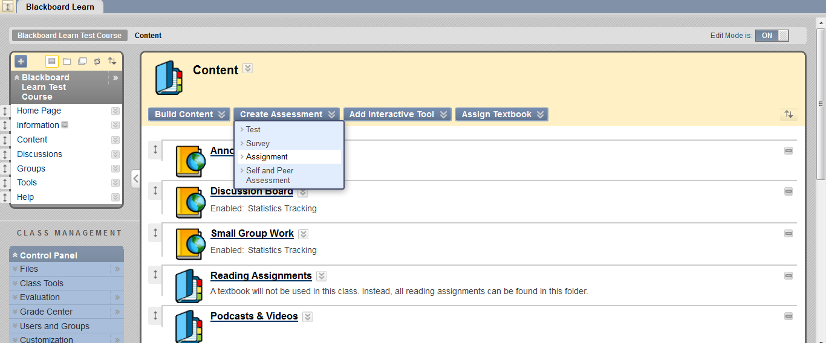
Creating an Assignment
The following steps will add an assignment to a folder:
Toggle Edit Mode ON.
Open a folder.
Click Create Assessment
Click Assignment.
Complete the Assignment Information, Assignment Files, Grading, Availability, Due Dates, and Recipients information.
Click Submit.

Slide 38
Grading Assignments
Assignments can be accessed for grading through the Needs Grading Page or through the Grade Center.
Accessing Assignments for Grading from the Grade Center
In the Control Panel, expand the Grade Center section.
Click Assignments.
Point to the cell to access the Action Link and click it to access the contextual menu.
Select Attempt.
On the Grade Assignment Page
The submission content can be found under Review Current Attempt.
Click the file name to view any attached files.
Type a numerical value in the grade box.
Click Save and Exit to return to the Grade Center.

Slide 39
Assigning a Test
Tests are deployed to students in the course by adding the tests to a folder.
Instructors may view and grade tests submitted by students in the Grade Center.
Tests submitted by students may not be viewed or graded from the folder where they are posted.
The following steps will add a test to a folder:
Toggle Edit Mode ON.
Select a folder.
Click Create Assessment.
Click Test.
There are two options for adding a Test:
Create a New Test (Click Create).
Select an existing Test (Select a Test from the Add Test box).
Click Submit.
After a Test is added to a folder, the Test Options page is displayed.

Slide 40
Test Options
Make the Test Link Available
If this option is set to No, it will not appear to students.
Add a New Announcement for this Test/Survey
The announcement will include the date and state “an Assessment has been made available in…”
Multiple Attempts
Allows students to take the assessment multiple times.
Force Completion
Students must complete the assessment the first time it is launched
Set Timer
Select this check box to set a time limit for finishing the assessment.
Password
Select this check box to require a password for students to access the test.

Slide 41
Exam View
Tests created in Exam View may be imported into a class.
Create test in Exam View
File>Export>Blackboard 7.1
Save test
Log in to Blackboard
Class Tools-tests/surveys/pool
Click on test link; import a test; browse computer and find test file
Submit
Edit the test as necessary and deploy the test from a folder.
Video Guide

Slide 42
Collaboration Tools

Slide 43
Collaboration Tools
Virtual Classroom
Users engage in a real-time discussion with other users, access the Web, and engage in question and answer sessions.
Users may also access the Whiteboard to display text and images.
Chat
part of the Virtual Classroom.
can also be accessed separately from Virtual Classroom.
Virtual Classroom and Chat sessions can be recorded and saved for future playback

Slide 44
Virtual Classroom
Follow the steps below to open the Virtual Classroom.
In the Class Tools area of the Control Panel, click Collaboration.
Click Join from the contextual menu of a Virtual Classroom session.

Slide 45
Management Tools

Slide 46
Enrolling Users
Click on the class that you would like to enroll students to
User pool is based on K12 Data Center usernames.
The following steps will enroll users in a class:
Click on Control Panel → Users and Groups → Users.
Click on Find Users to Enroll button.
In the Username text field type the user ID that you would like to enroll. (Use the Browse button to search by a different field)
Click the Submit button.
The student should appear on the bottom of the page.

Slide 47
Class Roles
Course Builder
The course builder role has access to most areas of the Control Panel.
Does not have access to Student Grades.
Grader
The grader role has limited access to the Control Panel.
Can assist the instructor in the creation, management, delivery, and grading of tests.
Guest
Users with the role of Guest have no access to the Course Control Panel
Instructor
Instructors have access to all areas in the Course Control Panel.
This role is generally given to the person developing, teaching or facilitating the class.
Student
Student is the default user role.
As user with the role of student has no access to any areas on the Course Control Panel.
Teaching Assistant
Teaching assistants have access to nearly everything in the Course Control Panel.
All new users added to a course are students by default.
To change someone to a different role, send an email message to help@k12.sd.us

Slide 48
Groups
Can be created one at a time or in sets.
Each Group has its own homepage, with links to tools to help students collaborate.
Instructors can manually select Group members or allow students to self-enroll.
Self-enrollment allows students to add themselves to a Group using a sign-up sheet.
For Manual Enroll, the teacher assigns each student in the class to a Group.

Slide 49
Creating Groups
Create a Single Group
On the Control Panel, select Groups in the Users and Groups section.
On the Groups listing page, point to Create Single Group.
Select Self-Enroll or Manual Enroll.
Complete the additional information about the Group.
Click Submit.
Create a Group Set
On the Control Panel, select Groups in the Users and Groups section.
On the Groups listing page, point to Create Group Set
Select Self-Enroll, Manual Enroll or Random Enroll.
On the Create Enrollment Group Set page, type a Name and optional Description.
In the Group Set Options section for Manual Enroll, type the Number of Groups to create or in the Membership section for Random Enroll, type the Number of Students per Group to create or the Number of Groups.
Click Submit.

Slide 50
Adaptive Release
Used in connection with Learning Modules.
Provides controls to release content to users based on a set of rules provided by the Instructor.
Basic Adaptive Release
rule consists of a set of criteria that defines the visibility of a content item to users.
if a rule has multiple criteria, the user must meet all criteria before the item is available.
Advanced Adaptive Release
enables teachers to create multiple rules for a single content item, and each rule can consist of multiple criteria.

Slide 51
Basic Adaptive Release Criteria
Criteria | Description
Date and Time | Display content based on a date or time.
Username | Display content to one or more users.
Class Groups | Display content to members of one or more Groups in a Class.
Grade Center Column | Display content item to users based a grade or a calculated column.
Grade Center: Item with at least one attempt | Display content based on a recorded attempt by the user, instead of a required score.
Grade Center: Item with a specific score | Display content based on a required score.
Grade Center: Item with a score between X and Y | Display content based on a range of scores.
Review Status an item | Display content to the user only after an associated item has been marked Reviewed by the user.

Slide 52
Adding Adaptive Release Criteria
Follow the steps below to add criteria to an adaptive release rule:
Open a Content Area from the Control Panel.
Edit Mode is ON.
Select Adaptive Release from the contextual menu for the item.
Complete the additional information.
Click Submit.

Slide 53
Performance Dashboard
Provides an up-to-date report on the activity for all students.
Review Status: Displays the number of Content Items that have been reviewed by a user.
Discussion Board: Displays the number of posts for the user.
How to Check User Progress from the Performance Dashboard
Under Evaluation, click Performance Dashboard on the Control Panel.
The Performance Dashboard appears.

Slide 54
Class Reports
Found within the Evaluation Tool on the Control Panel
Provides different ways to view information about student activity, content usage, class standards, and class objectives.
Running Reports
Click the action link next to the report title and select Run.
Enter the report specifications
Click Submit to run the report.

Slide 55
Early Warning System
A rule-driven communication tool that teachers can use to send notification messages to students when Early Warning System rule criteria are met.
Rules are created by teachers and can be based on a test score, calculated column, due date, or class access.
How to Create a Rule
On the Control Panel, click Early Warning System under the Evaluation section.
On the Early Warning System page, click Create Rule to access the drop-down list, and select Grade Rule, Due Date Rule, or Last Access Rule.
On the Add Early Warning System Rule page, enter a name for the rule.
Next to Availability, select the radio node next to Yes to activate the rule.
Under Rule Criteria, enter or select the information for the rule.
Click Submit.

Slide 56
Early Warning System
Refreshing Rules
The Early Warning System does not continuously monitor the class.
Refresh the Early Warning System rules periodically to discover incidents that trigger a warning.
Sending Notification Email Messages
The Early Warning System does not automatically notify students.
It is up to the Teacher to communicate the warning to the user by sending an email message from the Review Rule Status page.

Slide 57
Grade Center
A central repository for
assessment data
student information
instructor notes
A communication and reporting tool which can assist students and instructors to understand student progress
Found in the Control Panel

Slide 58
Needs Grading Page
Teachers can view assignments ready for grading or review on the Needs Grading page.
The total number of items to grade appears above the list of items.
Once attempts have been graded, they do not appear on the Needs Grading page.

Slide 59
Check Class Links
Allows teachers to check the links to class files that have been added to a class.
Detects any broken links added to the following areas:
Content, Learning Modules & Folders
Announcements, Calendar Events, and Tasks
Discussion Board, Journals, and Blogs
How to Check Class Links
On the Control Panel under Packages and Utilities, select Check Class Links.
On the Check Class Links page, click OK to start the tool.
This operation may take a few minutes to run
After Check Class Links is run, a results page appears, explaining the status of each link to a Class Files item.

Slide 60
More Resources

Slide 61
Exemplary Courses
Blackboard Learn recommended courses
http://kb.blackboard.com/display/EXEMPLARY/Exemplary+Course+Program
Click on “Course Tour” in the right hand column

Slide 62
Additional Resources
Teacher Help Manual
Link within the Control Panel
Student Help Manual
Link within the Course Menu
Blackboard Learn K12 Teacher Center
http://connections.blackboard.com/groups/690c134764/summary
Blackboard Partnerships
http://www.blackboard.com/Partnerships/Extensions.aspx
Blackboard On-Demand
http://ondemand.blackboard.com/

Slide 63
Still need help?
Try Google-ing your question
Several help videos and discussion boards exist
Search K-12 Data Center FAQs
http://k12.sd.us/
Email K-12 Data Center Help Desk
help@k12.sd.us

