Slide 1
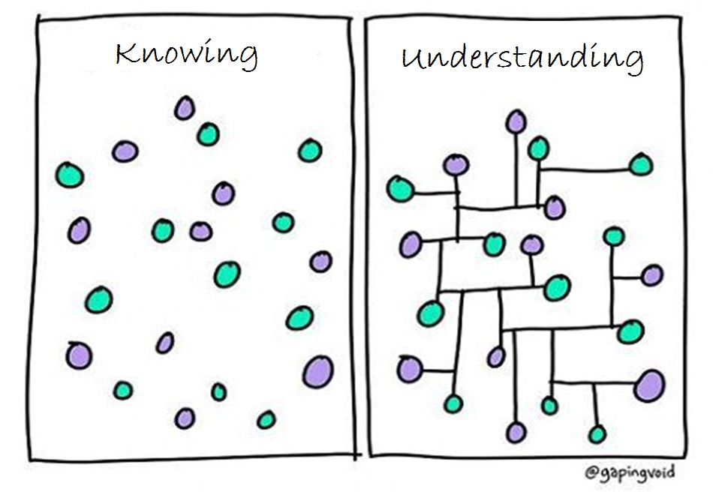
Image modified from: https://www.pinterest.com/pin/50313720815813086/

Slide 2
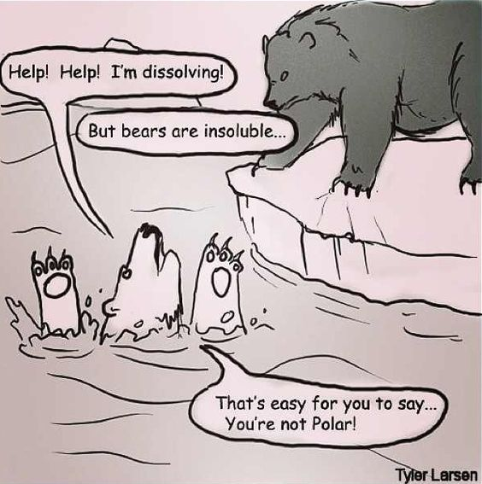
http://cdn.iwastesomuchtime.com/782012034822iwsmt.jpeg

Slide 3
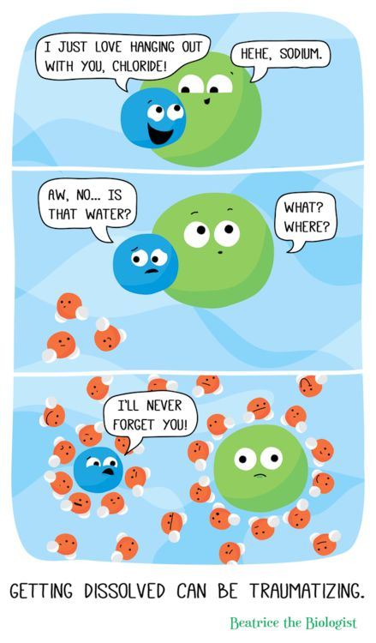
http://www.beatricebiologist.com/2014/07/getting-dissolved-can-be-traumatizing/

Slide 4
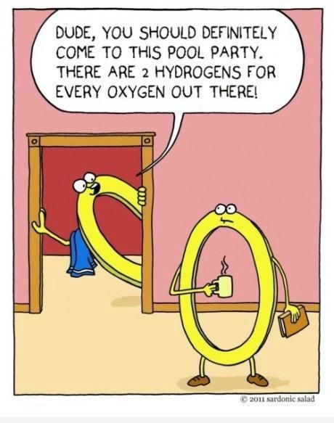
https://www.pinterest.com/pin/50313720816586136/

Slide 5
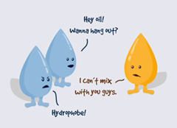
https://www.facebook.com/Carolina.Biological/photos/a.467232003653.259865.173476278653/10152807408233654/?type=1&theater

Slide 6
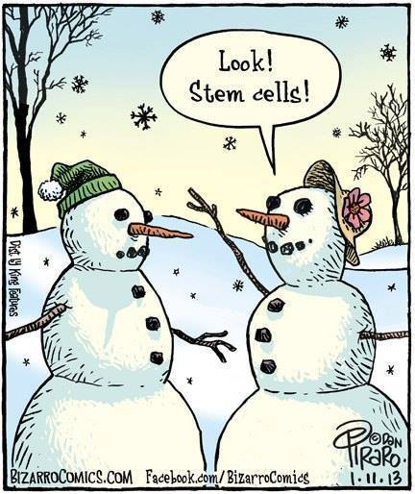
https://www.facebook.com/beingliberal.org/photos/a.180479986274.135777.177486166274/10152577904941275/?type=1&theater

Slide 7
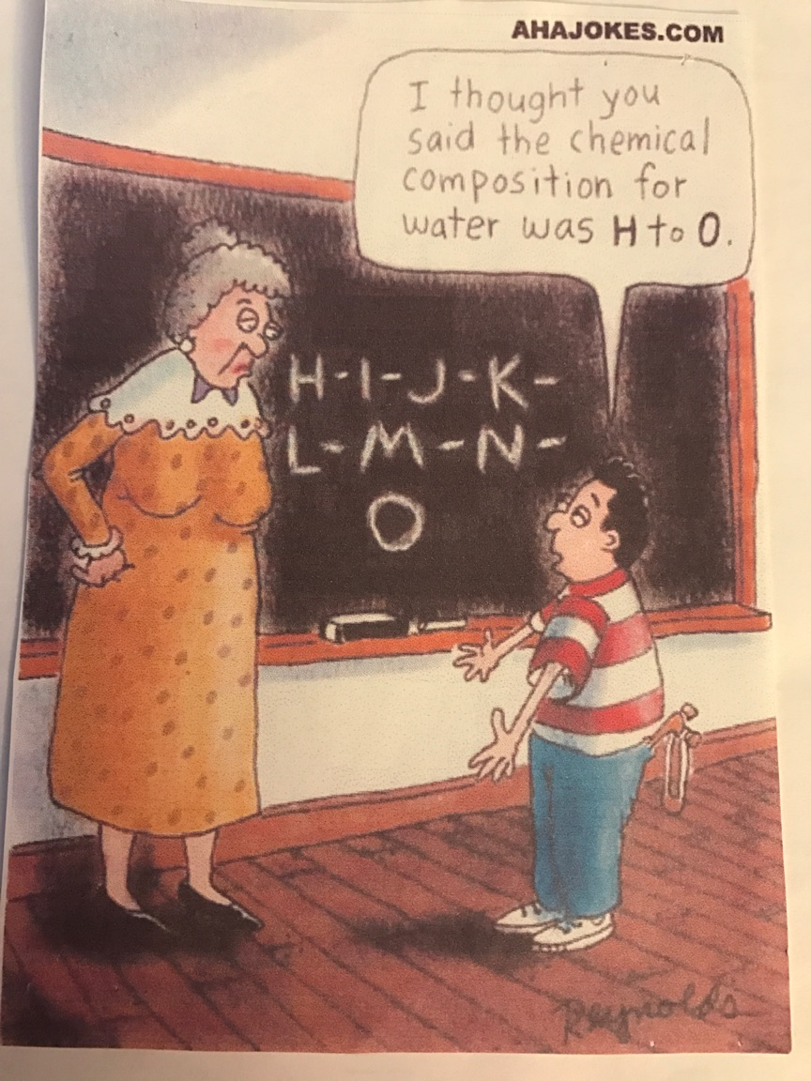

Slide 8
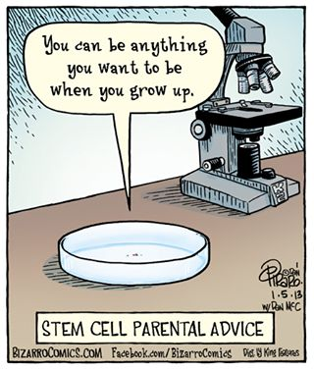
http://spartanburgimagery.org/jokes.html

Slide 9
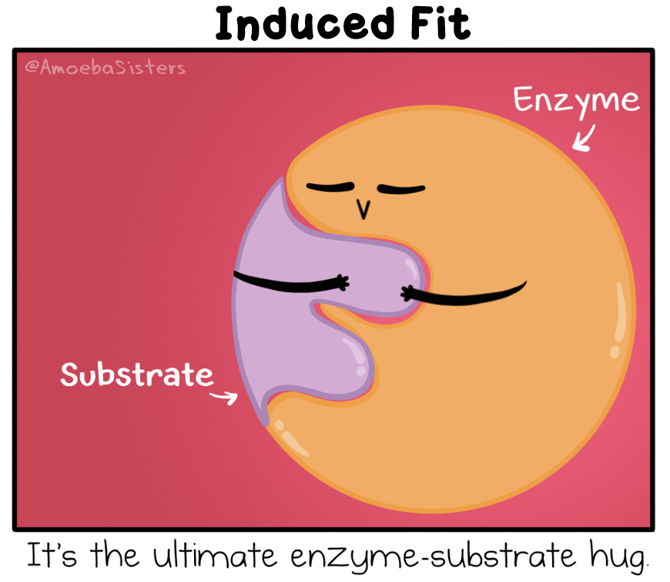
http://amoebasisters.tumblr.com/post/148695095482/truly-a-pair-that-was-made-for-each-other

Slide 10
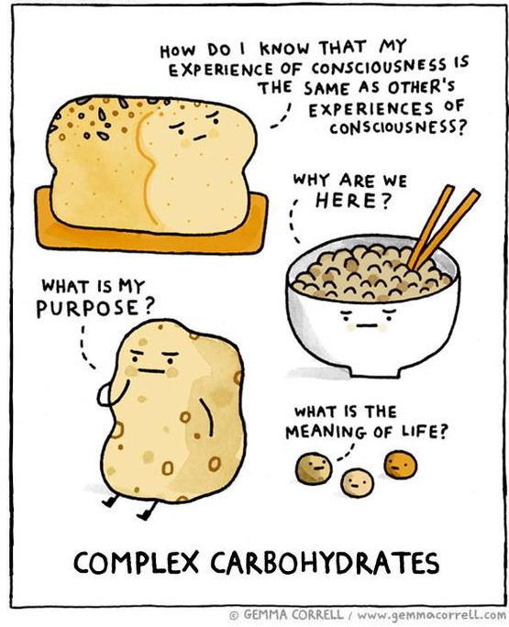
http://cdn3.bigcommerce.com/s-3yvzqa/product_images/uploaded_images/complex-carbs.jpg?t=1454429918

Slide 11
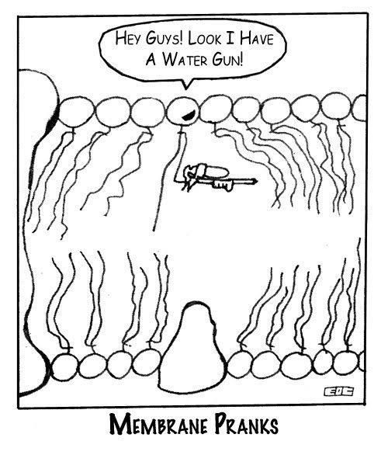

Slide 12
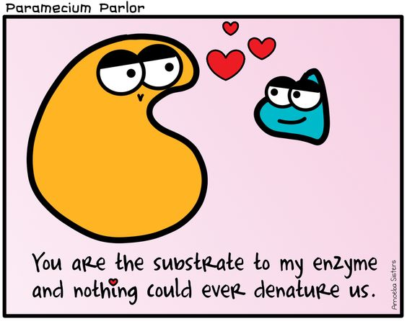
https://s-media-cache-ak0.pinimg.com/564x/ca/0c/1c/ca0c1ca2cf3de0f2e219ecd9b73cd224.jpg

Slide 13
https://wirdou.com/page/4/

Slide 14
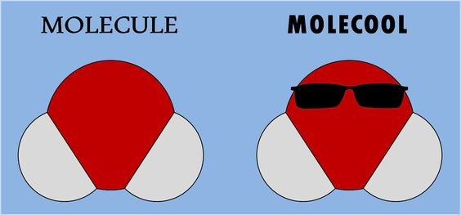
http://img1.rnkr-static.com/list_img_v2/7630/2427630/full/funny-science-puns.jpg

Slide 15
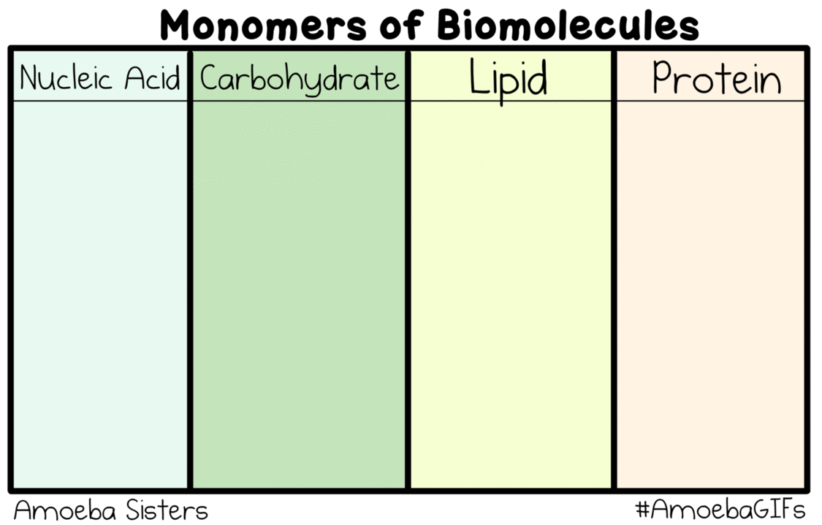
http://www.amoebasisters.com/gifs.html

Slide 16
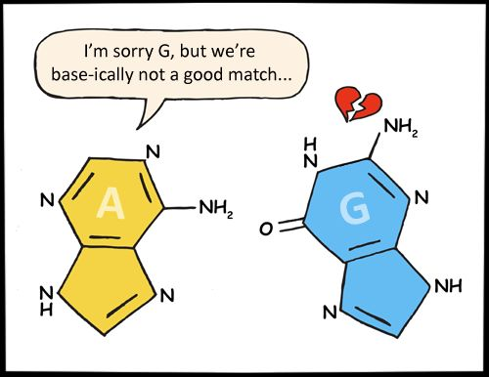
http://www.kappit.com/img/235305/im-sorry-g-but-were-base-ically-not-a-good-match/

Slide 17
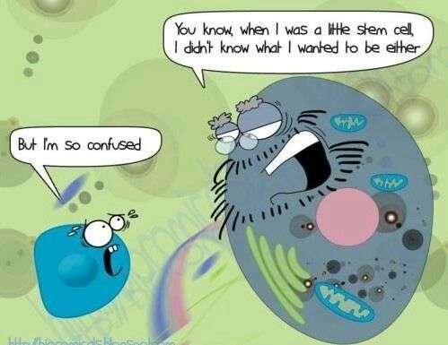
http://msfrancoisap.weebly.com/bio-jokes.html

Slide 18
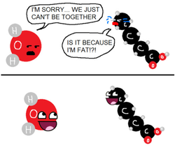
http://msfrancoisap.weebly.com/bio-jokes.html

Slide 19
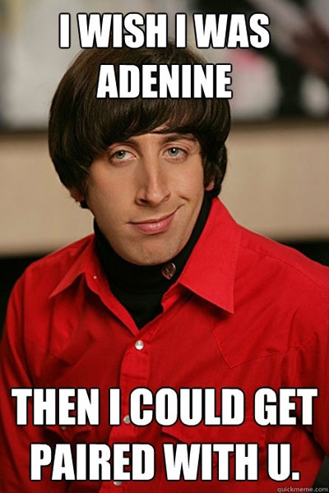
http://themetapicture.com/geeky-pick-up-line/

Slide 20
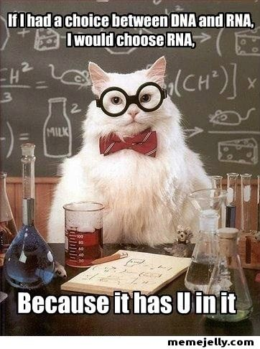

Slide 21
http://1.bp.blogspot.com/-Tb0DngTSUZU/VTFsBzym2bI/AAAAAAAAASQ/ldhvn55xxQg/s1600/Nerves.png

Slide 22
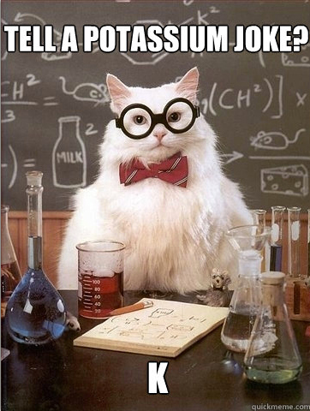
https://www.buzzfeed.com/daves4/the-best-of-chemistry-cat?utm_term=.iudJ3lJok#.ypPR9BR3W

Slide 23
https://amoebasistersgifs.blogspot.com/

Slide 24
https://www.tumblr.com/tagged/cell-membrane

Slide 25
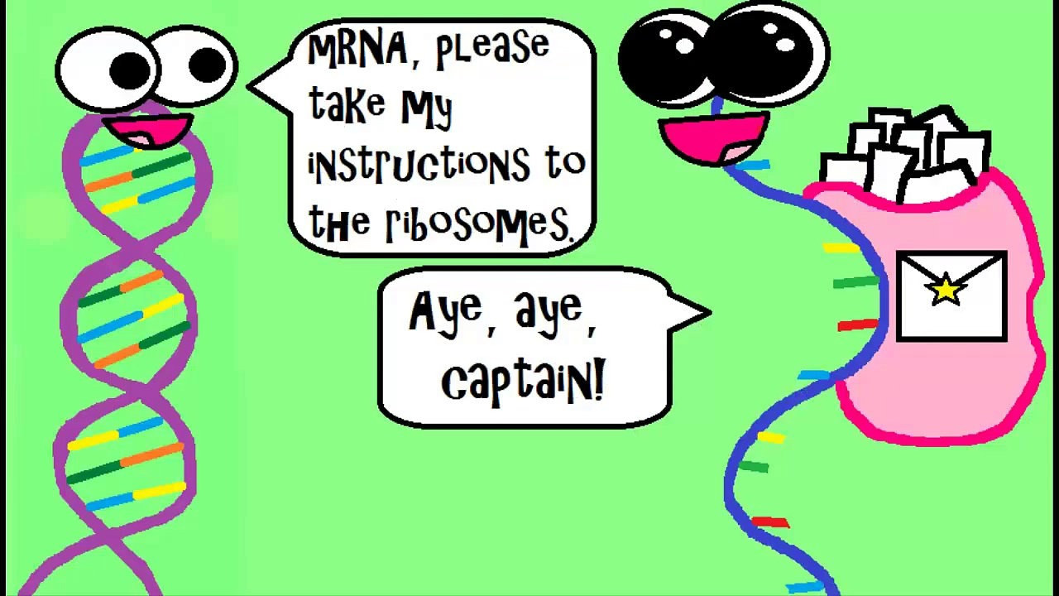
http://www.amoebasisters.com/parameciumparlorcomics

Slide 26
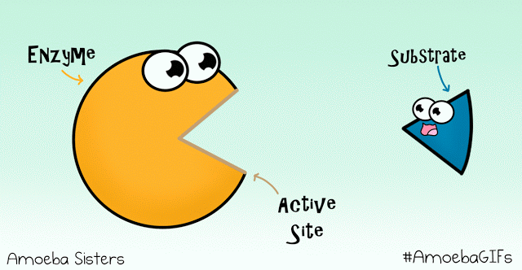
https://amoebasistersgifs.blogspot.com/

Slide 27
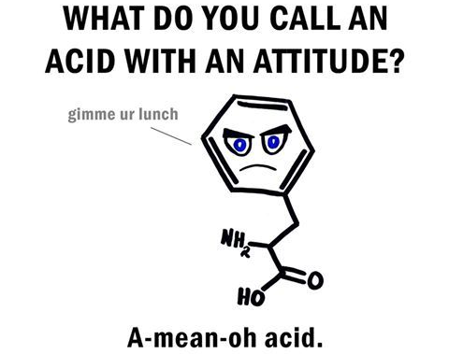
https://pics.onsizzle.com/Instagram-Science-puns-doyoueven-b0349c.png

Slide 28
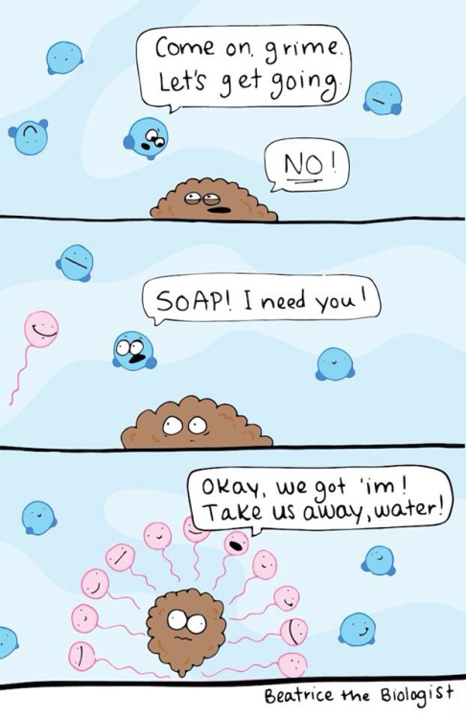
http://41.media.tumblr.com/7cb722d72f5bf68c3180b12c76b3c453/tumblr_mzt7bjWXcL1stoxi4o2_r2_500.jpg

Slide 29
https://www.pinterest.com/pin/50313720816864629/

Slide 30
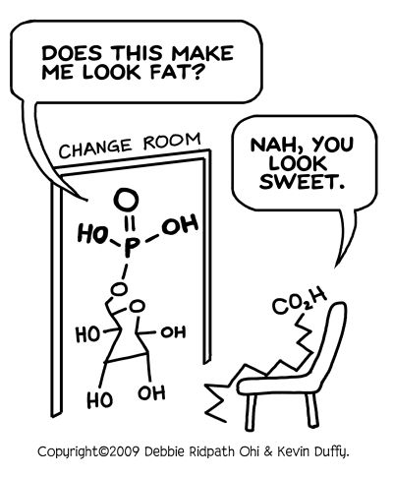
https://mrwinch.wordpress.com/sbi3u-course-info/

Slide 31
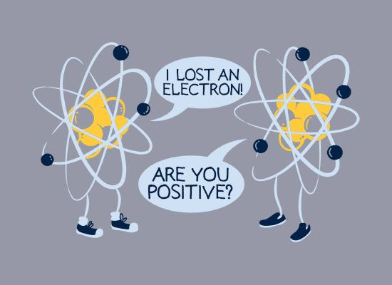
https://www.pinterest.com/pin/50313720816586103/

Slide 32
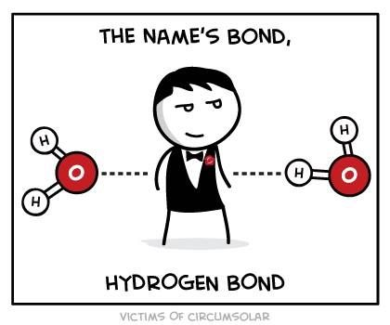
https://www.pinterest.com/pin/AY1yBSYigT3IoWFxRZCam3jqmB30fIz-OBOhiRM0PoZykOUd8OpEdhY/

Slide 33
https://www.pinterest.com/pin/50313720815906542/

Slide 34
https://www.pinterest.com/pin/469218854912084693/?utm_campaign=bprecs&e_t=033208929d04402992350c0c5d9654ae&utm_content=469218854912084693&utm_source=31&utm_term=1&utm_medium=2004

Slide 35
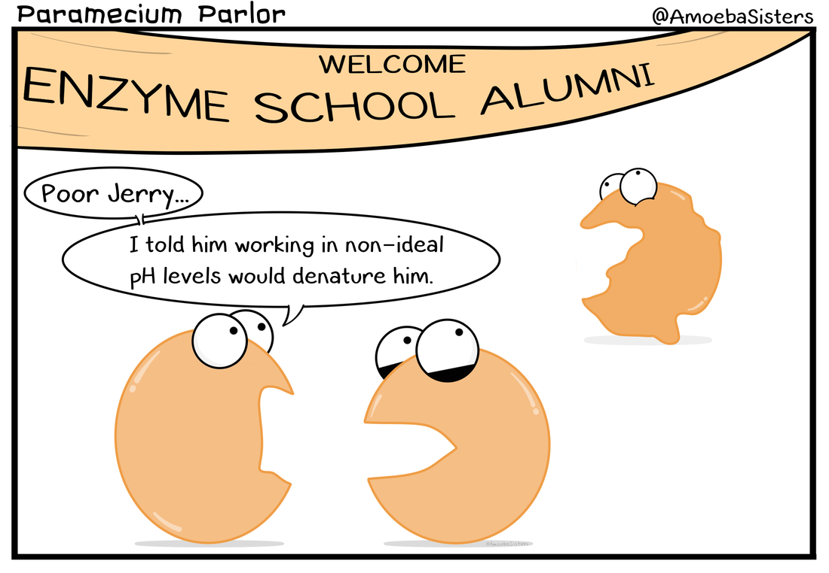
http://www.amoebasisters.com/parameciumparlorcomics

Slide 36
http://www.amoebasisters.com/parameciumparlorcomics

Slide 37
http://www.amoebasisters.com/parameciumparlorcomics

Slide 38
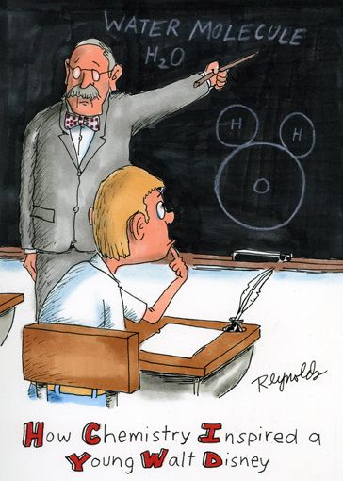
https://www.flickr.com/photos/pastilha/5655440124/in/photostream/

Slide 39
http://www.kappit.com/img/pics/201510_2200_aidgf_sm.jpg

Slide 40
http://amoebasisters.tumblr.com/post/148695095482/truly-a-pair-that-was-made-for-each-other

Slide 41
https://www.pinterest.com/pin/50313720816915425/

Slide 42
https://s-media-cache-ak0.pinimg.com/originals/06/2f/cc/062fcc91bca1baa8ff929a211d8f7ca6.jpg

Slide 43
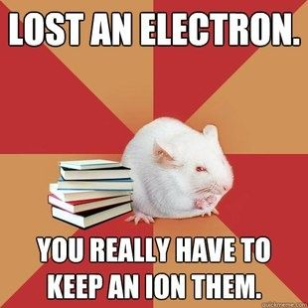
https://www.pinterest.com/pin/50313720817079899/

Slide 44
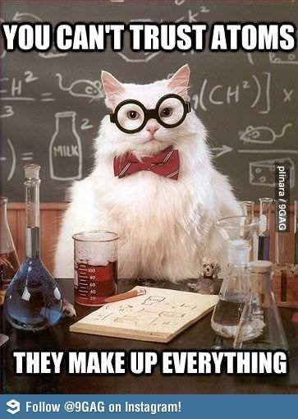
https://www.pinterest.com/pin/50313720817081466/

Slide 45
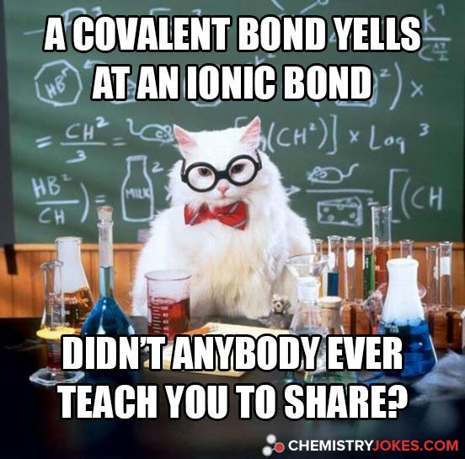
https://www.pinterest.com/pin/AQeO1Ywd_24Thg8mS5qOKOud2t-r9-s2LUKwKTzPkYvT7HBeKRN_aq4/

Slide 46
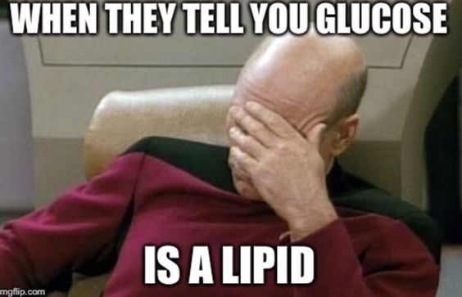
https://pbs.twimg.com/media/CiN_f2TWsAEem6e.jpg

Slide 47
https://www.pinterest.com/pin/50313720817003348/

Slide 48
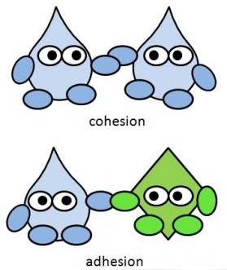
https://www.fastbleep.com/biology-notes/40/1166

Slide 49
http://bestlifemistake.blogspot.com/2014/02/middle-school-science-teacher-humor.html

Slide 50
http://bestlifemistake.blogspot.com/2014/02/middle-school-science-teacher-humor.html

Slide 51
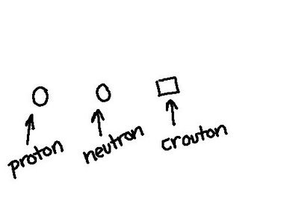
http://ondulyne.tumblr.com/post/6007971588

Slide 52
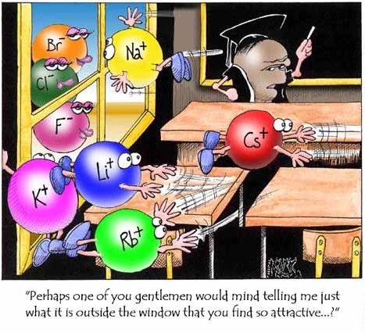
http://mkulling.cmswiki.wikispaces.net/

Slide 53
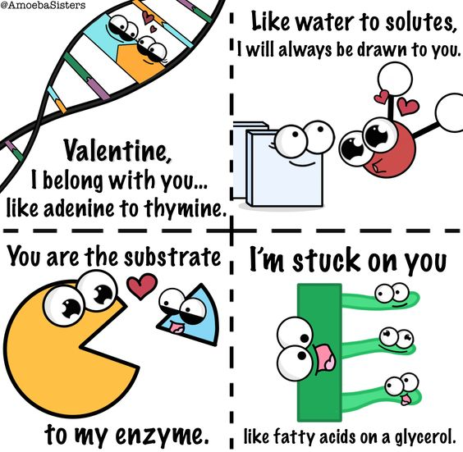
https://s-media-cache-ak0.pinimg.com/originals/6b/19/13/6b19136b658d454f593013393b80e96b.png

Slide 54
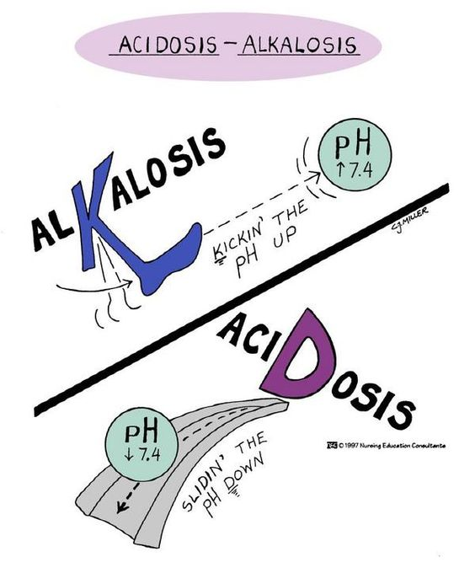
http://misslittlenurse.blogspot.com/2010/04/abg-analysis.html

Slide 55
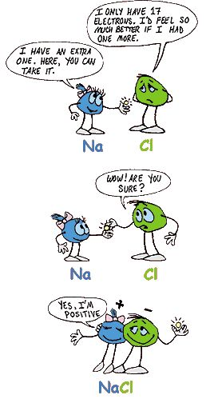
https://www.pinterest.com/pin/50313720817171935/

Slide 56
http://amoebasisters.tumblr.com/image/152825632443

Slide 57
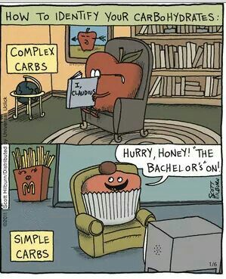
https://s-media-cache-ak0.pinimg.com/originals/c3/3a/7f/c33a7fac9078861b63e01cb66243049e.jpg

Slide 58
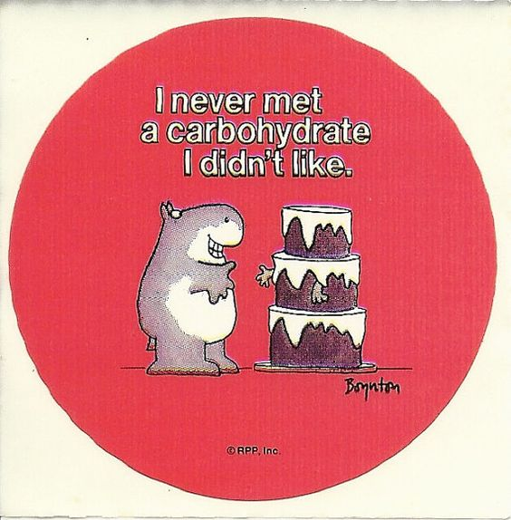
https://www.etsy.com/listing/119633874/vintage-80s-sandra-boynton-hippopotamus?utm_source=Pinterest&utm_medium=PageTools&utm_campaign=Share

Slide 59
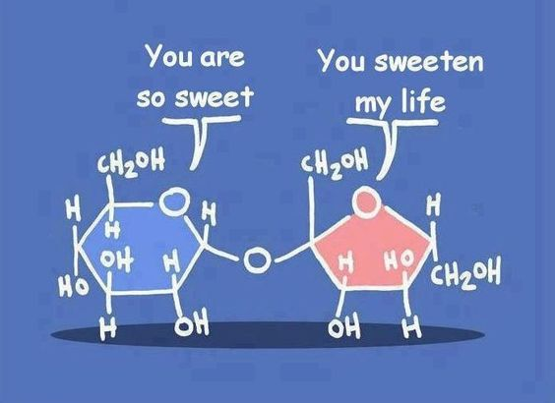
https://www.pinterest.com/pin/50313720817130164/

Slide 60
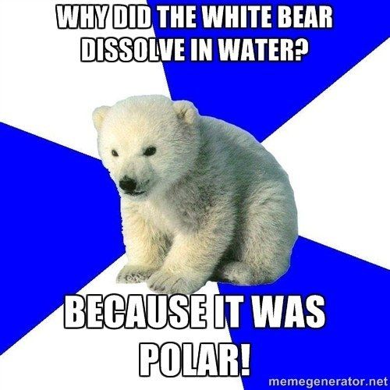
https://www.pinterest.com/pin/50313720817130126/

Slide 61
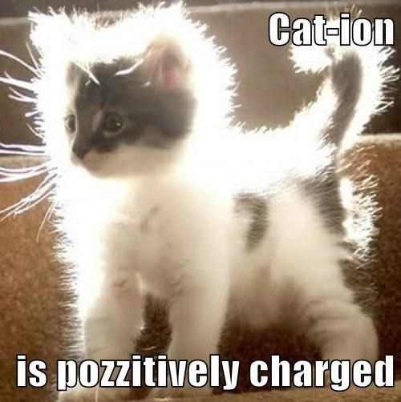
https://www.buzzfeed.com/alexkasprak/best-science-memes?sub=4061600_7204280&utm_term=.fpMyv6XQX#.nalRdv9P9

Slide 62
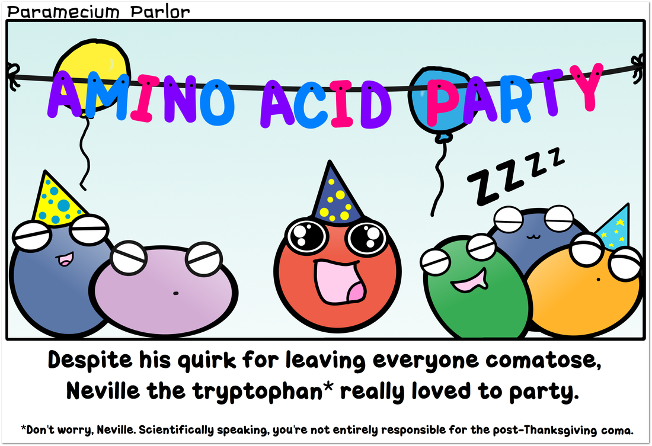
http://www.amoebasisters.com/parameciumparlorcomics/tryptophan-thanksgiving

