Slide 1
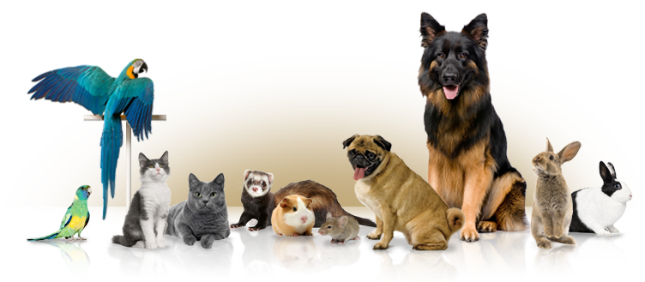
Can Pets Improve Mental Health?
By: Kalli Kuebler

Slide 2
What do pets help with?
Ease loneliness
Reduce stress, anxiety, and depression
Promote social interaction
Encourage exercise and playfulness
Provide unconditional love and affection

Slide 3
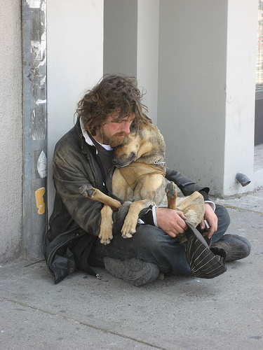
What do pets help with?
Children grow up more secure and active when caring for a pet.
They can provide valuable companionship for older adults.
A pet can add real joy to any human life.

Slide 4
What pet seems to affect our mental health the most?
Studies have shown that dogs have evolved to become acutely connected to humans and our behavior and emotions.
Dogs are able to understand many of the words we use.
But they’re even better at interpreting our tone of voice, body language, and gestures.
A loyal dog will look into your eyes to interpret your emotional state and try to understand what you are thinking and feeling

Slide 5
Statistics
Dog owners are less likely to suffer from depression than those without pets.
People with dogs have lower blood pressure in stressful situations than those without pets. (One study even found that when people with borderline hypertension adopted dogs from a shelter, their blood pressure lowered significantly within five months. )
Playing with a dog or cat can elevate levels of serotonin and dopamine, which calm and relax you.
Pet owners have lower triglyceride and cholesterol levels than those without pets. That means they have less signs of a heart attack.
Heart attack patients with dogs survive longer than those without.

Slide 6
Other facts
Children with ADHD can benefit from having a pet. It helps them learn to take care of a pet and learn to keep a schedule. Playing with the pet is a great way to release extra energy. It also calms the child with ADHD down so that they can sleep later. Pets can also help with a child’s self-confidence.
Children with autism often find it calming to work with animals. It has been claimed that when people have autism, animals can reduce stereotyped behavior and increase the desire and ability to connect socially with others.

Slide 7
Sources
http://www.helpguide.org/articles/emotional-health/the-health-benefits-of-pets.htm#top
http://www.mentalhealth.org.uk/help-information/mental-health-a-z/P/pets-mental-health/

