Slide 1
Cyborg Technology
Adam Young

Slide 2
What is it?
A cyborg is defined as a living organism with both organic and electronic parts. It is created from the words cybernetic and organism. This is often achieved with mechanical prosthetics.
The current tasks that scientists are working on are creating organs out of mechanical parts and a way to convert brain activity into a signal the robotic components can pick up.

Slide 3
Who’s Working on it?
Currently, groups such as DARPA (Defense Advanced Research Projects Agency) are working on creating robotics to replace human body parts. Although work on that is getting closer and closer each day, a human brain isn’t able to be implemented into a robot in the near future, even though it is possible.

Slide 4
How close are we?
Currently, we have the technology for many parts, including arms, legs, eyes, kidneys, hearts, and bones. The limbs that have been replaced can be controlled by the users mind as well.
The parts we have yet to implement are the liver, intestines, stomach, gallbladder, spleen, lymph system, and the brain. There is difficulty in keeping a brain alive in the body of a machine, but it is quite possible that we will see it complete in our lifetime.

Slide 5
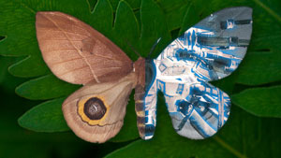
Related Projects
There is currently programs testing similar techniques. Probes were attached to a moth to test the flight patterns more accurately, and a rat had an electronic cerebellum implanted to help with brain function.

Slide 6
Sources
http://gizmodo.com/how-close-are-we-to-building-a-full-fledged-cyborg-1443146375
http://www.yalescientific.org/2014/10/creating-a-cyber-moth-bot-researchers-create-a-cyborg-moth-to-better-understand-its-flight-patterns/
http://www.newscientist.com/article/mg21128315.700-rat-cyborg-gets-digital-cerebellum.html#.VVkHamaPMyM

