Slide 1
Talking to Animals, the Possibilities of Science
By: Ariel Czlapinski

Slide 2
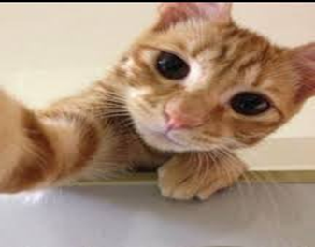
The Idea
I’ll bet everyone in the room, at one point or another, has thought it would be cool if they could talk to the local dog or converse with your spoiled cat. Well, maybe it is possible. Scientists are currently researching the possibility of humans talking to animals, or rather exchanging impressions and such that portray a certain thought or idea and making it understandable to humans.

Slide 3
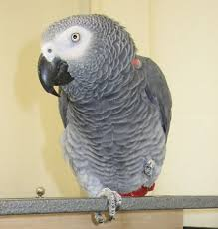
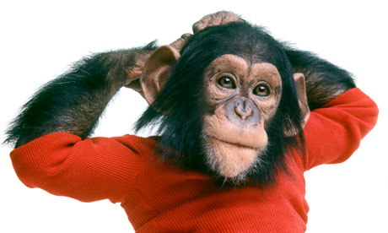
What We Have Thus Far
If you’re looking for an example of talking animals, just look at Nim Chimpsky and Alex the African grey parrot. Nim learned sign language and Alex can name objects and colors as well as count and ask for water. His creepy last words were “You be good, I’ll see you tomorrow. I love you.”
And you said animals were unintelligent.

Slide 4
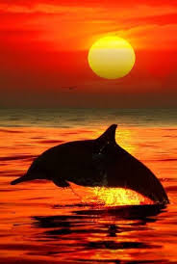
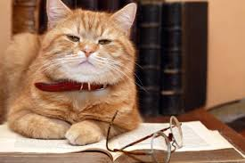
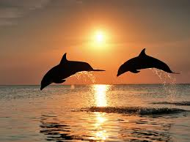
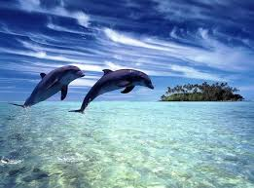
Science Involved
Scientists are working on the possibility of using a computer to translate what a dolphin says. Earlier researchers tried experiments with highly intelligent creatures that had a good brain- body ratio.

Slide 5
Sources http://www.theguardian.com/commentisfree/2014/jul/22/can-we-talk-to-the-animals

