Slide 1
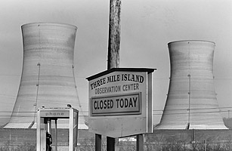
Three Mile Island
What Happened?

Slide 2
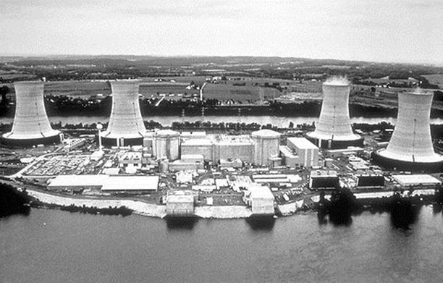
What is Three Mile Island?
Well Three Mile Island is on the Susquehanna River, it is known as a Nuclear Power Plant. You may think I have never heard of that River. Where is that? It is in Pennsylvania in the Londonderry Township. On March 28, 1979 tragedy struck here. What tragedy? Three Mile Island had the United States worst Nuclear Meltdown!
Before Accident:
Three Mile Island

Slide 3
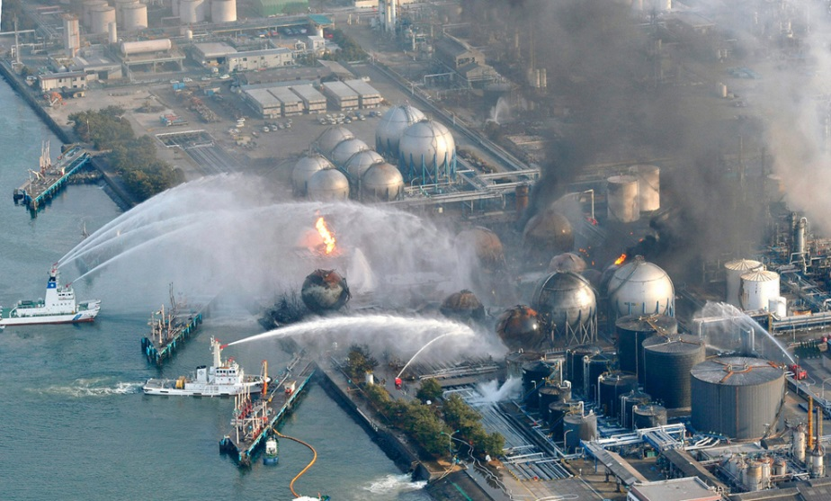
The Accident on Three Mile Island
This accident involves a combination of stuck valves, misread gauges and poor decisions. This was in the March of 1979 if you were wondering. Although this accident didn’t have major health affects it made several power plants shut down. It also scared people for the explosions like this in there work areas.

Slide 4
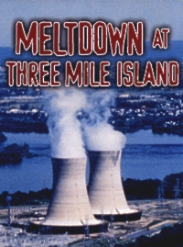
More on the Accident
One thing that caught my eye was they had to have pregnant women evacuate the town because it wasn’t safe enough for them. The radio activity that was released was declared as being non threatening to you health but that didn’t stop people from being scared.

Slide 5
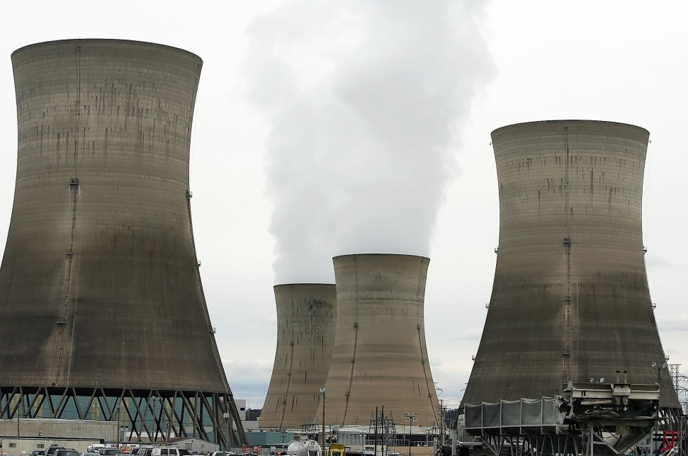
Three Mile Island Today
They had there 35th Anniversary to the accident. One thing that still isn't quite cleared up is what to do with all the nuclear waste. That was one thing they had to take action on first before deciding how they were going to go about bringing the plant back. Restoration of this site is still decades away.
Three Mile Island Today!

Slide 6
Sources
http://www.history.com/topics/three-mile-island
http://imgarcade.com/1/three-mile-island-explosion/
http://www.ratical.org/radiation/movies/meltdown.html
http://learning.blogs.nytimes.com/2012/03/28/march-28-1979-nuclear-accident-occurs-at-three-mile-island-plant/?_r=0
http://stateimpact.npr.org/pennsylvania/2014/03/28/three-mile-island-35-years-later/

