Slide 1
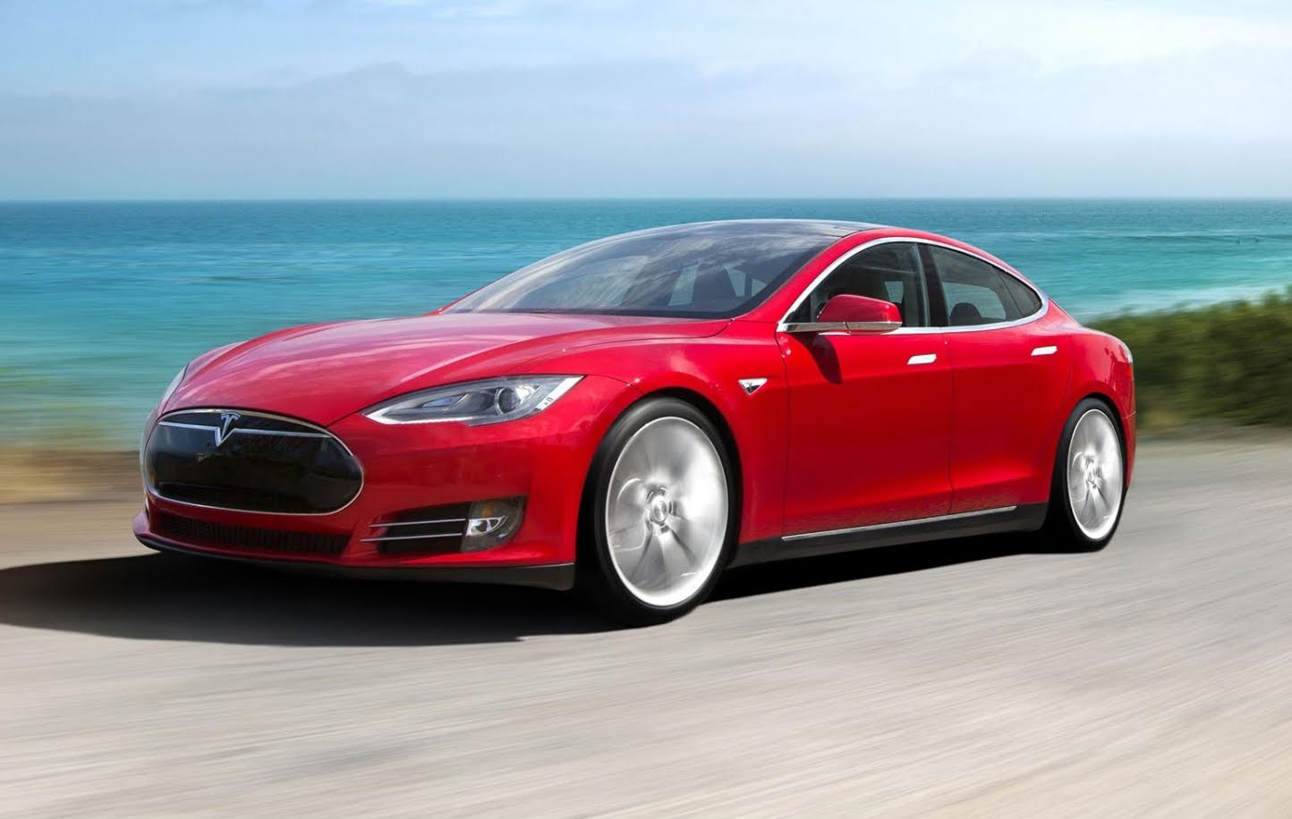

Slide 2
TESLA
TESLA MOTORS was founded by Elon Musk and a few of his business partners in 2010. He is owner of multiple electricity and electric motor patents.
The company is named after Nikola Tesla, a brilliant scientist with many new concepts of electricity. Tesla was also the first to have controlled Lightning indoors.

Slide 3
MODEL S
The MODEL S has been the company”s best selling car. It is availible in RWD or AWD.
They have sold nearly 30,000.
RWD model:
85
AWD models:
70D
85D
P85D

Slide 4
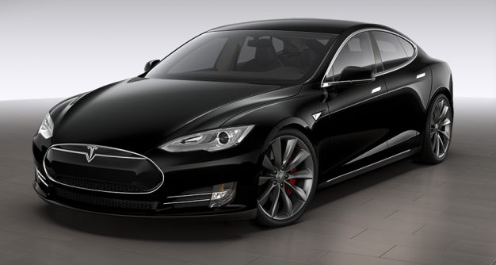
MODEL S
The MODEL S P85 D uses a high performance Dual Motor System. The Larger dual Motor makes 470 hp, and powers the rear wheels. The smaller electric motor make 221 hp and power the front wheels. This leads to 691 hp and 687lb of torque.
This leads to unbelieveable acceleration times. It can get from 0 to 60 mph in just 3.2 seconds.

Slide 5
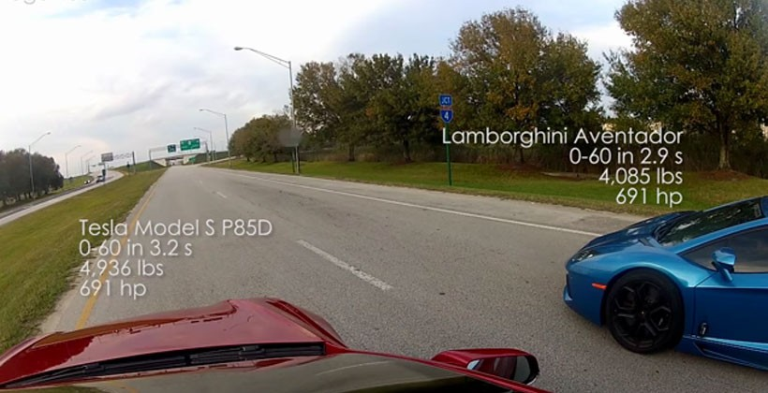
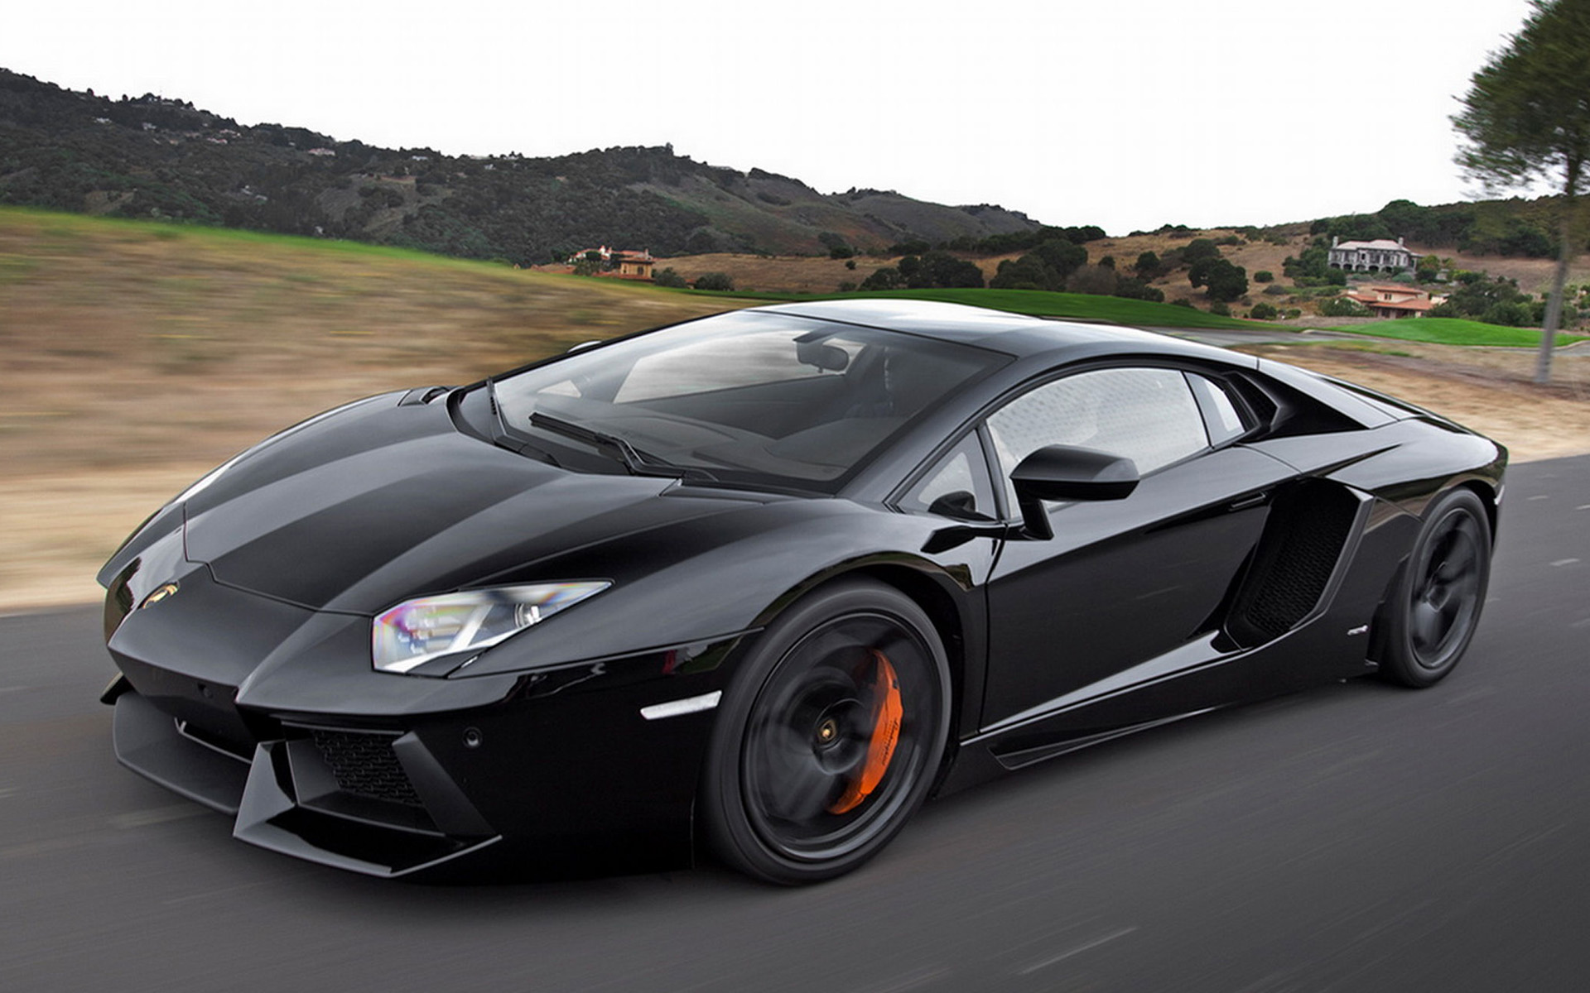
P85D
The MODEL S P85D has been known to beat other supercars in drag races.
It has the same amount of hp and around 100 lb ft more torque than a Lamborghini Aventador.

Slide 6
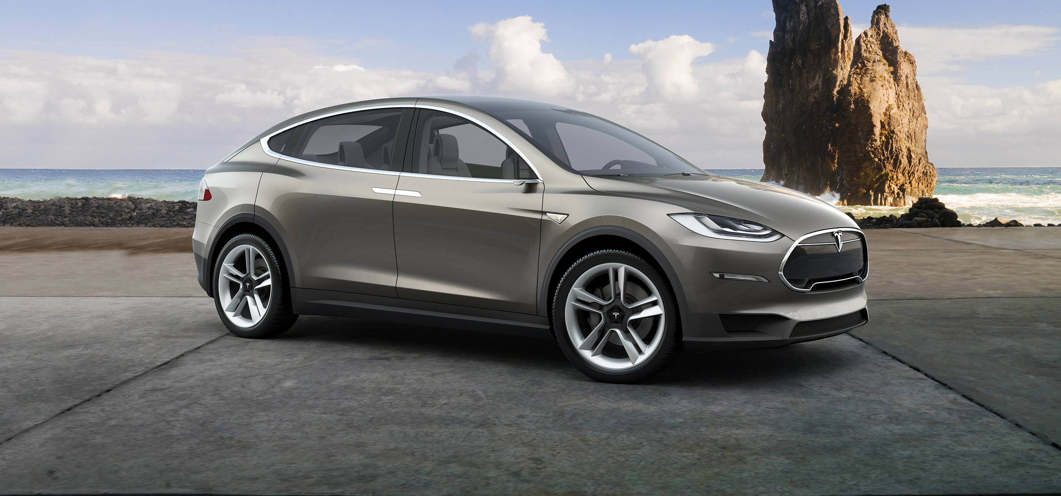
MODEL X
The MODEL X is a concept vehicle.
It is based off the platform of the MODEL S, but is an SUV.
It has the same motors and technology, but currently is not in production.

Slide 7
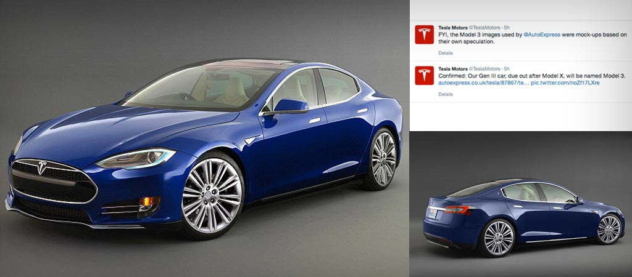
MODEL III
The MODEL III is another concept vehicle of TESLA.
It will have a shortened chassis of the MODEL S, and will be smaller.
It is considered to be entry-level sedan, and will be much less expensive.

Slide 8
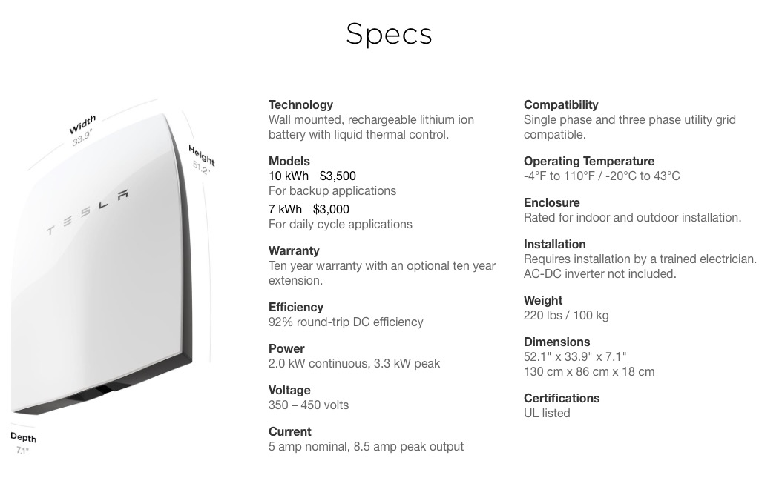
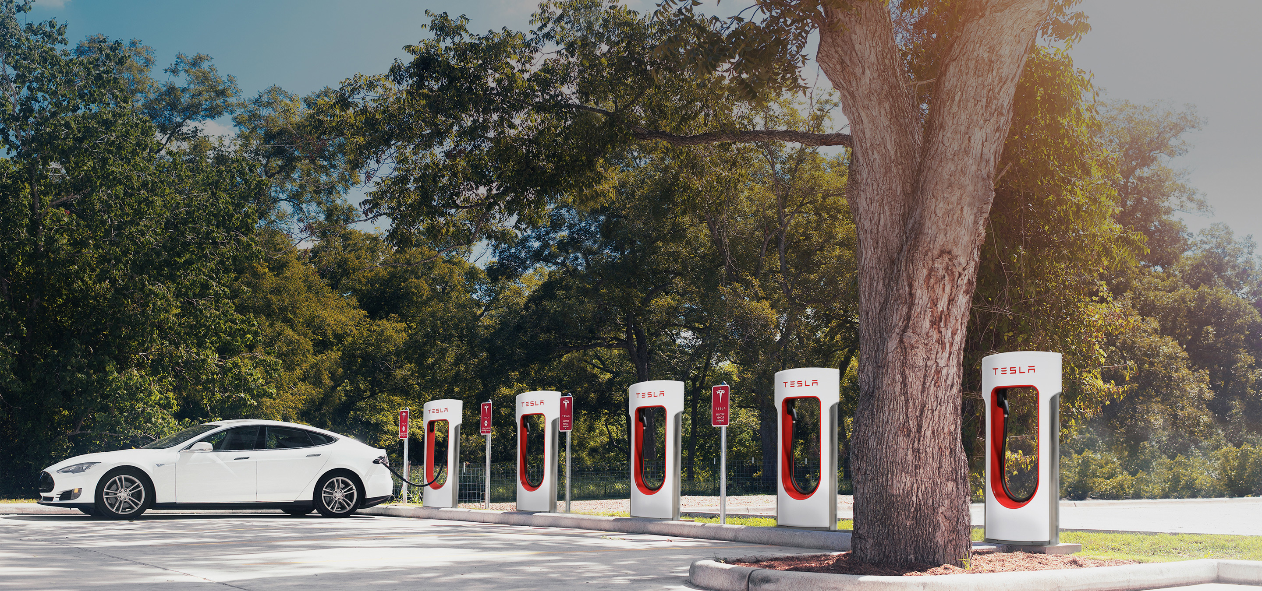
SUPERCHARGING SYSTEM and POWERWALL
TESLA has developed a SUPERCHARGING SYSTEM that allows it’s customers a qick 30 minute full charge of their vehicles.
The system is free
It provides a range of between 250 and 300 miles.
The POWERWALL is a solar power system that provides electricity for homes.
These homes will be energy independent.

Slide 9
SOURCES
http://www.teslamotors.com
http://jalopnik.com/tesla-model-s-p85d-this-is-it-and-i-went-for-a-ride-1644637002#

