Slide 1
Moon vs. Mars
Isaac von Fischer

Slide 2
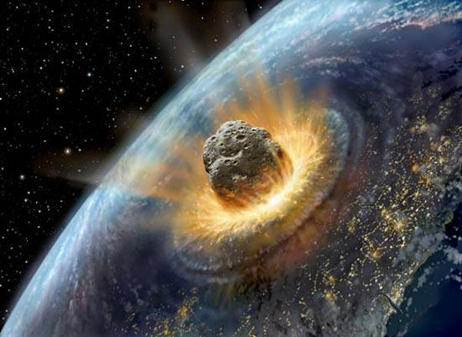
Moving off of Earth
The sun is ever changing and eventually will die out like any other star. As we know, we need the sun to survive on Earth.
With our population on only one planet, what happens if there is a catastrophic disaster that wipes out the planet? Our whole population would become extinct.
In order for our population to become immortal, we have to move off of Earth.

Slide 3
Why the moon?
The moon is an obvious option. With its close distance from earth and potential water.
Scientists believe that water could be found, frozen, in the Moon’s deep craters. Liquid water is not something that can be found on the moon.
Even though the moon is convenient, the surface is exposed to high-energy cosmic radiation. In order to live there, it would not be possible to live directly on the surface. Colonies would have to be dug several feet under the surface.

Slide 4
Why Mars?
In 2002, the Mars Odyssey spacecraft found water ice the size of continents on Mars surface.
Mars also has enough carbon in the soil for plants to grow.
The daytime temperature can sometimes reach 70 degrees Fahrenheit.
Hypothetically, the planet could be terraformed. Terraformed means to transform a planet to resemble earth, especially so it could support human life. It could be terraformed because of the amount of water on the planet that could potentially help create an atmosphere fit for human life.

Slide 5
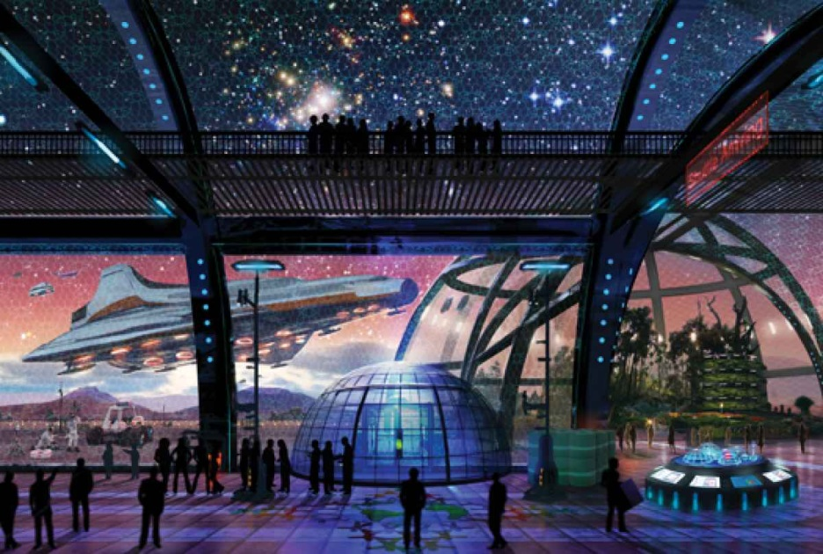
Travel
Space travel is not easy or cheap.
There are many seemingly impossible obstacles to conquer before we can create stable human life on another planet.
We are still years away from sending a man to Mars. Human colonies on other planets are still a long ways away.

Slide 6
Sources
http://www.popsci.com/science/article/2011-02/after-earth-why-where-how-and-when-we-might-leave-our-home-planet
http://www.blastr.com/sites/blastr/files/styles/blog_post_media/public/images/asteroidimpactingearth.jpg?itok=rqumTwNx
http://sservi.nasa.gov/articles/colonizing-the-moon/
http://en.wikipedia.org/wiki/Lunar_water

