Slide 1
Mad Cow Disease
By: Rylee and Cassidy

Slide 2
What is it?
Mad Cow disease is a incurable, fatal brain disease that affects cattle and sometimes goats and sheep
It attacks the cow’s nervous system and causes it to lose control of its ability to perform everyday tasks, like walking
Its medical name is bovine spongiform encephalopathy (BSE)

Slide 3
Can People get it?
People don’t contract Mad Cow disease, but if they eat the meat from an affected cow they can develop vCJD
vCJD is a type of protein that cause the brain cells to die, and the brain will eventually be spongy-like.
People will slowly lose control on their physical and mental abilities

Slide 4
Prevention
When you buy meat, make sure it comes from a reliable source
The Government (FDA) created a procedure to remove the parts of a cow that are at the highest risk of BSE (spinal chord and brain)
Ranchers also test their cattle regularly for the disease

Slide 5
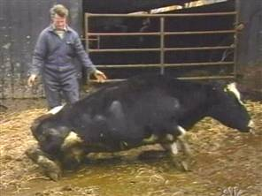
A cow with BSE is
trying to walk

Slide 6
Sources
http://kidshealth.org/teen/infections/bacterial_viral/mad_cow_disease.html#
http://schoolworkhelper.net/mad-cow-disease-history-causes/

