Slide 1
Is Invisibility Possible???
Sidney & Sam
Period 6

Slide 2
Is it possible???
In 2010, a German scientist made a 3D object disappear from view for the first time ever.
The lighting distorts the object making it appear invisible.
“When we looked at it through a lens and did spectroscopy, no matter what angle we looked at the object from, we saw nothing. The bump became invisible.”-Nicholas Stenger
"Theoretically, it would be possible to do this on a large scale but technically, it's totally impossible with the knowledge we have know," said Stenger. "But it could become a reality in 10 (2020) years."

Slide 3
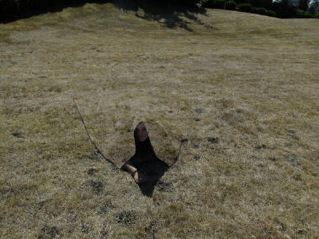
Benefits of Invisibility???
The military is working on Quantum Stealth, which will save lives.
Saving lives.

Slide 4
Disadvantages of Invisibility???
Blindness. If he and thus his eyes are invisible, how is light going to be absorbed by them, allowing him to see anything?
Injury. No one could be careful not to injure him, because they can't see him. the truck that would ordinarily yield to him in the crosswalk doesn't know that he is there. So he has to be really careful, all the time.

Slide 5
Is it ever going to Happen???
Scientists in the USA say they are a step closer to developing materials that could make people invisible. Researchers at the University of California have found a way to cloak humans and objects using special materials that redirect light around things. The findings were published in the journals ‘Nature’ and ‘Science’.
Hyperstealth is a successful Canadian camouflage design company with over two million military issued uniforms and over 3000 vehicles and fighter jets using their patterns around the world.

Slide 6
Bibliography
http://www.dailymail.co.uk/
www.breakingnewsenglish.com/
www.everything2.com/

