Slide 1
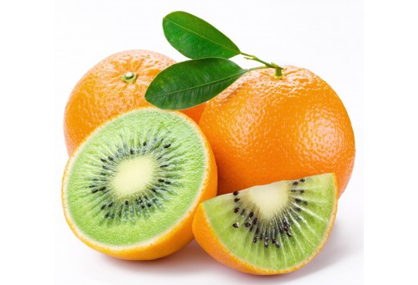
GMOs: The Pros and Cons
By George Roy
Period 7

Slide 2
What are GMOs?
GMO stands for Genetically Modified Organism.
GMOs are defined as “are living organisms whose genetic material has been artificially manipulated in a laboratory through genetic engineering”
GMOs are very important today: over 80% of U.S food products are GMOS.

Slide 3
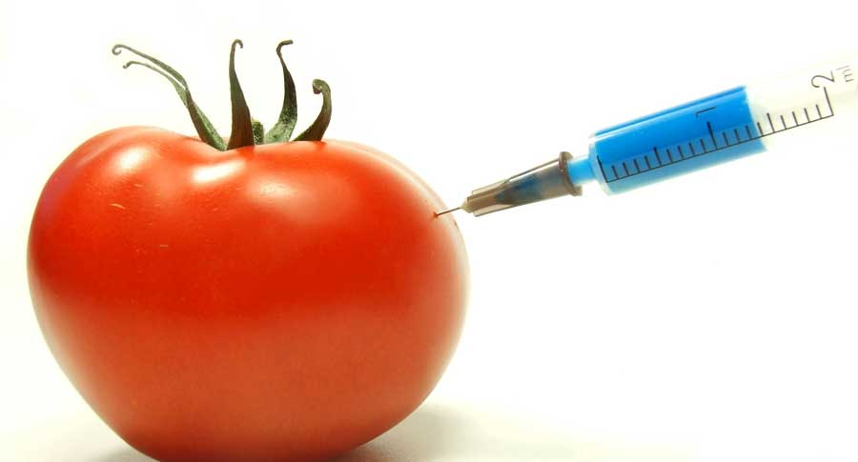
The History of GMOs
In 1975, the first conference determining guidelines on GMOs was held.
Humulin (which helps with diabetes) was released onto the market in 1984.
Labeling of GMO products was decreed mandatory by the European Union (this has yet to happen in the US) in 1997.
By 1999, over 100 million acres have been planted with modified seeds.

Slide 4
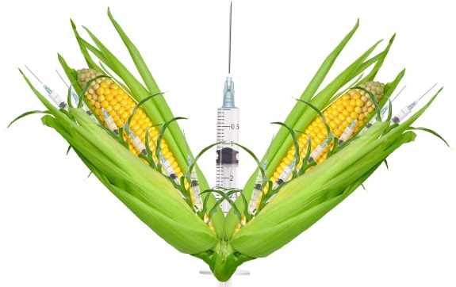
The Pros of GMOs
GMOs have been lauded for their ability to be made resistant to weeds to and insects, yielding more bountiful crop yields and feeding more people.
This would also reduce the amount of pesticides needed for farming.
GMO foods can be engineered to have better texture of flavor, or contain additional nutrients.
Finally, GMO foods could be modified to increase shelf life.

Slide 5
The Cons of GMOs
GMOs can create super bugs and weeds (bugs and weeds extremely resistant to pesticides) due to their resistant properties.
GMOs have been shown to be harmful to humans, causing autism, reproductive disorders, digestive problems and other disorders in some cases.
GMOs have been shown to disrupt individual organisms and whole ecosystems with the harmful chemicals that they contain.
Finally, the genetic engineering involved in making GMOs has many unpredictable, uncontrollable side effects.

Slide 6
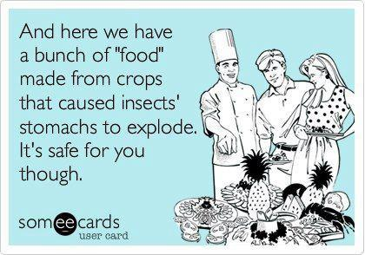
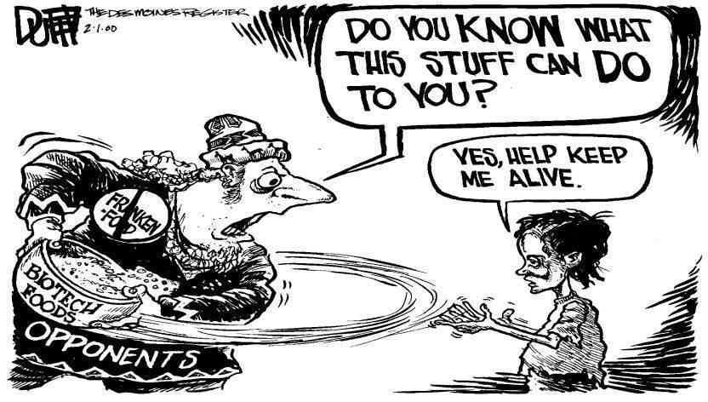
The Politics of GMOS
GMOs are on extremely unstable political ground.
Supporters of GMOs claim that studies against it are largely inflated, and that the “GMO threat” is mostly imaginary.
Those against GMOs claim that corporations purposely puts spins on GMOs to make them look harmless, and that negative reports are censored.
Claims against them also include that the government barely knows GMOs effects.

Slide 7
Citation
http://www.nongmoproject.org/learn-more/
http://gmoinside.org/gmo-timeline-a-history-genetically-modified-foods/
http://www.humulin.com/
http://findourcommonground.com/food-facts/gmo-foods/
https://classes.soe.ucsc.edu/cmpe080e/Spring05/projects/gmo/benefits.htm
http://www.nongmoproject.org/learn-more/
http://www.responsibletechnology.org/10-Reasons-to-Avoid-GMOs

Slide 8
Image Citation
https://www.google.com/search?q=gmos&client=firefox-a&hs=ZtU&rls=org.mozilla:en-US:official&channel=np&source=lnms&tbm=isch&sa=X&ei=bZRbVcqxNZKtogStxYCoCw&ved=0CAgQ_AUoAg&biw=1366&bih=631#imgrc=lV_Vo1wR2anERM%253A%3Bpvhu_Zj2CudbFM%3Bhttp%253A%252F%252Fsustainablewarwick.org%252Fwp-content%252Fuploads%252F2015%252F02%252Fgmo-orange-kiwi.jpg%3Bhttp%253A%252F%252Fsustainablewarwick.org%252Fscary-gmos%252F%3B540%3B369
https://www.google.com/search?q=gmos&client=firefox-a&hs=ZtU&rls=org.mozilla:en-US:official&channel=np&source=lnms&tbm=isch&sa=X&ei=bZRbVcqxNZKtogStxYCoCw&ved=0CAgQ_AUoAg&biw=1366&bih=631#imgrc=We8rz6lzjOxWvM%253A%3BjnouT1_Gdx6J7M%3Bhttp%253A%252F%252Fwww.foodrenegade.com%252Fpics%252Fcornpharma.JPG%3Bhttp%253A%252F%252Flikes.com%252Fpolitics%252Fgmos-safe-or-deadly%3B550%3B329
https://www.google.com/search?q=gmos&client=firefox-a&hs=ZtU&rls=org.mozilla:en-US:official&channel=np&source=lnms&tbm=isch&sa=X&ei=bZRbVcqxNZKtogStxYCoCw&ved=0CAgQ_AUoAg&biw=1366&bih=631#imgrc=ObljymGfH84lIM%253A%3BjG2-urck7Qtp-M%3Bhttps%253A%252F%252Fsumofus-production-media.s3.amazonaws.com%252Fa%252Fimg%252FGMOs-MIX.jpg%3Bhttp%253A%252F%252Faction.sumofus.org%252Fa%252Fcall-british-meps-gmo-vote%252F%3B900%3B485
https://www.google.com/search?q=gmos&client=firefox-a&hs=ZtU&rls=org.mozilla:en-US:official&channel=np&source=lnms&tbm=isch&sa=X&ei=bZRbVcqxNZKtogStxYCoCw&ved=0CAgQ_AUoAg&biw=1366&bih=631#imgrc=Oge0jv5mvL7NUM%253A%3Bj0tcQZLZS_wLLM%3Bhttp%253A%252F%252Fdrleonardcoldwell.com%252Fwp-content%252Fuploads%252F2013%252F10%252FScience-GMO-Tomato-Gasmask.jpg%3Bhttp%253A%252F%252Fdrleonardcoldwell.com%252F2013%252F10%252F03%252Frussia-considering-total-gmo-ban%252F%3B300%3B250
https://www.google.com/search?q=gmos&client=firefox-a&hs=ZtU&rls=org.mozilla:en-US:official&channel=np&source=lnms&tbm=isch&sa=X&ei=bZRbVcqxNZKtogStxYCoCw&ved=0CAgQ_AUoAg&biw=1366&bih=631#rls=org.mozilla:en-US:official&channel=np&tbm=isch&q=pro-gmo+cartoon&revid=772071283&imgrc=hNVZUuIkJ0QZ5M%253A%3BoAXtgo0FTWiM6M%3Bhttp%253A%252F%252Fwww.cyberounds.com%252Felements%252Fresources%252F508%252Ffigure6.jpg%3Bhttp%253A%252F%252Fohs.oxford.libguides.com%252Fcontent.php%253Fpid%253D466314%2526sid%253D4893216%3B832%3B472
https://www.google.com/search?q=gmos&client=firefox-a&hs=ZtU&rls=org.mozilla:en-US:official&channel=np&source=lnms&tbm=isch&sa=X&ei=bZRbVcqxNZKtogStxYCoCw&ved=0CAgQ_AUoAg&biw=1366&bih=631#rls=org.mozilla:en-US:official&channel=np&tbm=isch&q=gmo+cartoon&imgrc=3GiB7yJoydi3NM%253A%3BTLytk4vUhiDt2M%3Bhttps%253A%252F%252Fnlynch07.files.wordpress.com%252F2013%252F04%252Fgmo-cartoon.jpg%3Bhttps%253A%252F%252
Fnlynch07.wordpress.com%252Fwhy-should-we-care%252F%3B420%3B294
https://www.google.com/search?q=gmo&client=firefox-a&hs=hY&rls=org.mozilla:en-US:official&channel=sb&biw=1366&bih=631&source=lnms&tbm=isch&sa=X&ei=YJlbVZHMKc6zogSxiICoBw&ved=0CAcQ_AUoAg#imgrc=xsb5GMswLKrZRM%253A%3BoI468lGj-QUz2M%3Bhttp%253A%252F%252Fhealthimpactnews.com%252Fwp-content%252Fuploads%252Fsites%252F2%252F2014%252F09%252Fgmo_corn_vaccines.jpg%3Bhttp%253A%252F%252Fhealthimpactnews.com%252F2014%252Fare-experimental-vaccines-growing-in-a-gmo-corn-field-near-you%252F%3B1197%3B751

