Slide 1
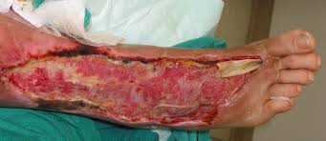
Flesh Eating Bacteria (Necrotizing Fasciitis)
Dylan
Connor

Slide 2
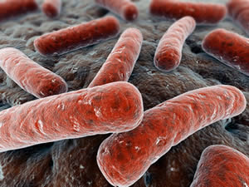
Necrotizing Fasciitis
It is a rare infection often described in media reports as a condition involving flesh eating bacteria
It can be fatal if not treated properly
It spreads quickly and aggressively in an infected person
Every year 6000 to 700 cases are diagnosed in the U.S
25-30% of cases are fatal.

Slide 3
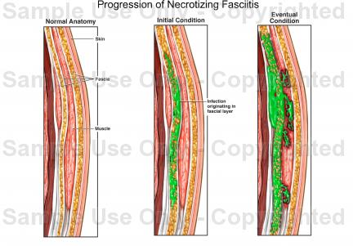
How Do You Get It
It enters the body through surgery or injury
Minor cuts
Insect bites
Abrasions
Once it takes hold it rapidly destroys muscle tissue.

Slide 4
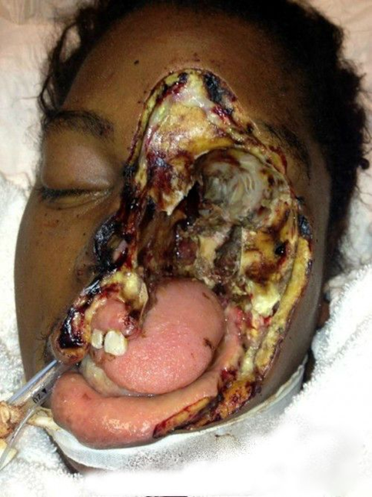
Symptoms
Increasing pain around area of injury
Pain that is worse than expected
Redness and warmth around the wound
Flu like symptoms
Dehydration

Slide 5
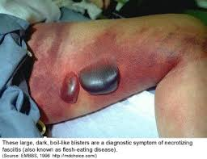
Even more symptoms
Swelling
A purple rash
Blisters filled with foul smelling liquid
Discoloration, peeling, and flakiness of skin
Severe drop in blood pressure
Toxic shock
Unconsciousness

Slide 6
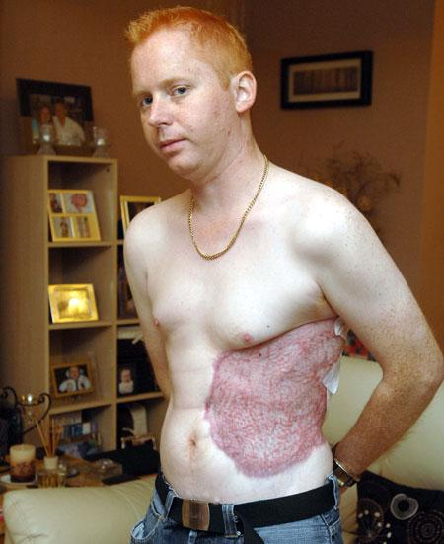
Treatment
Antibiotic therapy
Surgery to remove dead tissue
Amputation
Blood transfusuion

Slide 7
Bibliography
http://www.webmd.com/skin-problems-and-treatments/necrotizing-fasciitis-flesh-eating-bacteria
http://www.sepsisalliance.org/sepsis_and/necrotizing_fasciitis/
http://www.medicinenet.com/flesh_eating_bacterial_infection/views.htm

