Slide 1
Should Extinct Species Be Brought Back?
By: Jake Devine

Slide 2
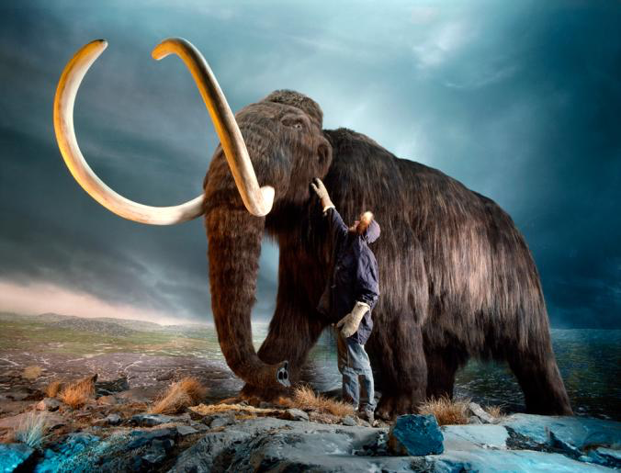
Why is this questioned today?
Curiosity has sparked the idea that we through genetic engineering could bring back extinct animals such as a Wooly Mammoth.

Slide 3
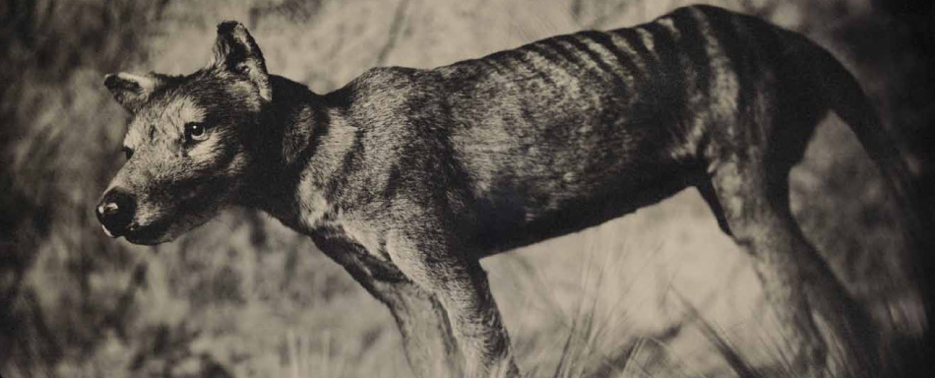
Is it actually possible?
Yes, it is possible. The main method suggested to do such a feat would be cloning. This is said to be possible by paleontologist Michael Archer. Two methods for bringing back an animal such as Tasmanian Tiger would be putting its DNA into a Tasmanian devil’s nucleus or putting a single cell into a Tasmanian devil embryo until a Tasmanian Tiger emerged.

Slide 4
Pros vs. Cons
If people over time pushed animals into extinction, we owe it to the environment to bring them back.
De-extinction could be a big step forward in the understanding or evolution and genetic engineering.
Animals would be alien to environments and be invasive species in many habitats.
De-extinction could lead to advanced research in that area and leave others to stay at the level they are.

Slide 5
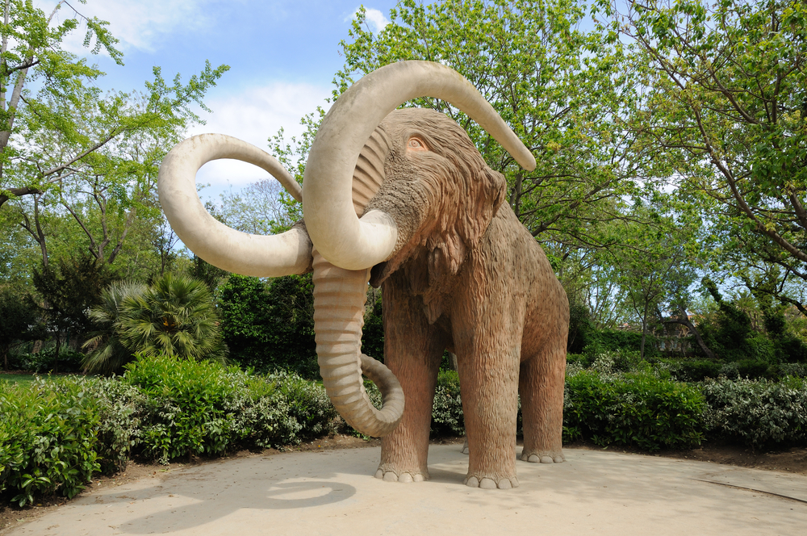
Do scientists bring extinct animals back?
The choice is ours, the people of Earth. The facts are at our finger tips. We have the technology. We know the pros and cons. The real question is, do we do it?

Slide 6
Sources
http://news.nationalgeographic.com/news/2013/13/130310-extinct-species-cloning-deextinction-genetics-science/
http://blogs.discovermagazine.com/d-brief/2013/04/04/5-reasons-to-bring-back-extinct-animals-and-5-reasons-not-to/#.VVqlCkL4v8t

