Slide 1
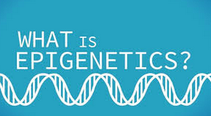
Marah Dobrenski & Ally Zerfas
https://vimeo.com/79827169

Slide 2
What is epigenetics?
http://learn.genetics.utah.edu/content/epigenetics/

Slide 3
epigenetics
Epigenetics are changes in gene expression; a change in phenotype without a change in the genotype.
This would be a change in the eye color but not the genes responsible for eye color.
http://examples.yourdictionary.com/examples-of-genotype-phenotype.html

Slide 4
epigenetics
Genotypes
Genes responsible for:
Eye color
Hair color
Height
Skin Color
Phenotypes
Physical Traits:
Eye color
Hair Color
Height
Skin Color
http://examples.yourdictionary.com/examples-of-genotype-phenotype.html

Slide 5
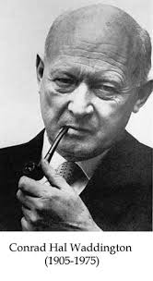
More about epigenetics
C.H. Waddington came up with epigenetics in 1942.
The words epigenetics comes from the two words epigenesis and genetics.
http://en.wikipedia.org/wiki/Epigenetics
https://sketchyintellect.wordpress.com/2012/03/25/waddingtons-definition-and-process-of-science/

Slide 6
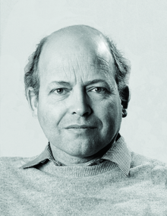
Epigenetics
Robin Holliday, a British molecular biologist, defined epigenetics by saying, “the study of mechanisms and temporal and spatial control of gene activity during the development of organisms.”
http://en.wikipedia.org/wiki/Robin_Holliday

Slide 7
epigenetics
The term has been used to describe processes that are not heritable, like histone modification. This means there are attempts to widen the definition.
http://en.wikipedia.org/wiki/Epigenetics

