Slide 1
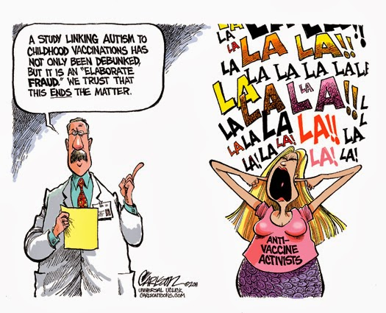
Do Vaccines Cause Autism?
By: Jenny Jin

Slide 2
When did the rumor start?
Andrew Wakefield, a former British surgeon, published a controversial paper in The Lancet that seemed to find a link between the MMR vaccine and “autistic enterocolitis,” autism combined with bowel disease
Other scientists have struggled to produce the same results as Wakefield did; millions of children have been tested, showing no substantial link between vaccines and autism
Wakefield has since been banned from practicing medicine in the UK
If the scientific community refutes this connection between vaccines and autism, why do so many ordinary parents support it?

Slide 3
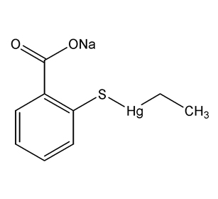
Thimerosal
Before 2001, many vaccines contained thimerosal, a chemical that contains mercury (Hg).
Children were receiving a level of mercury that exceeded the level considered safe by government standards
Some people argue that the presence of mercury leads to the development of autism
Mercury poisoning and autism have similar symptoms; however, many scientists believe that the similarities are coincidental
By 2001, all childhood vaccines were made available thimerosal-free.

Slide 4
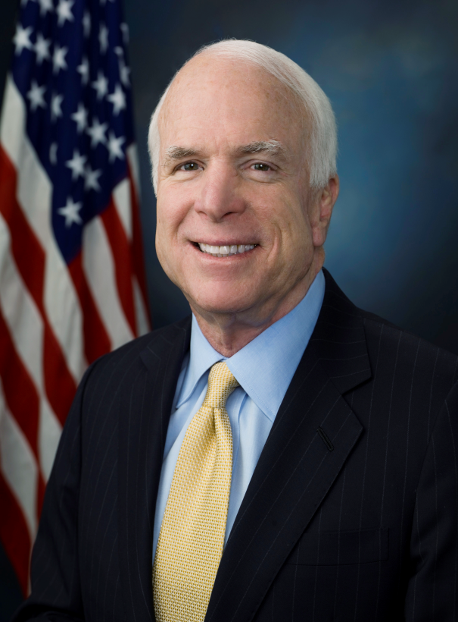
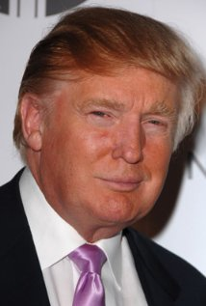
It’s not just normal people who believe this…
Jenny McCarthy
John McCain
Donald Trump
ALL BELIEVE THAT VACCINES CAUSE AUTISM

Slide 5
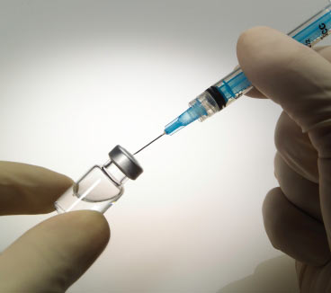
If kids are not vaccinated…
They risk developing such deadly diseases as measles, polio, tetanus, diphtheria, whooping cough, and influenza, and they risk spreading these diseases to other kids
According to the World Health Organization, every year, 2.5 million children in the world die of diseases that could have been prevented by vaccinations
The countries without readily-available vaccines are not worried about their kids developing autism; they’re worried about survival

Slide 6
In America, where there are many opportunities to get your child vaccinated, fear of autism is a poor and unfounded excuse
Not only are children being put at risk of preventable diseases, but they will also become threats to others
The threat of autism is practically nonexistent, but the threat of infectious diseases is very real
The cofounder of Autism Speaks urges parents to vaccinate their children, based on scientific research that cannot find a legitimate connection between vaccines and autism

Slide 7
Scientific Evidence
There is an abundance of scientific research done on the possible link between vaccines and autism, almost all of which have discredited it
For example, an extensive study done in the Oxford Journals showed no link between thimerosal and autism. The large size of the studied populations would have detected discrepancies, but there were none
Studies on the causes of autism should focus on more plausible leads.

Slide 8
Sources
http://www.cdc.gov/vaccinesafety/concerns/autism/
http://www.webmd.com/brain/autism/searching-for-answers/vaccines-autism
http://www.immunize.org/catg.d/p4017.pdf
https://www.autismspeaks.org/science/policy-statements/information-about-vaccines-and-autism
http://cid.oxfordjournals.org/content/48/4/456.full

