Slide 1
Do Cell Phones Cause Cancer?
By: Samantha Gannon and Bailie Jensen

Slide 2
How Do Cell Phones Work?
Send signals to nearby cell towers using RF (radiofrequency) waves
RF waves don’t have enough energy to cause cancer by directly damaging the DNA inside cells
RF waves are different from stronger types of radiation such as; x-rays, gamma rays, and ultraviolet light, which can break chemical bonds in DNA

Slide 3
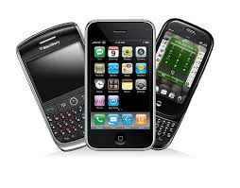
Factors That Affect Amount of RF Energy
The amount of time the person is on the phone
Whether or not the person is using the speaker mode on the phone or a hands-free device
The distance and path to the nearest cell phone tower
The amount of cell phone traffic in the area at the time
The model of the phone

Slide 4
Do Cell Phones Cause Tumors?
Some scientists have reported that the RF waves from cell phones produce effects in human cells that might possibly help tumors grow
Studies in rats and mice have shown whether RF energy might promote the development of tumors caused by other known carcinogens. (cancer-causing substance) The studies did not find evidence of tumor promotion.

Slide 5
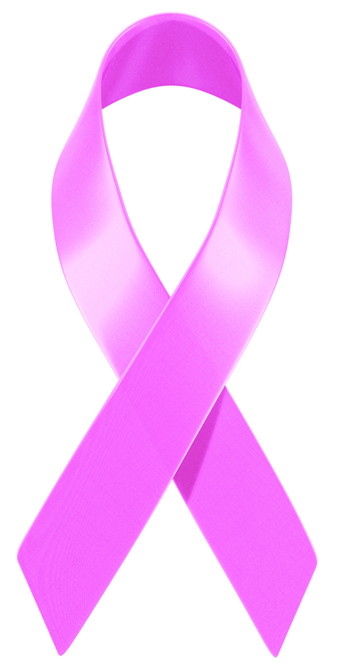
What Do Studies in Humans Suggest?
Most studies do not show a tendency for the risk of brain tumors to be higher with increasing cell phone use. However, it would be expected if cell phone use caused brain tumors.
There are few instances of breast cancer in young woman who have kept their phone in their bras. This is not very likely to happen because woman develop breast cancer every year by chance, not because the cell phone caused it.

Slide 6
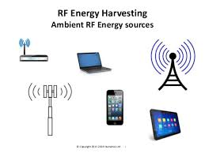
Conclusion
Many studies have shown no link to cancer and cell phone use; however, in some rare conditions it can be possible.
If you’re concerned about developing cancer from cell phones, limit the factors of RF energy stated on the second slide.

Slide 7
Sources
http://www.cancer.org/cancer/cancercauses/othercarcinogens/athome/cellular-phones
http://scienceblogs.com/gregladen/2014/06/14/does-keeping-a-cell-phone-in-your-pocket-reduce-male-infertility/
https://www.pinterest.com/pin/529102656195538673/
http://www.mayoclinic.org/healthy-lifestyle/adult-health/expert-answers/cell-phones-and-cancer/faq-20057798
http://www.slideshare.net/humavox/rf-energy-harvesting
Clip Art- breast cancer symbol

