Slide 1
De-Extinction
Is cloning now-extinct animals ok?

Slide 2
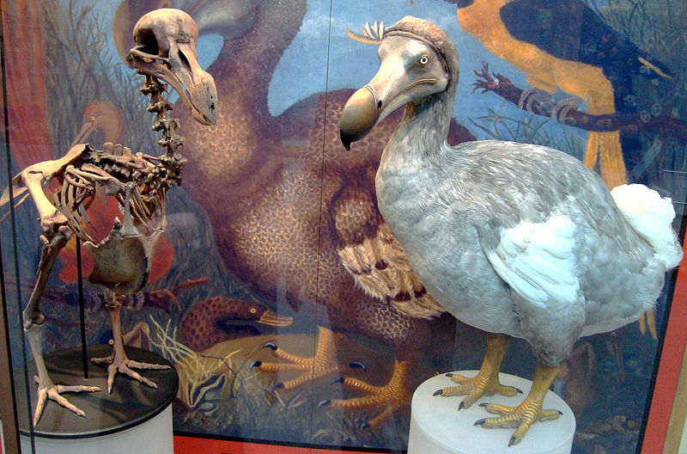
What is de-extinction?
De-extinction is the process of bringing now extinct species or endangered species, cloning them to make their species living again
We can clone organisms using stem cells from the organism’s DNA and coaxing them to become the kind of cells we want, like an egg or sperm

Slide 3
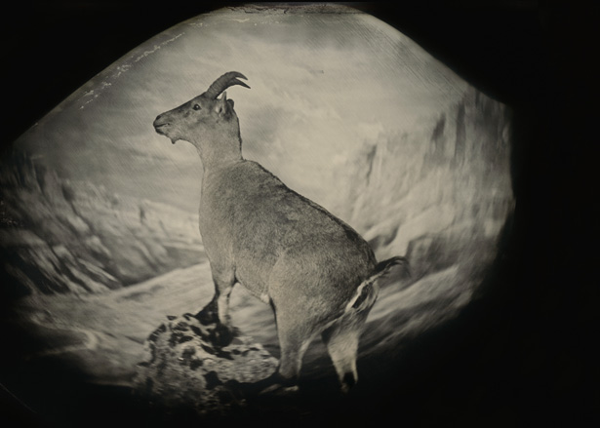
The Bucardo
On July 30, 2003, a team of scientists led by Alberto Fernandez successfully cloned a species of Spanish wild goat called the Bucardo.
Despite the cloned animal living only 10 minutes, it was the first time de-extinction was performed and proved that it could work

Slide 4
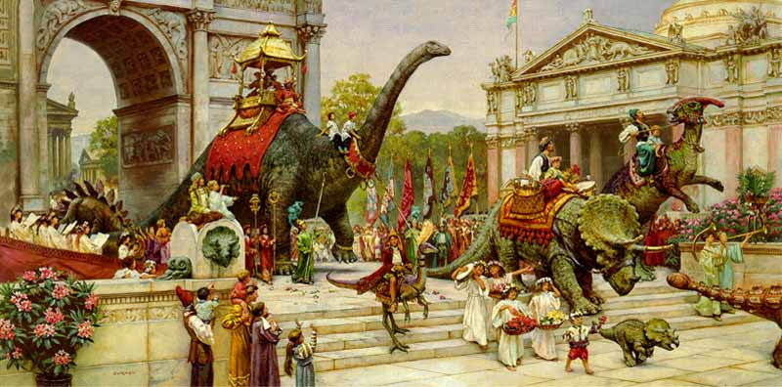
Can we clone EVERYTHING?
This process is not applicable to every extinct organism
In order to clone an organism, we would need a sizable chunk of DNA from them, so we can only clone organisms that have become extinct in the last few tens of thousands of years
So sorry, no dinosaurs

Slide 5
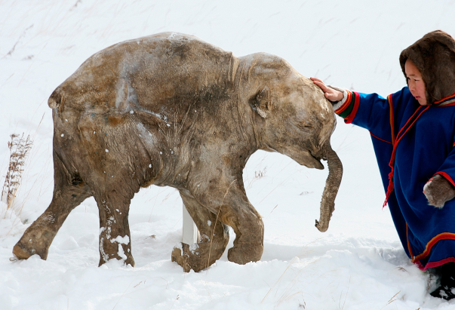
Reasons to De-extinct
De-extinction could help us study the animals
It would be a big step forward for genetic engineering
Threatened or damaged ecosystems could be restored with more biodiversity
If people made these species extinct, maybe we owe these species new life
Entertainment: How cool would it be to ride a mammoth?

Slide 6
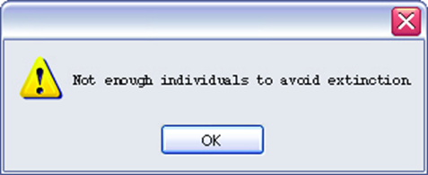
Reasons not to de-extinct
People could be harming these species
Species could carry new germs and viruses
The habitat of the organism has changed without them and the species may be invasive
De-extinction may take priority over medical research or conserving other endangered species
Is this the right thing to do?

Slide 7
What are we doing now?
Many species are candidates for de-extinction or genetic assistance, such as the black-footed ferret, the dodo bird, the wombat, the Easter island palm, an the Caribbean monk seal.
This is a big scientific debate, and will continue into the future.

Slide 8
Sources
http://ngm.nationalgeographic.com/2013/04/125-species-revival/zimmer-text
http://blogs.discovermagazine.com/d-brief/2013/04/04/5-reasons-to-bring-back-extinct-animals-and-5-reasons-not-to/#.VVvgeflViuk

