Slide 1
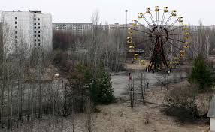
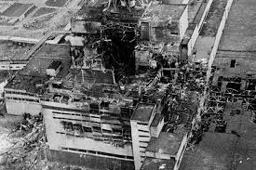
Chernobyl:
Nuclear Core Reactor Meltdown

Slide 2
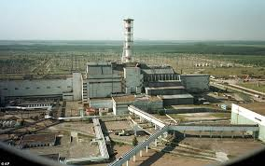
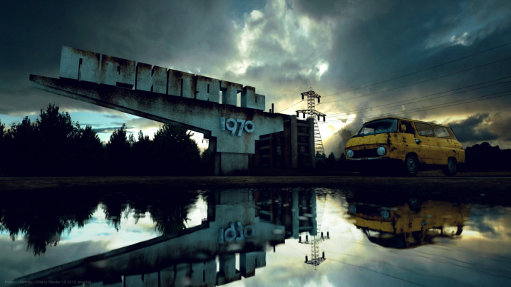
Background of Chernobyl
Chernobyl is a city located in Ukraine. (Near the border of Belarus.)
Largely abandoned following the Nuclear Power Plant catastrophe in 1986.
Had a population of 50,000 preceding disaster.
Pripyat-growing young city to house power plant workers (average age 26)

Slide 3
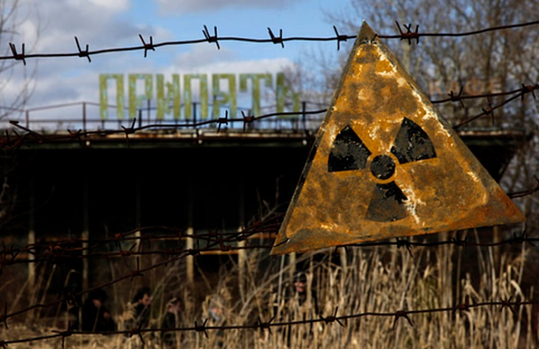
The Horrid Event
In 1986 on Saturday, April 26, the disaster happened early in the day.
Started with eruptions and infernos.
Released large quantities of radiation upon much of the USSR and Europe.
Know as worst nuclear melt down ever.
Is classified as one of only two level 7 event on the International Nuclear Events Scale.

Slide 4
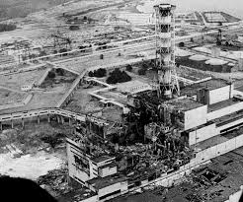
Why?
Eruptions started in Unit 4 of power station. (During turbine test for sufficient energy during power outage)
Safety systems had to be switched down 25% of capacity, but procedure failed and power level fell below 1%.
30 seconds after the start of test, there was an unexpected power surge and the reactor’s emergency shutdown didn’t work.

Slide 5
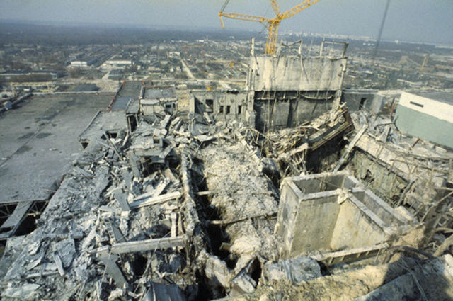
The Event
1,000-ton sealing cap was completely blown of the plant.
Graphite covering of reactor ignited creating huge flames. (burned for nine full days)
Entire accident released huge quantities of radiation. (Entire city was devastated by event)
Forced population to move (Still can’t live there)
31 killed on the spot (64 died of radiation)

Slide 6
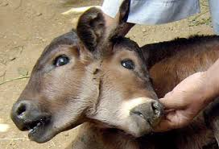
Mutations/Cancer
Many mutations were created due to the radioactivity released in the air.
After event, thyroid cancer cases greatly rose. (Caused by exposure to radiation.)
Rates of cancer for those living close is high.

Slide 7
Sources
http://www.greenpeace.org/international/en/campaigns/nuclear/nomorechernobyls/what-happened-in-chernobyl/
https://www.google.com/search?q=google+images&es_sm=93&source=lnms&tbm=isch&sa=X&ei=VGRbVbvUDsOpogS5uIGIDA&ved=0CAcQ_AUoAQ&biw=667&bih=639#tbm=isch&q=chernobyl
http://www.ncbi.nlm.nih.gov/pmc/articles/PMC3107017/

